Slide 1
Supplier Enablement – Dashboard QRG

Slide 2
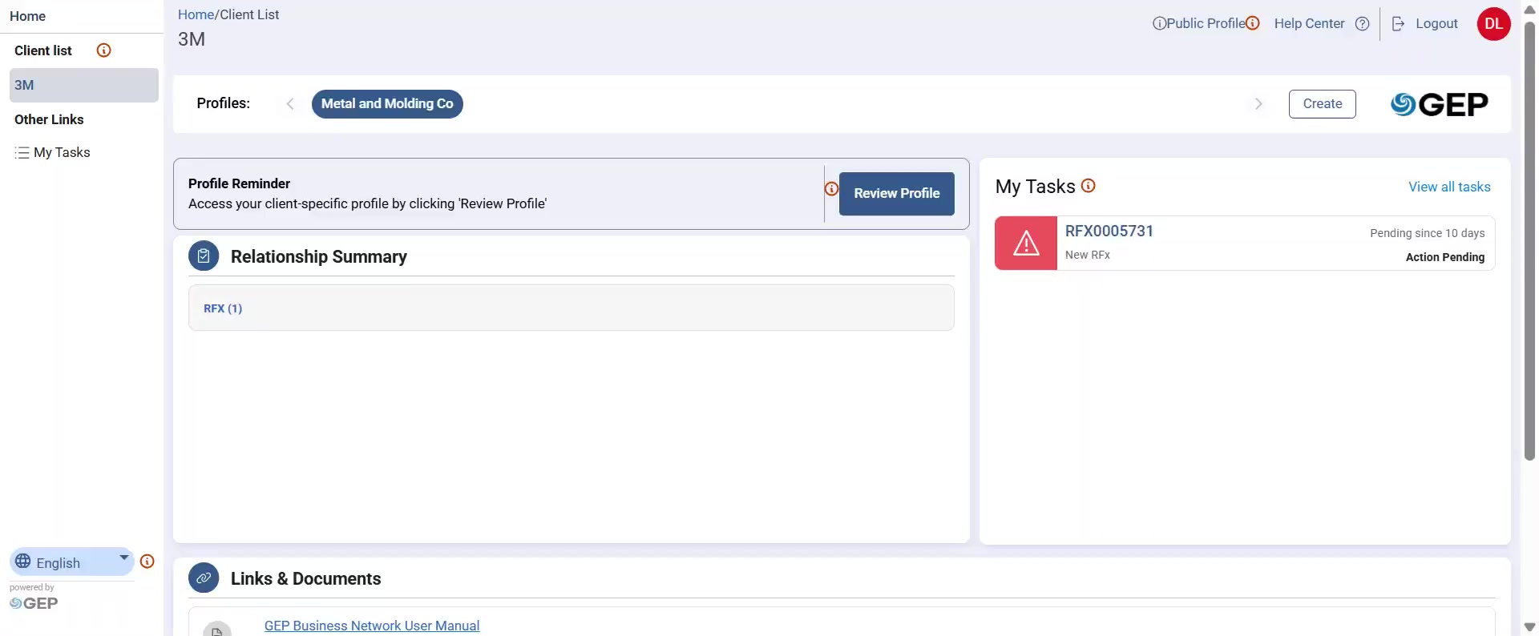
Dashboard (or Landing Page)
The Supplier Landing Page is your central dashboard for all activities.
It provides a clear, organized view of tools to help you collaborate with 3M
Your Dashboard provides quick access to key features and information needed to manage your supplier account examples links to help center, supplier profile, pending tasks, help center etc.

Slide 3
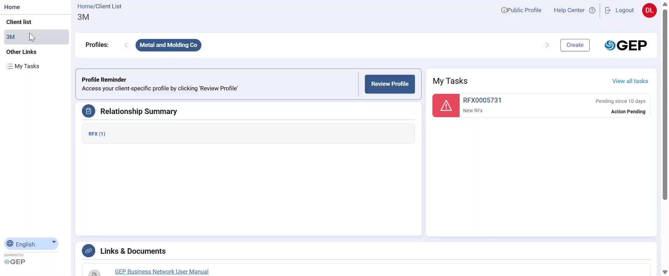
Dashboard – Client list
Client List: Displays all client entities linked to your account. You can easily switch between client profiles (example 3M to other client) to manage sourcing events, contracts, and compliance requirements specific to each client.

Slide 4
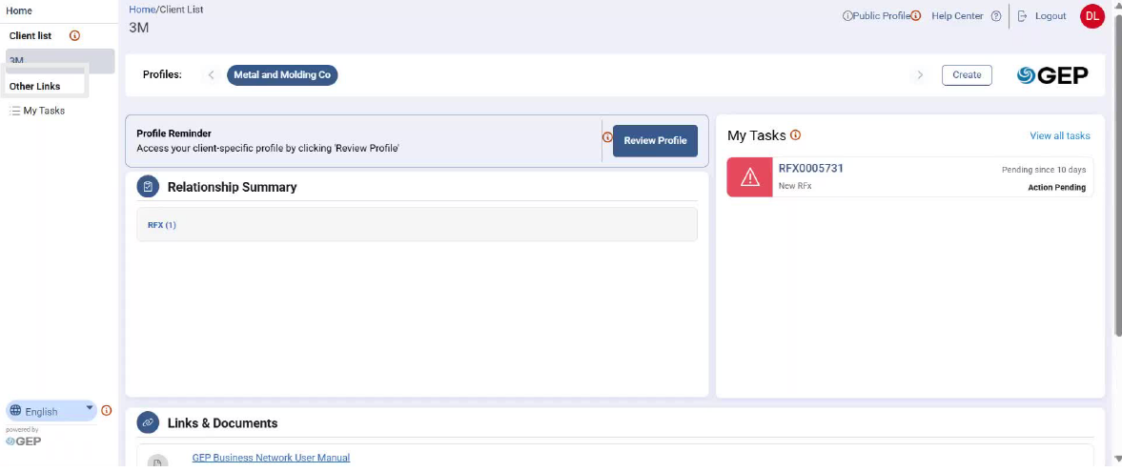
Dashboard – Other Links
Other Links: Provides convenient access to important features such as pending tasks, notifications, and navigation shortcuts for navigation. This section allows you to move between modules without returning to the main dashboard.

Slide 5
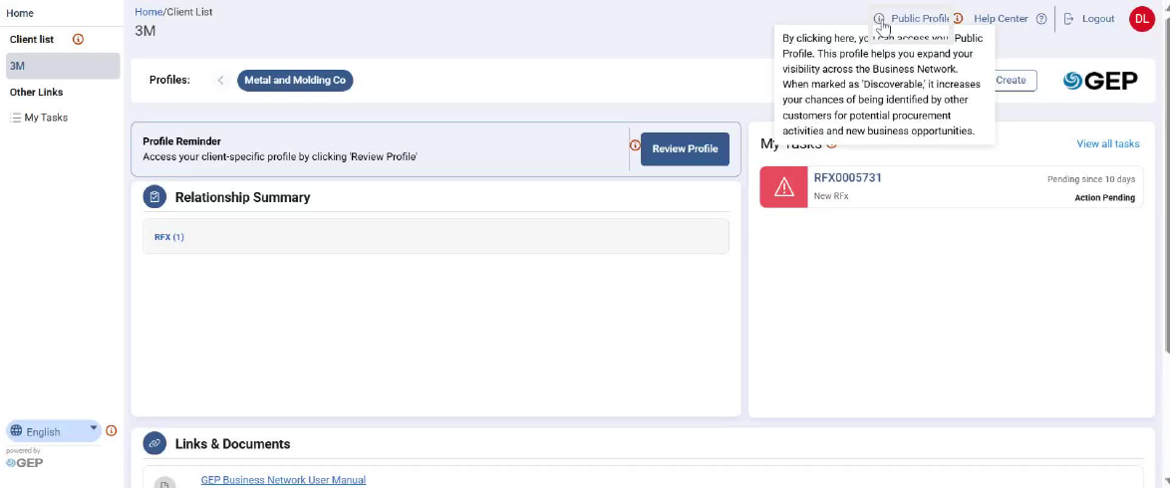
Dashboard – Public profile
Public Profile: Shows your company’s general profile information as visible to all buyers on GEP. You can update details such as company name, address, certifications, and diversity status.

Slide 6

Dashboard – Help Center
Help Center allows Supplier to access FAQs, GEP Business Network Platform user guides, and support options.

Slide 7
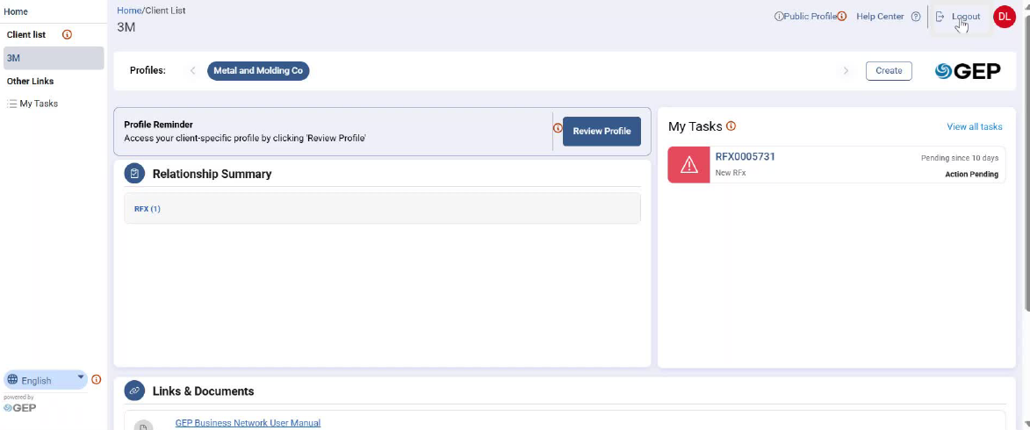
Dashboard - Logout
Logout: Securely end your session to protect sensitive information and prevent unauthorized access.

Slide 8

Dashboard – Review Profile
Review Profile enables Supplier profile management. Review profile displays client-specific profile information either added by Supplier themselves or by 3M.

Slide 9
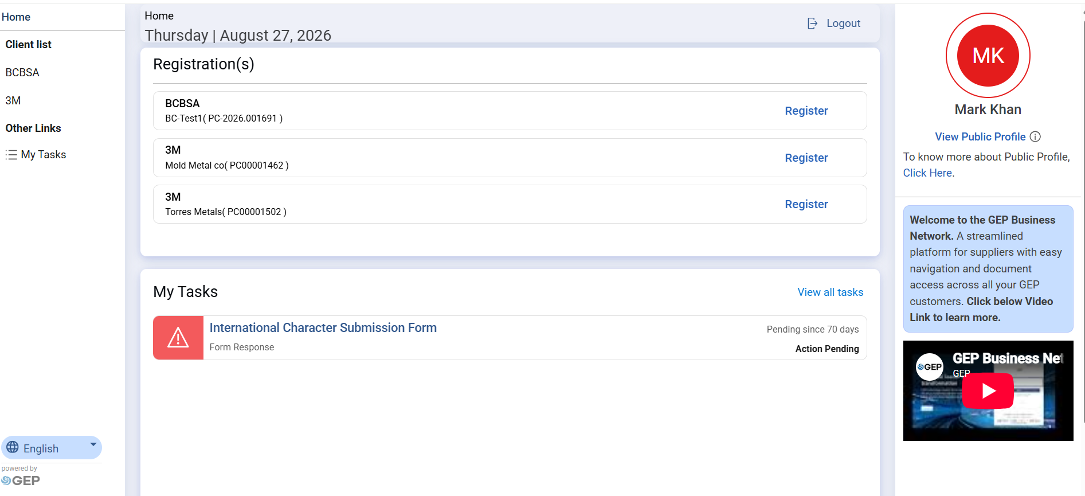
Dashboard - Register
If the Supplier has not yet registered on GEP then it will show Register instead of Review Profile

Slide 10
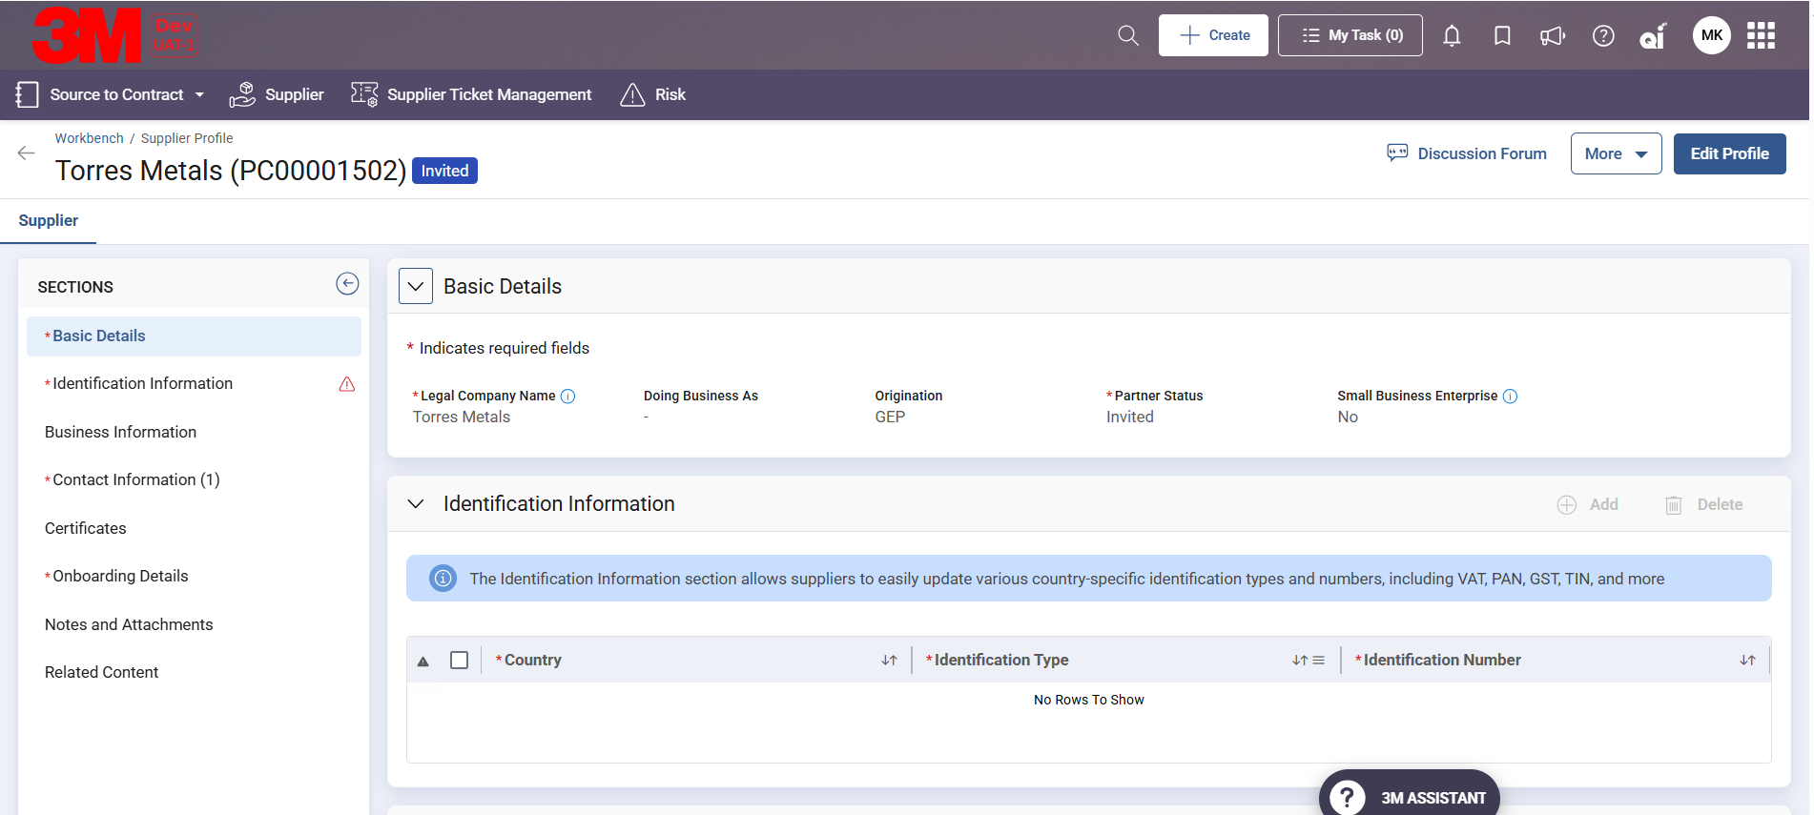
Dashboard – Supplier Profile
Supplier information may include tax information, banking details, and compliance documents if provided. You can update these fields to ensure accuracy for transactions and sourcing activities.
On Supplier profile page, Supplier needs to click on Edit button to start making changes to Supplier profile

Slide 11
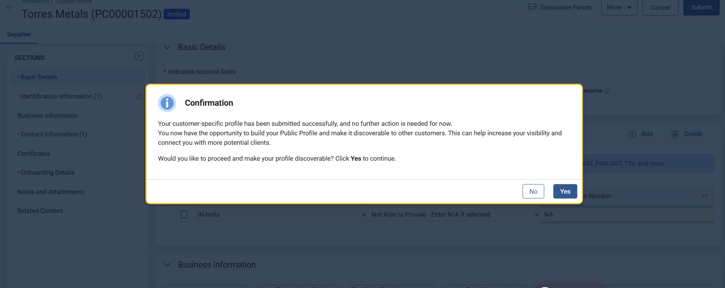
Dashboard – Profile Discoverability
After completing mandatory details when Supplier clicks on submit, a pop-up message will appear which would ask Supplier if they would like to proceed and make their profile discoverable.
Supplier can select Yes or No as per their requirement.
If they select No, another pop-up message will appear with message "Profile change request has been submitted and it will be reflected once the change request is approved by the Approver"

Slide 12
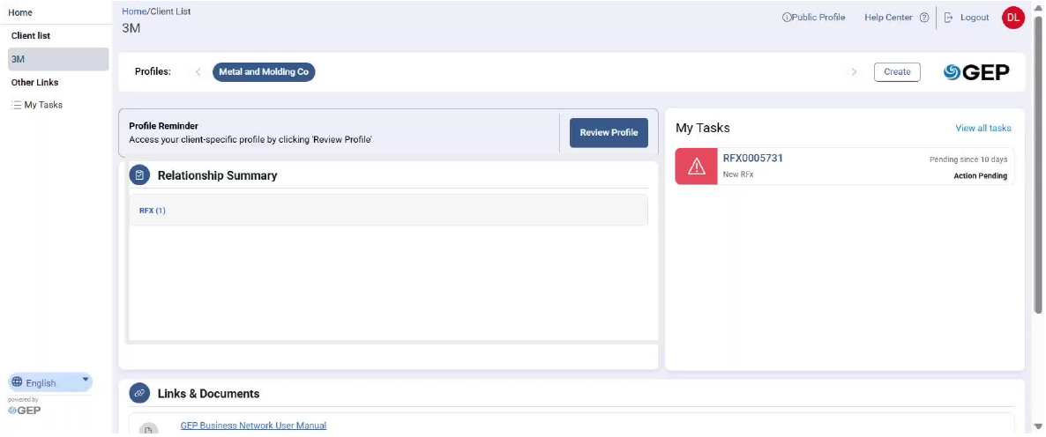
Dashboard – Relationship Summary
Relationship Summary: Provides a consolidated view of all activities, including completed and pending actions. This section serves as a central hub where requests and tasks created across modules, such as Sourcing, Contract Management, Risk, and Ticket Management, are displayed.
From here, you can review details and take appropriate action to respond promptly to 3M’s requests.

Slide 13

Dashboard – My Tasks
The My Tasks section on the supplier homepage serves as a centralized dashboard for managing all pending actions. It provides a clear and organized view of tasks that require your attention, helping ensure timely completion and ongoing compliance.
Each task includes details such as status and the number of days it has been pending, allowing you to prioritize actions effectively and respond within required timelines.

Slide 14
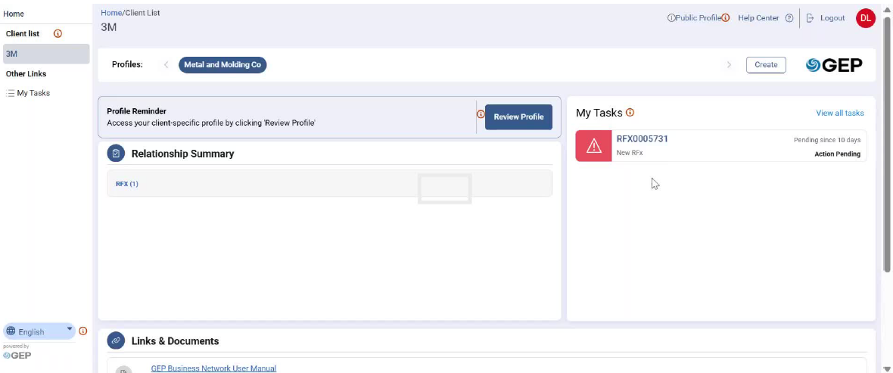
Dashboard – My Tasks (Contd..)
Clicking on Pending task will take Supplier to the respective document where they can take necessary action.

Slide 15
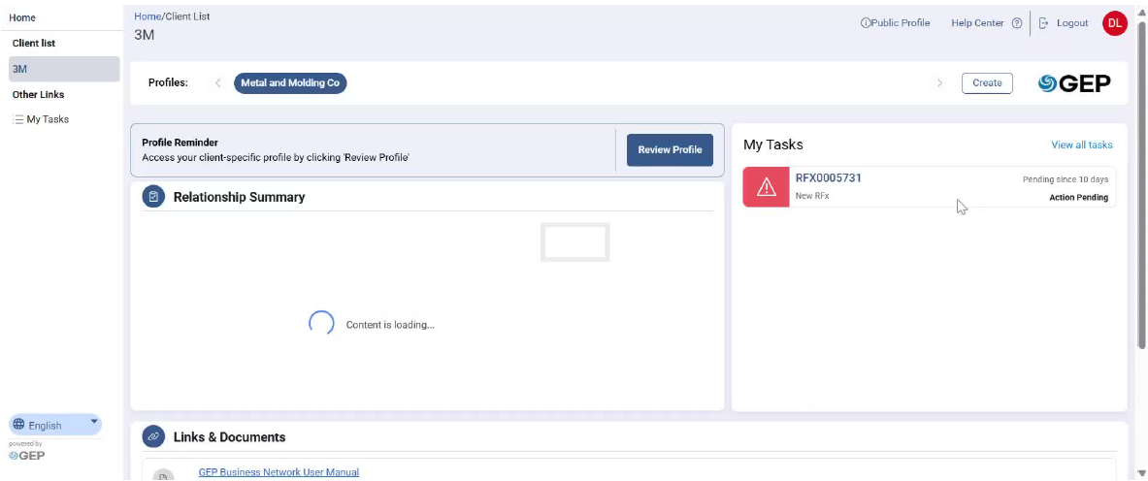
Dashboard – My Tasks (Contd..)
Clicking on View all tasks or My Tasks will display a drill down of all tasks including document name, number and task types.

Slide 16
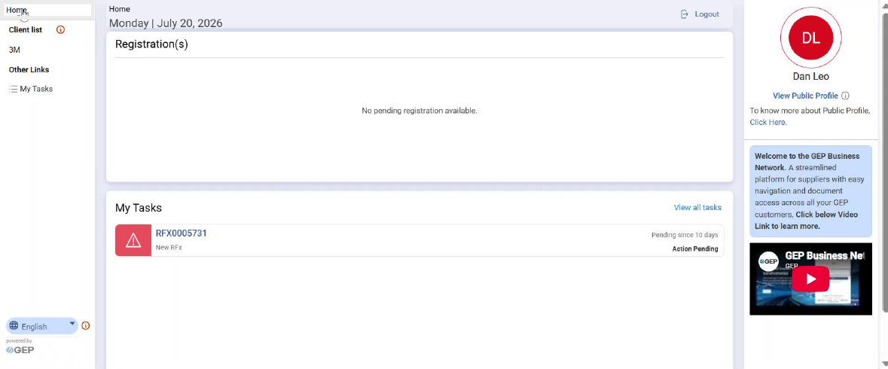
Dashboard – Additional support
On Supplier Dashboard> Home Page, there are additional support resources available for Supplier, which will help them navigate the platform

Slide 17
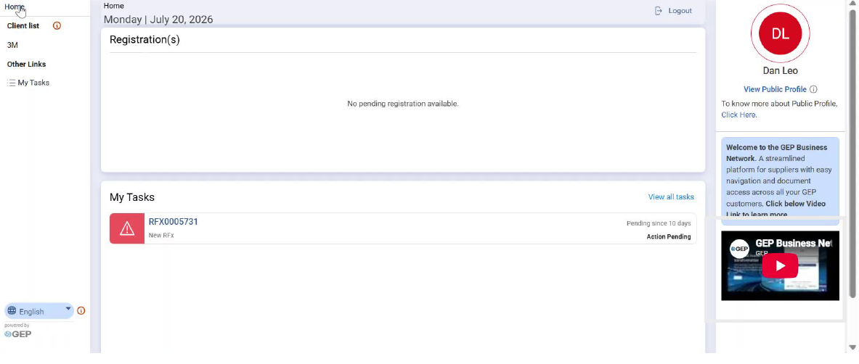
Dashboard – YouTube Video
Youtube Video- An instructional YouTube video titled GEP Business Network Portal: Quick Start Guide for Suppliers provides a walkthrough of the platform’s key features and functionalities.

Slide 18
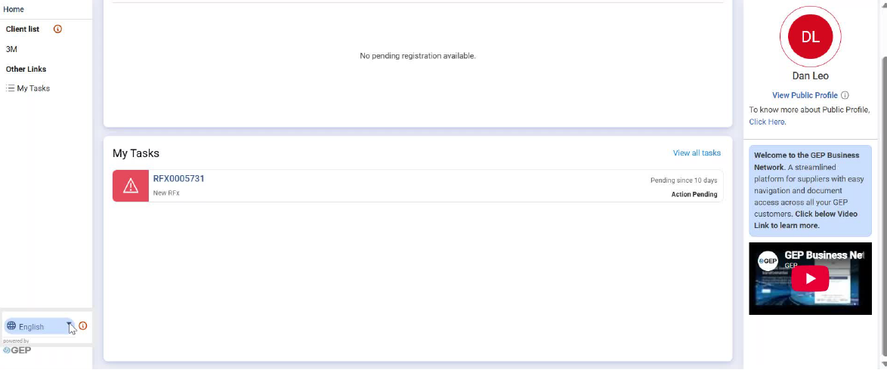
Dashboard – Language Translation
Language Translation The platform includes a language translation feature that allows you to select your preferred language for improved accessibility and convenience.

Slide 19
Thank You

