Slide 1
Supplier Registration &
Profile Management QRG

Slide 2
Introduction to the GEP Business Network
The GEP Business Network is a secure online platform that 3M uses to work with its suppliers — one place to manage sourcing events, proposals, onboarding, contracts, and offboarding tasks.
Instead of emails, spreadsheets, or disconnected systems, everything is handled in a single, centralized platform, making the process clearer, more efficient, and easier to track for both 3M and its suppliers. Registration and use of the platform are free of charge.
By joining the GEP Business Network, you can respond to sourcing events and submit proposals, view and manage contracts and risk forms, track the status of your submissions in real time, and complete required compliance and risk forms.
Note: Some topics are not in scope of the Aug’26 go-live, like responding to risk forms and creating tickets — though suppliers can view and respond to assigned tickets. From the next phase, suppliers can also use GEP to manage P2O processes such as Purchase Order acknowledgement, Advance Shipment Notification (ASN), and invoice sharing.

Slide 3
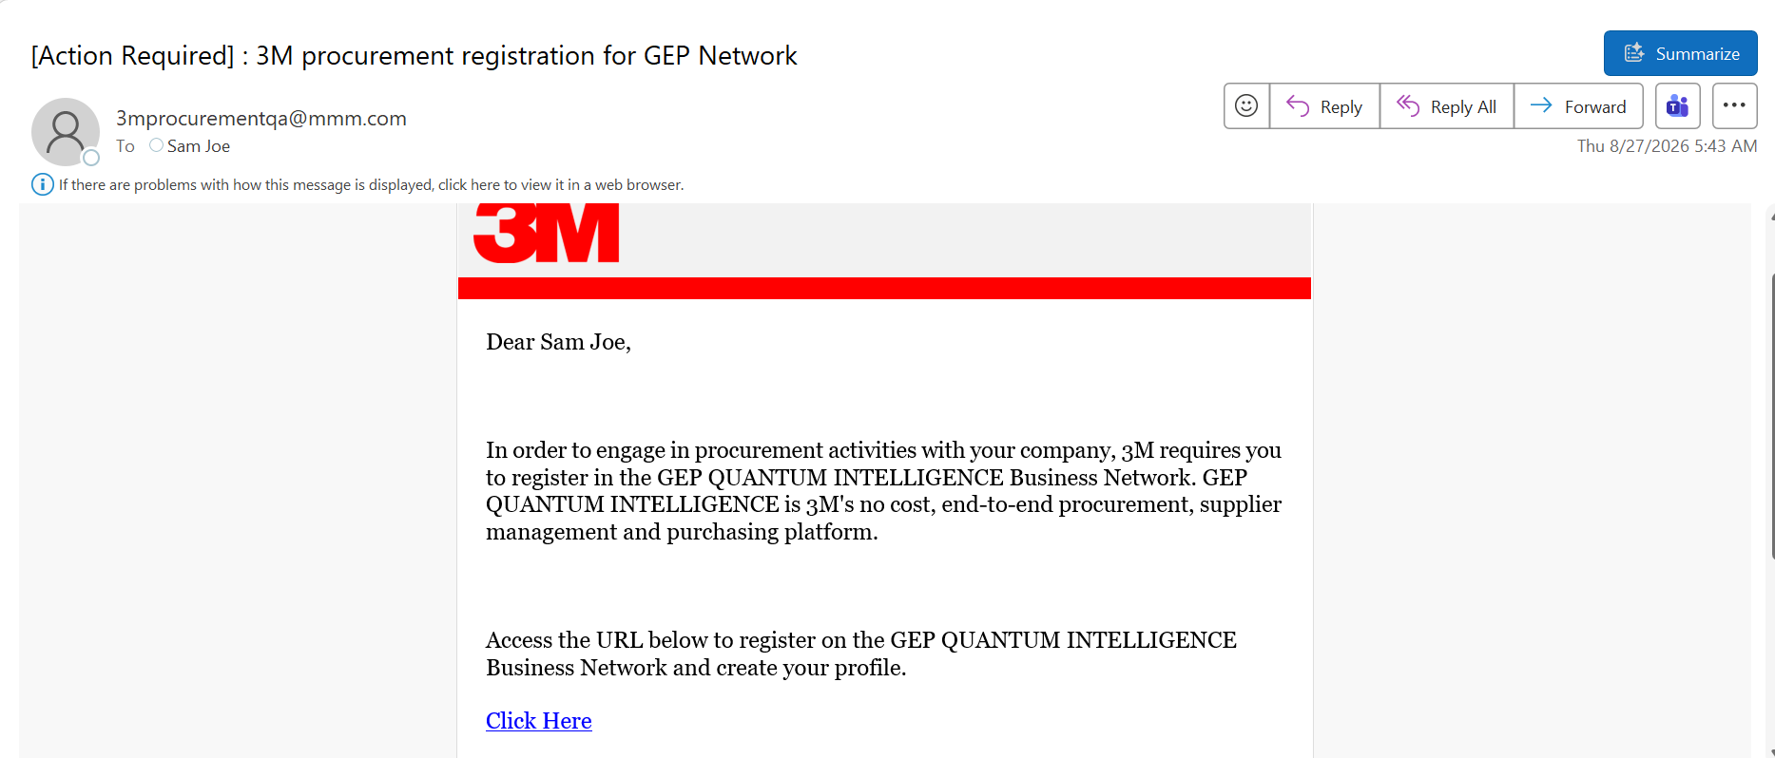
Registration via Invitation Email
Refer to the invitation email containing the link to register for GEP. Select Click Here to access the registration portal.

Slide 4
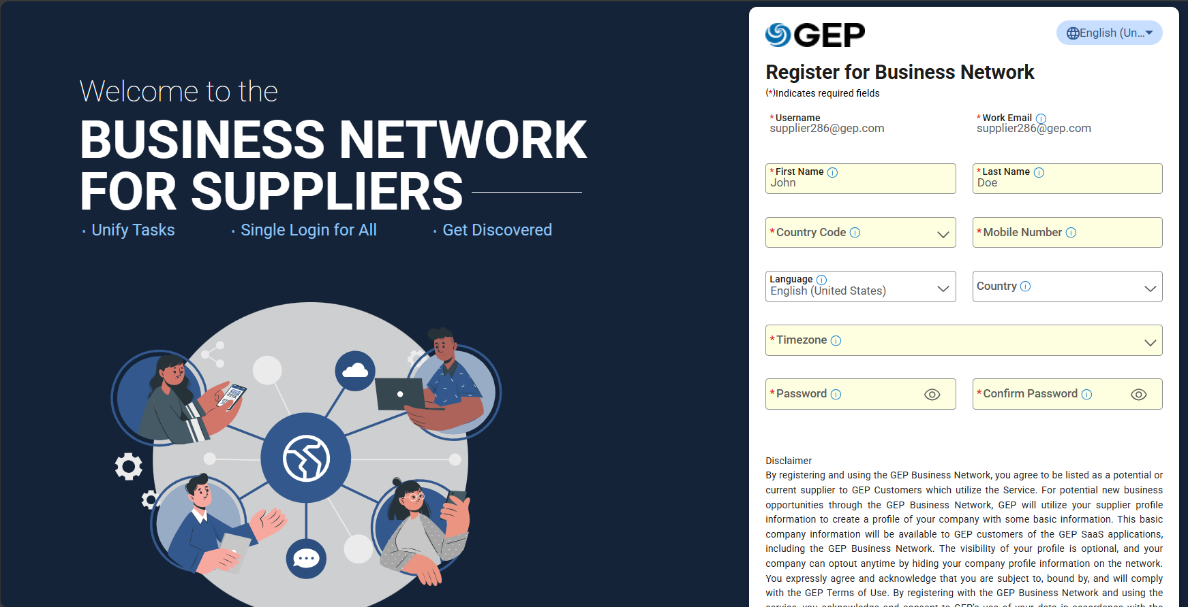
Registration via Invitation Email
Enter the required details — the highlighted fields must be completed to register.
Review the disclaimer carefully. The Terms & Conditions, Privacy Policy, and Non-Disclosure Agreement (NDA) are provided as hyperlinks that open in a new browser tab.

Slide 5
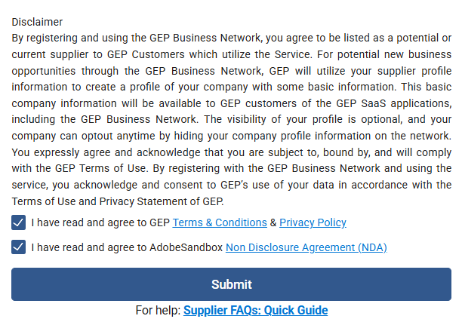
Registration via Invitation Email
Click Supplier FAQs: Quick Guide for additional resources to assist with the registration process.

Slide 6
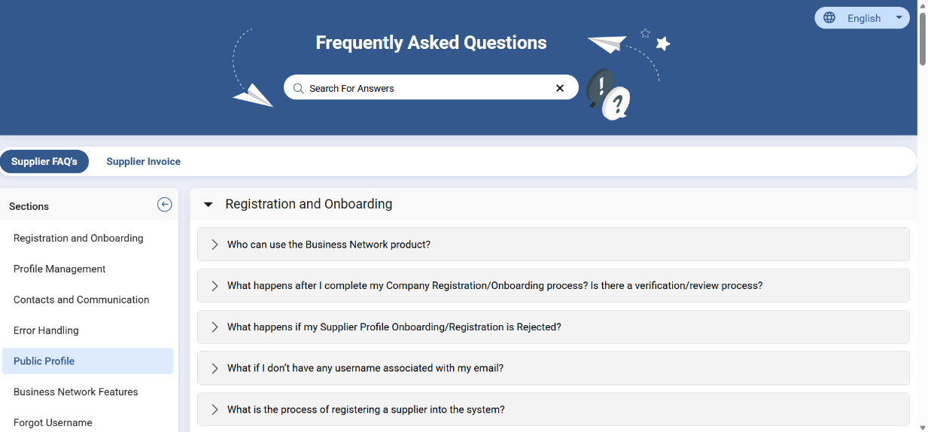
Registration via Invitation Email
The Frequently Asked Questions (FAQ) page opens in a new browser tab, providing practical guidance and answers to common questions on registration, profile management, and system functionality.

Slide 7
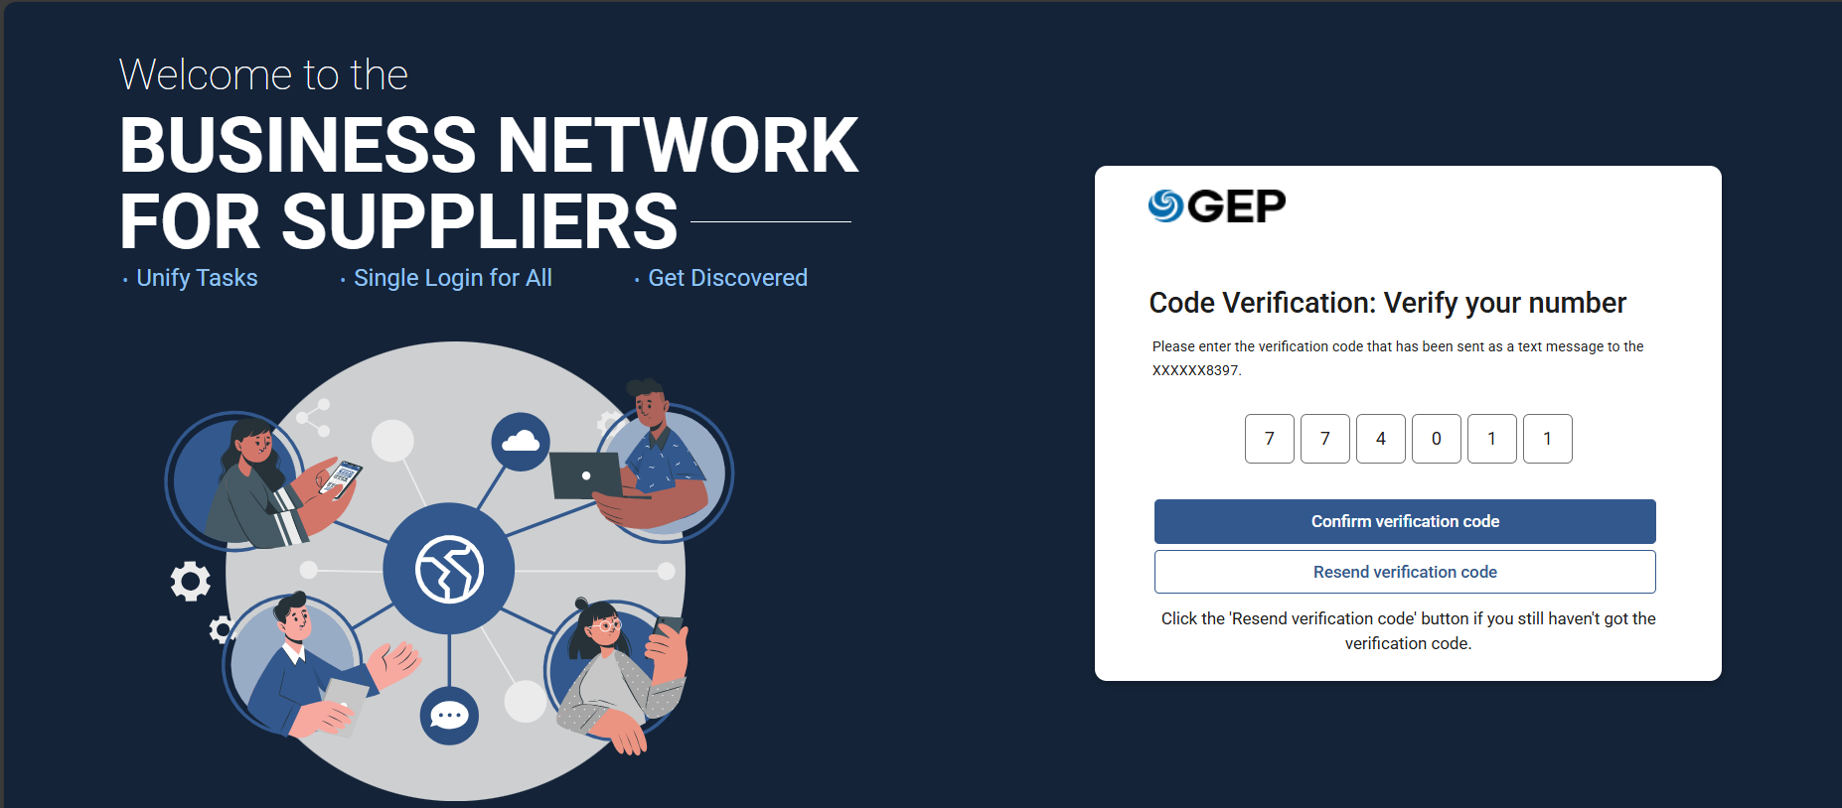
Registration via Invitation Email
After submitting your registration, a verification code is sent to your registered mobile number. Enter the six-digit code and select Confirm Verification Code.

Slide 8
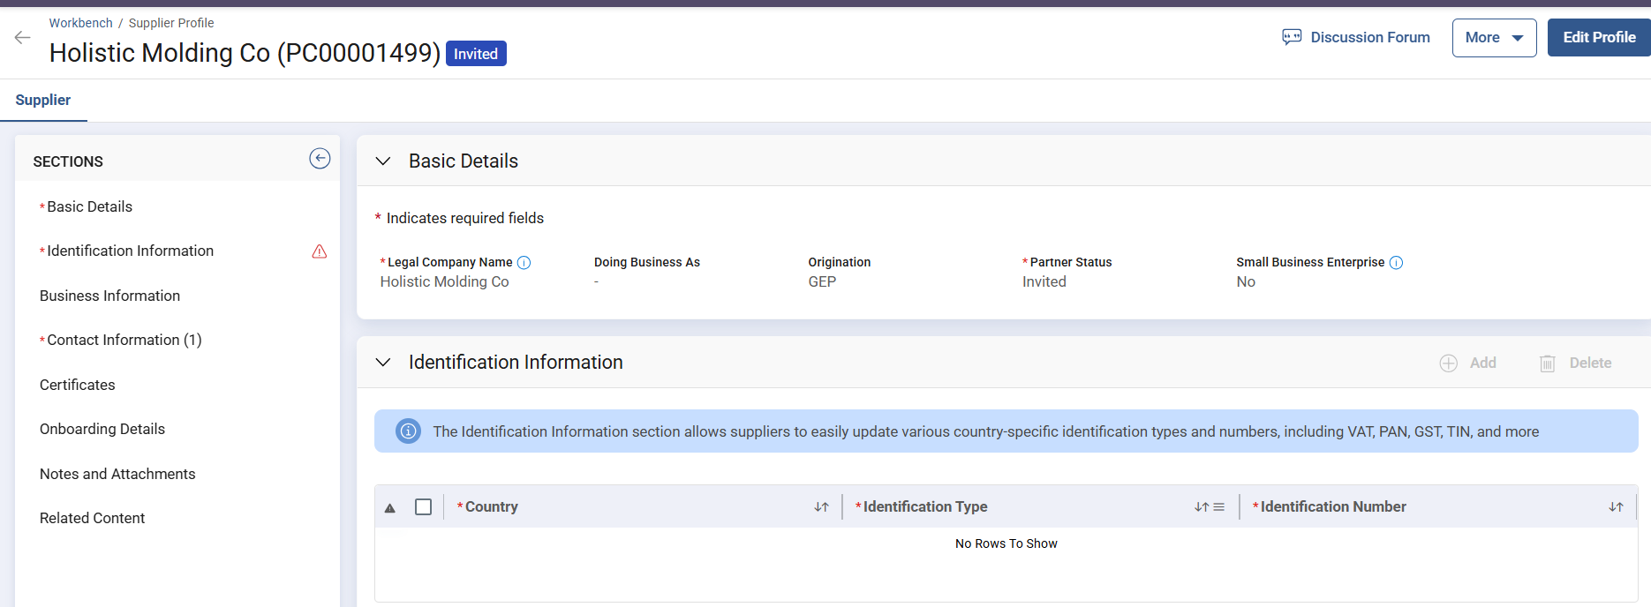
Registration via Invitation Email
Once verification is complete, your supplier profile opens in Invited status. Click Edit Profile to review and edit your supplier profile.
Note: Both Supplier and Buyer (3M) must fill in all mandatory fields — the profile can only be submitted once complete, changing the status from Invited to GEP Registered.

Slide 9
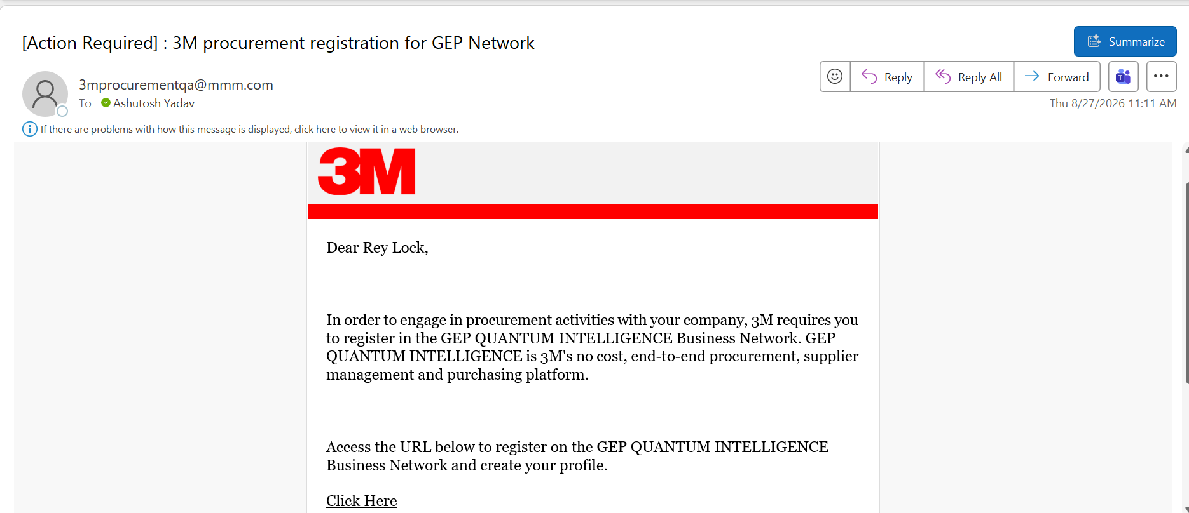
Existing Accounts with GEP
When your supplier profile is created in GEP, you receive an email notification to register. Select the hyperlink in the email.

Slide 10
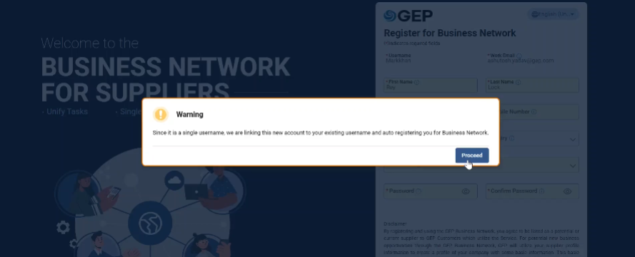
Existing Accounts with GEP
When you open the registration link in your browser, a message notes that since it's a single username, the new account will be linked to your existing username and you'll be auto-registered for Business Network.

Slide 11
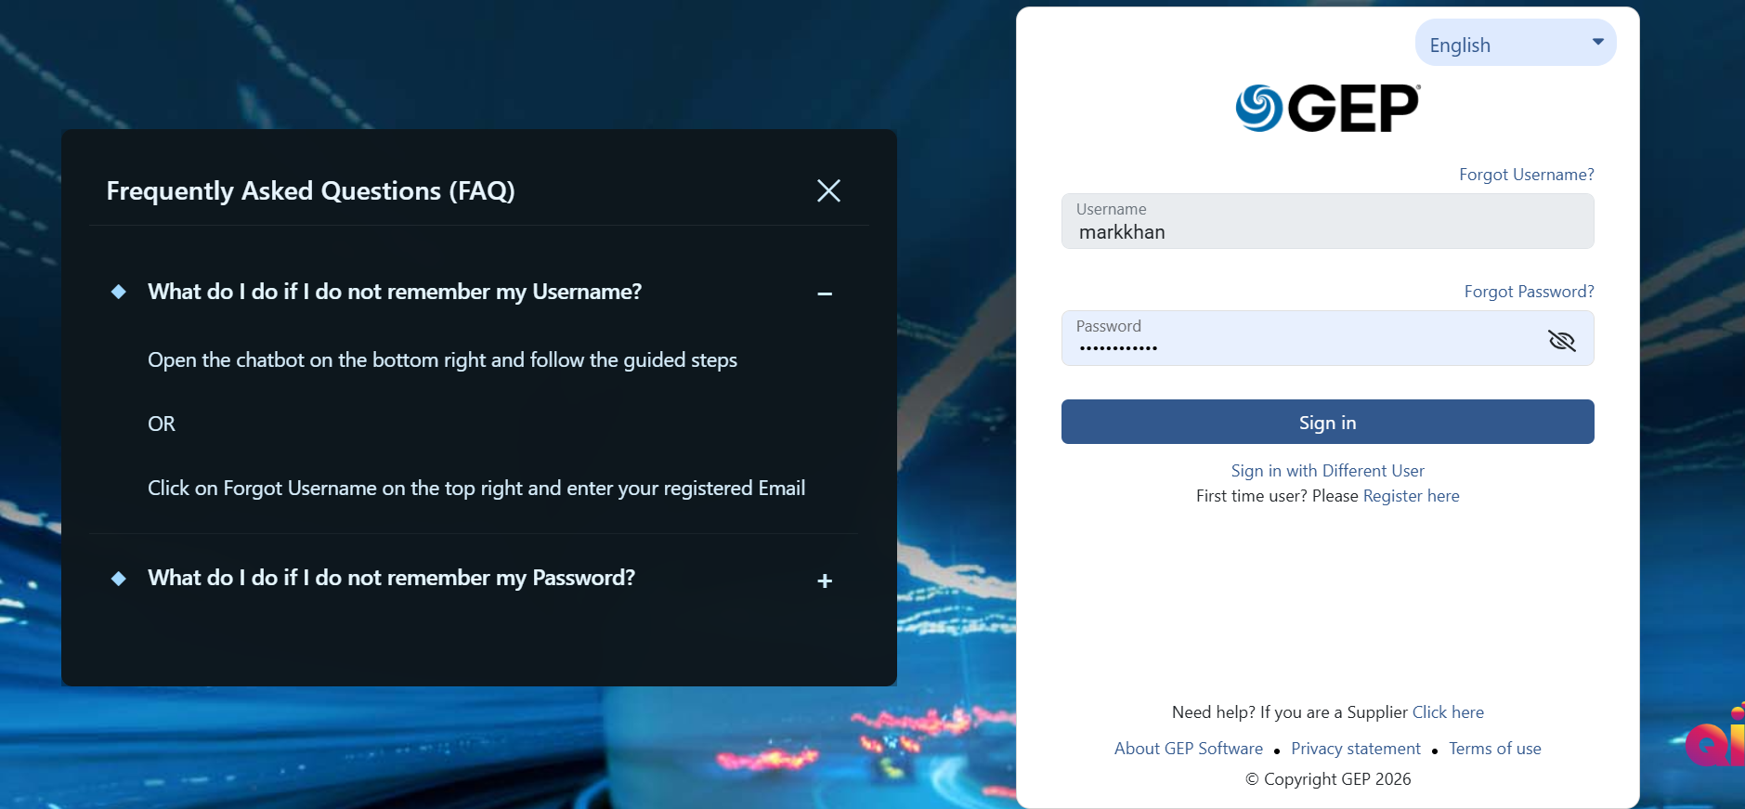
Existing Accounts with GEP
Log in using your existing user ID and password.

Slide 12
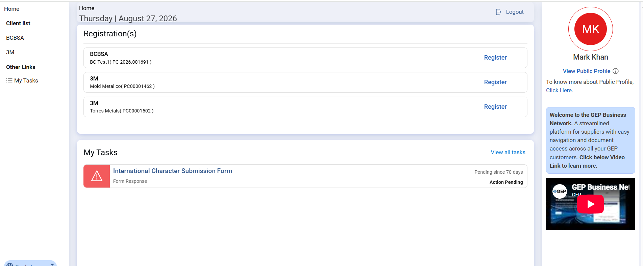
Existing Accounts with GEP
Open the registration link mapped to the 3M client.

Slide 13
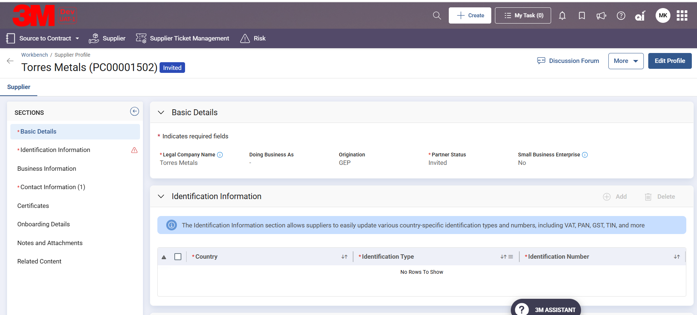
Existing Accounts with GEP
Your supplier profile opens in Invited status. Click Edit Profile to review and edit your supplier profile.
Note: Both Supplier and Buyer (3M) must fill in all mandatory fields before the profile can be submitted, changing the status from Invited to GEP Registered.

Slide 14
Logging into GEP
Log in to GEP using your registered credentials to access your profile and dashboard.
Your profile includes company details, tax information, compliance documents, and banking data.
The dashboard lets you update profile and company information, participate in and manage sourcing events, and maintain compliance requirements.

Slide 15
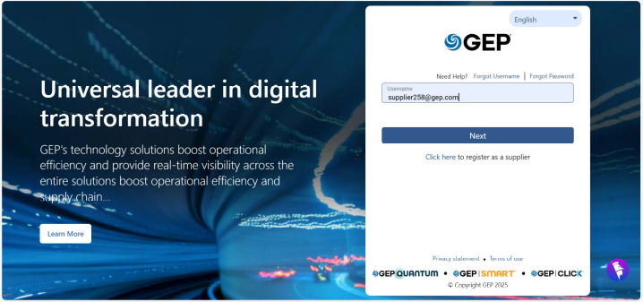
Login Instructions
Access the link provided by your 3M Supplier Manager and enter your username to log in to GEP.

Slide 16
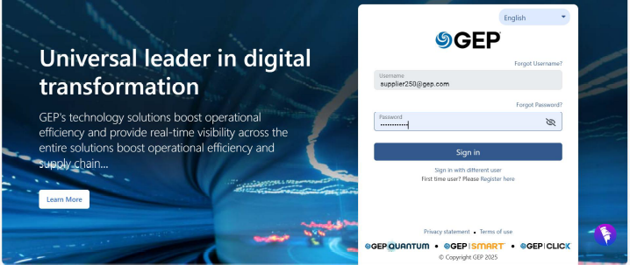
Login Instructions
Enter your password and click Sign in.

Slide 17
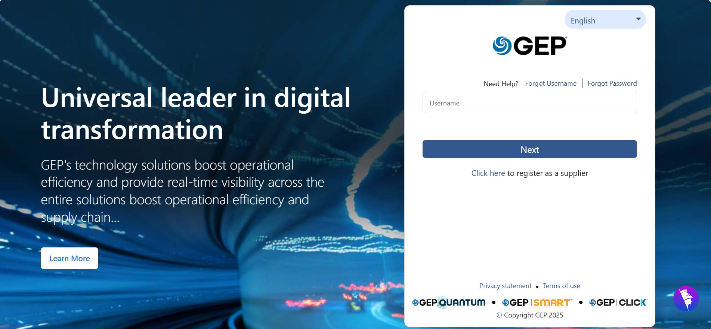
Forgot Username
Click Forgot Username on the login screen.

Slide 18
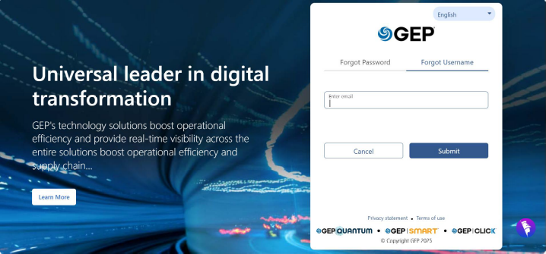
Forgot Username
Enter your registered email address and click Submit to retrieve your username.

Slide 19
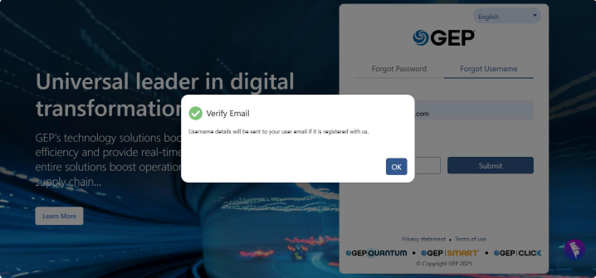
Forgot Username
The system triggers a username retrieval email to your registered email address.
Note: If you don't see the email in your inbox, check your Spam or Junk folder.

Slide 20
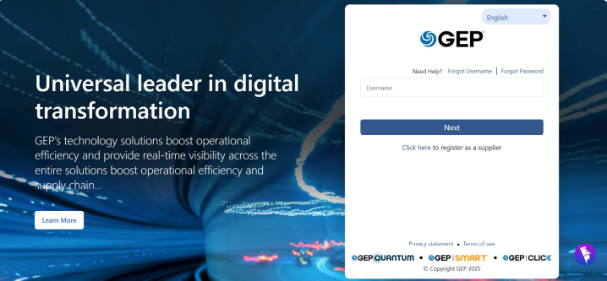
Forgot Password
Click Forgot Password on the login screen.
Resetting your password is secure and fully automated — for added security, you may be required to complete multi-factor authentication (MFA) during the reset process.

Slide 21
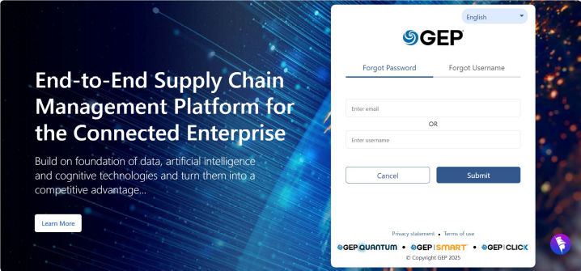
Forgot Password
Enter your registered email or username and click Submit.

Slide 22
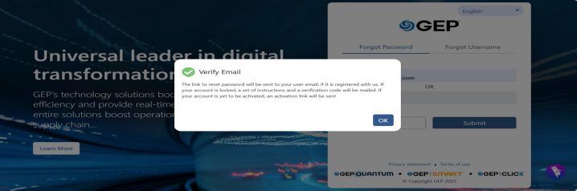
Forgot Password
You will receive an email to reset your password.

Slide 23
Supplier Profile Management
Supplier Profile Management is a core feature that simplifies and centralizes supplier information, enabling seamless collaboration with 3M.
Through a secure, cloud-based platform, suppliers can create a comprehensive profile that highlights their capabilities, certifications, and compliance credentials.
The sections a Supplier can view depend on the relationship type — see the visibility matrix on the next page.

Slide 24
Section Visibility by Relationship Type
 | Lite Onboarding | Full Onboarding | Payee | Intercompany Vendor
Basic Details | Yes | Yes | Yes | Yes
Contact Information | Yes | Yes | Yes | Yes
Identification Information | Yes | Yes | Yes | Yes
Certificates | Yes | Yes | Yes | Yes
Business Information | Yes | Yes | Yes | Yes
Banking | No | Yes | Yes | Yes
Location > Location Details | No | Yes | Yes | No
Location > Address | No | Yes | Yes | No
Location > Roles & Contacts | No | Yes | Yes | No
Notes and Attachments | Yes | Yes | Yes | Yes
Related Content | Yes | Yes | Yes | Yes
Onboarding Details | Yes | Yes | Yes | Yes

Slide 25
Changes to Supplier Profile
When specific profile details are updated, the changes are automatically submitted as a Change Request and must be approved before taking effect.
Changes in these sections require 3M's approval before they reflect on the Supplier's profile: Basic Details, Identification Information, Location (Location Details, Address, Roles & Contacts), Certificate, Banking Information, Business Information, and Contact Information.
Approval is not required for changes to: Notes and Attachments, Onboarding Details (non-editable), and Related Content (non-editable).

Slide 26
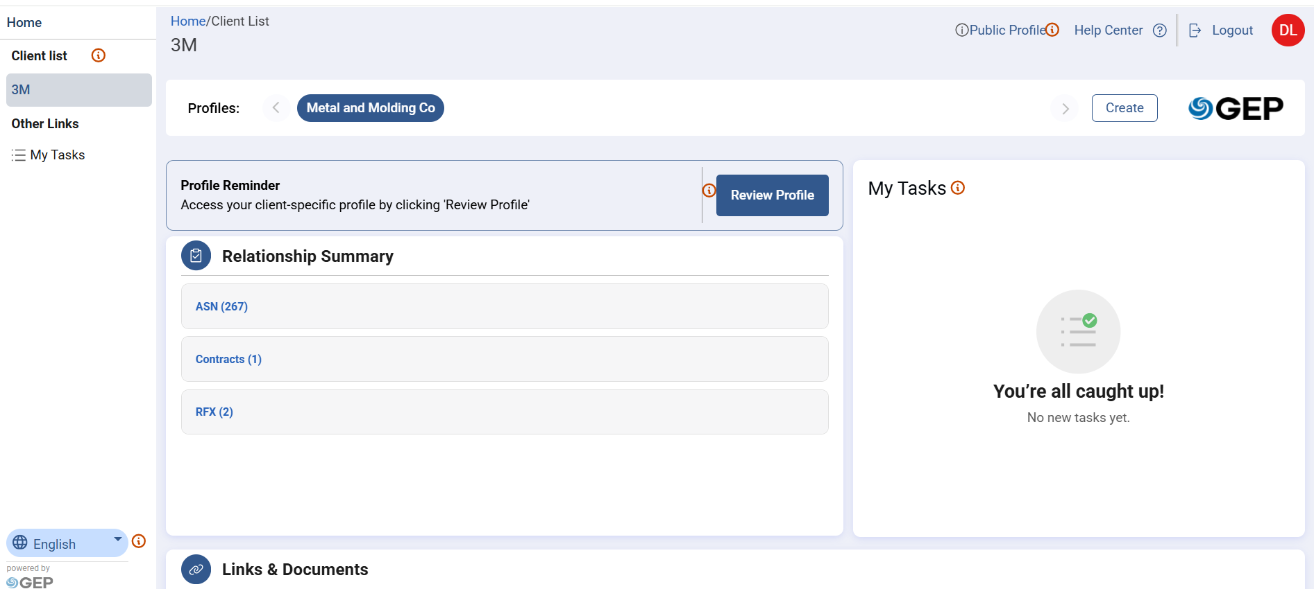
Changes to Supplier Profile
From the Supplier Landing Page, click the Review Profile button to access your Supplier Profile.

Slide 27
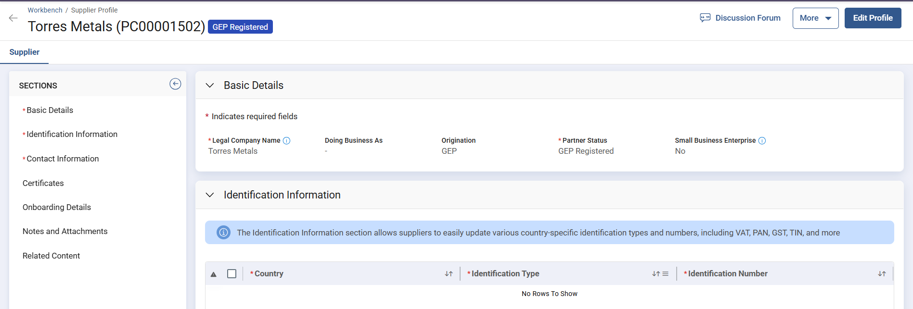
Changes to Supplier Profile
Click the Edit Profile button in the top-right corner to update your profile information.
Note: Some fields are read-only and can only be updated by 3M. Fields marked with an asterisk (*) require your update, and fields highlighted in yellow are fields you can edit.

Slide 28
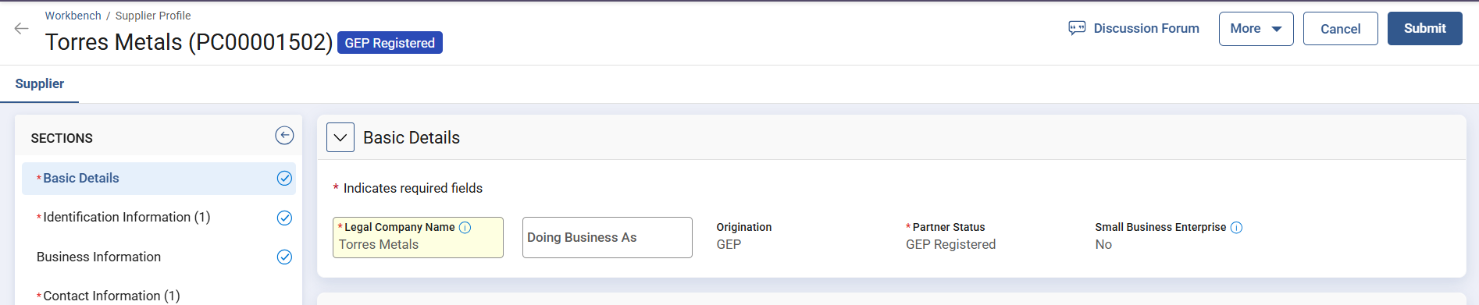
Changes to Supplier Profile
Basic Details — update the highlighted fields and make sure your information is up to date.

Slide 29
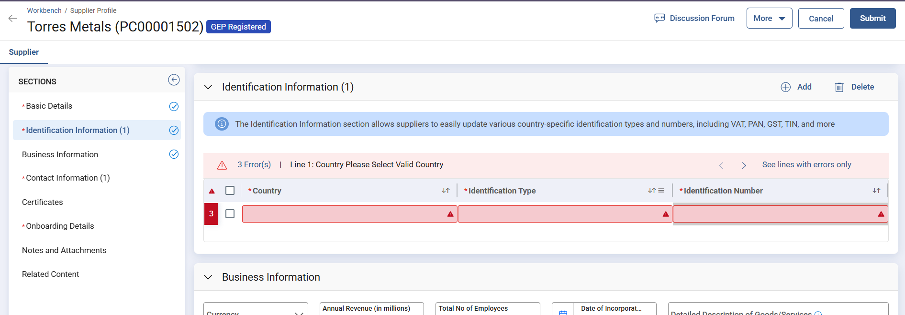
Changes to Supplier Profile
Identification Information is a mandatory section and must be completed accurately. Click Add — the Identification Type varies depending on the country selected.

Slide 30
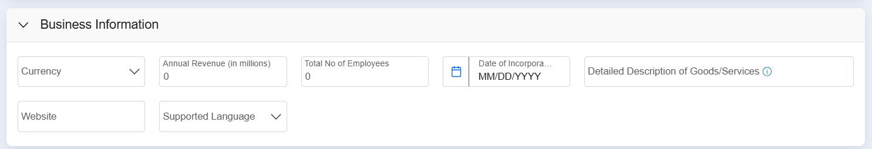
Changes to Supplier Profile
Business Information — enter or select the Supplier's business information. These are generic details typically filled in by the 3M Supplier contact.

Slide 31
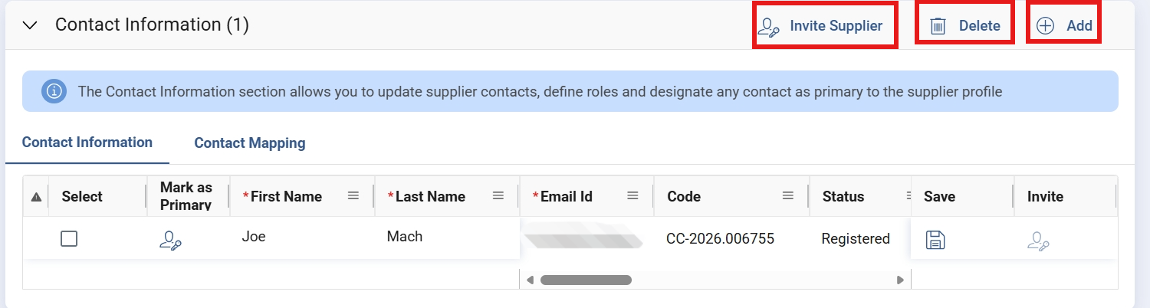
Changes to Supplier Profile
Contact Information — shows Supplier points of contact (email, phone, title) for efficient communication. Every profile needs at least one primary contact; additional contacts can be added as secondary.

Slide 32
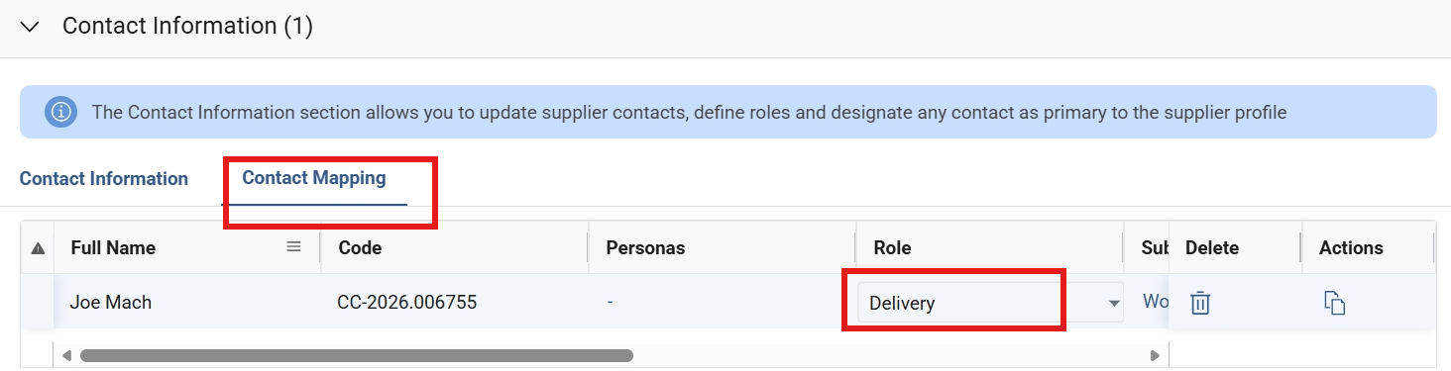
Changes to Supplier Profile
Contact Mapping — map Supplier contacts to different 3M roles, helping assign contacts to the right assignments, such as Accounts Receivable or Delivery.
Note: When making changes to the profile, Supplier must first submit the changes and get the newly added contact approved by 3M before sending invitations.

Slide 33
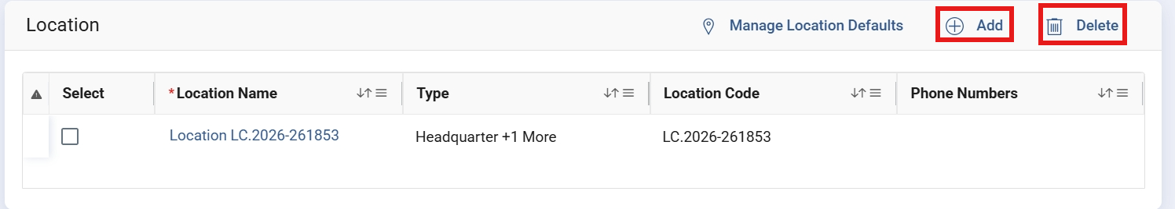
Changes to Supplier Profile
Location — the central place for managing Supplier sites, plants, or offices, each with independent transactional and compliance information. Subsections: Location Details, Address, and Roles & Contact.

Slide 34
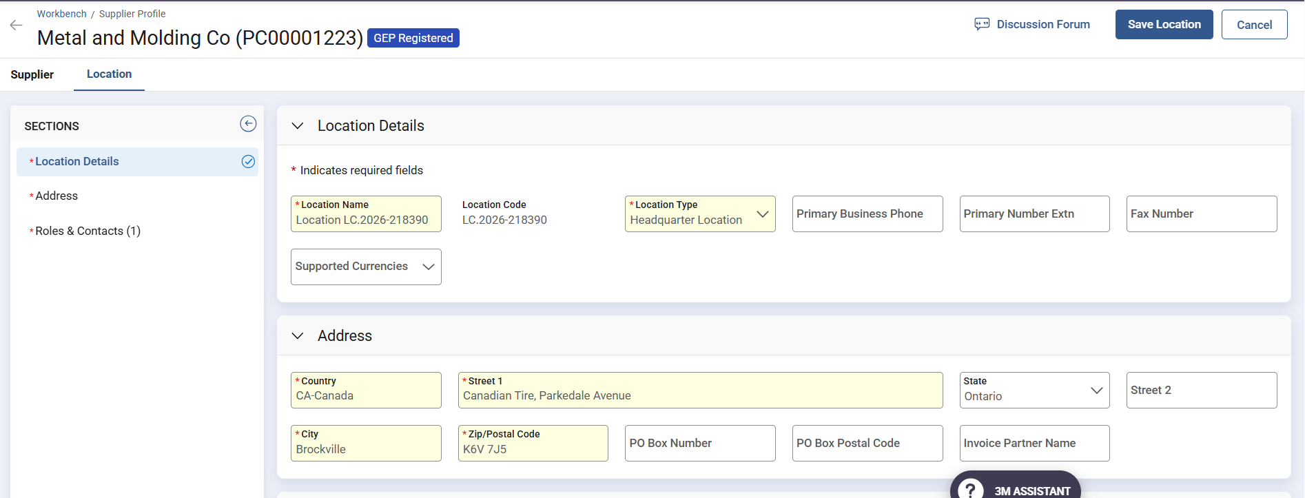
Changes to Supplier Profile
Click Add Location to navigate to the Locations tab, then click each section shown to add or update information.

Slide 35
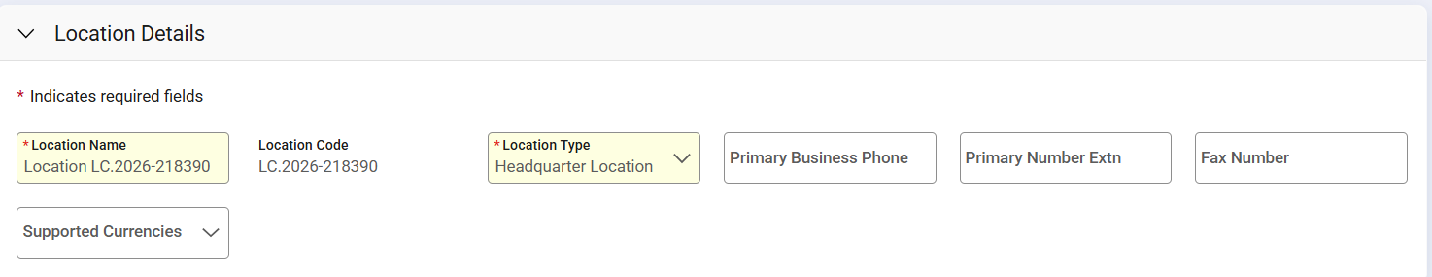
Changes to Supplier Profile
Location — this section contains mandatory Supplier location-related information; select or enter information in each field.

Slide 36
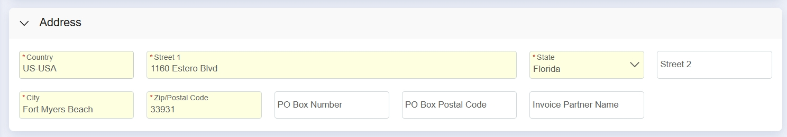
Changes to Supplier Profile
Address — enter the Supplier's physical and mailing address, required for logistics and tax documentation, such as City, Country, and Zip Code.

Slide 37
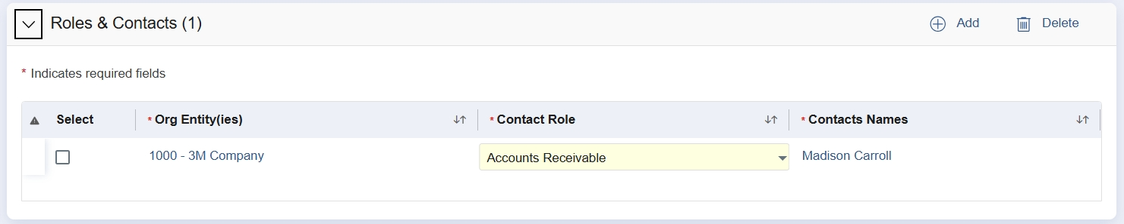
Changes to Supplier Profile
Roles and Contacts — specify the Supplier point of contact and role assigned to a location, such as Plant Manager or Invoicing Contact. You can also add Role and Contacts here.

Slide 38
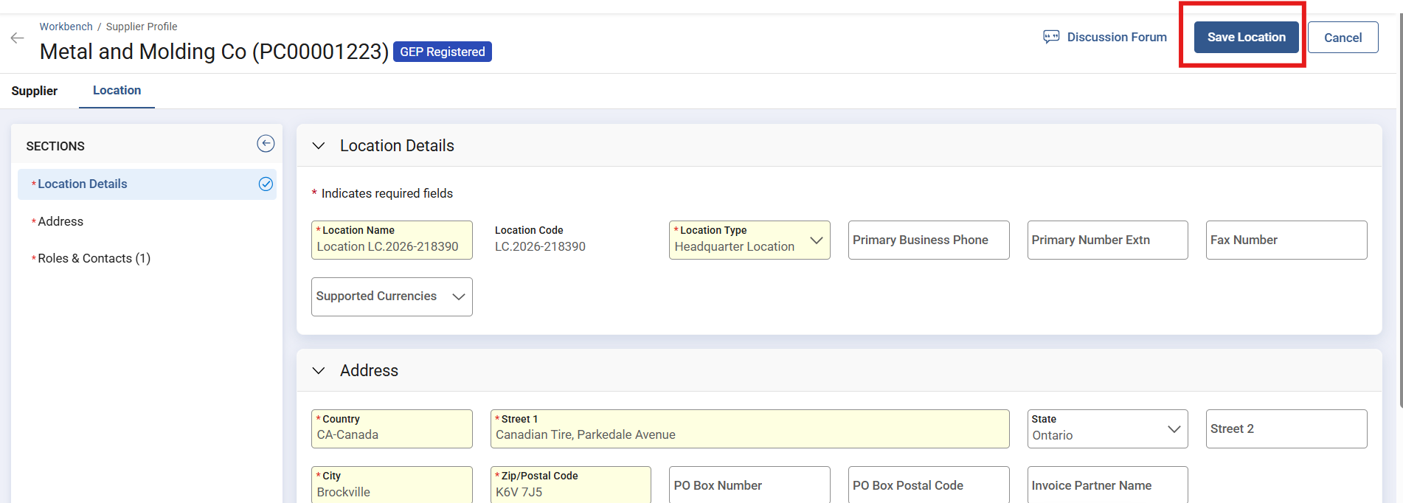
Changes to Supplier Profile
Once location information is filled out, click Save Location. You'll return to the Supplier Profile page to fill in other onboarding details.

Slide 39
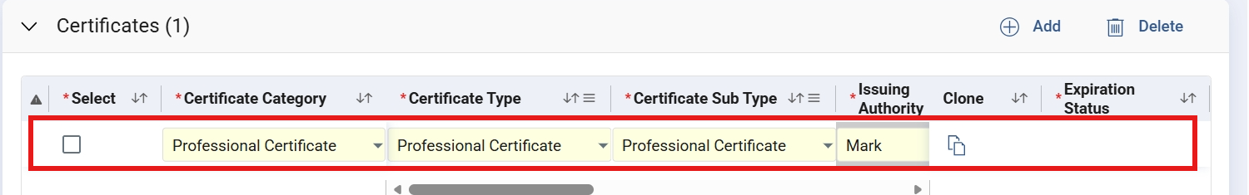
Changes to Supplier Profile
Certificate — captures the Supplier's professional certification details, including expiration date, status, compliance requirements, and issuing authority. Certificates fall under two business categories: Professional Certificate and Business Size Certificate.

Slide 40
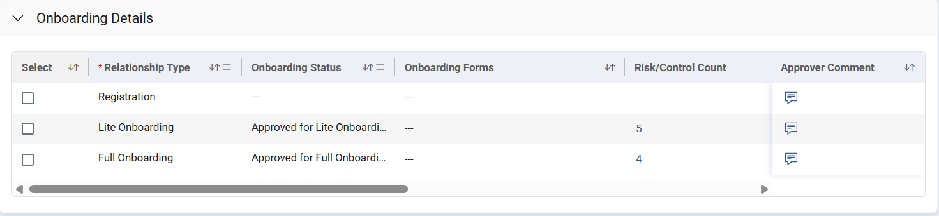
Changes to Supplier Profile
Onboarding Details — shows the Supplier's onboarding workflow information, including relationship type, onboarding status, onboarding form, risk/control, and approver comments.

Slide 41
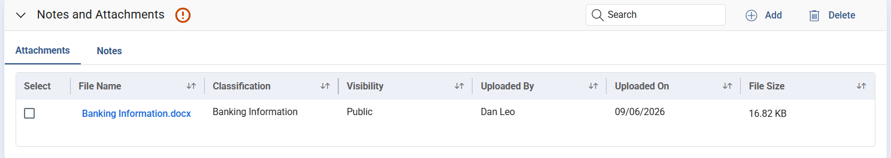
Changes to Supplier Profile
Attaching support documents is mandatory to proceed with the full onboarding relationship — the expectation is for the Supplier to attach documents in their profile rather than send them to 3M separately.
3M provides guidance on which supporting documents are required — hover over the red exclamation icon in the Attachments section for details.

Slide 42
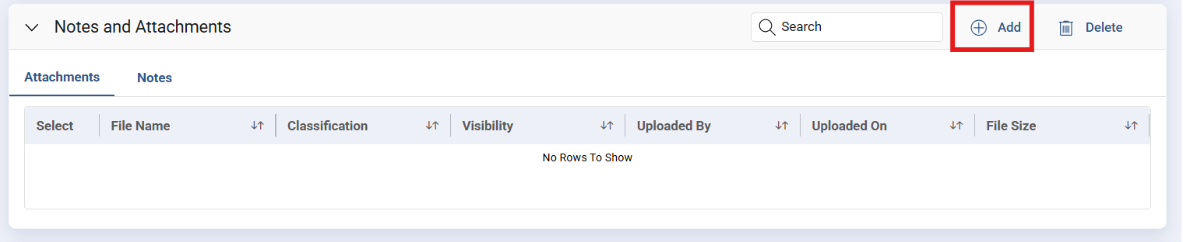
Changes to Supplier Profile
To upload a document, click the Add icon.

Slide 43
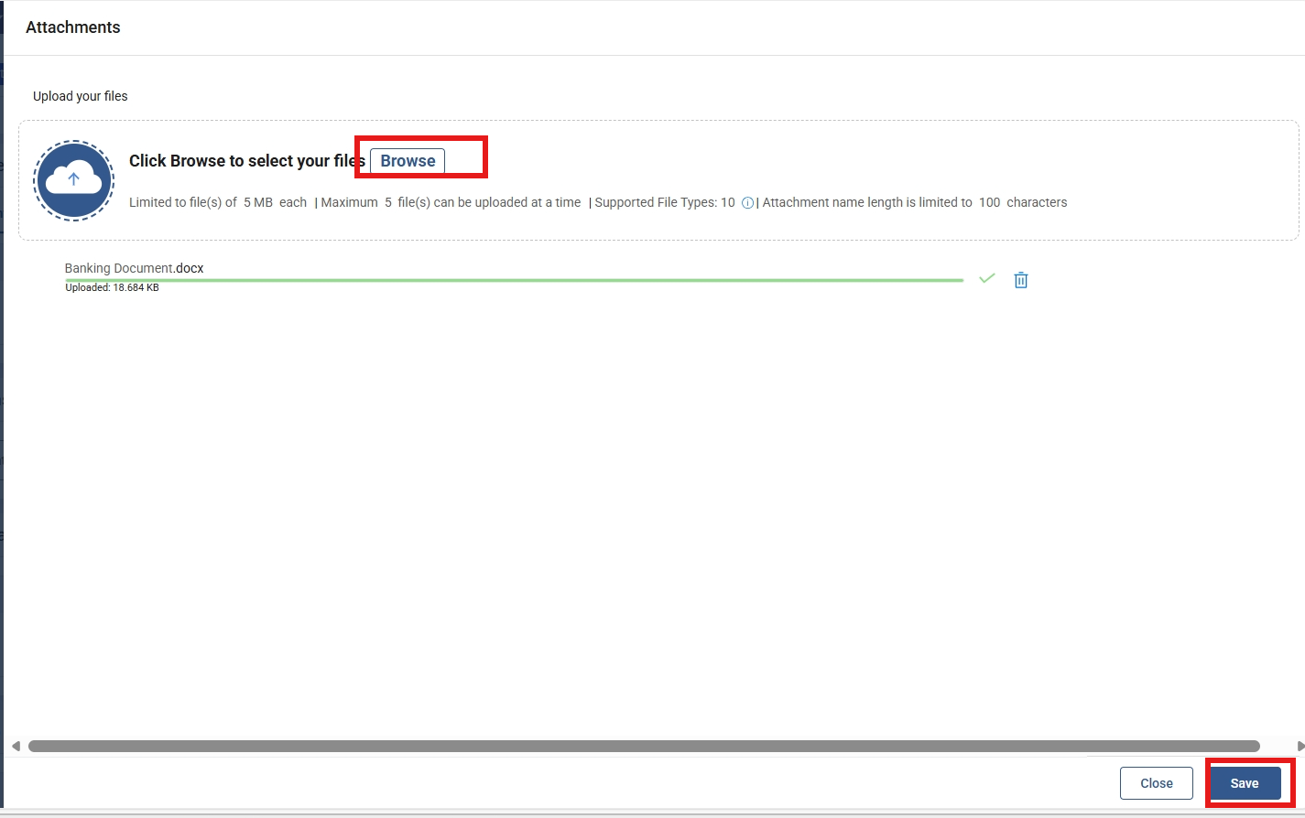
Changes to Supplier Profile
Click Browse to select the document (or drag and drop it), then click Save and Close once the upload is complete.

Slide 44
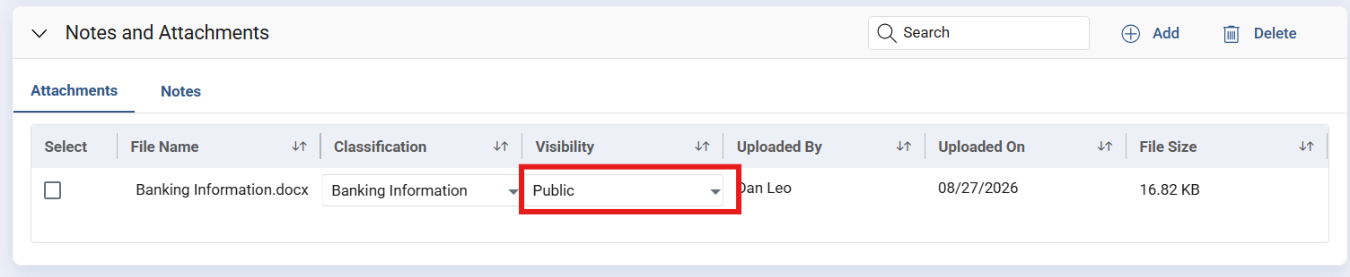
Changes to Supplier Profile
Once uploaded, specify the document's Classification Type and Visibility — for example, select Banking Information for a banking-related document.
Visibility has three options: Public (Supplier and Buyer users can view), Buyer Only (all 3M users with access can view), and Confidential (only the uploader can access it).

Slide 45
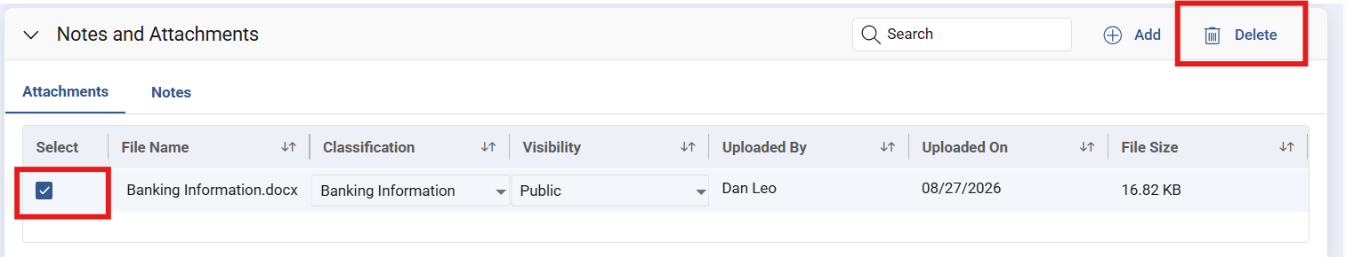
Changes to Supplier Profile
To delete an existing attachment, select it and click Delete, then confirm in the dialog that appears.

Slide 46
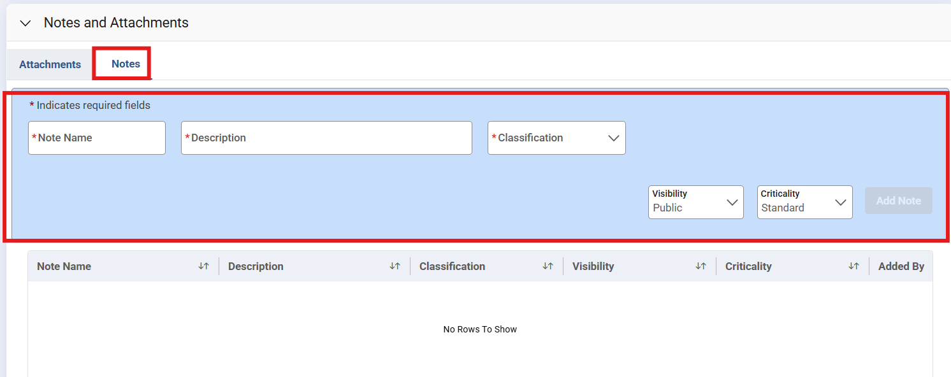
Changes to Supplier Profile
Notes — click Notes, enter a Name and Description, select the Classification type, Visibility, and Criticality, then click Add Note.

Slide 47
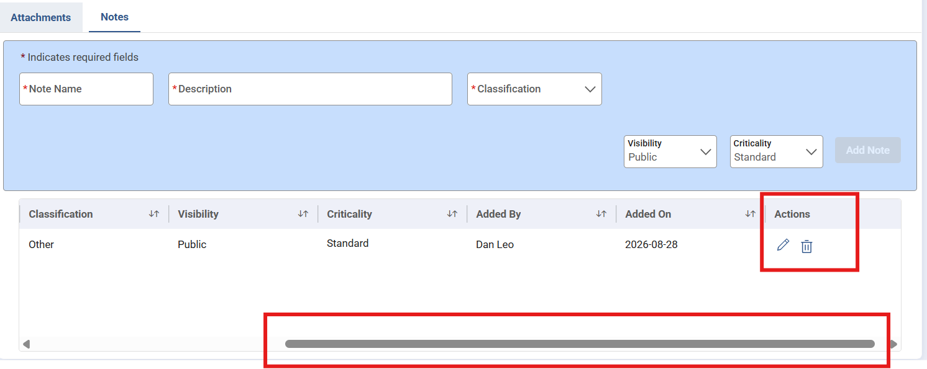
Changes to Supplier Profile
In the Notes table, scroll right and click the edit icon to modify an existing note, or the delete icon to remove it.

Slide 48
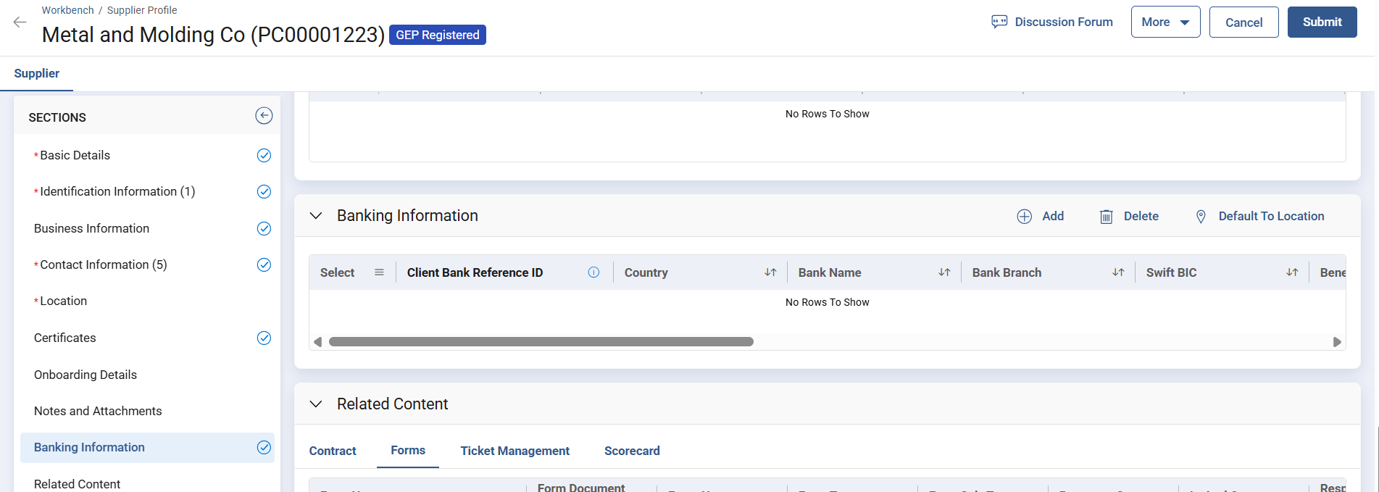
Changes to Supplier Profile
Banking Information — go to the Banking Information section and click Add.

Slide 49
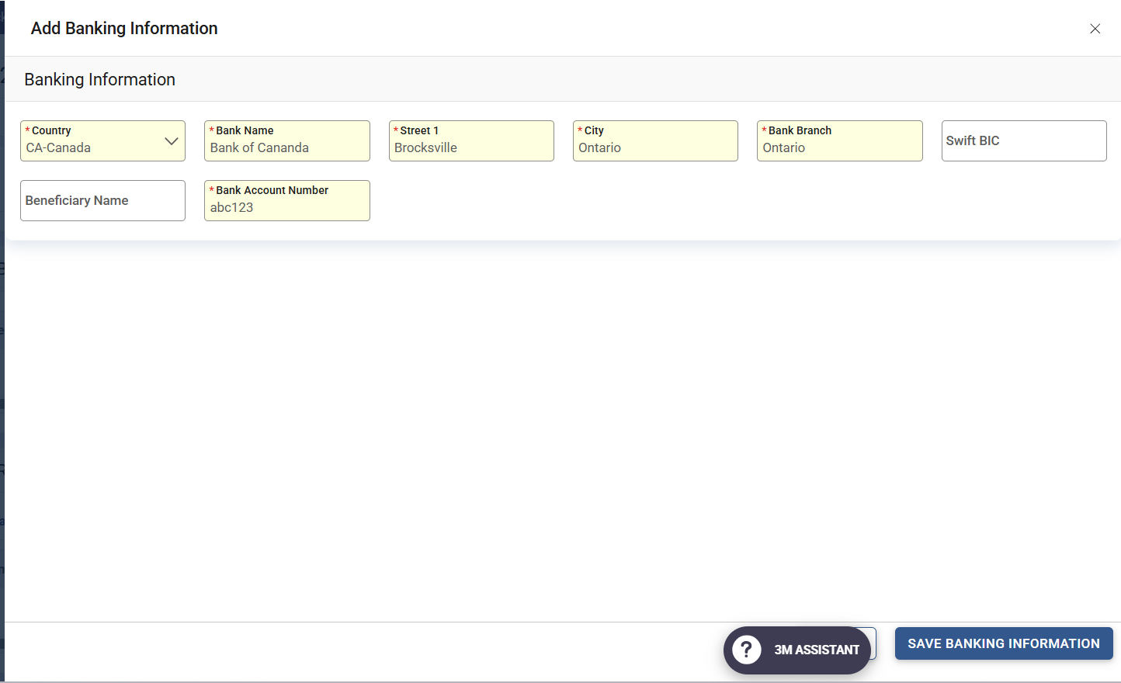
Changes to Supplier Profile
Select the country, provide the banking details, and click Save Banking Information.

Slide 50
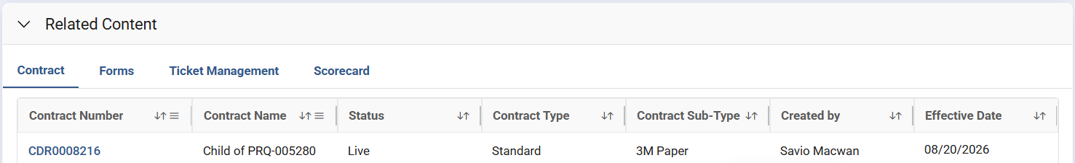
Changes to Supplier Profile
Related Content — displays all documents related to a Supplier, such as RFx, Contracts, Forms, Ticket Management, Scorecard, Invoice Order, Project, and Catalog. Click a tab to view the associated documents.

Slide 51
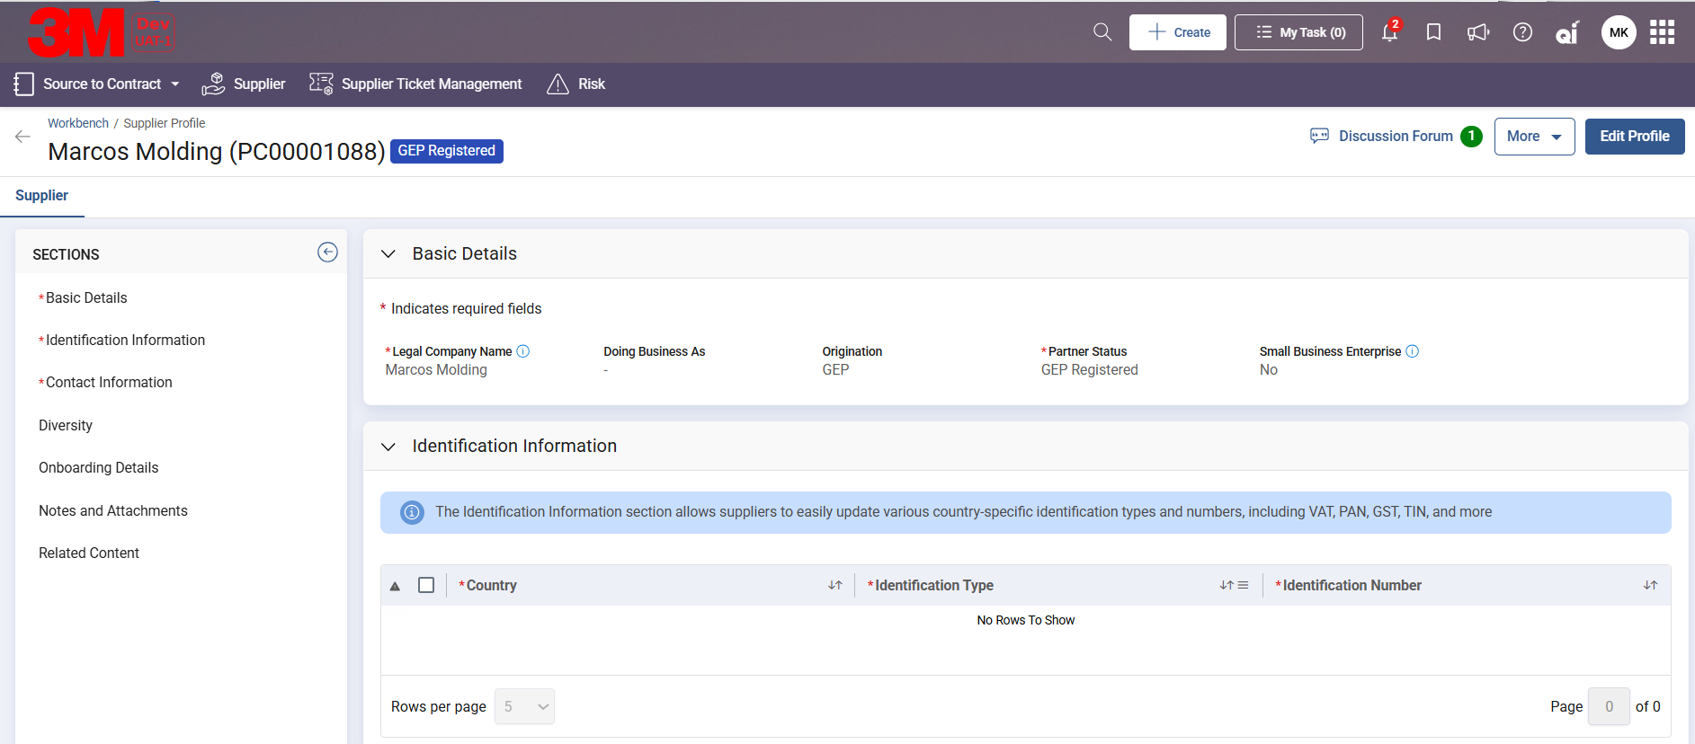
Changes to Supplier Profile
Discussion Forum — review the forum to check for pending messages requiring a response, and reply by including a message and clicking Post.

Slide 52
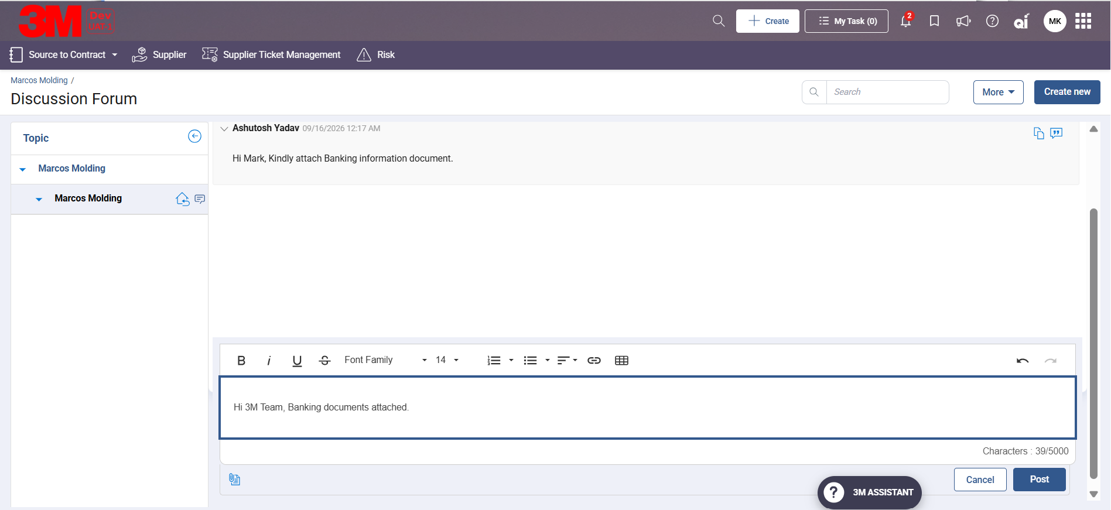
Changes to Supplier Profile
This triggers an automated email and platform notification to the 3M team. The Discussion Forum can also serve as a real-time chat, keeping all messages recorded.

Slide 53
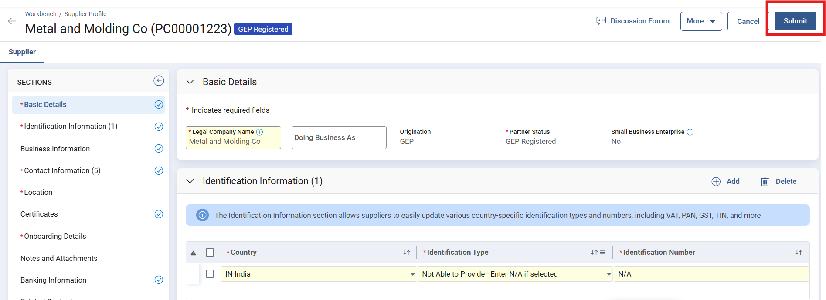
Changes to Supplier Profile
Once changes are complete, click Submit to send the profile changes for 3M approval.

Slide 54
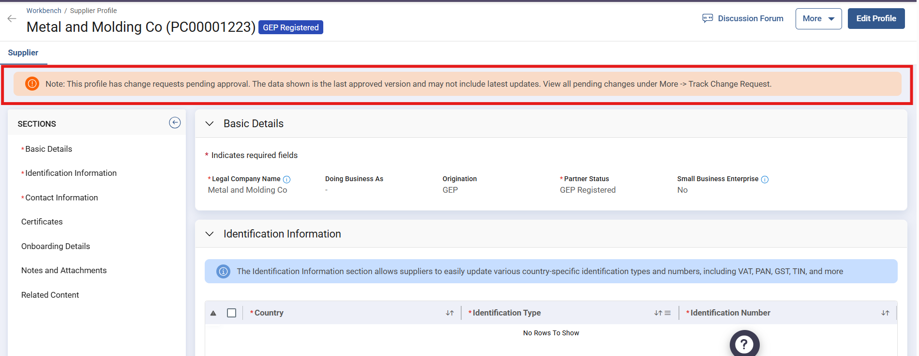
Changes to Supplier Profile
A banner appears at the top of the Supplier profile page noting that the profile change request is pending approval.

Slide 55
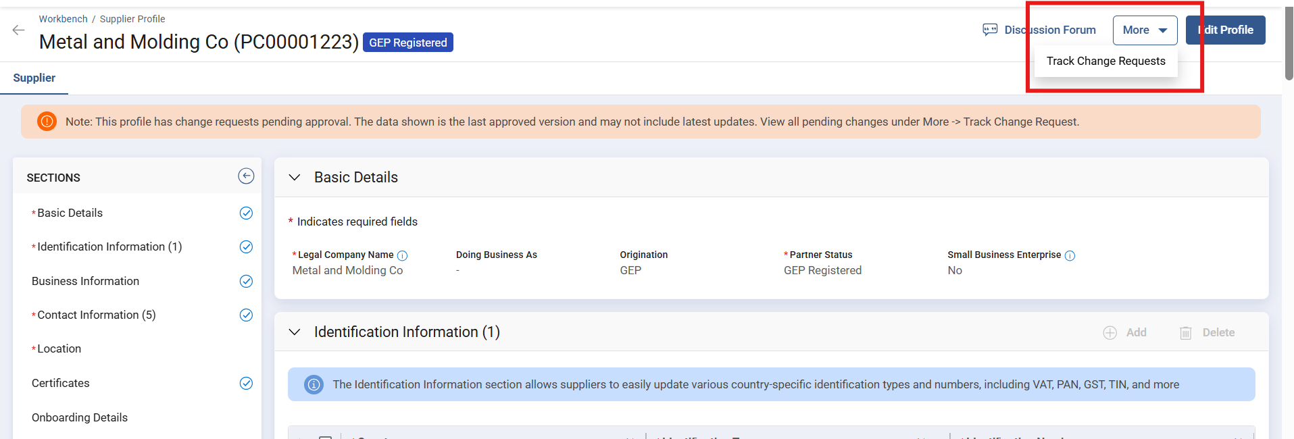
Changes to Supplier Profile
Click Track Change Requests to view the status of your change approval.

Slide 56
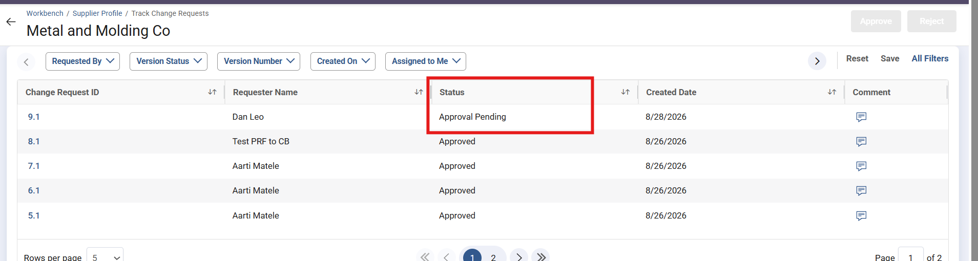
Changes to Supplier Profile
View the change request approval status, including any Approver comments.

Slide 57

Changes to Supplier Profile
Once approved or rejected, the status updates and the pending-approval banner disappears — if approved, the changes begin reflecting on the Supplier profile page.

Slide 58
Thank You

