Slide 1
Supplier Enablement – Sourcing – How to submit RFx response

Slide 2
About Sourcing - RFx
This session covers topics related to RFx module and how Supplier can submit RFx response.
RFx events are sourcing events issued by 3M to request for supplier information.
Types of RFx events are-
RFP(Request for proposal)
RFQ(Request for Quotation)
RFI(Request for Information)
The GEP platform allows suppliers to respond electronically while maintaining full auditability. Let's review the RFx response process step-by-step.

Slide 3
Supplier RFx response process flow
3M
SUPPLIER
Start
Publish RFP
Manage RFP
Receive RFx invitation
Review RFx details
Acknowledge RFP Guidelines and review RFx details
Supplier may receive email notification of awarding or non-awarding RFx event. They can also reach out to 3M contact for any updates.
Respond to Questionnaire
Submit Responses
End
Depending on type of RFx(RFQ, RFI or RFP) Supplier will submit response for either Questionnaire or Quote or both
Enter Quotes
Withdraw & Resubmit
3M Action
Supplier Action
Options
Product Flow
Possible Flow
Start/End
Decision Box

Slide 4
Sourcing – RFx response process steps
The RFx process begins when 3M publishes an event
  3M creates and Publishes RFx
  Supplier receives invitation via email notification to participate in the RFx event. The email notification contains RFx event document hyperlink to navigate to the RFx document in GEP portal. Supplier can also open the RFx document from their Supplier Dashboard> Relationship summary or My Task section
  Supplier opens the RFx event, reviews RFx event details such as guidelines or terms and conditions, event basic details, response timeline, notes or attachments etc.
  Supplier acknowledges the guidelines or terms if required
  Depending upon the type of RFx event(RFQ, RFP, RFI) Supplier will have to respond to Questionnaire or Pricesheet or both
  Supplier responds to questionnaires
  Supplier enters pricing and commercial responses
  Supplier reviews information provided and submits the response
  Finally, Supplier may receive email notification of awarding or non-awarding RFx event. They can also reach out to 3M contact for any updates
There are some optional step which Supplier can perform, if permitted, before RFx event closure:
  Supplier can withdraw their responses. Make updates to their responses and resubmit their response.
Some of the Best practices:
  Submit early
  Validate pricing
  Review attachments carefully
  Ensure all mandatory questions are answered

Slide 5
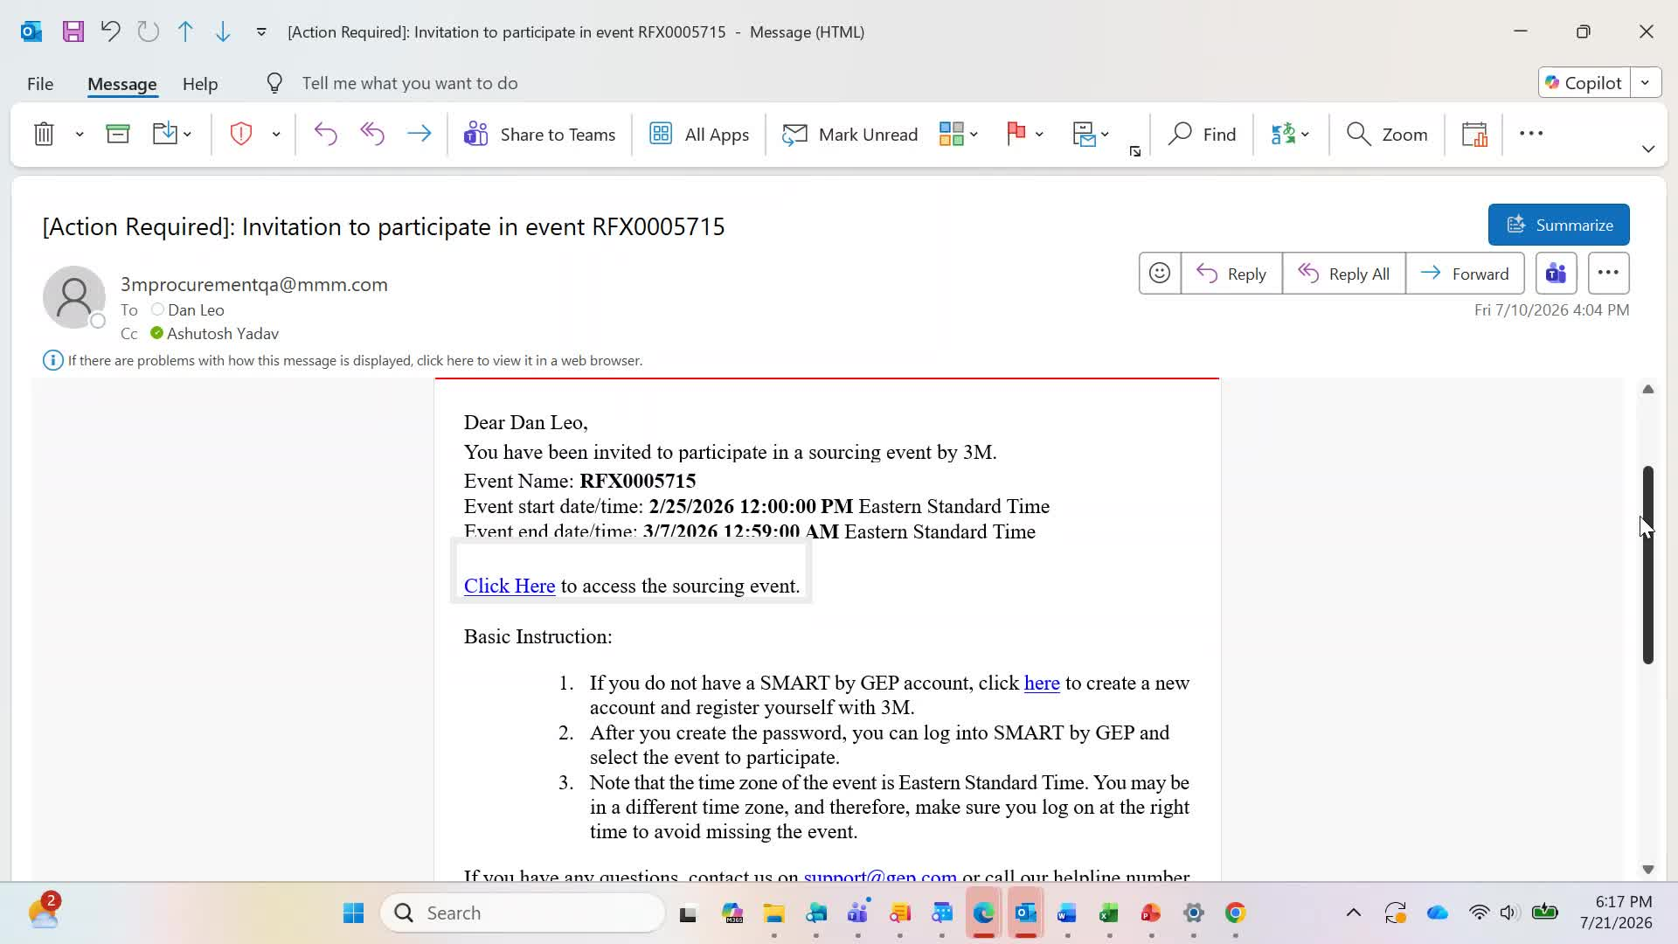
RFx response – Invitation Email
When RFx is published by 3M, Supplier contact will receive an Invitation email notification to participate in the RFx event.
Email will contain details such as event name, event start and end date and a hyperlink to GEP system to open the RFx document.
Supplier can click on the hyperlink to access Sourcing event. This will open GEP webpage on their default web browser.

Slide 6
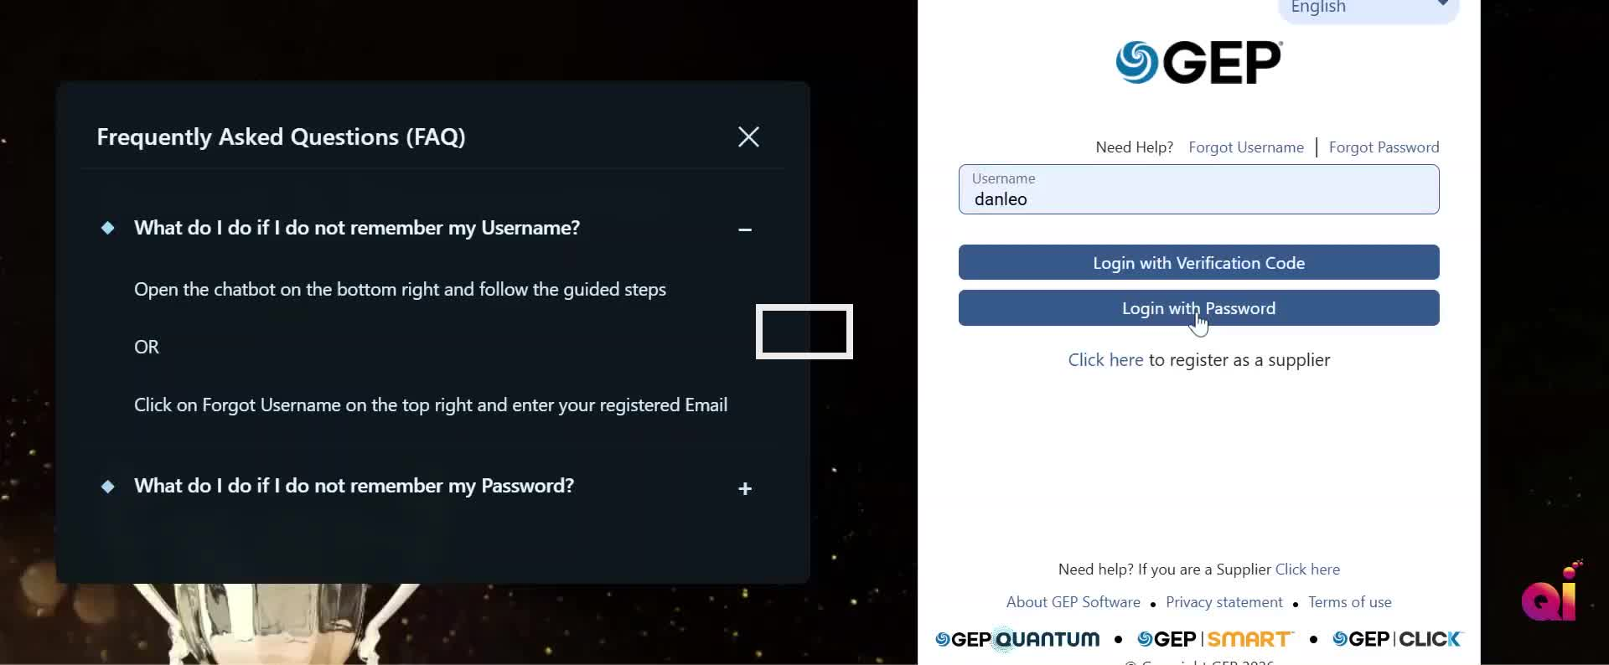
RFx response – Supplier Login
Supplier will Login using their user id and password and they will be auto-navigated to the RFx document page where they can start reviewing and responding to the event details.

Slide 7
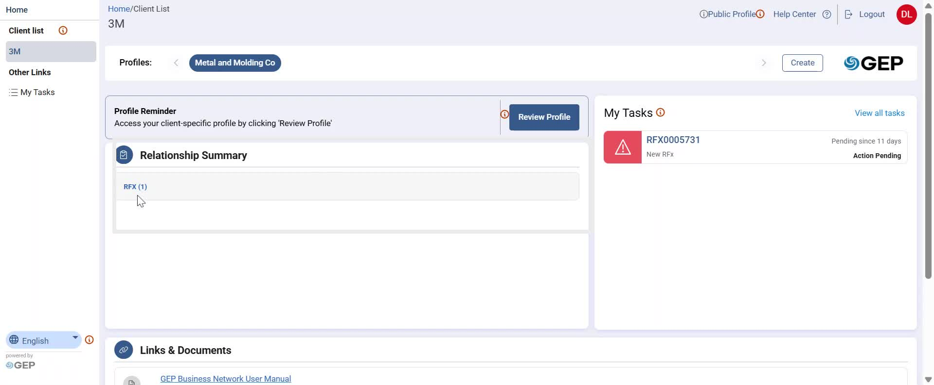
RFx response – How to access RFx event
There are two other ways through which Supplier can get to know if they have been invited to any RFx event or not.
They are Relationship summary and My Tasks section in Supplier Dashboard page.
Users can click on the RFx event link to open the RFx document page.

Slide 8
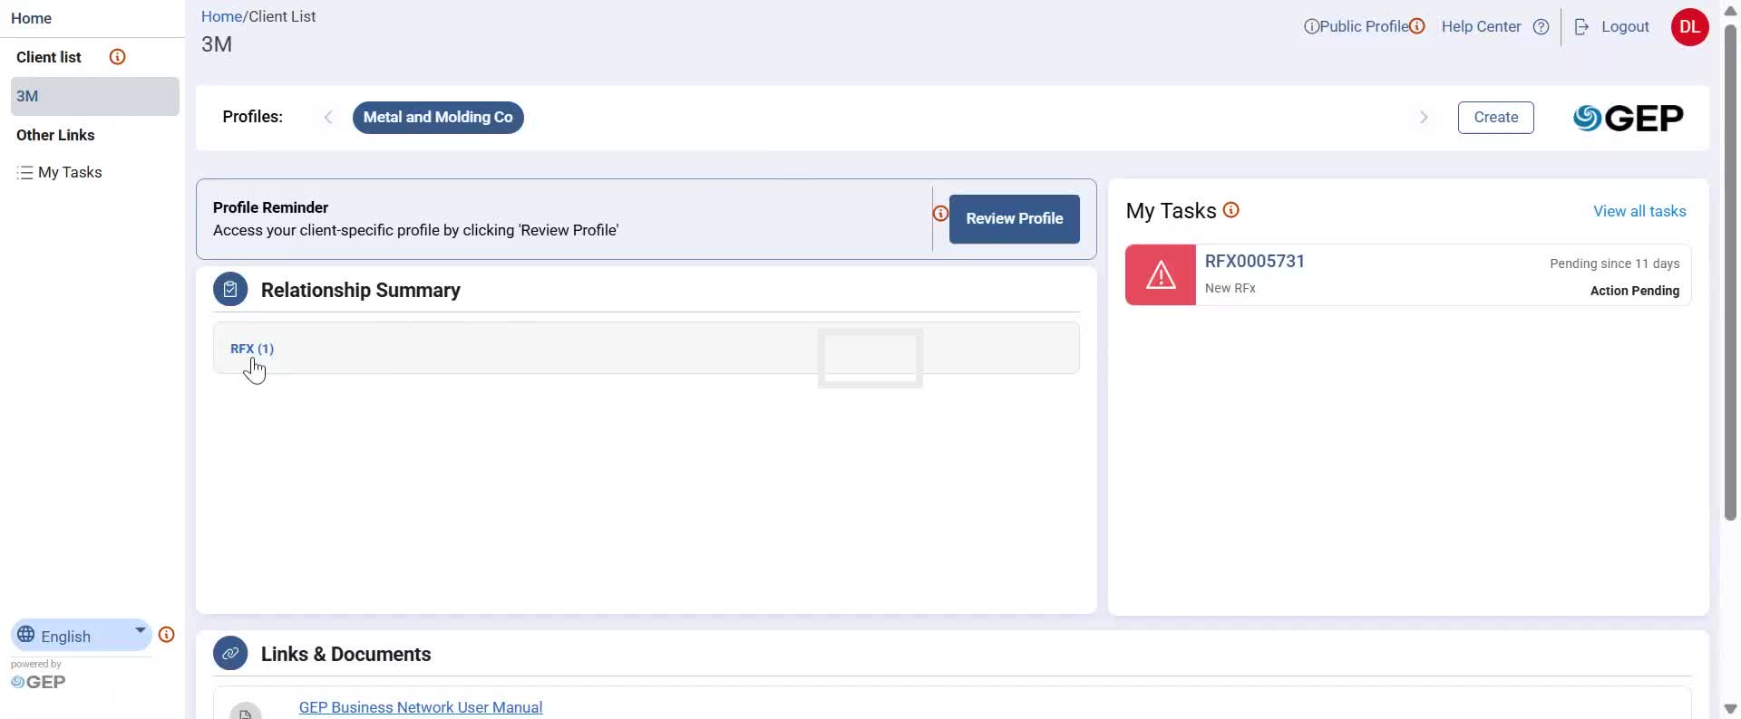
RFx response – What is RFx workbench
Before moving to show how to respond to an RFx event, let us see What is RFx workbench and what are the different functionalities available on RFx workbench.
From supplier Dashboard page, when supplier clicks on Rfx link in Relationship summary they would be navigated to the RFx workbench.

Slide 9
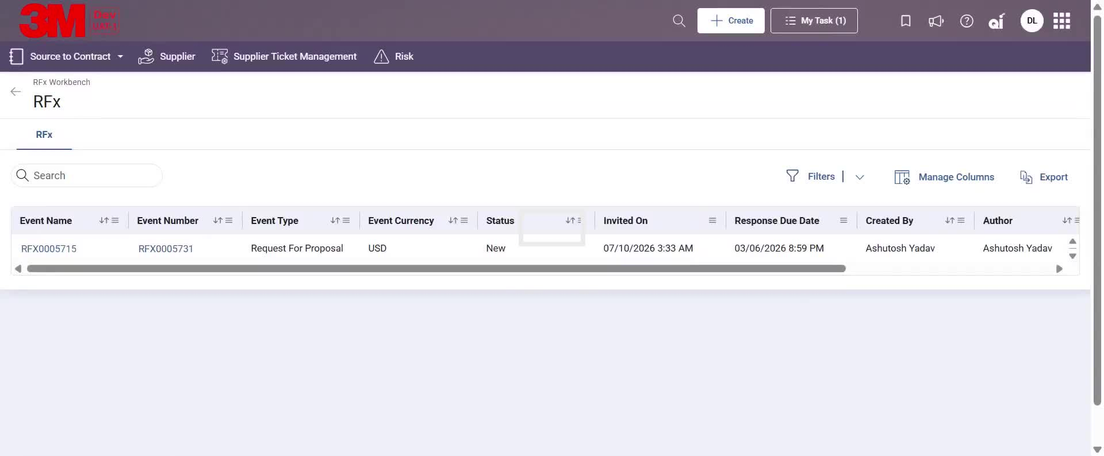
RFx response – What is RFx workbench
On RFx workbench, Supplier will get to see following functionalities
  Search: Quickly find sourcing events by entering keywords or event details.
  Filters: Narrow down event results using criteria such as status, type, or date.
  Manage Columns: Customize the columns displayed in your event list for easier viewing.
  Export: Download event details in a preferred file format for offline reference.
And columns such as
  Event Name: Title or name of the sourcing event.
  Event Number: Identify the unique number assigned to each sourcing event for tracking purposes.
  Event Type: Identify the type of sourcing event (e. g. , RFQ, RFP, RFI).

Slide 10
RFx response – What is RFx workbench
And columns such as -
  Event Currency: See the currency in which event transactions are conducted.
  Status: Monitor the event's current stage (e. g. , New, Response Submitted).
  Invited On: See the date and time when you were invited to participate in the event.
  Response Due date- By when supplier needs to respond to the event
  Created By - Who created the RFx event
  Author - Who has authored the RFx event
  Created On - When was the RFx event created
  Last Modified on - When was the RFx event modified
These columns visibility can be modified using Manage Column functionalities.

Slide 11
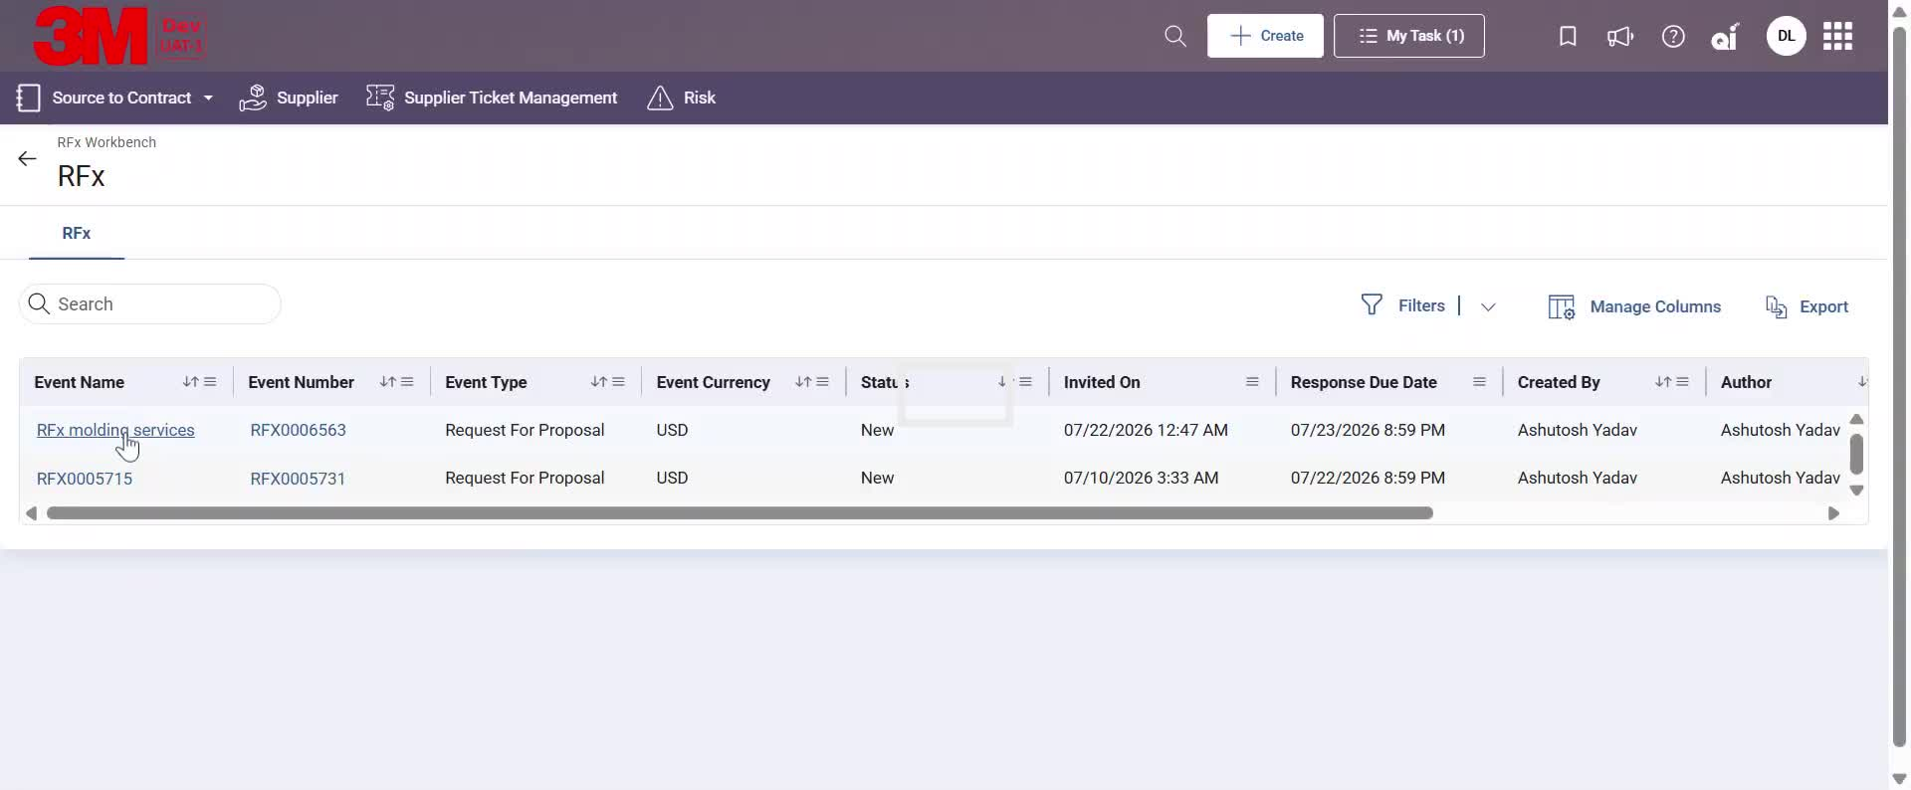
RFx response – Open RFx event
Click on an Event Name or Event Number hyperlink to access the document.

Slide 12
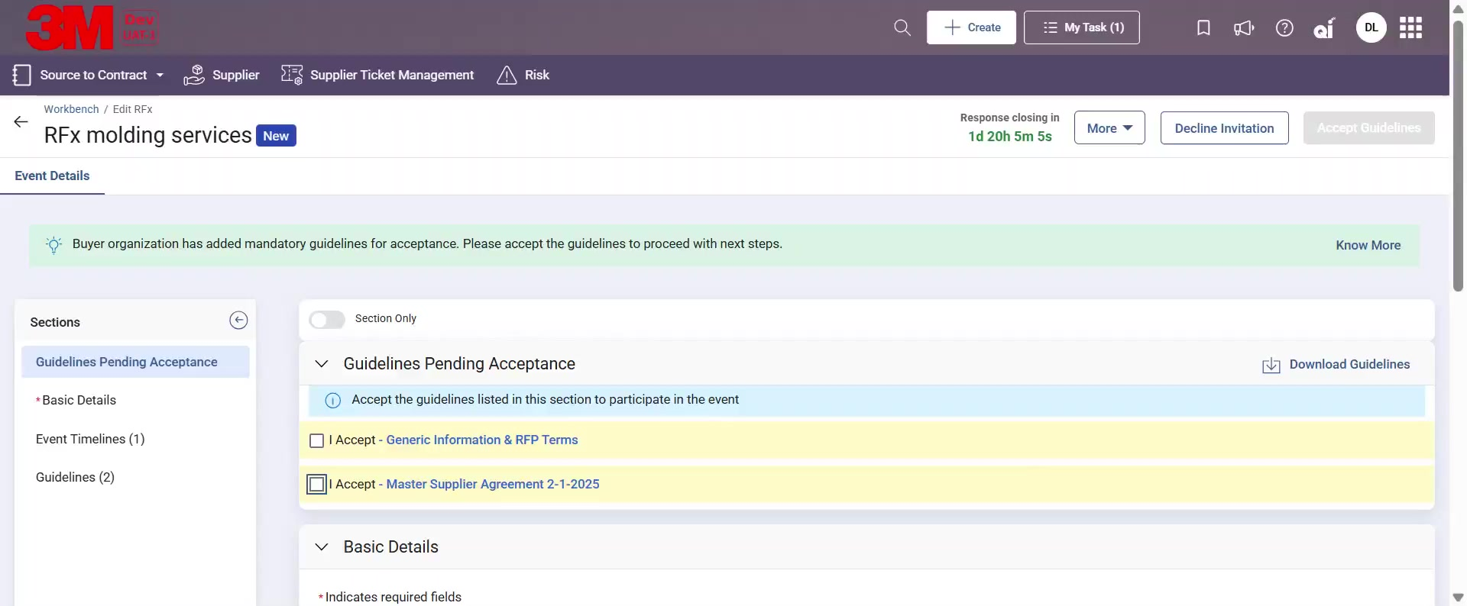
RFx response – Acknowledge guideline
After opening the sourcing document, review and acknowledge all pending guidelines to gain access to the sourcing event

Slide 13
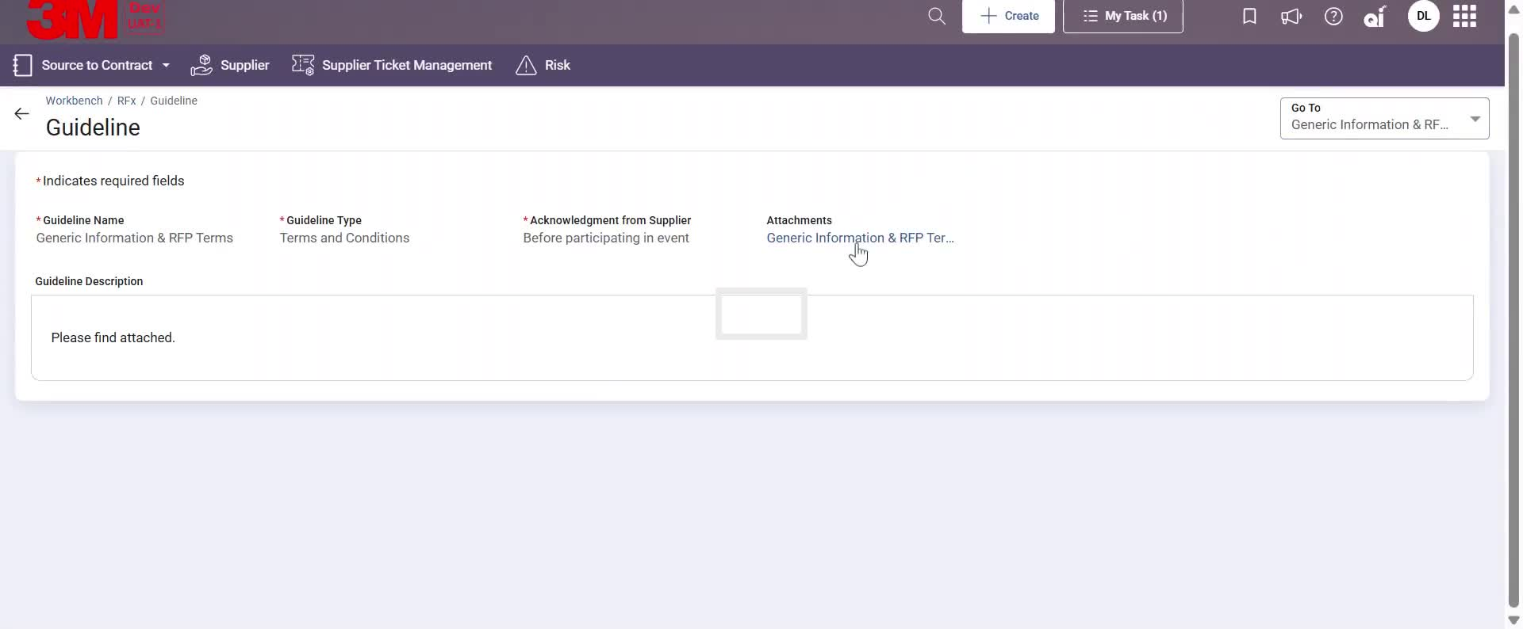
RFx response – Acknowledge guideline
Open and Read all the Guidelines

Slide 14
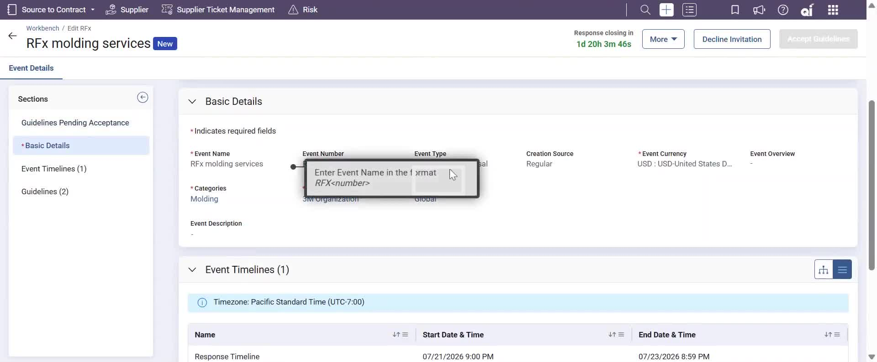
RFx response – RFx page
Review each sections like Basic details, Event timelines and Guideline list.

Slide 15
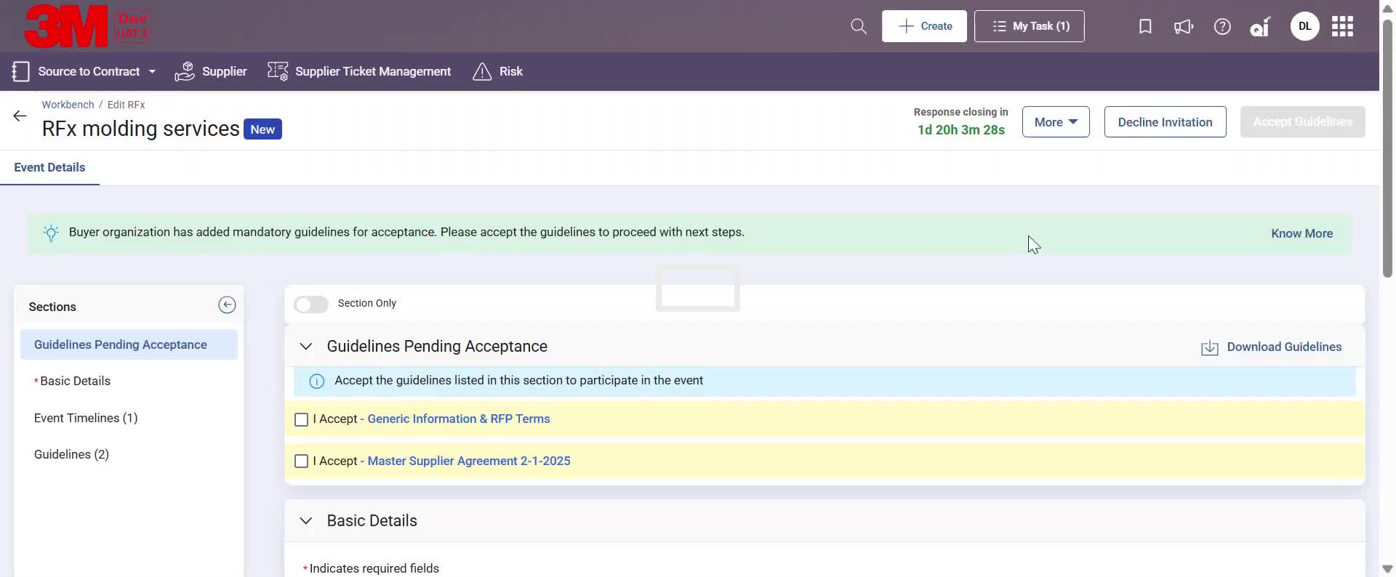
RFx response – RFx page (More Options)
Open More dropdown to view Upload and Download logs

Slide 16
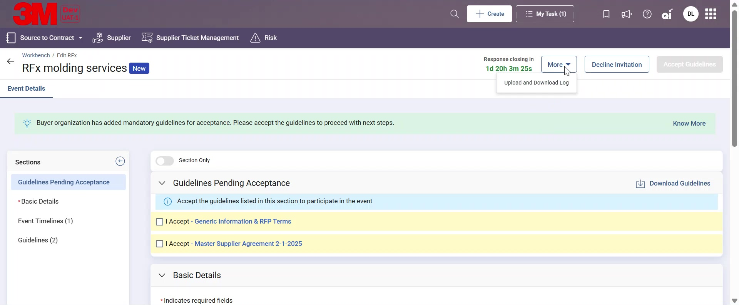
RFx response – Decline participation
If after reviewing Event details, Supplier wish to Decline the Invitation, they can click the Decline Invitation button.

Slide 17
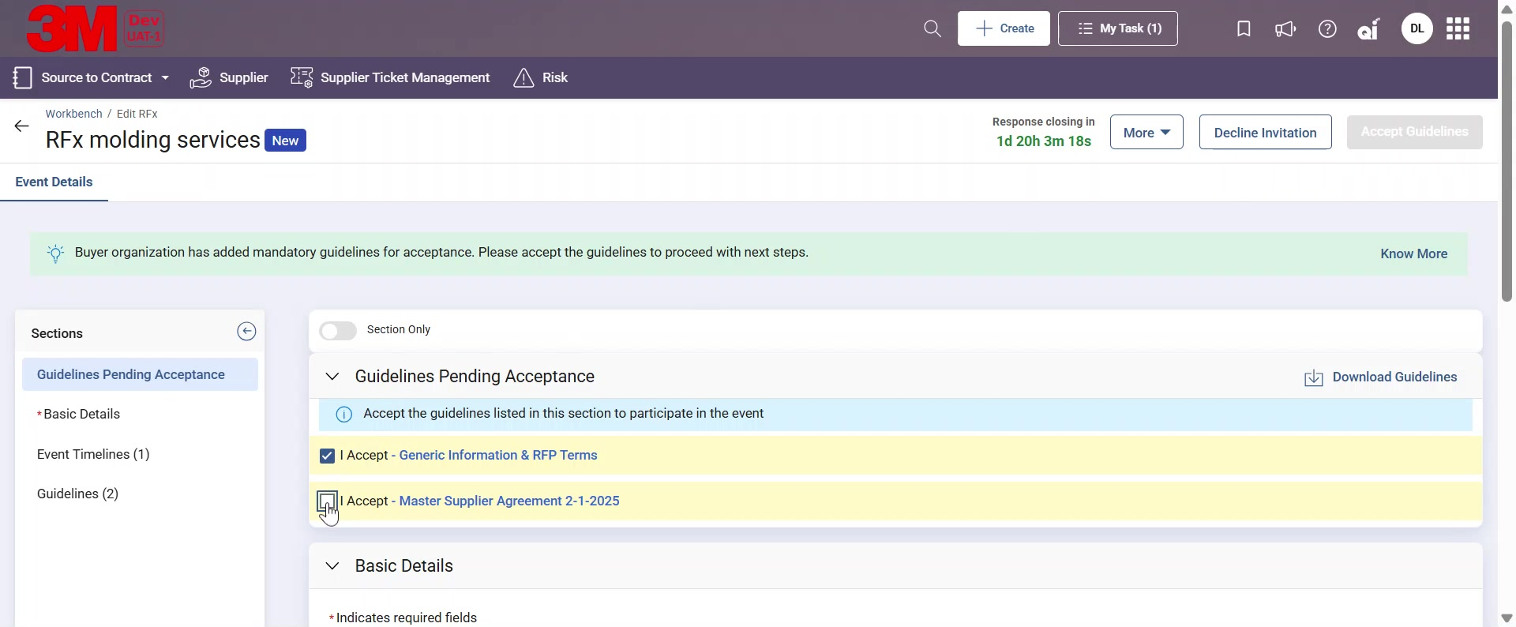
RFx response – Accept Guideline
If Supplier wants to participate in the sourcing event, Supplier will select the Guidelines checkbox and click on Accept Guidelines button.

Slide 18
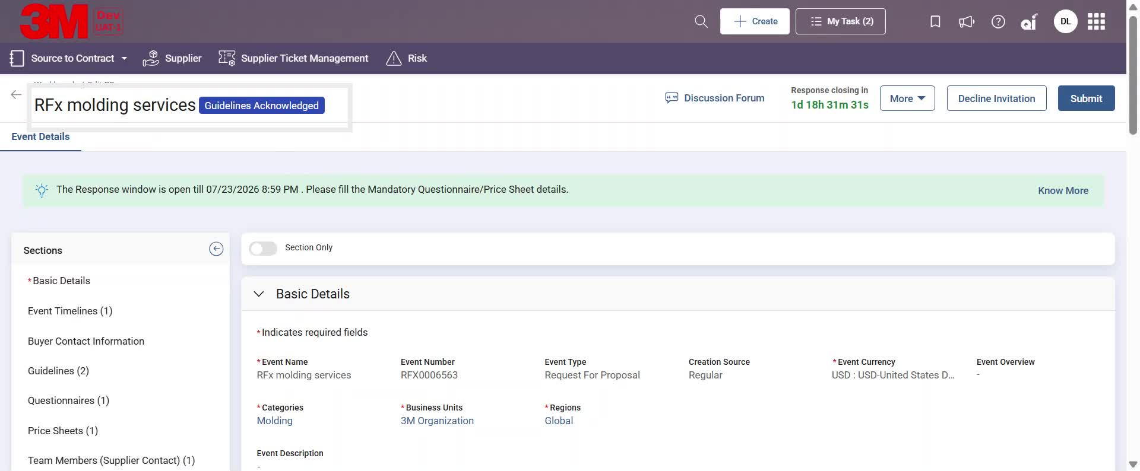
RFx response – Guidelines Acknowledged
Once Supplier completes the acknowledgement, the status of the document will change to Guidelines Acknowledged.

Slide 19
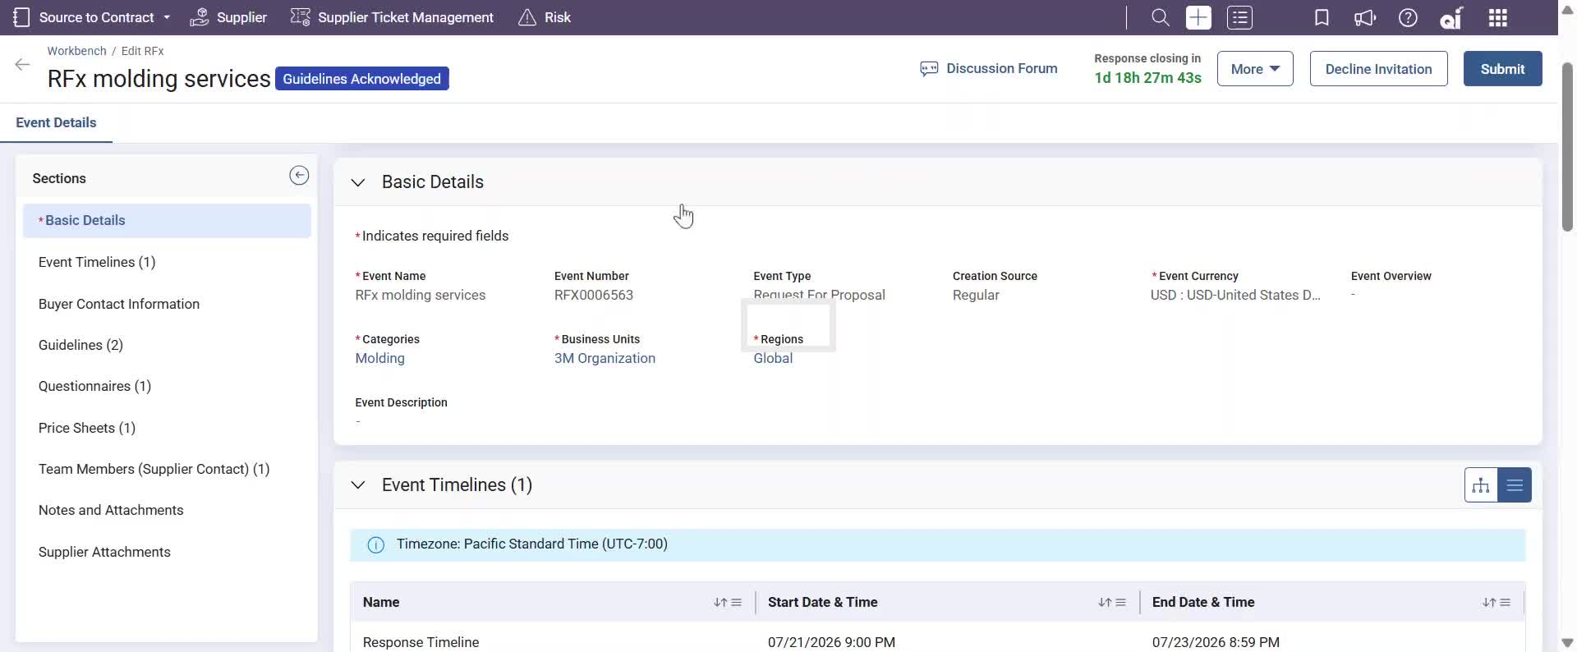
RFx response – Respond to Questionnaire
Navigate to the Questionnaires section to access the questionnaire created by 3M.
Click on the questionnaire Name hyperlink. The displayed sections may vary depending on the sourcing event type like in case of RFP and RFI, Questionnaire section will be visible however in case of RFQ only Price sheet will be visible.

Slide 20
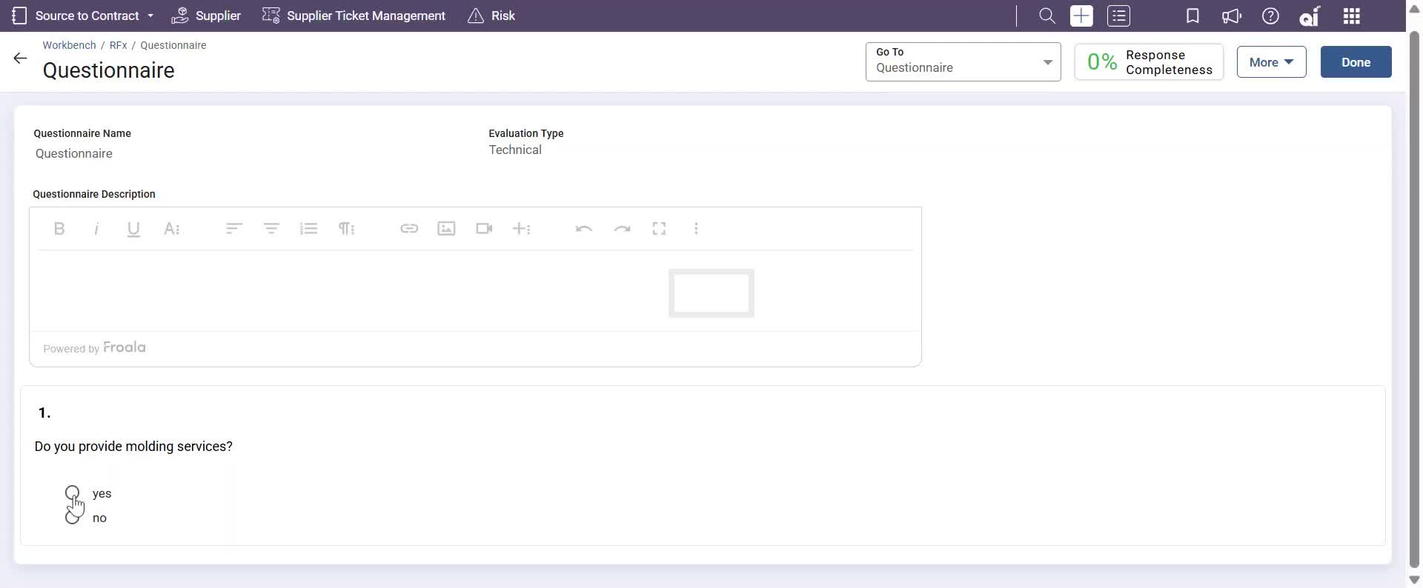
RFx response – Respond to Questionnaire
Complete the questionnaire by providing responses to all questions. The progress bar will indicate the completion percentage. Click Done to return to the sourcing document.

Slide 21
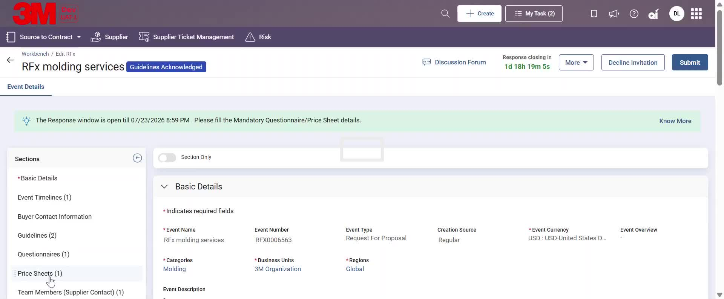
RFx response – Respond to Pricesheet
Navigate to the Price Sheets section and click on a Price Sheet Name to submit bid responses

Slide 22
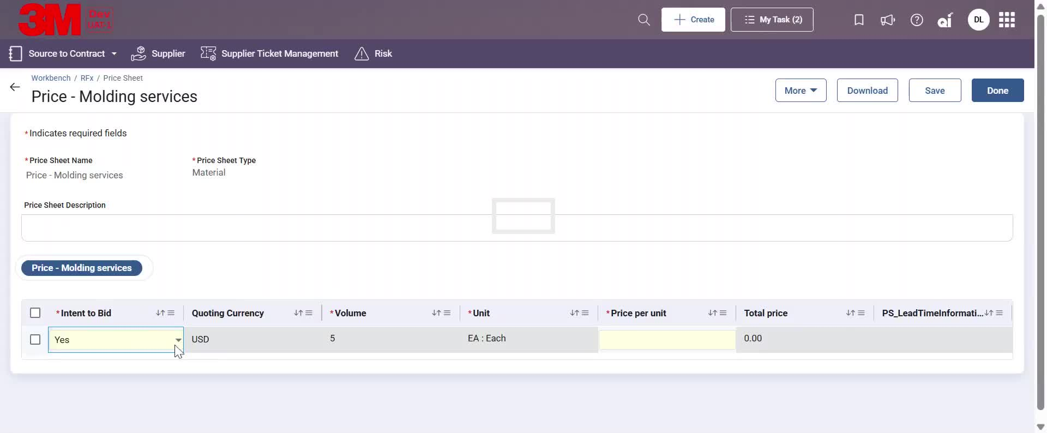
RFx response – Respond to Pricesheet
Enter the Price Per Unit (bid amount) for line details listed in the pricesheet and click Done to navigate back to the sourcing document.

Slide 23
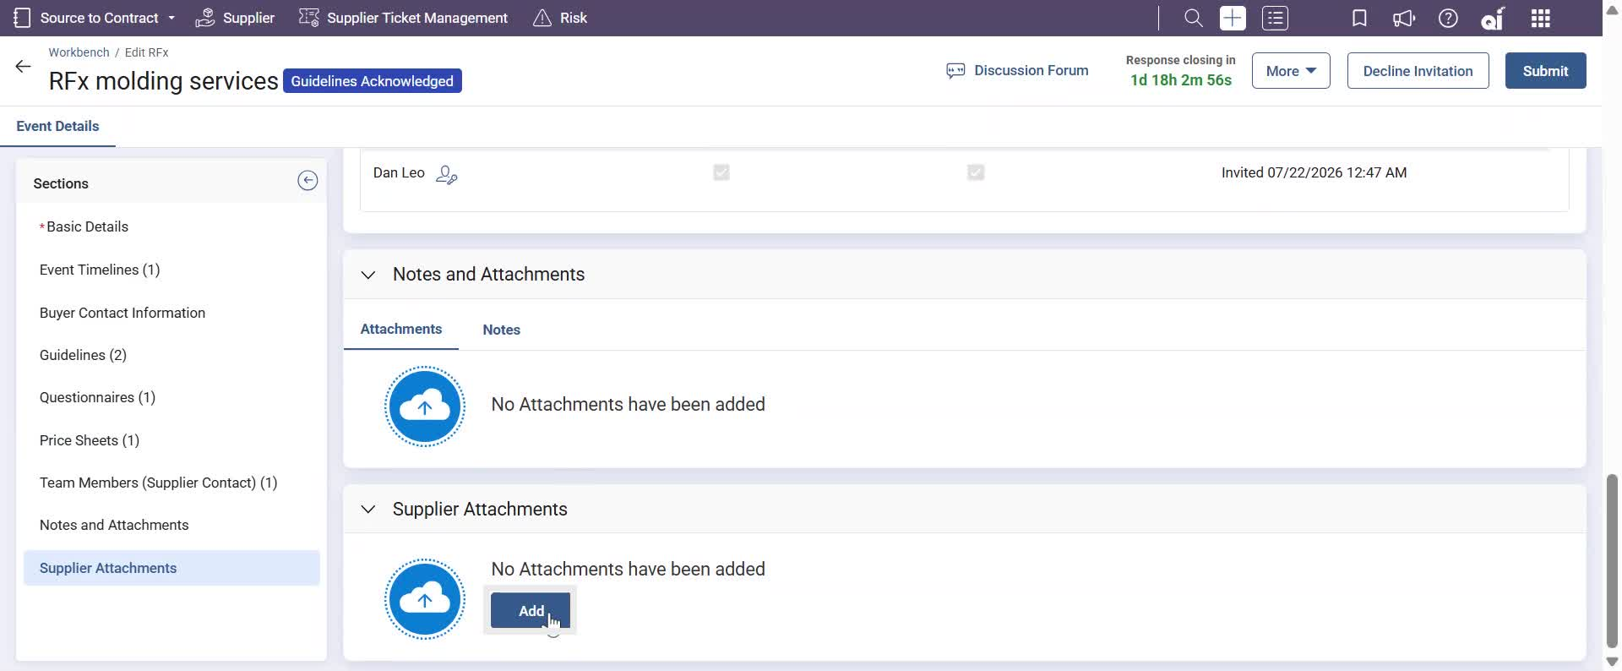
RFx response – Supplier Attachments
Suppliers have an option to attach supporting documents under the Supplier Attachments section if required. These documents will be visible to the 3M teams once the sourcing document is submitted.

Slide 24
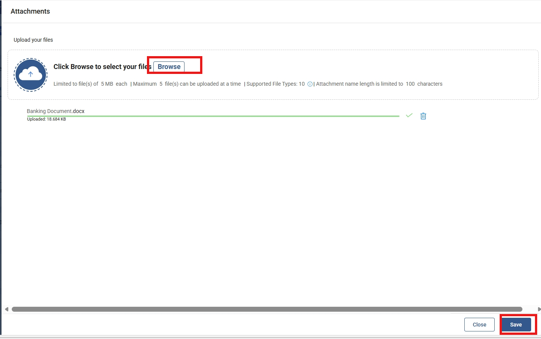
RFx response – Supplier Attachments
In the pop-up window, attach files by clicking Browse
Attach the necessary files and click on Done

Slide 25
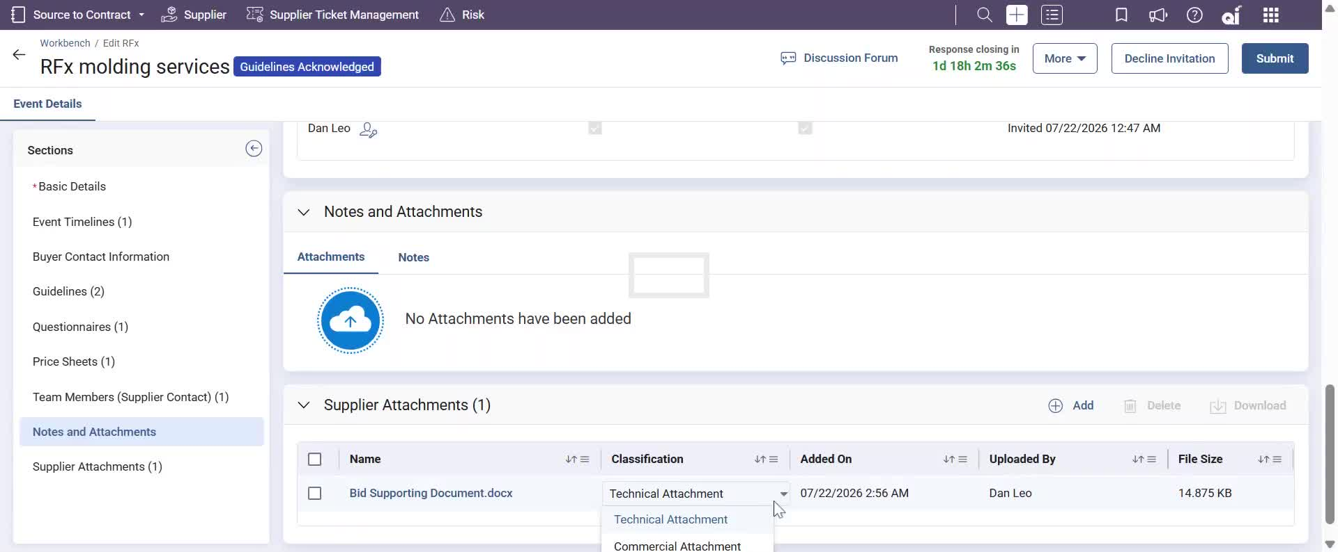
RFx response – Supplier Attachments
Supplier can also classify their attachment as Technical or Commercial.

Slide 26
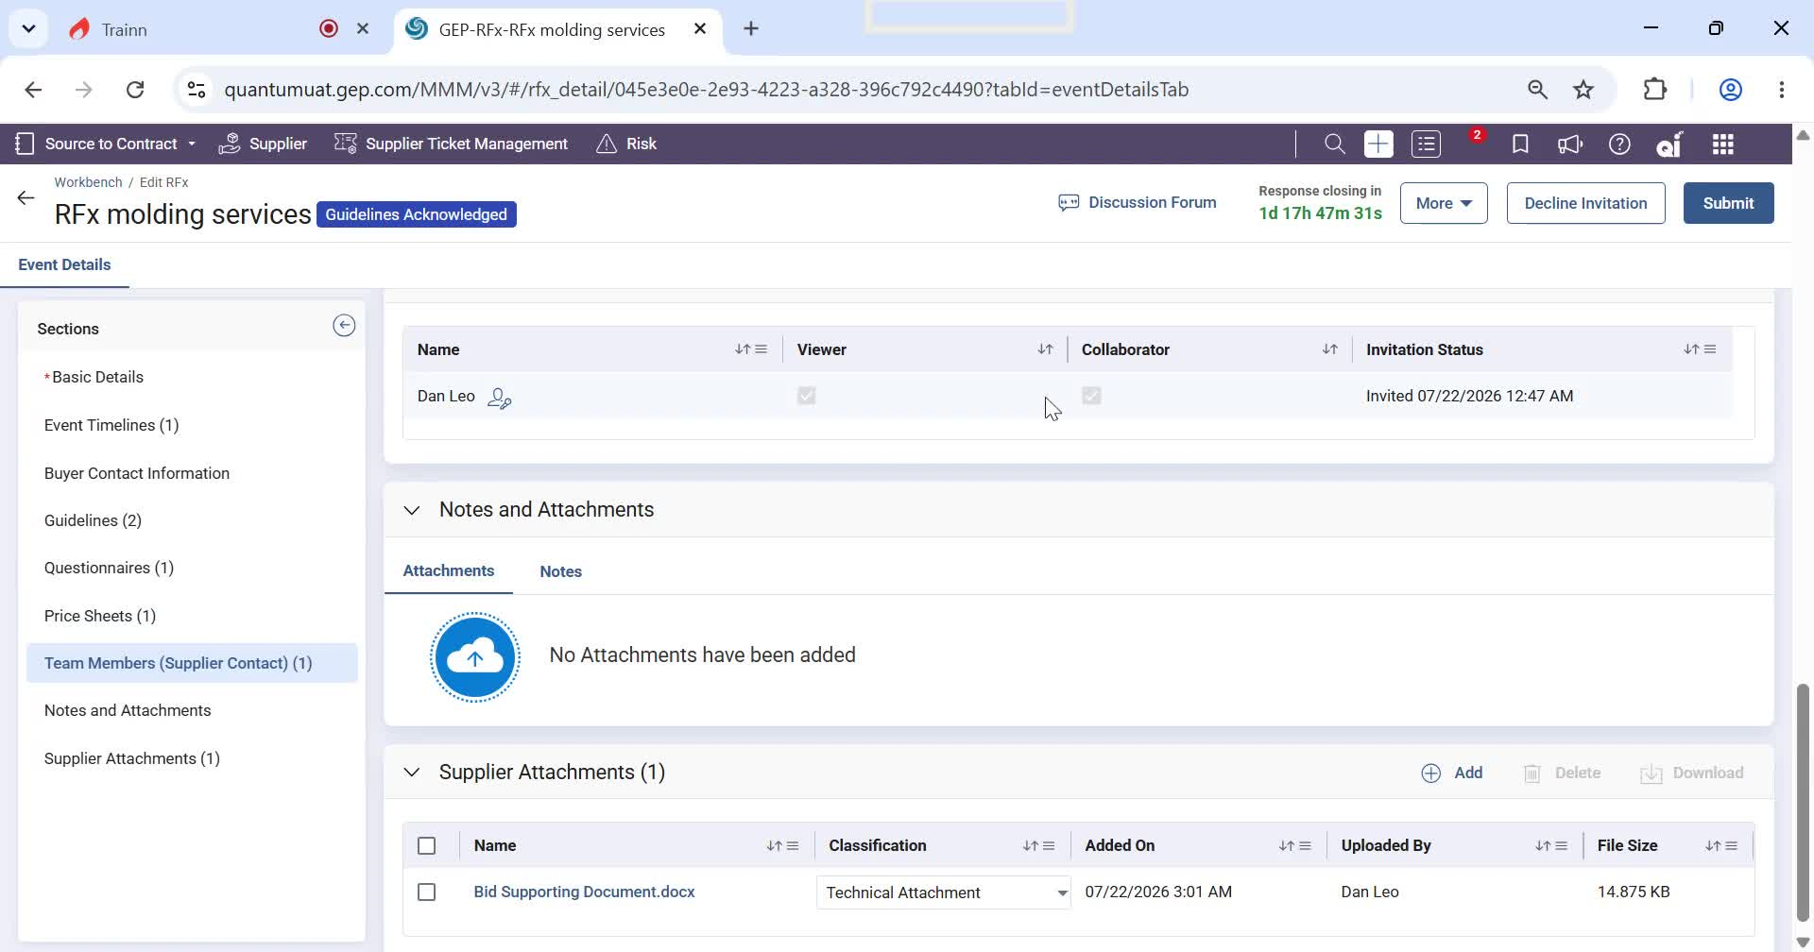
RFx response – Discussion Forum
Once you return to the sourcing document, review the Discussion Forum to confirm that there are no pending requests or messages requiring responses.

Slide 27
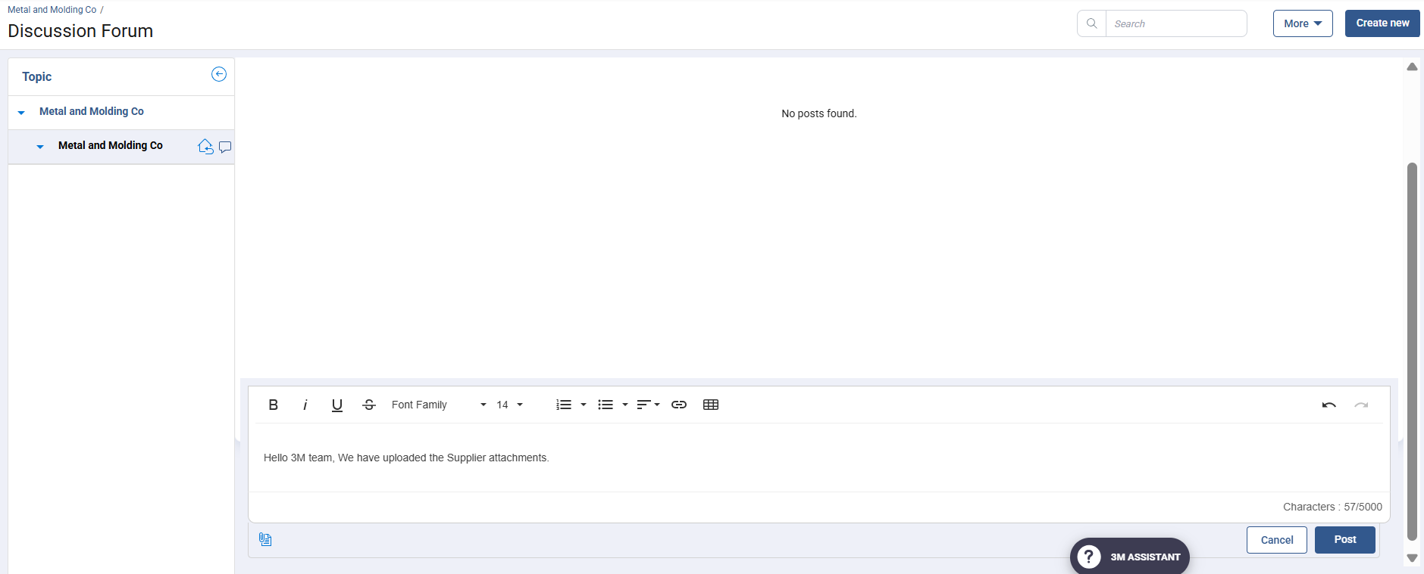
RFx response – Discussion Forum
Suppliers can respond to the requests in the Discussion Forum by including a message and clicking on Post.
This will trigger an automated email and platform notification to the 3M team.
Discussion forums can also be used as a real-time chat platform to ensure all messages are recorded.

Slide 28
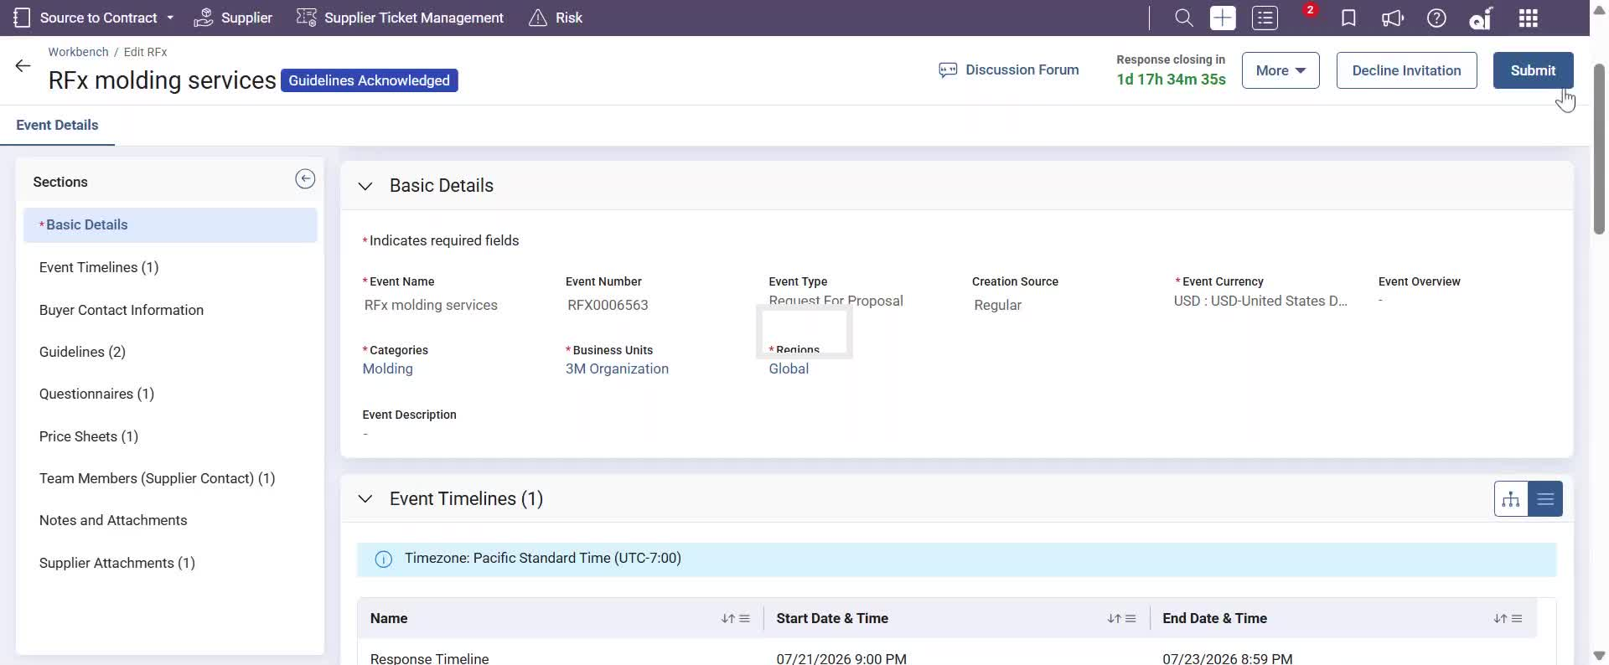
RFx response – Submit Response
Click Submit to complete and send your response. All required documents must be submitted before the event response window closes.
After the response window has passed, you will no longer be able to submit or modify your response.

Slide 29
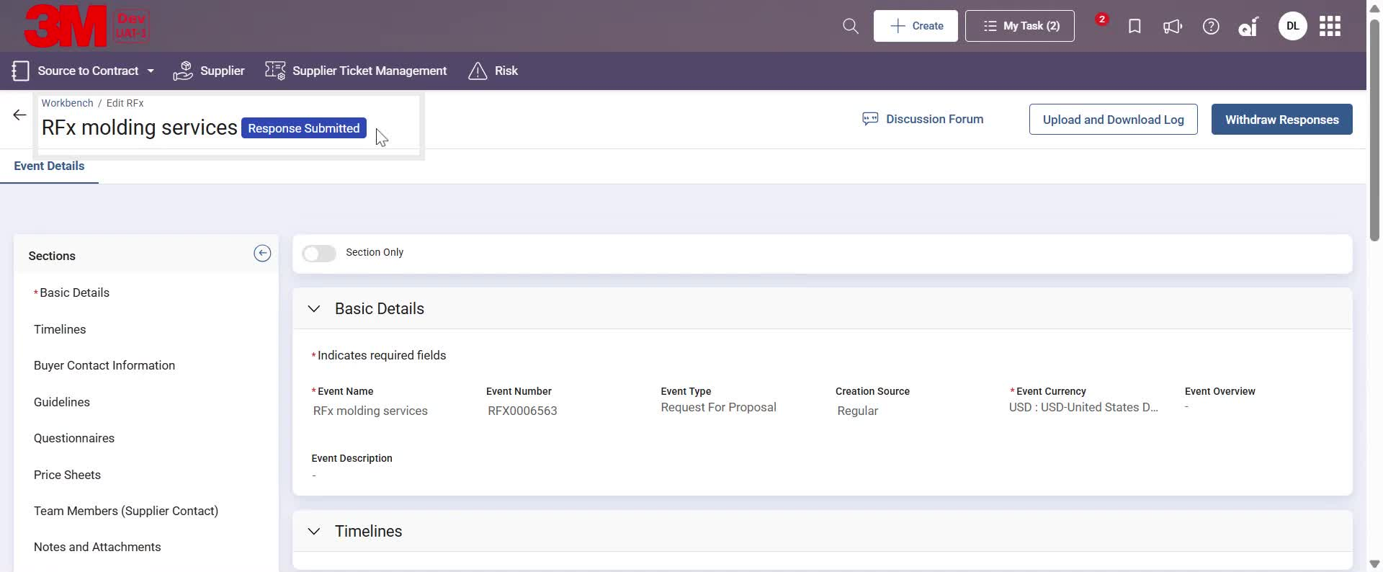
RFx response – Response Submitted
After submitting your response RFx event status would change to Response Submitted

Slide 30
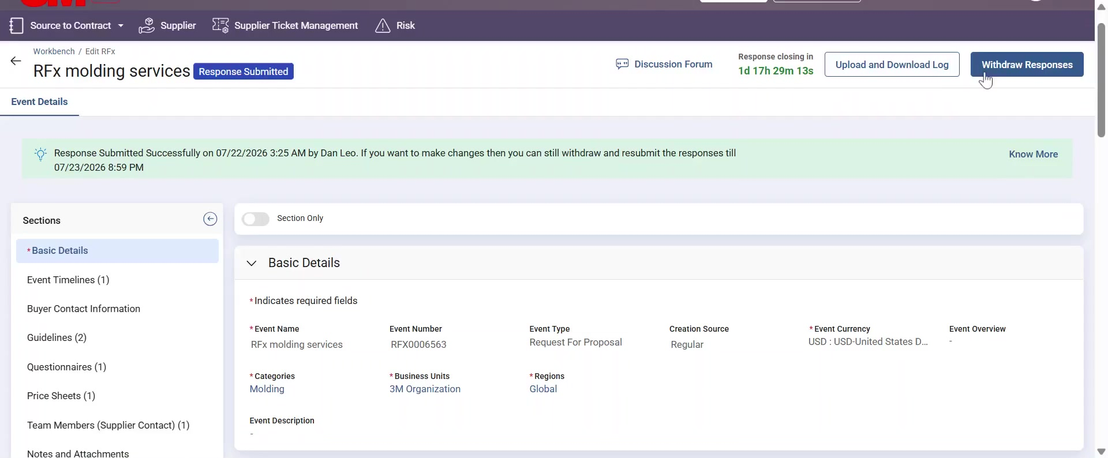
RFx response – Withdraw Response
Until the RFx event response window is open, Supplier will have an option to Withdraw from the event. Withdraw allows Supplier to make changes in their response and resubmit their response.

Slide 31
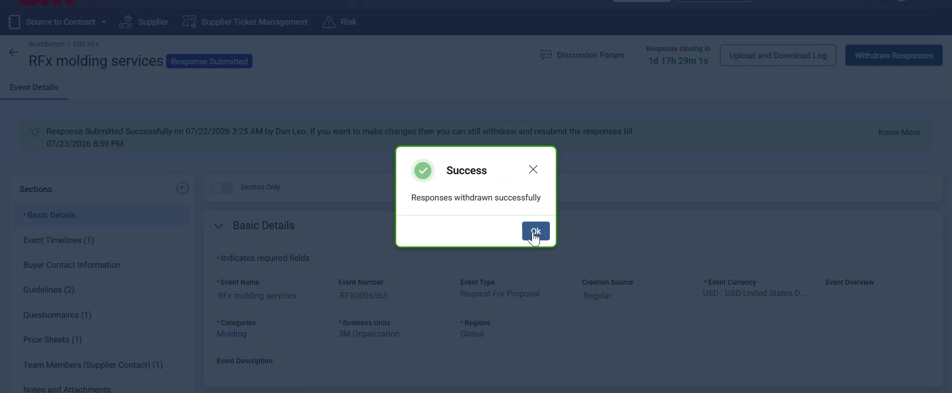
RFx response – Withdraw Response
Status changes to Response Withdrawn, while option to Submit the response will start appearing until the Response window is open.

Slide 32
Thank You

