Slide 1
Supplier Enablement –
Contracts QRG

Slide 2
Contracts
The Contracts Module within GEP is designed to make managing contractual agreements effortless and transparent for suppliers.
It provides a centralized, secure environment where suppliers can access, review, and respond to contract documents.
In this video we will learn, how as a supplier you can access the Contracts workbench, how to respond to a review request and finally how to sign the contract document digitally.

Slide 3
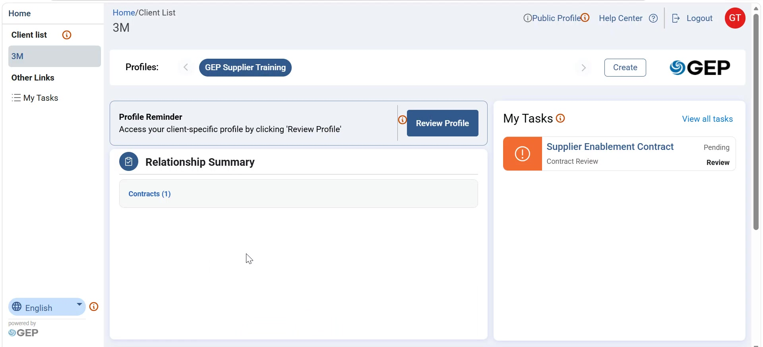
Contracts
The Contract Workbench is exposed in the Supplier Portal to give suppliers a controlled, centralized place to interact with contracts that involve them, without giving access to internal buyer‑only authoring capabilities. On the supplier landing page, click on the Contracts hyperlink to access the contracts workbench

Slide 4
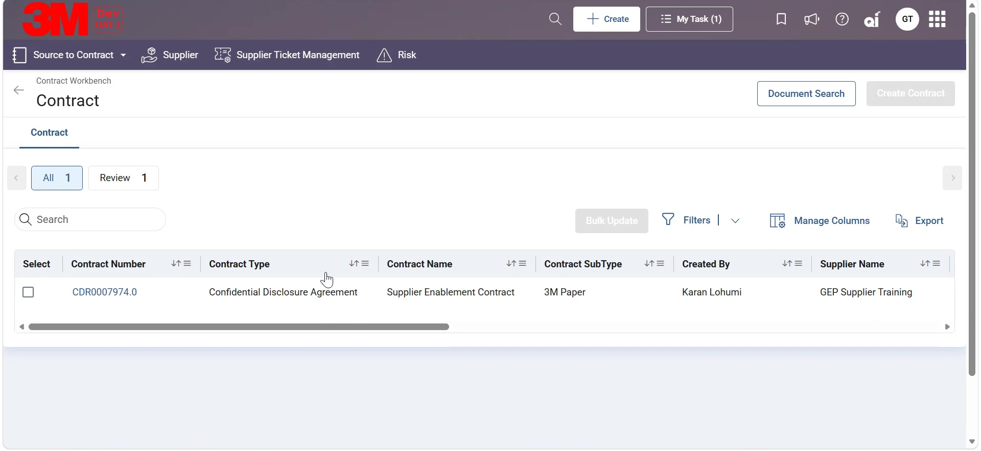
Contracts
You will see the following columns in the contracts workbench, Contract Number, this Displays the unique, clickable contract ID for tracking and access, then Contract Type, this Shows the high‑level classification of the contract, Contract Sub Type, Contract Name, Created by, Supplier Name, Stage, this Displays the current stage of the contract lifecycle , status, this Indicates the current contract status , currency, contract value, Effective date, expiry date.

Slide 5
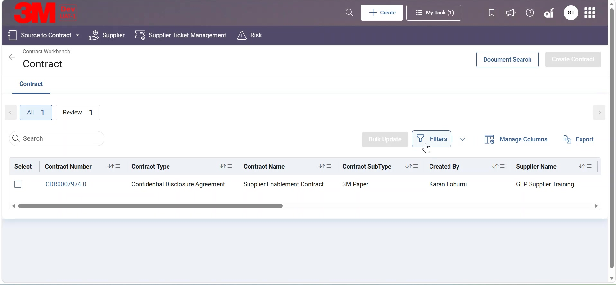
Contracts
Now we will see, how to apply filters on the workbench. Click on the filters option, the filter slider window will appear from the right. In this slider window you will be able to see various fields on which you can apply filters.

Slide 6
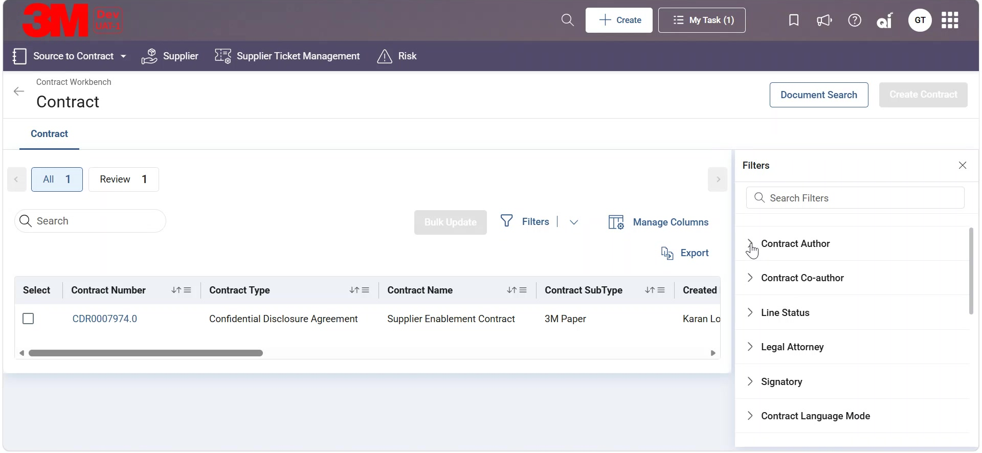
Contracts
Let us try applying a filter on Contract Author field. Expand the dropdown on the Contract author field, type in the name of the author and click on the checkbox against the author name. The workbench will show only the contracts which are authored by the selected author.

Slide 7
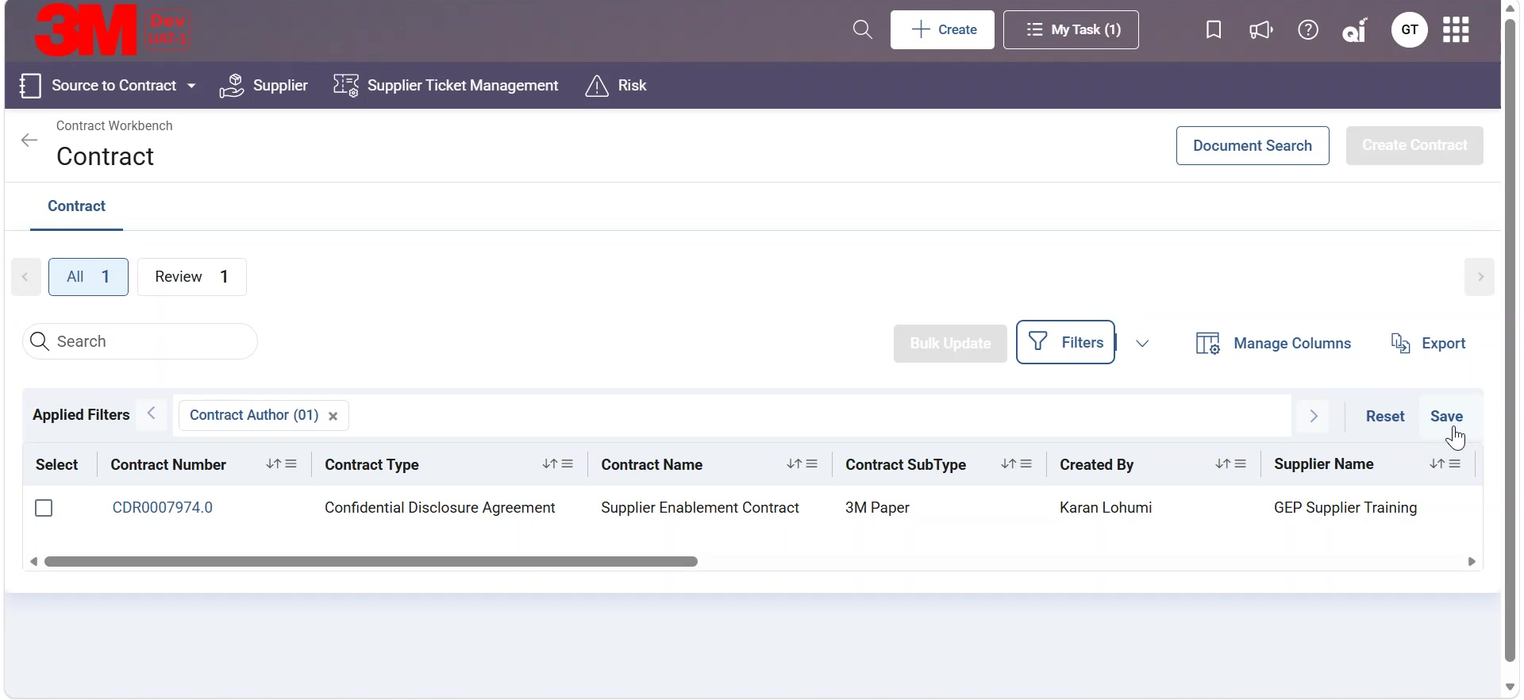
Contracts
You can also save filters by clicking on Save. Input the name of the filter and click on save. To view the saved filter, click on the dropdown besides filters option and you can see your saved filter there.

Slide 8
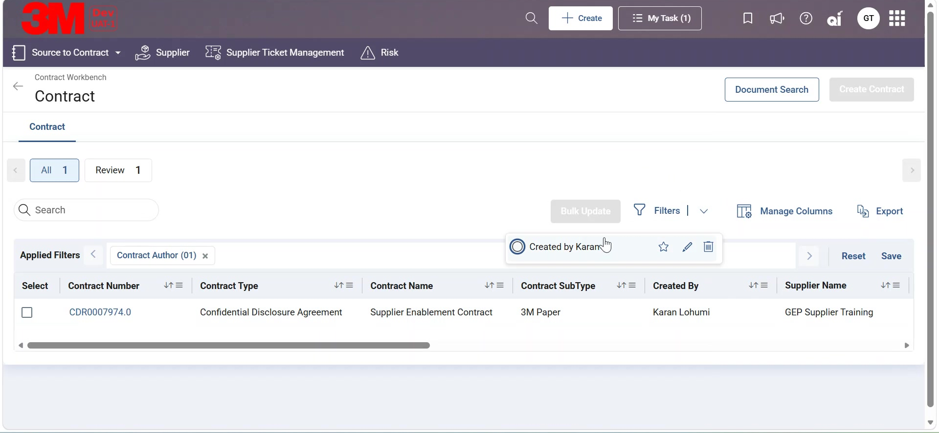
Contracts
You also have the option to mark your filter as default for your user, you can rename or delete the filters as well. Now we will see, how to rearrange, hide or freeze columns in the workbench. Click on Manage columns.

Slide 9
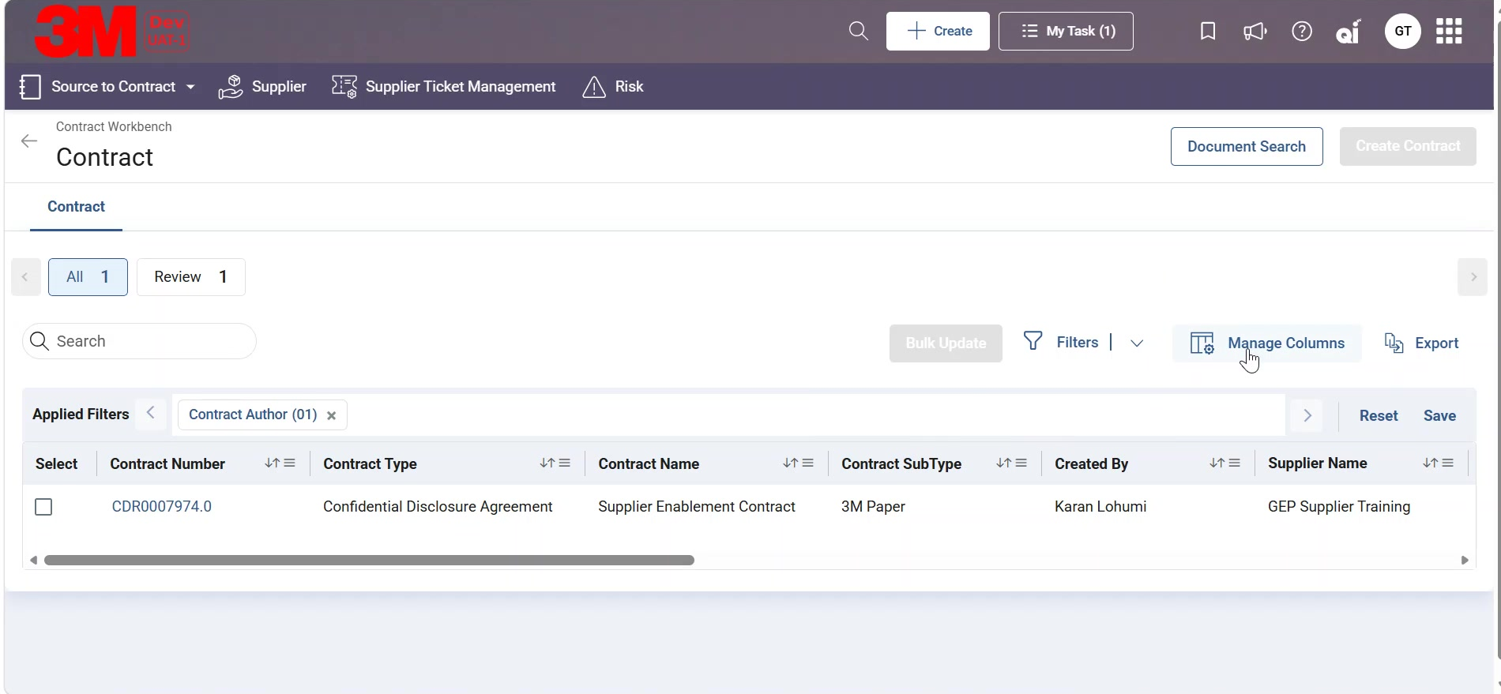
Contracts
The manage column slider window will appear, You can drag to rearrange the columns as required. You can click on eye icon against a column name to hide or unhide the column. Click on dropdown in the freeze and unfreeze column to pin the column as required and then click on Apply.

Slide 10
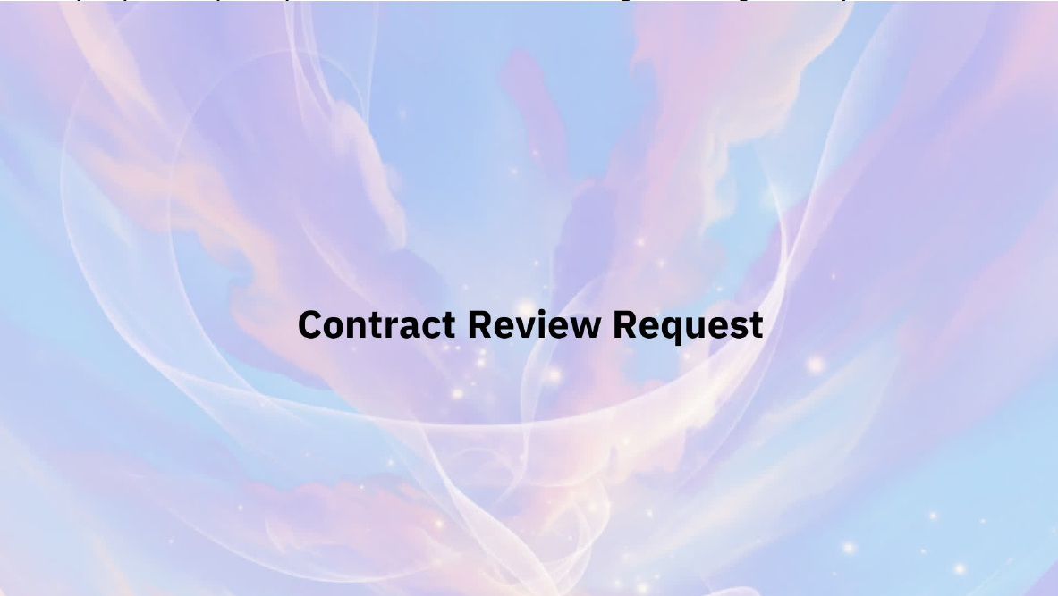
Contracts
Now we will see, how you can review a contract. Contract review Requests allow suppliers to review contract documents shared by 3M, provide required inputs, and take actions such as reviewing and redlining within the platform. This ensures timely collaboration, clear visibility, and compliance throughout the contracting process

Slide 11
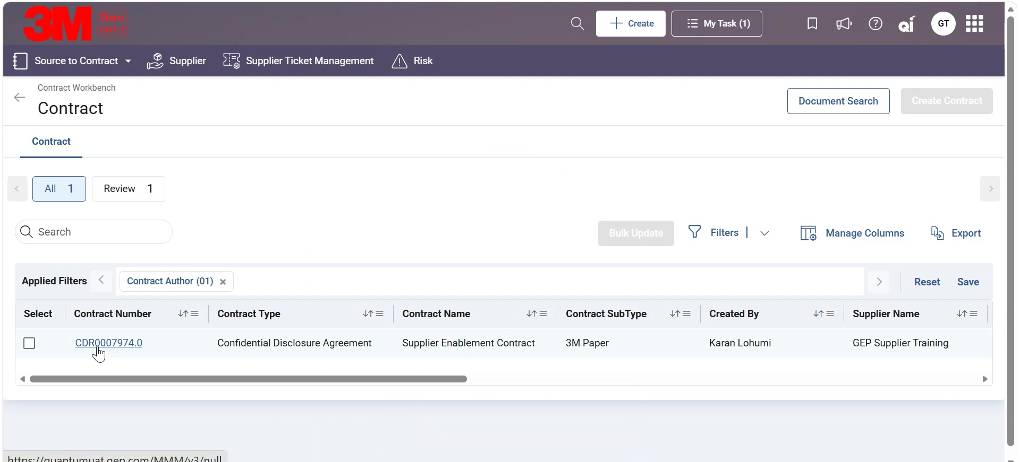
Contracts
In the Contract Workbench, to access the contract, select the contract by clicking on the Contract Number hyperlink.

Slide 12
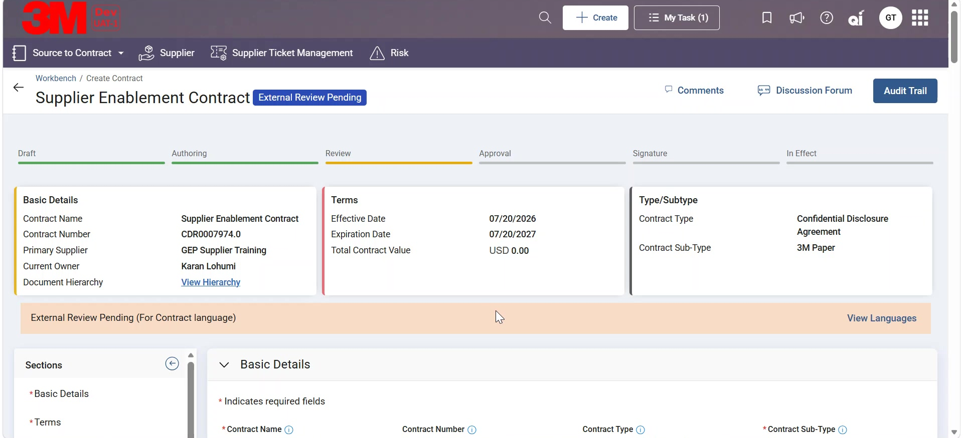
Contracts
In the contract document, click on View languages and you will be redirected to the Contract Language section in the document.

Slide 13
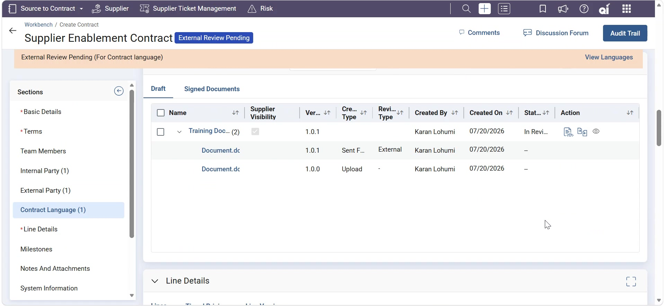
Contracts
Click on the view review request button, a slider window will appear with the details of the request

Slide 14
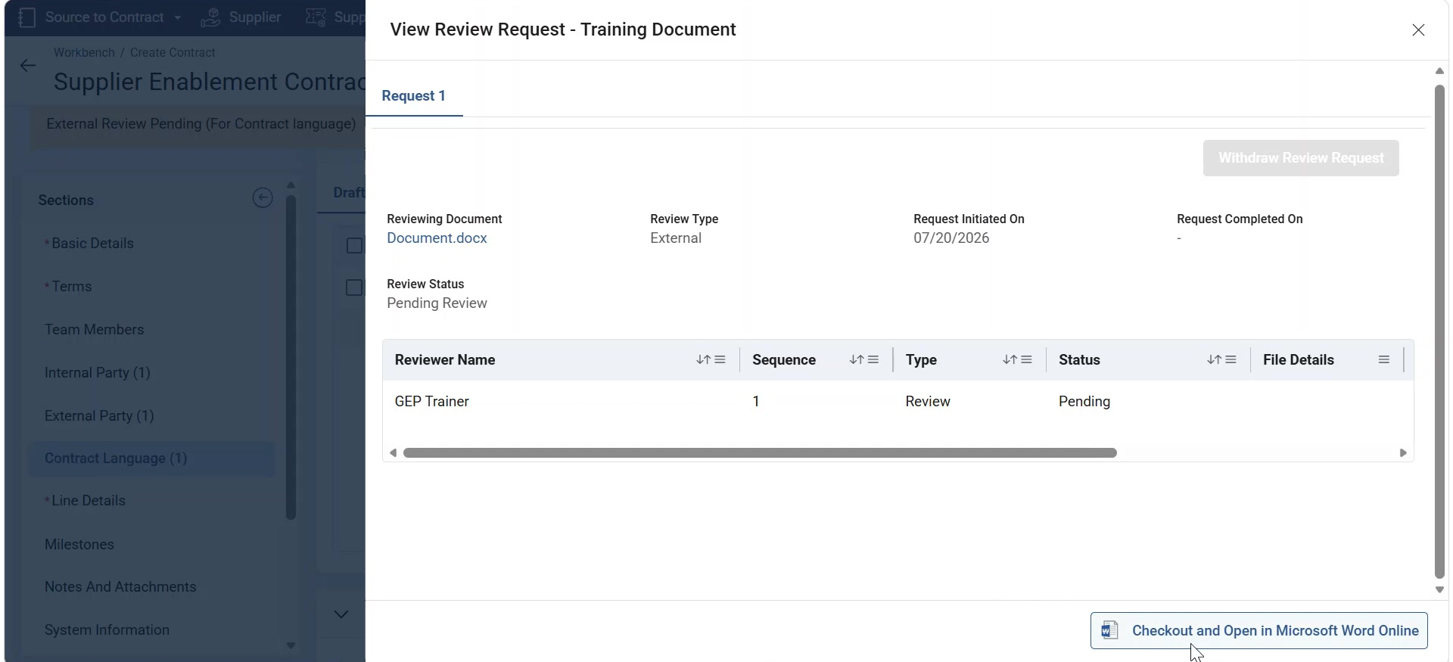
Contracts
Click on Checkout and open in Microsoft word online button to review and redline a contract document. the Contract document will open in word online.

Slide 15
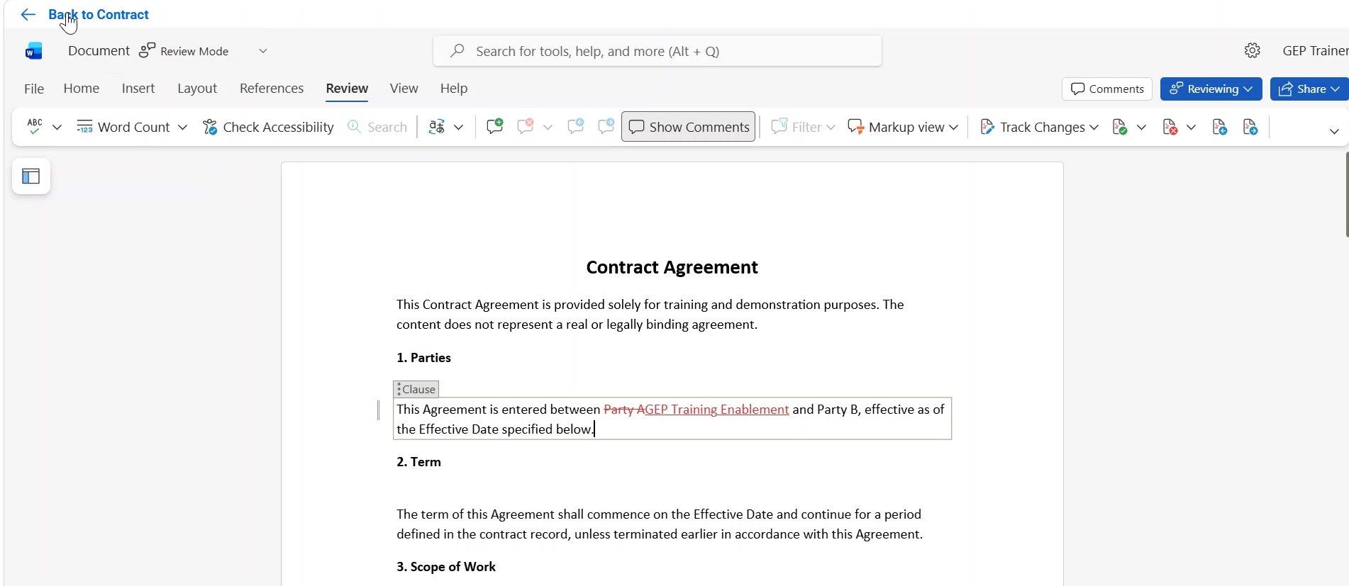
Contracts
Review and redline the document. Once complete, click on Back to Contract to navigate back to the contract document.

Slide 16
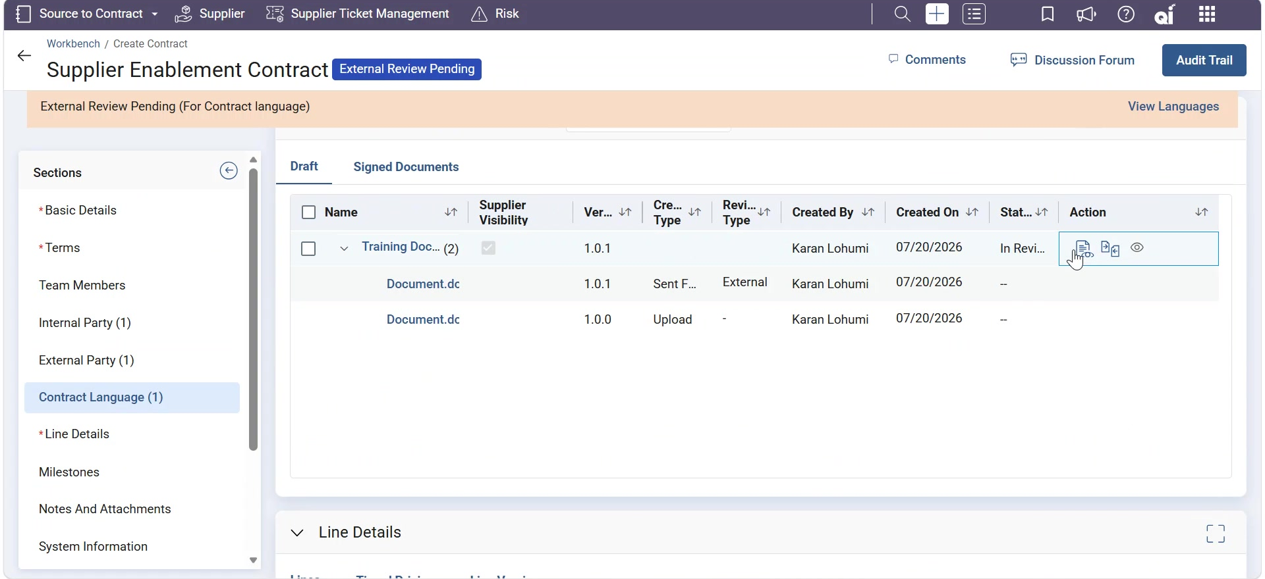
Contracts
Now again Navigate to the View review request button in the contract language section. Here you will have the option to Mark the request as completed, reject the request or go for another round of editing. Click on Mark as completed.

Slide 17
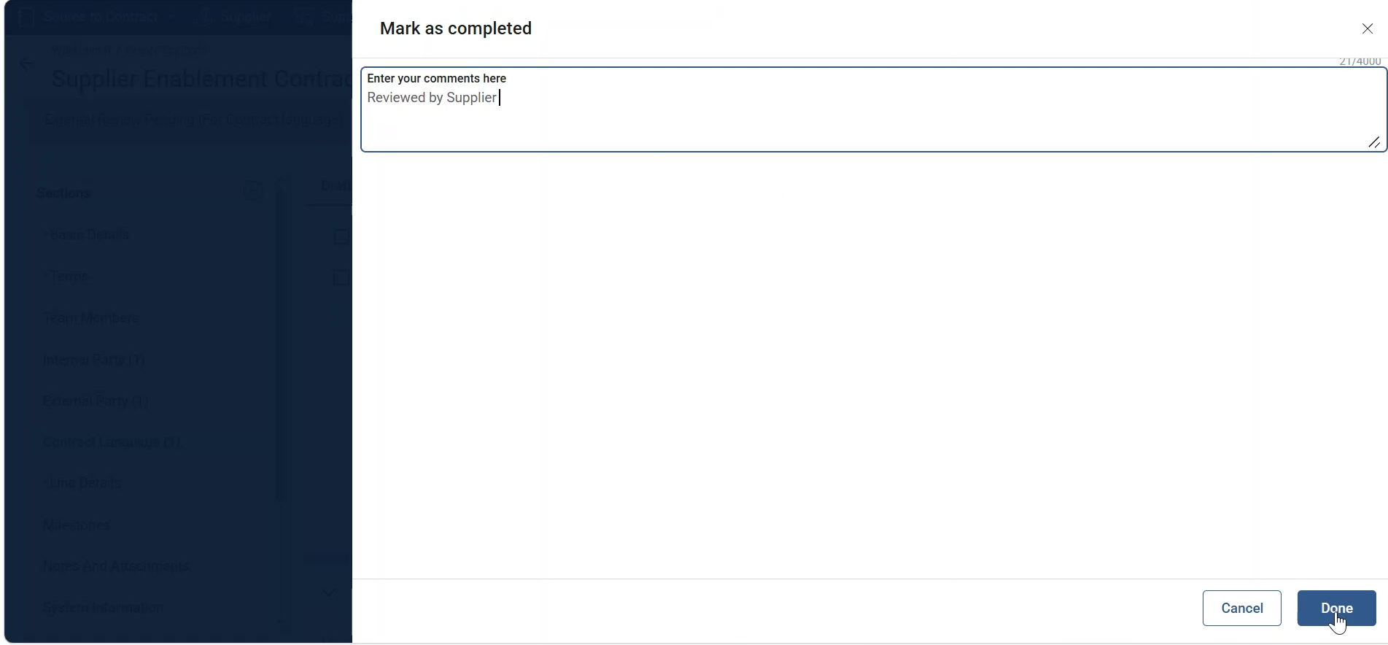
Contracts
Provide optional comments and then click on done to complete the review request.

Slide 18
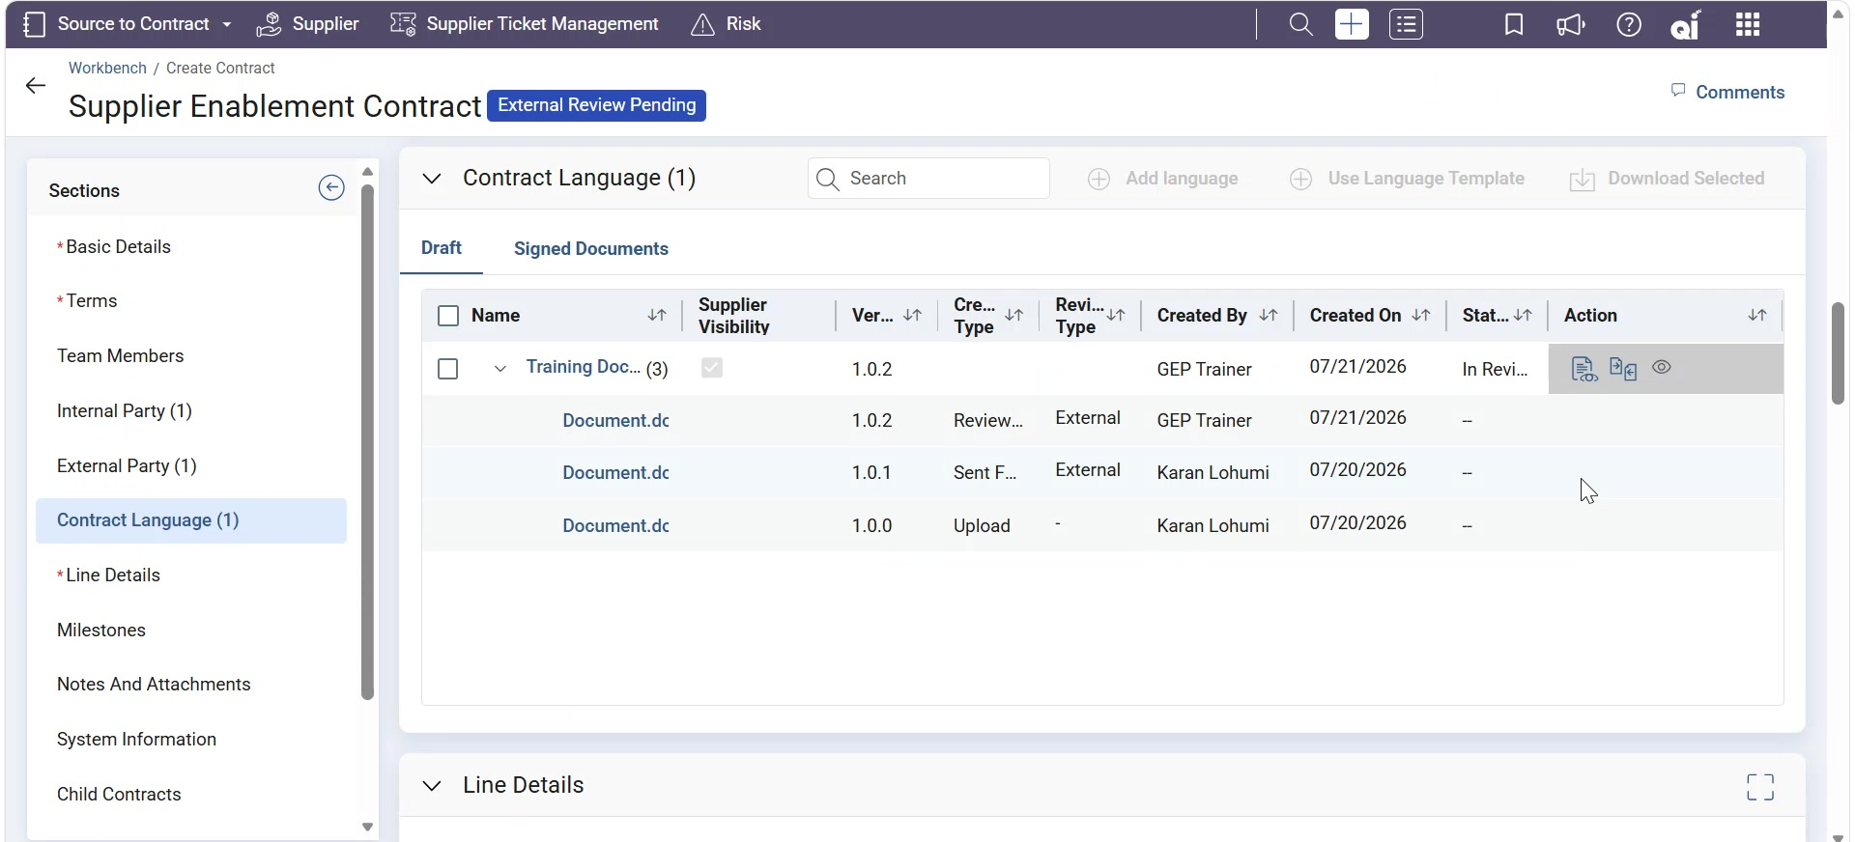
Contracts
Navigate to the View review request button, in the slider window you will see the status of the request updated to Completed.

Slide 19
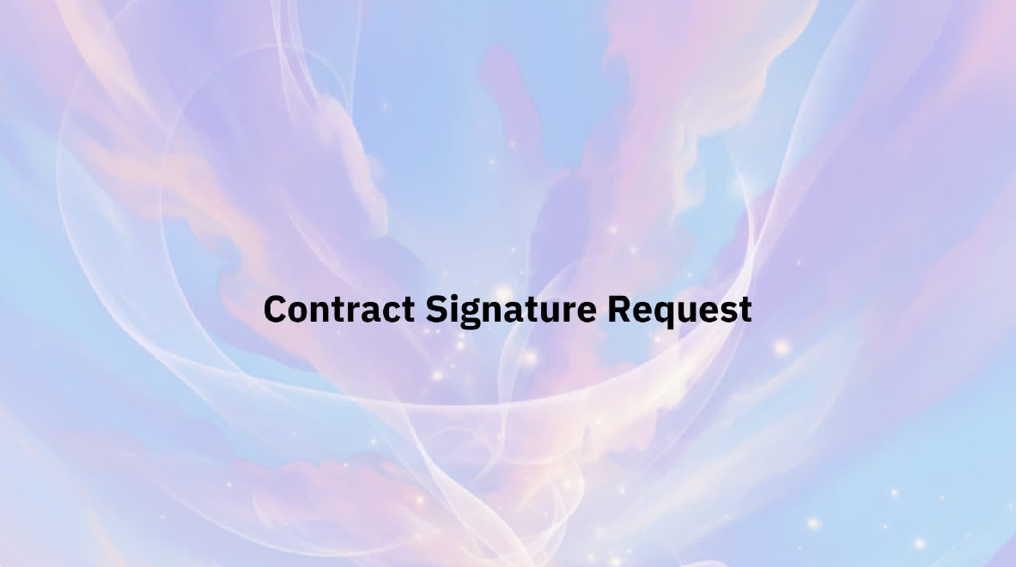
Contracts
Now we will see, how you can sign a contract. A Contract Signature Request notifies suppliers that a contract is ready for signature and requires their review and action. Suppliers can access the request to review the final contract document and complete the signature process as prompted by 3M.

Slide 20
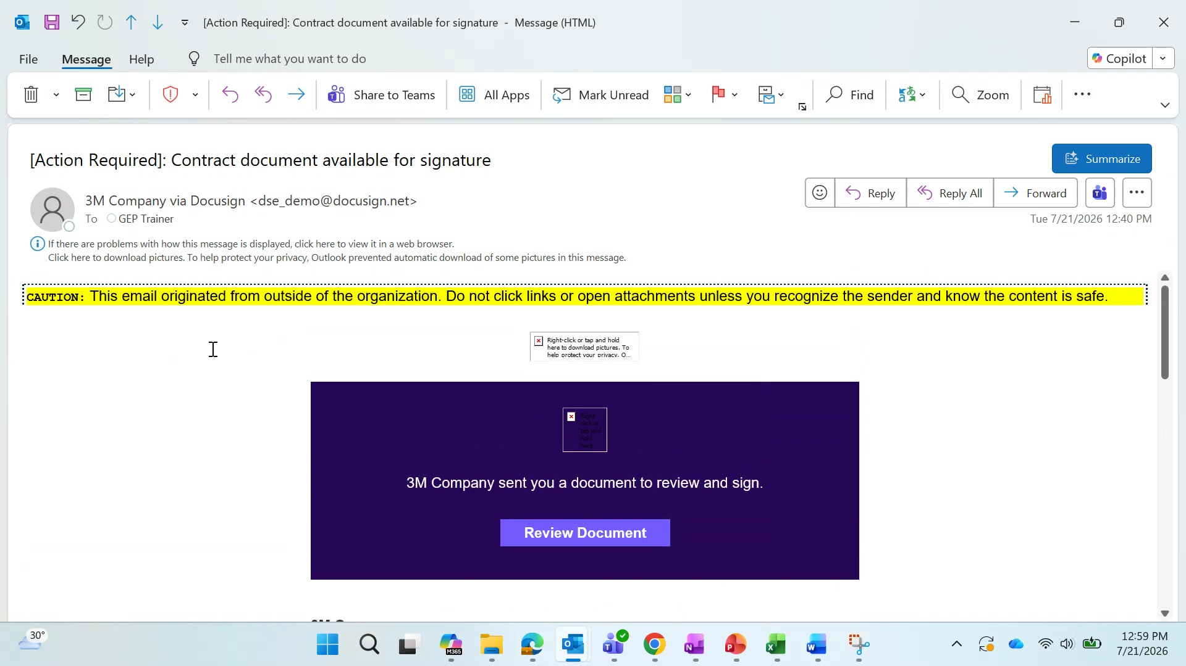
Contracts
The authorized signatory will receive an email to review and sign the contract document. Click Review Document to initiate the signature process.

Slide 21
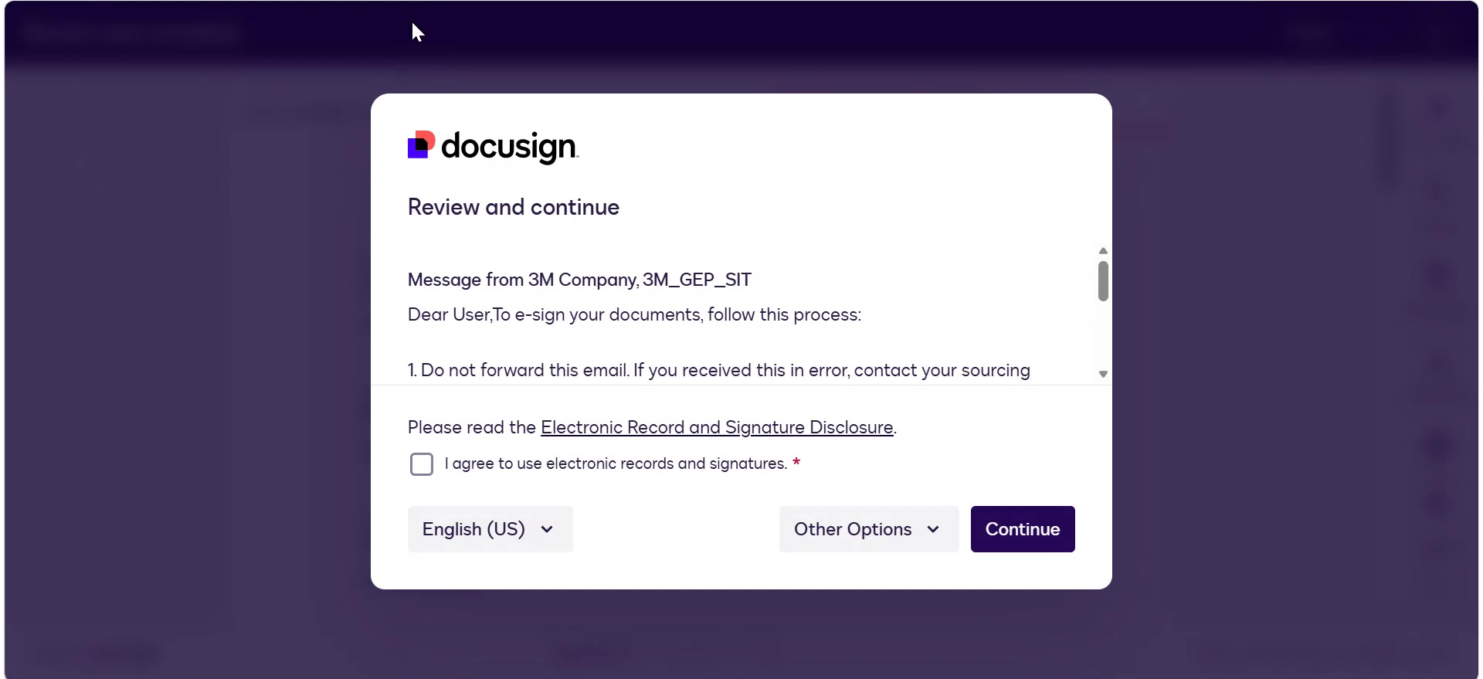
Contracts
You will be redirected to the DocuSign app page on your default browser. Read the terms and conditions, click on the check box to agree to the terms and conditions and then click on continue

Slide 22
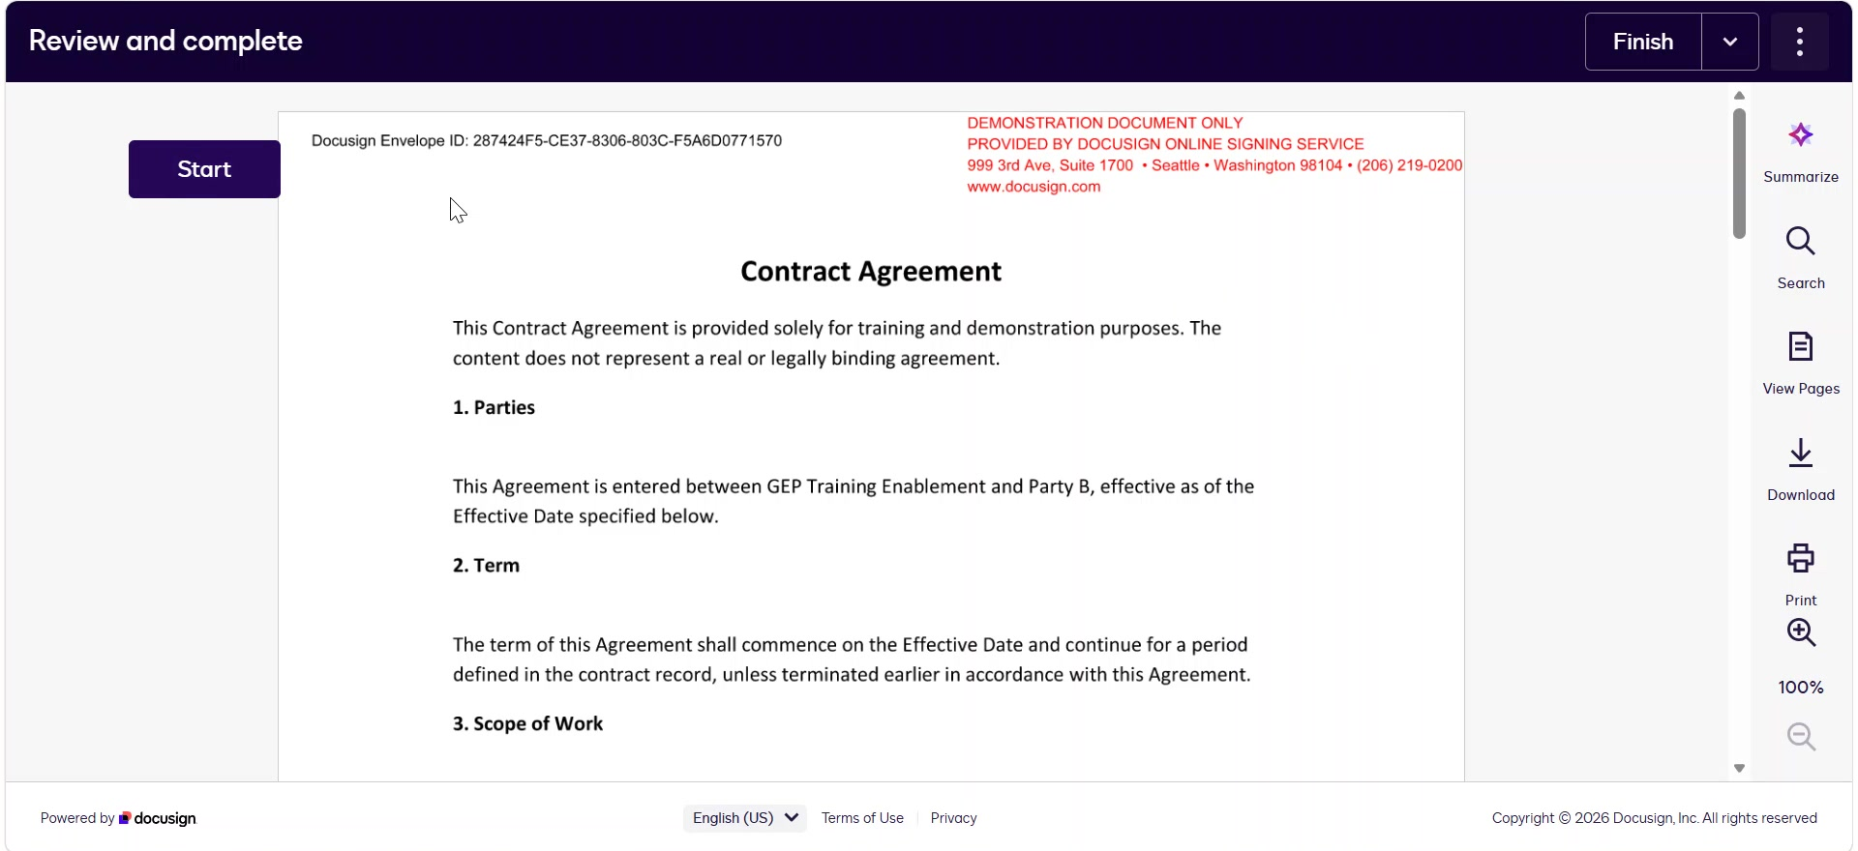
Contracts
Review the document carefully and then click on start to go the signature box location.

Slide 23
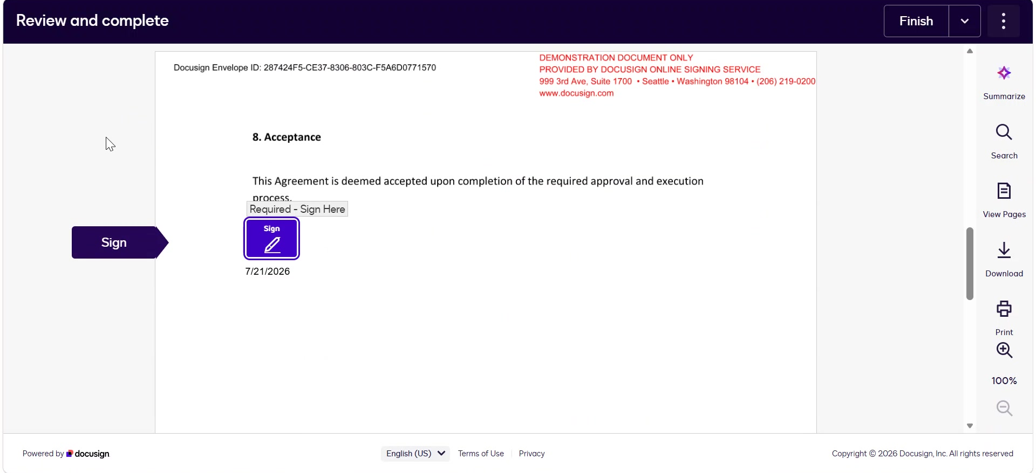
Contracts
Click on Sign, the Adopt your Signature pop up will appear.

Slide 24
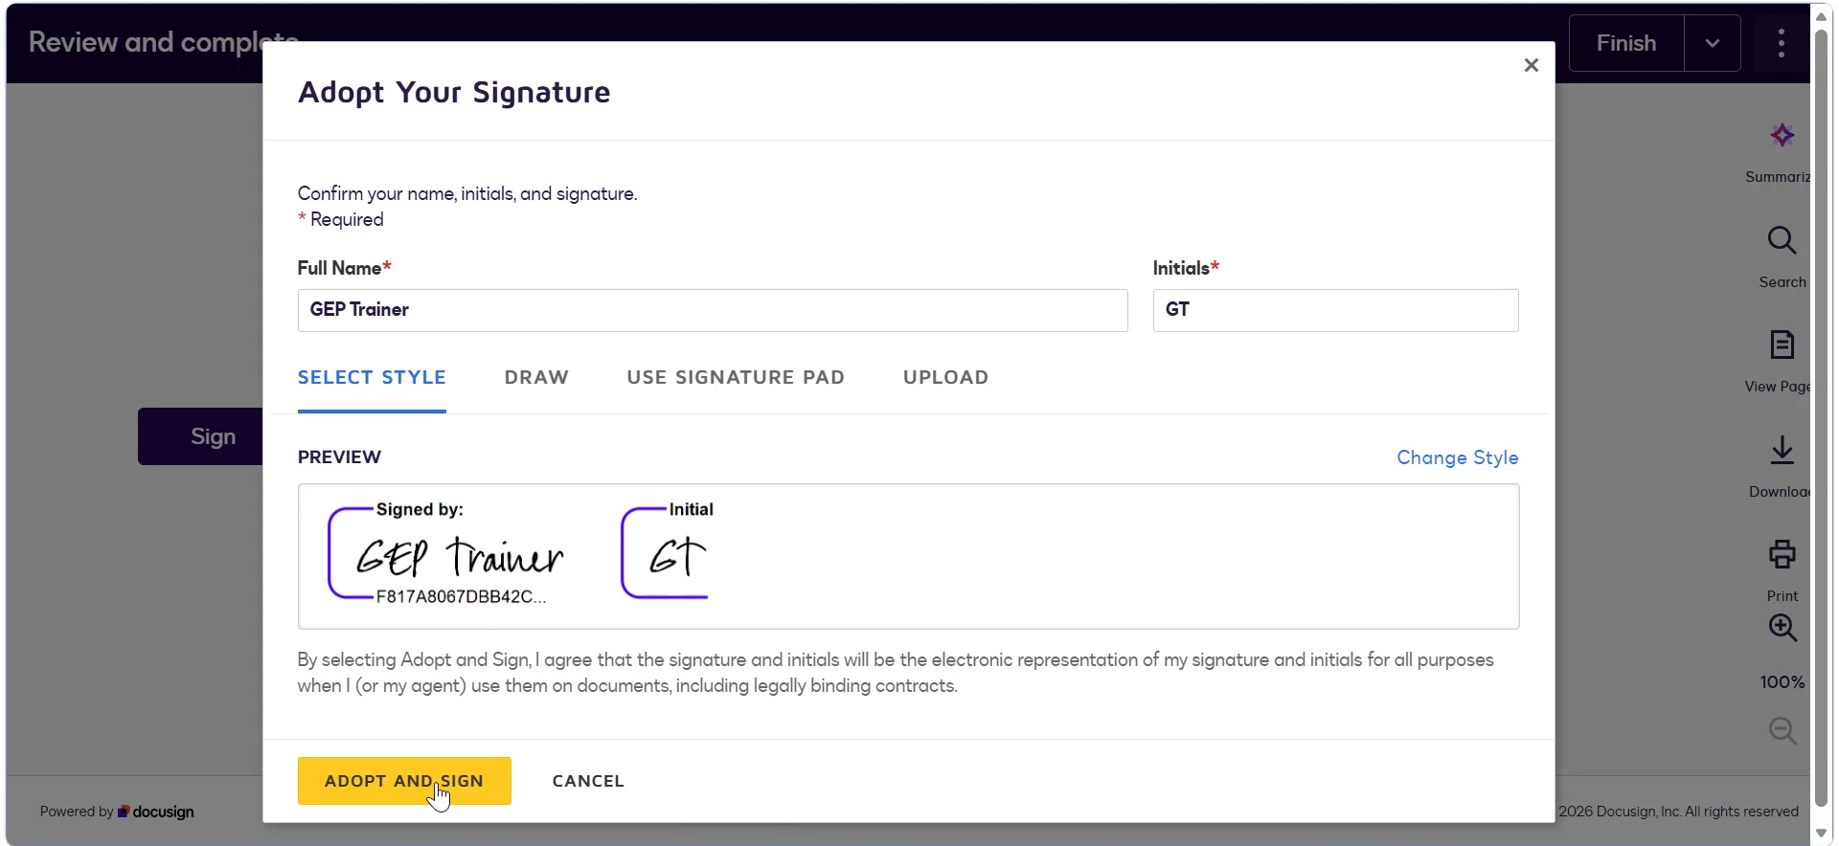
Contracts
Click on Adopt and sign and then click on Finish to complete the signature process.

Slide 25
Thank You

