Slide 1
Supplier Enablement – Scorecard QRG

Slide 2
Scorecard
Scorecards enable 3M to evaluate supplier performance by collecting Key Performance Indicators(KPI) responses and sharing the final assessment.
When a buyer(3M) completes the scorecard and shares the scorecard summary, the supplier receives email notification containing the hyperlink to access scorecard summary on GEP portal
The supplier can view their overall evaluation and Spider Chart, which provides a visual breakdown of performance across all KPIs.
Supplier can download the scorecard summary if required

Slide 3
Scorecard Process flow
3M
SUPPLIER
Share Scorecard Summary
Start
End
Receive the Scorecard Summary
View score summary details(KPI Weightage, Score, feedback)
Download score summary
3M Action
Supplier Action
Option
Product Flow
Possible Flow
Start/End
Decision Box

Slide 4
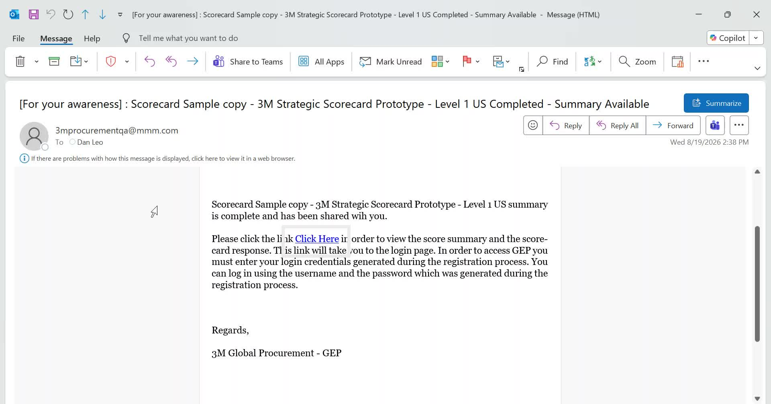
Scorecard – Notification email to Supplier
The supplier receives an email with the subject line: "[For your awareness]: Scorecard Name" . This email contains a link to view the evaluation score summary.
The supplier can either click the "Click Here" link or copy the link and paste it into a new browser window to view it.

Slide 5
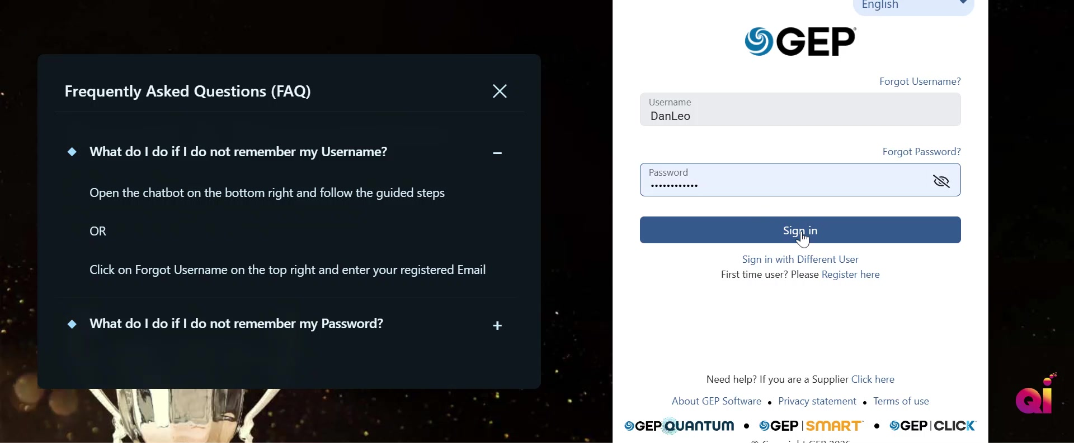
Scorecard – Supplier Login GEP Business portal
The Supplier will login to GEP business portal by using their username and password

Slide 6
Scorecard – Supplier Login GEP Business portal
The Supplier will login to GEP business portal by using their username and password

Slide 7
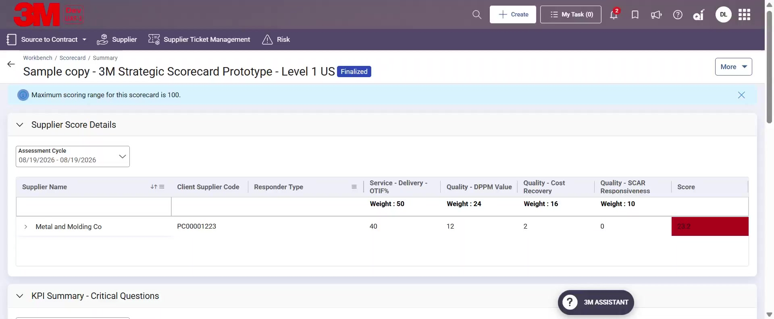
Scorecard – Scorecard Summary
Supplier will be able to view the Scorecard summary page.
The scorecard summary page will contain details like Supplier score details which will show information like Assessment cycle, Supplier name, service and quality related Key Performance Indicator's and overall score.

Slide 8

Scorecard Summary – KPI and Critical question
Supplier can view the KPI summary and response to critical questions if any responded by 3M

Slide 9
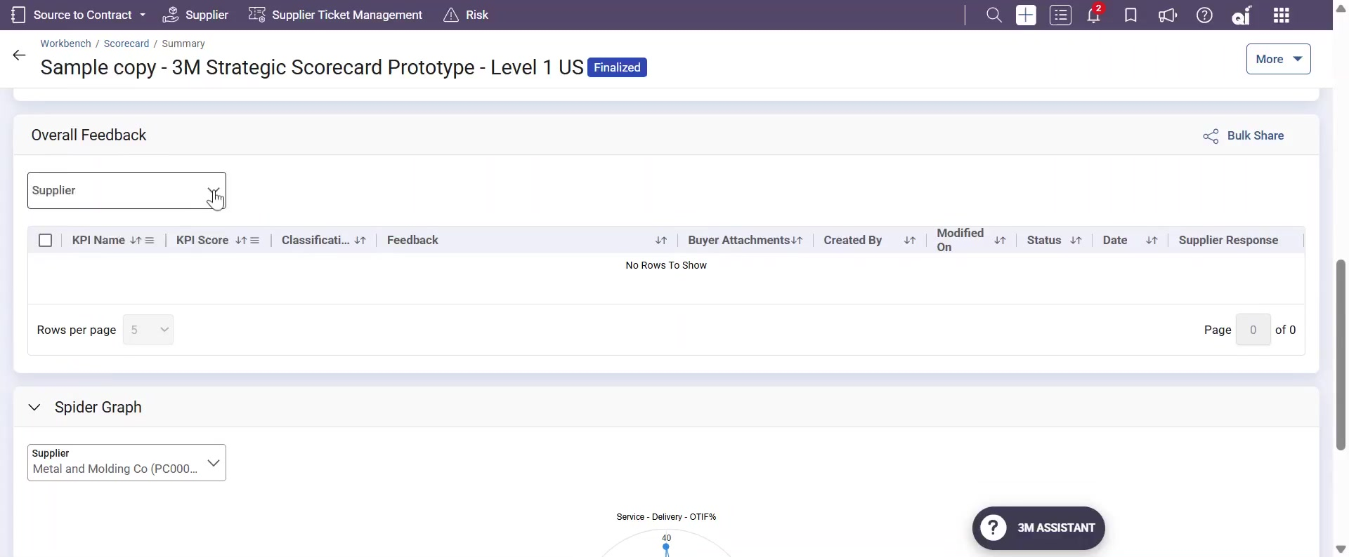
Scorecard Summary – Overall Feedback
Supplier can view the Overall feedback if any shared by 3M

Slide 10
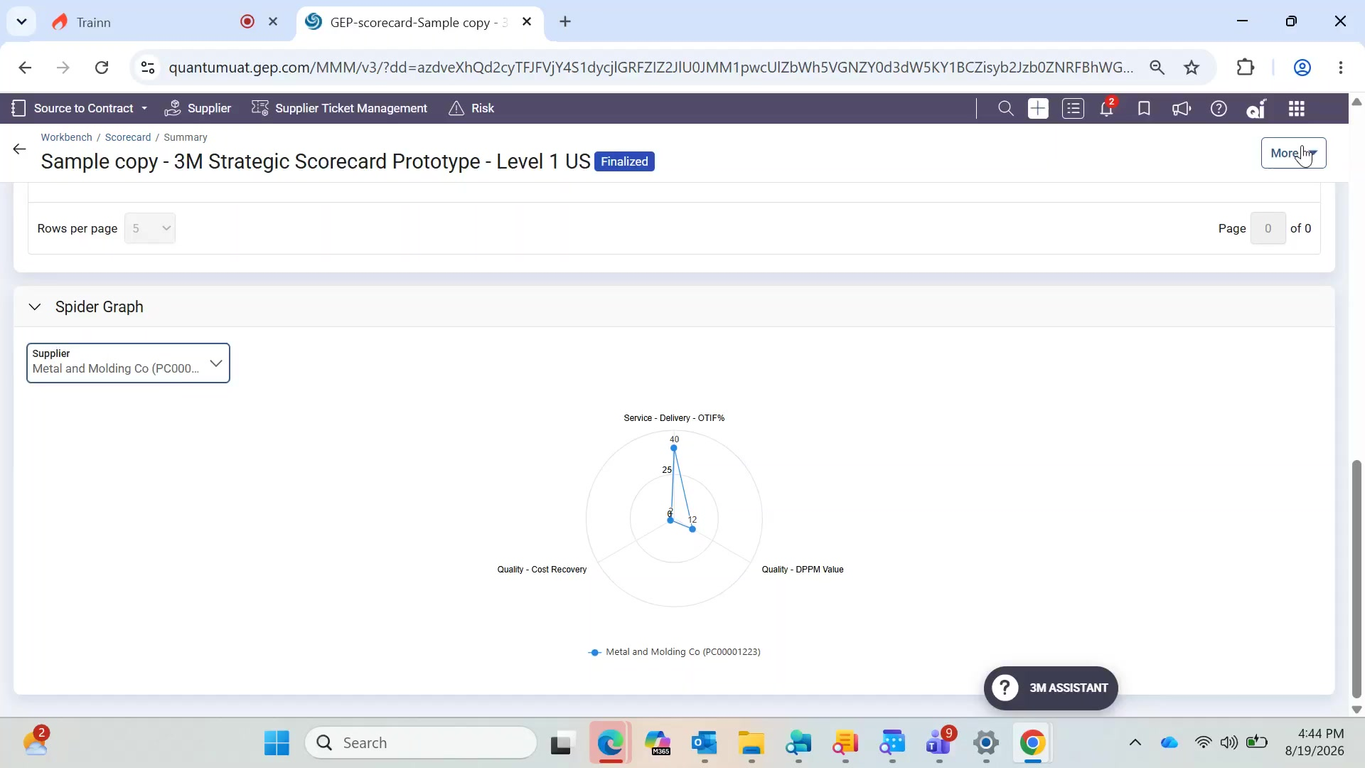
Scorecard Summary – Spider Graph
Supplier can view the KPI score in Spider graph format for better visualization of KPI scores

Slide 11
Scorecard Summary – Download
If supplier wish to Download the scorecard summary they can do so by clicking on More and then Export to Excel.

Slide 12
Thank You

