Slide 1
Supplier Enablement – Supplier Ticket Management

Slide 2
Supplier Ticket Management - Introduction
Supplier Ticket Management module is designed to help address and resolve risk‑related issues identified during Supplier Risk Assessment.
In 3M terms, Supplier Ticket Management is also known as Supplier Issue management.
Supplier Ticket Management module used to resolve or remediate risks related to-
  Responsible Sourcing
  Financial Health risks
  Performance Risks
  Commercials Risks
This guide explains how Suppliers can view Milestones and Activities assigned to them in GEP system, how they can mark them achieved in GEP system and view any notes or attachments shared by 3M

Slide 3
Supplier Ticket Management – Process Flow
3M
Supplier
Start
Create ticket
Assign Milestones and Activities to Supplier
Note- 3M can also create tickets and assign activities or milestones for 3M to achieve
Manage Ticket
Add and Assign Milestones and Activities
End
Supplier notified via email or checks My Task
View assigned Activities and Milestones
Mark Activities and Milestones Achieved
Note- Supplier can view Notes and attachments, Comments shared by 3M
3M Action
Supplier Action
Options
Product Flow
Possible Flow
Start/End
Decision Box

Slide 4
Supplier Ticket Management – Process steps explained
The Supplier Ticket Management process begins when 3M creates a ticket.
3M will add Milestones and activities and assign it to Supplier contacts or 3M
Once Tickets is created Assignees will be notified via email, If Supplier contact is the assignee they can open the notification email which will contain the hyperlink to access Milestone or activities assigned to them
Supplier can also access the ticket from GEP system, My Task, Action Pending page.
Supplier can view the assigned milestones and activities . Supplier can also check the notes, attachments and comments if any added by 3M in Ticket.
Supplier can take the necessary actions to achieve the milestones and activities. Supplier can then open the Ticket go to the Milestones and activities mark it as achieved.
3M will be notified once the milestone, and activities are achieved by Supplier.

Slide 5
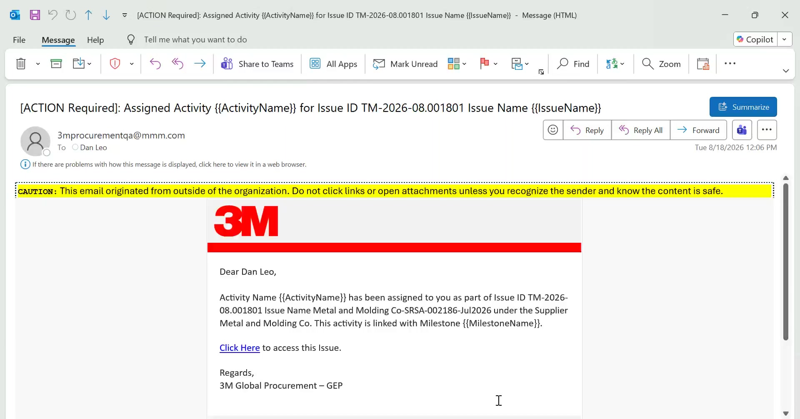
Supplier Ticket Management – Email notification
Supplier primary contact will be notified via email if any ticket milestones or activities are assigned to them.
There will be an hyperlink in email to open the Ticket or Issue in GEP system.

Slide 6
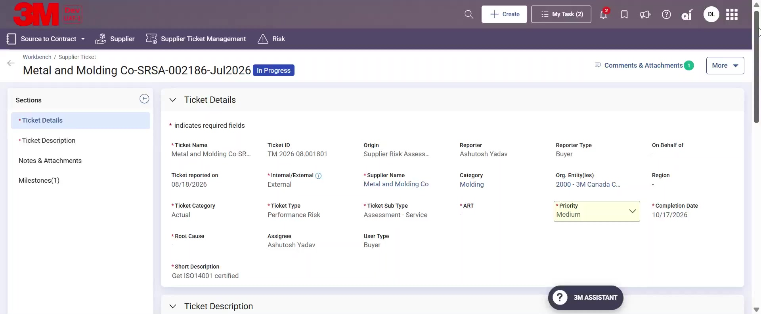
Supplier Ticket Management – Milestones section
When supplier clicks on the hyperlink it opens the Supplier Ticket in their web browser.
Supplier can go to the Milestones section to open the assigned Activity or Milestone

Slide 7
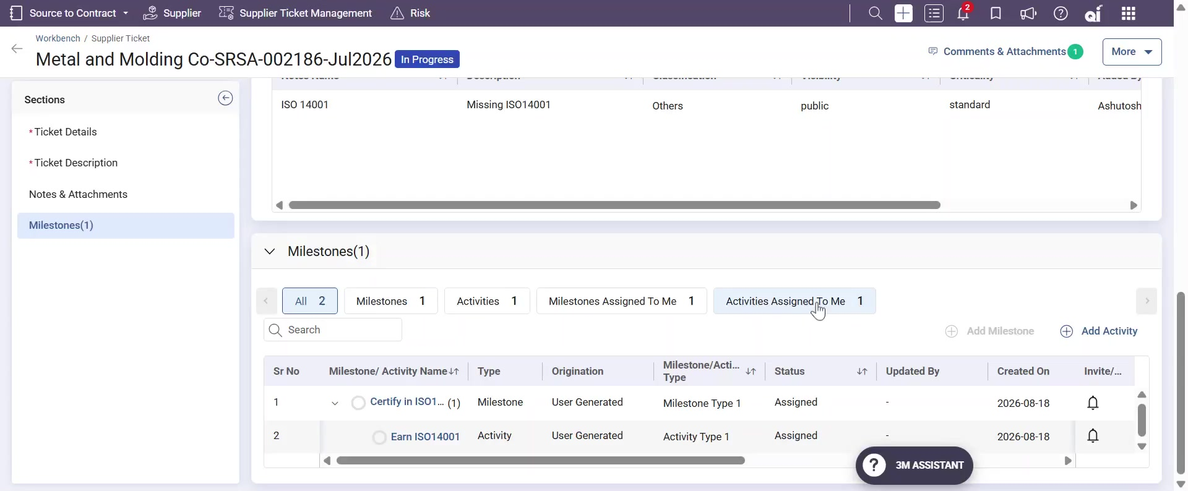
Supplier Ticket Management – Assigned Activity
From the Activities Assigned to Me, Open the assigned Activity

Slide 8
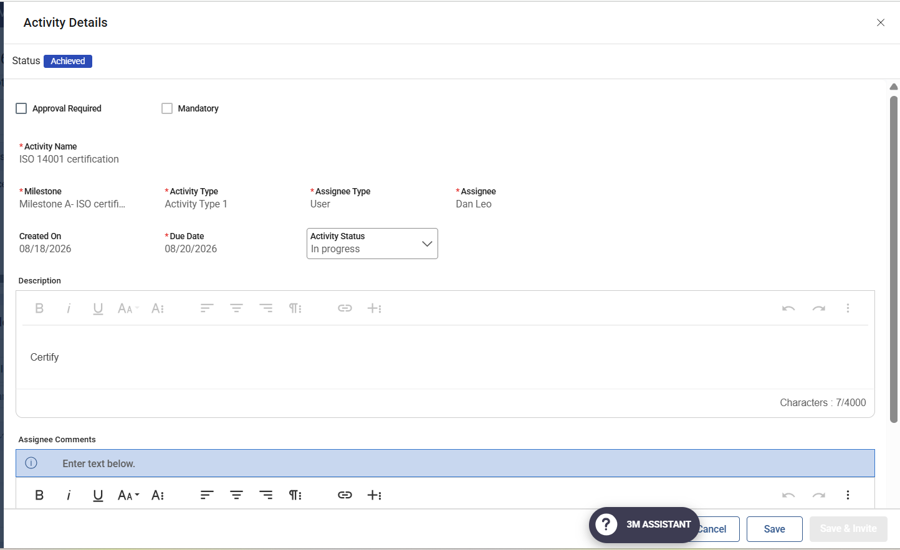
Supplier Ticket Management – Assigned Activity to me
Within Activity details, view details such as Approval required, Mandatory, Due date, Description
  Approval required means when the supplier marks the Activity status as Achieved, it will require 3M approval to show Activity status as Achieved else status shows as Achieved - Pending Approval
  Mandatory means Activity must be achieved, only then 3M can Mark the Ticket as Complete
  Due date means the date until when the assignee has to mark the activity as achieved.
  Description provides more details about the assigned activity.

Slide 9
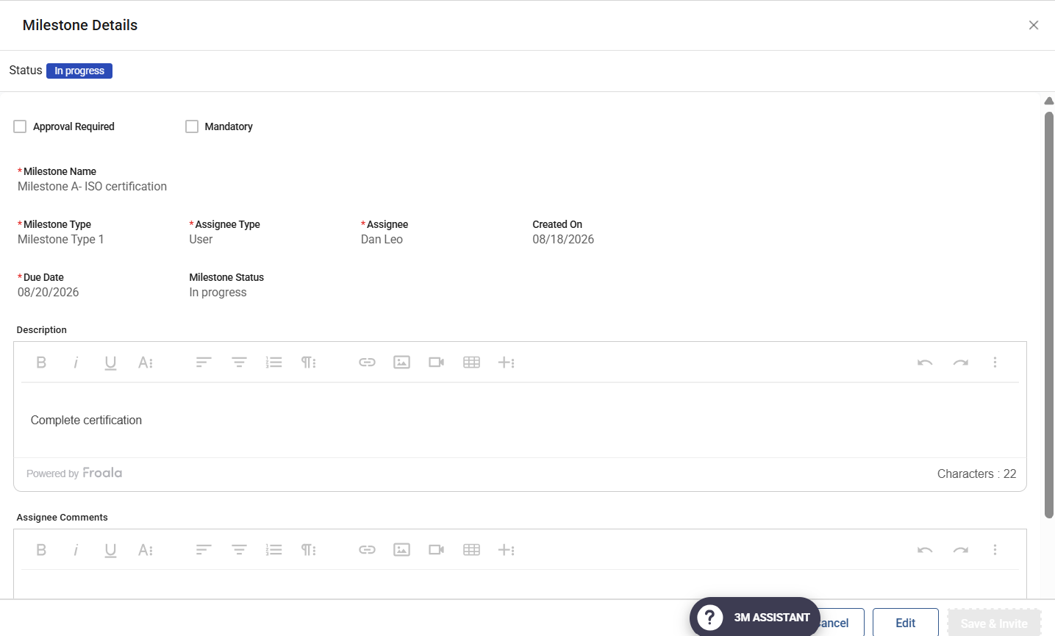
Supplier Ticket Management – Assigned Milestones to me
Similarly, view the assigned Milestone details.

Slide 10
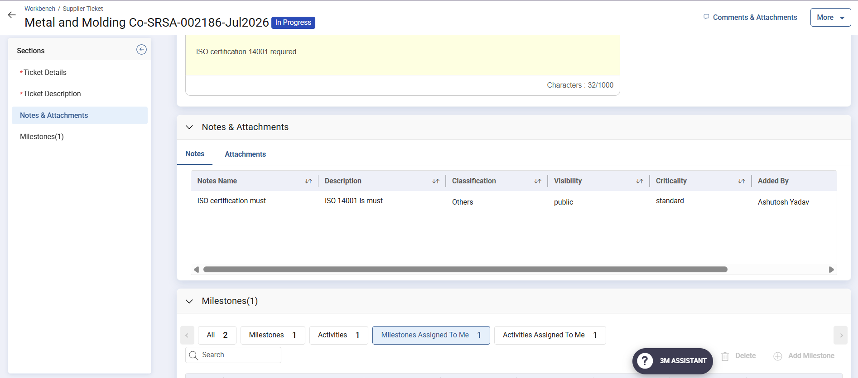
Supplier Ticket Management – Notes and Attachments
Supplier can go to the Notes and Attachment section to view the notes and attachment if any added by 3M

Slide 11
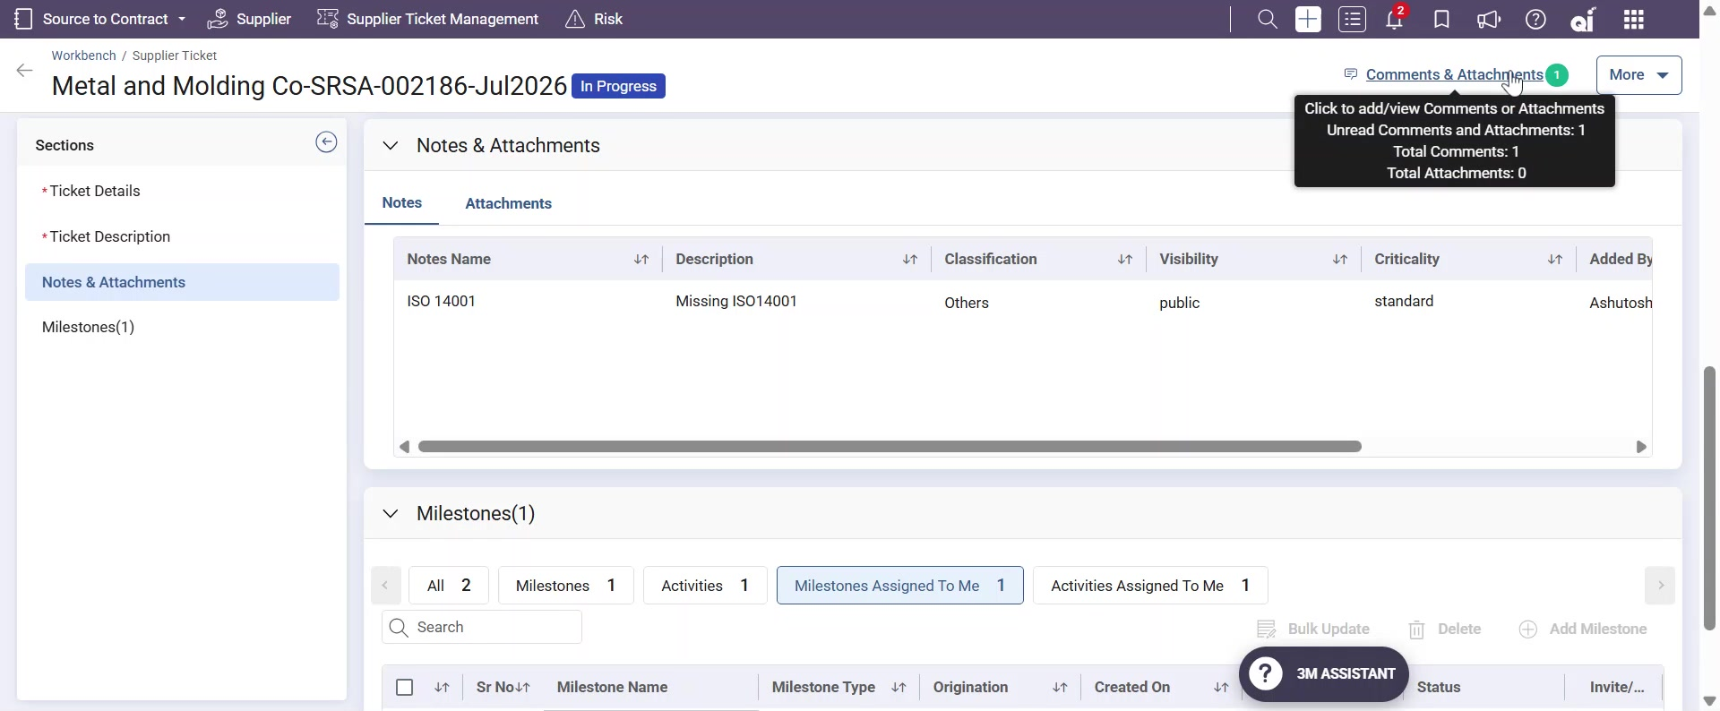
Supplier Ticket Management – Comments and Attachments
Open the Comments and Attachment link to view if any comments or attachment added by 3M.

Slide 12
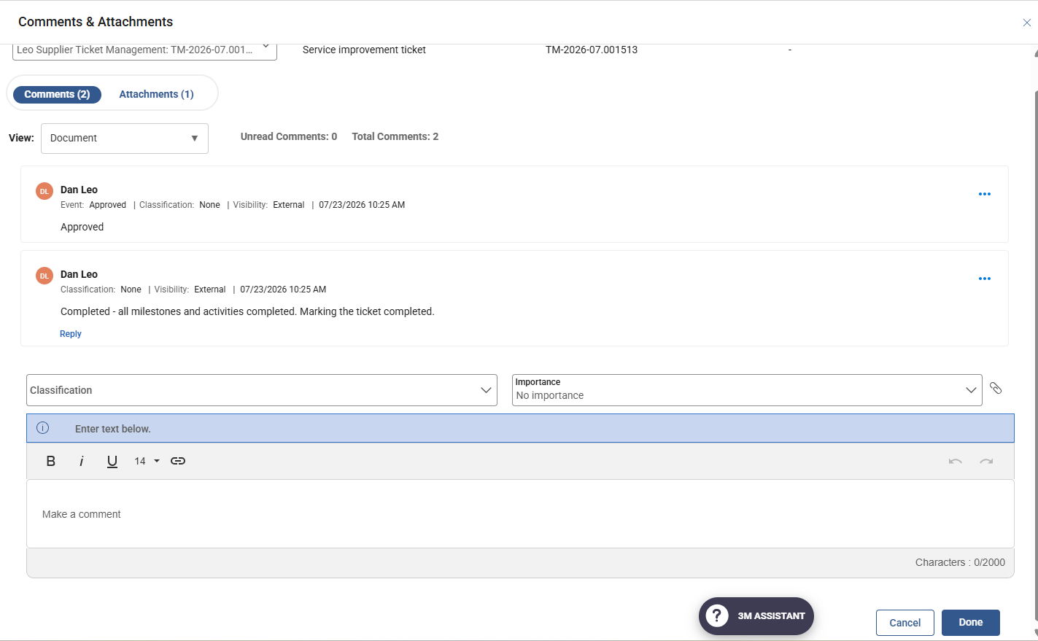
Supplier Ticket Management – Comments and Attachments
Supplier can respond to the Comment and click Done

Slide 13
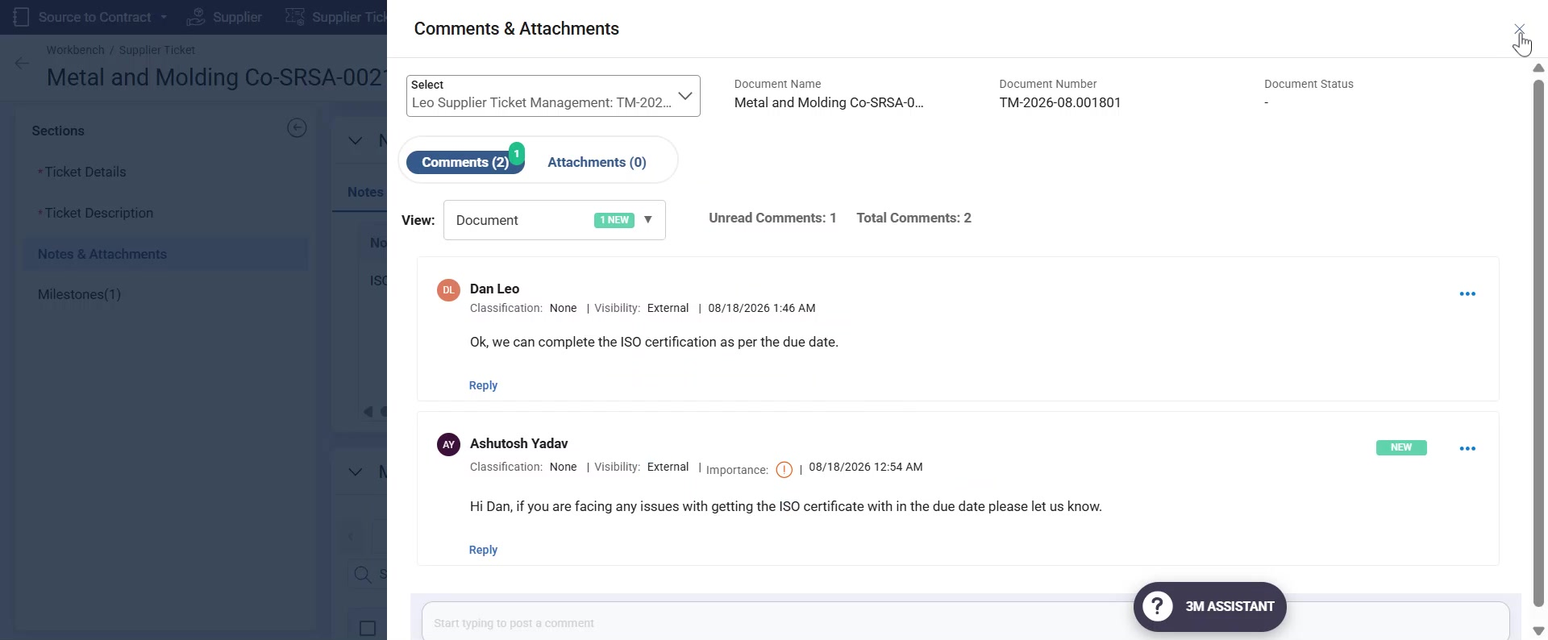
Supplier Ticket Management – Comments and Attachments
To close the Comments and Attachment page click on x at top right corner

Slide 14
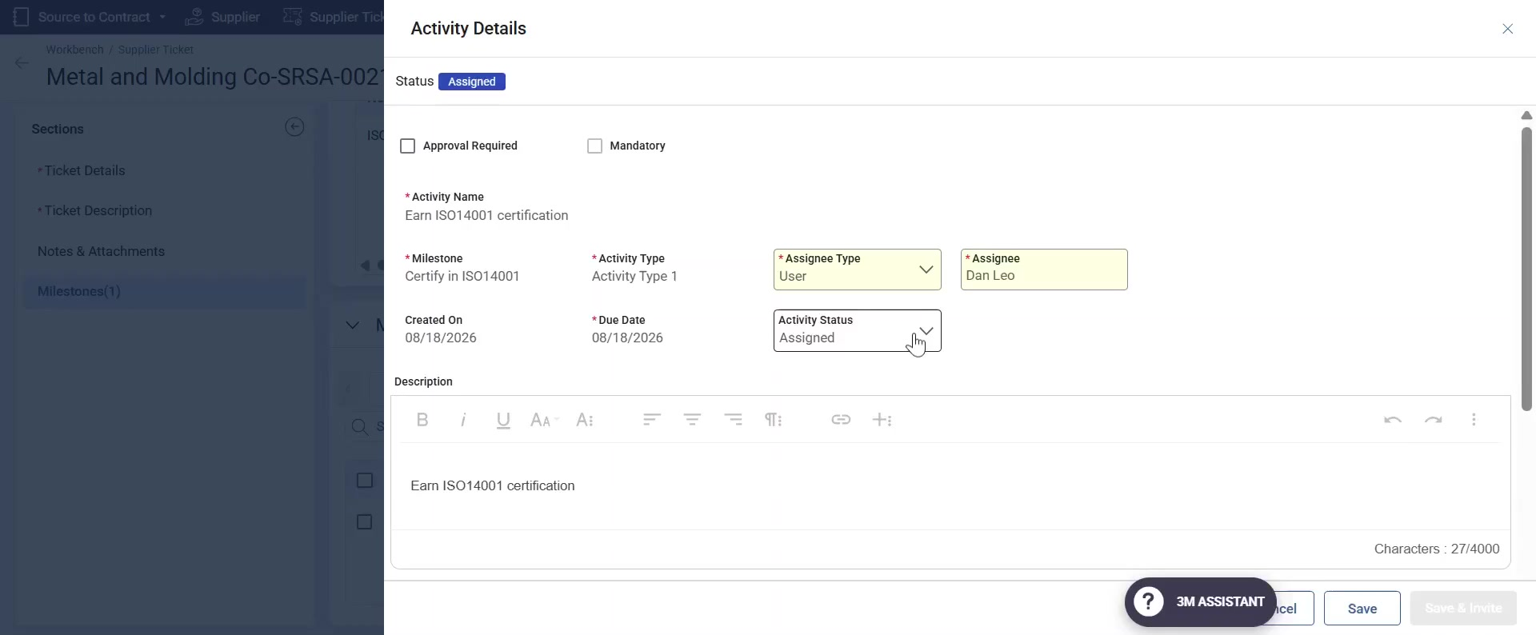
Supplier Ticket Management – Mark activity achieved
Once the Supplier completes the Activity, they can open the Activity to update the Activity status to Achieved.

Slide 15
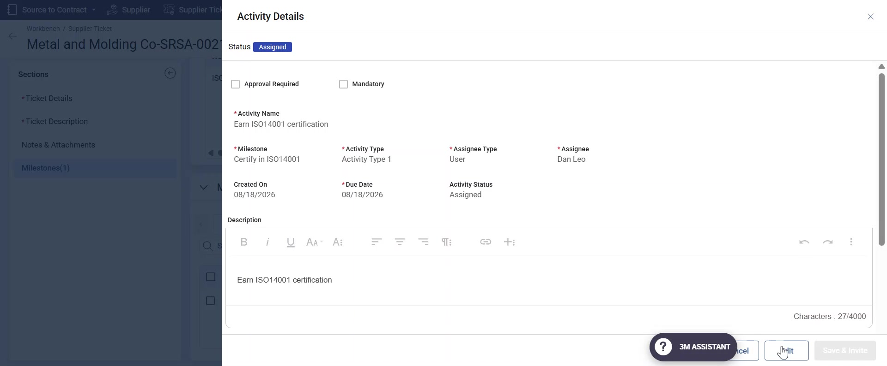
Supplier Ticket Management – Mark activity achieved
Click on Edit button

Slide 16
Supplier Ticket Management – Mark activity achieved
Change the Activity status from Assigned to Achieved

Slide 17
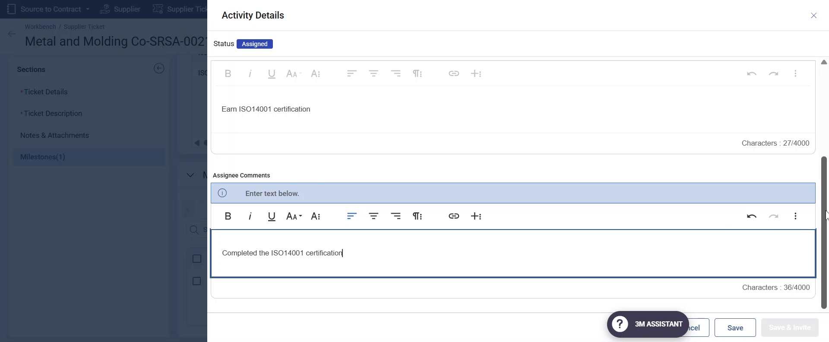
Supplier Ticket Management – Mark activity achieved
Supplier can add comments if any

Slide 18
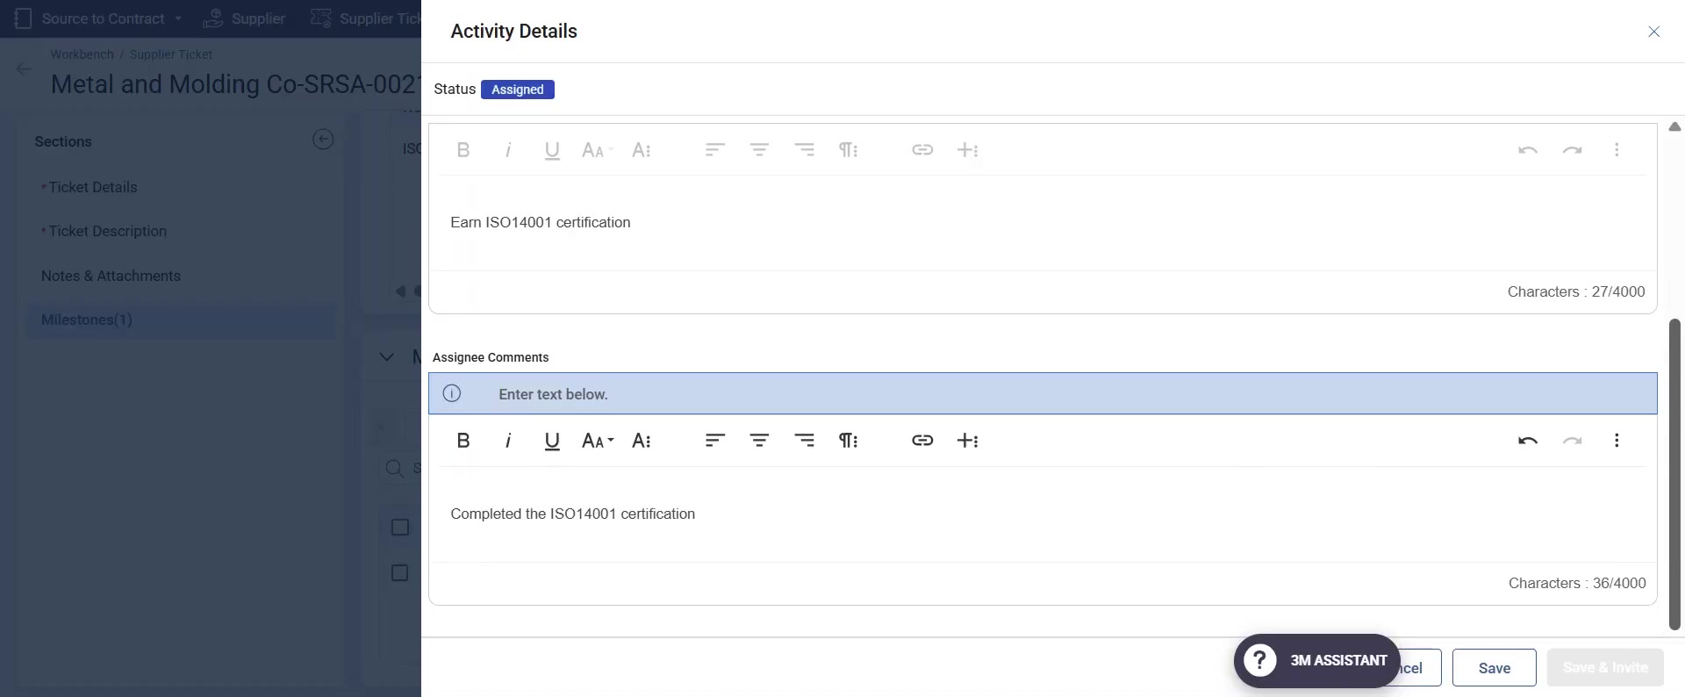
Supplier Ticket Management – Mark activity achieved
Click on Save

Slide 19
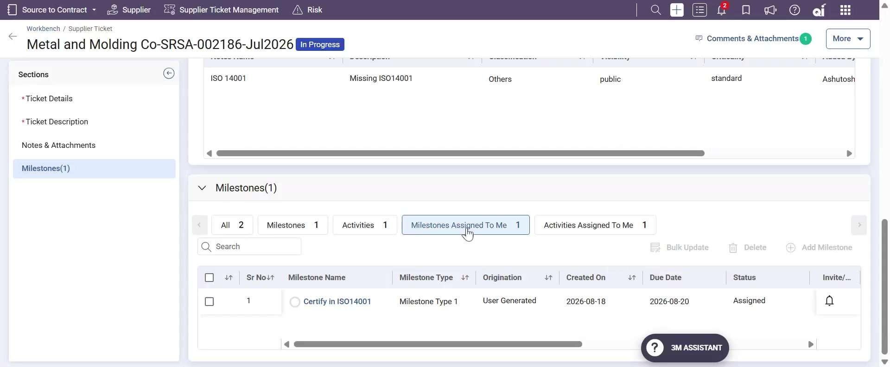
Supplier Ticket Management – Mark Milestone achieved
Similarly, Supplier can open and mark the assigned milestone as achieved after completing the required actions

Slide 20
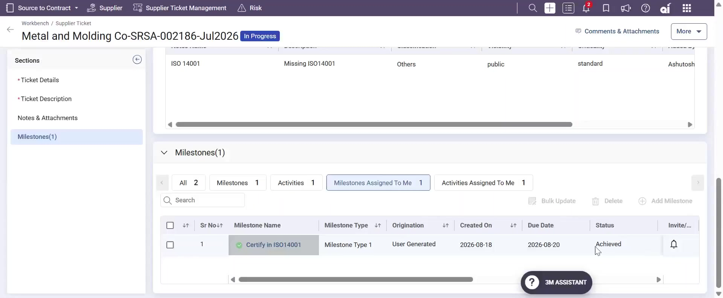
Supplier Ticket Management – Status change to Achieved
After marking the Milestone or Activity achieved, the status changes from In Progress to Achieved.
If approval required is enabled by 3M, then the status will show as Achieved - Approval pending. And once Approver approves it the status changes to Achieved

Slide 21
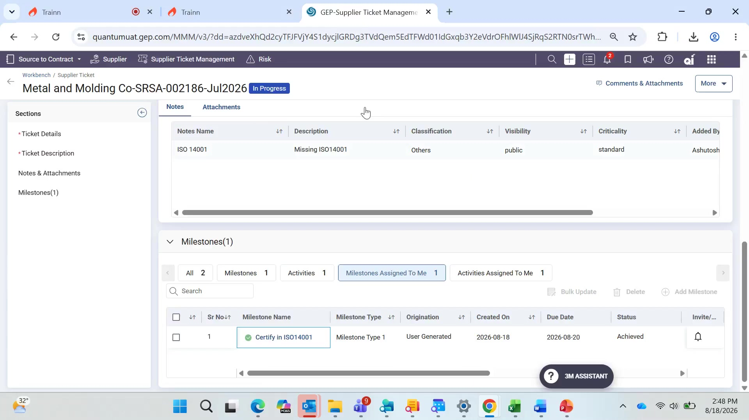
Supplier Ticket Management – Comments and Attachments
To upload any attachment Supplier can click on the Comments and Attachment link

Slide 22
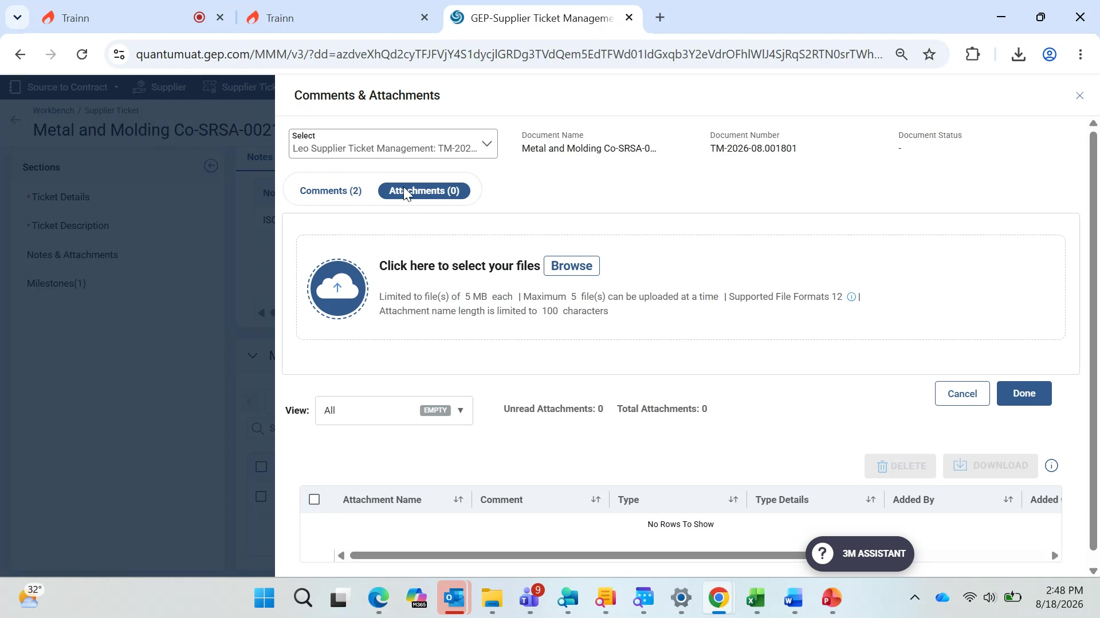
Supplier Ticket Management – Comments and Attachments
Open the Attachments tab

Slide 23
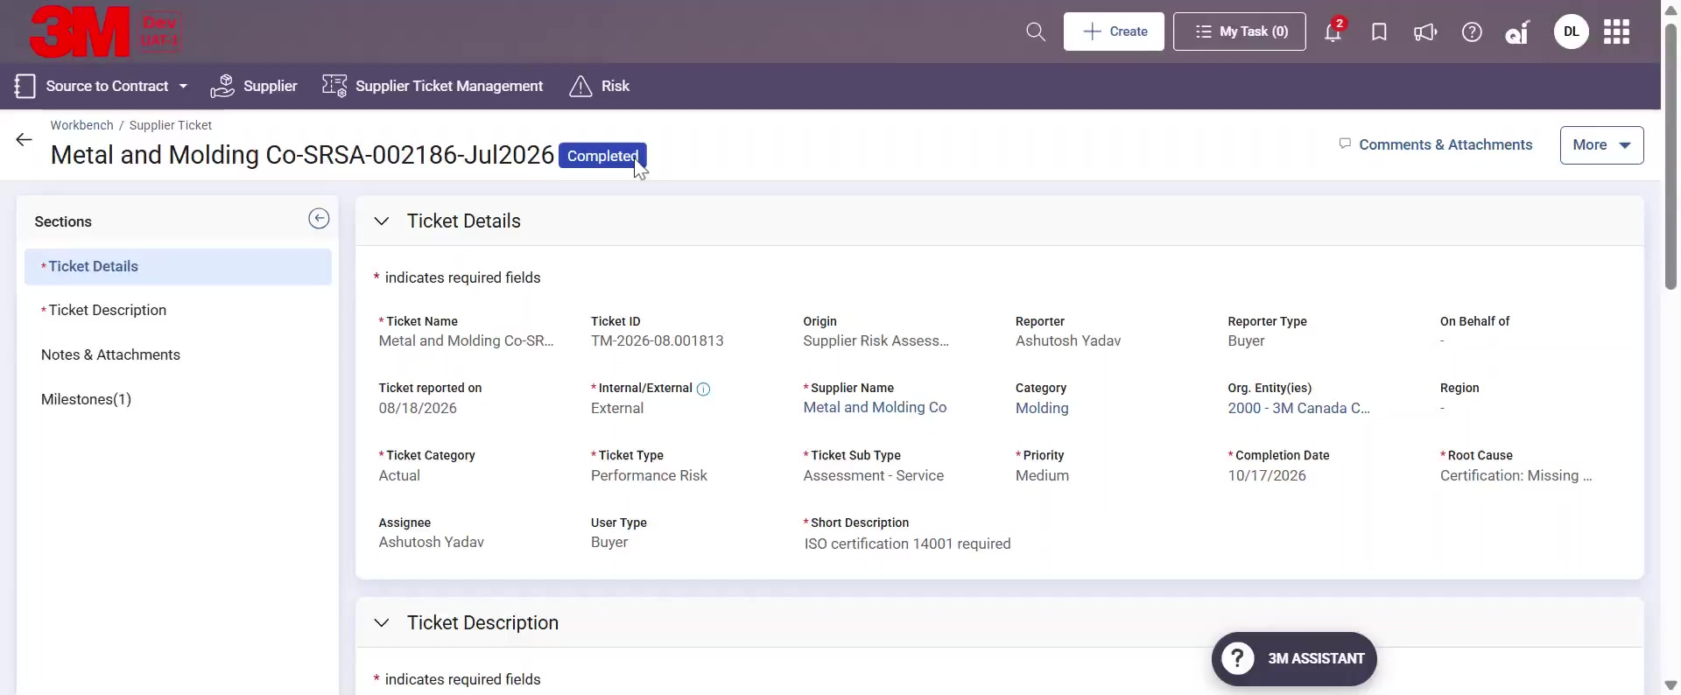
Supplier Ticket Management – Ticket status –Completed(No Approval required)
Once all the milestone and activities are achieved, 3M(the ticket creator) can mark the Ticket Complete.
Depending upon the Approval workflow configured the ticket will go for Approval. If there are no approval workflow the Ticket status will change from In Progress to Complete.

Slide 24
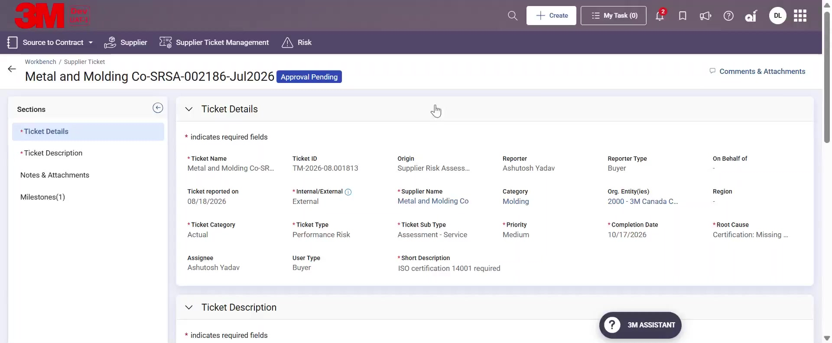
Supplier Ticket Management – Ticket status –Approval Pending
Once all the milestone and activities are achieved, 3M, the ticket creator can mark the Ticket Complete.
Depending upon the Approval workflow, if configured, the ticket will go for Approval. For Supplier the Ticket status will change from In Progress to Approval pending.

Slide 25
Supplier Ticket Management – Ticket status –Completed
When the 3M Approver approves the Ticket, the Supplier can view the ticket status as Completed.
Otherwise in case Approver rejects for supplier the ticket status would change from Approval Pending to In progress.

Slide 26
Thank You

