Slide 1
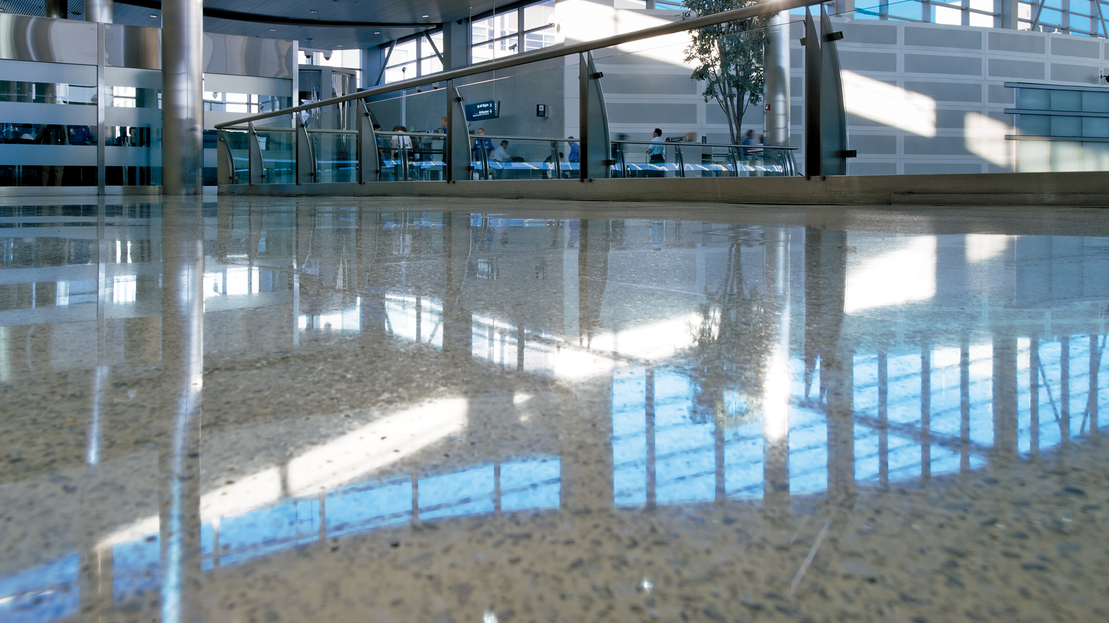

Before and After Floor Images
Using 3M™ Floor Protection Systems
Notes:
https://multimedia.3m.com/mws/securemedia/822672O/3mtm-stone-floor-protection-system.tif

Slide 2
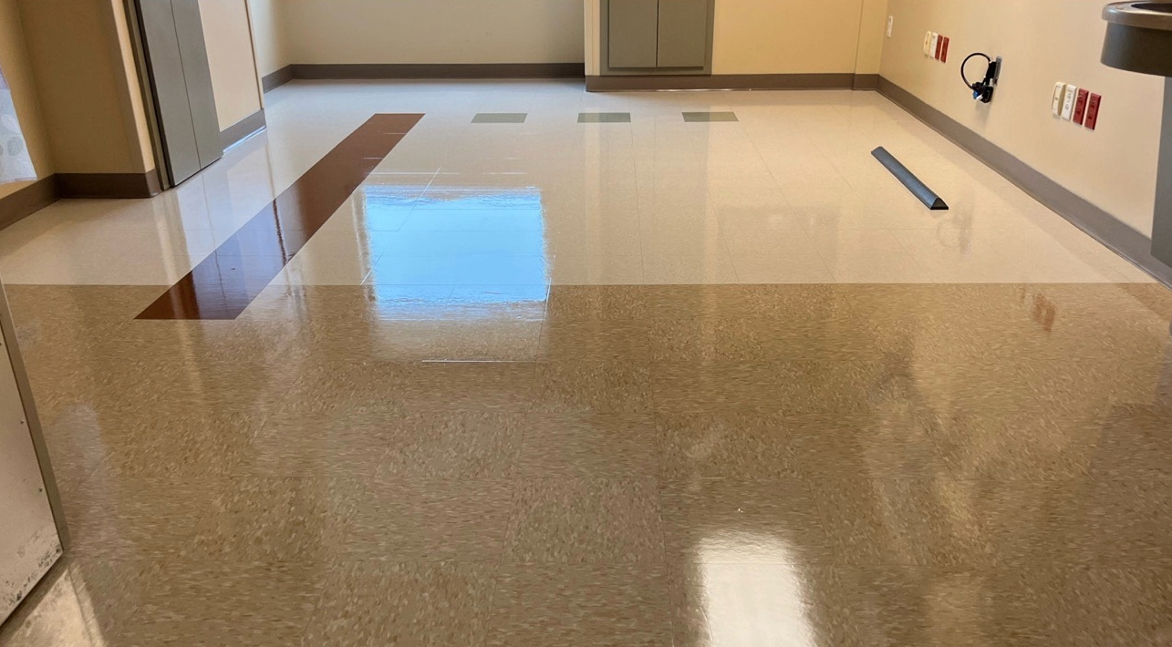

Resilient Floor Protection

Slide 3
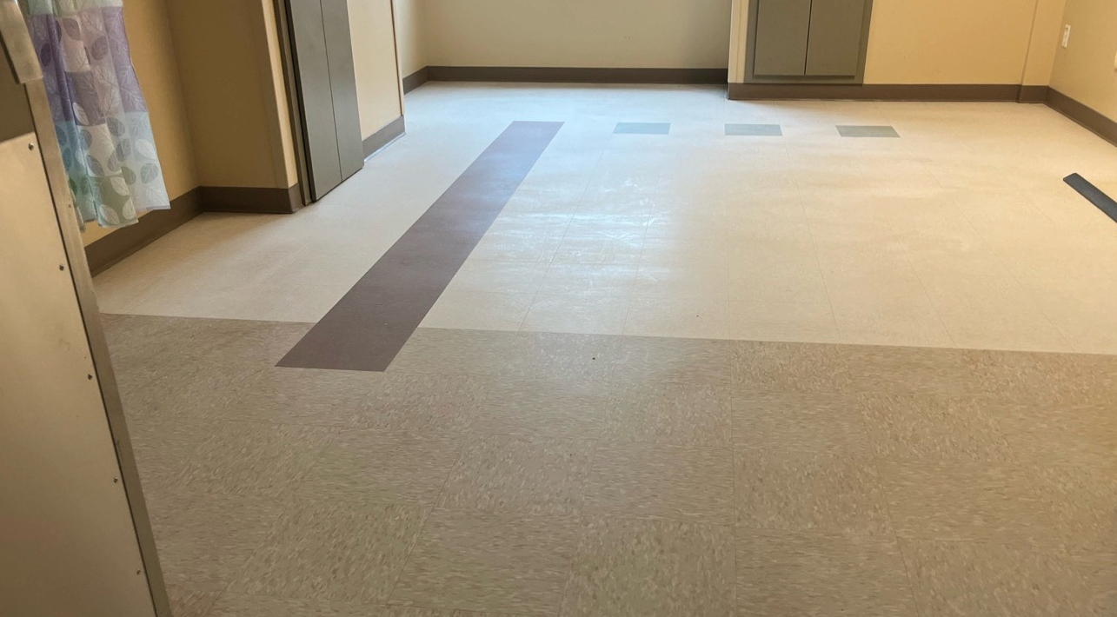
Resilient Floor Care
1
Example
Before
After
Notes:
Dull floor image: https://multimedia.3m.com/mws/media/2567169O/vct-floor-before-protect-and-shine-9.jpg
Shiny floor image: https://multimedia.3m.com/mws/media/2567162O/vct-floor-after-protect-and-shine-9.jpg

Slide 4
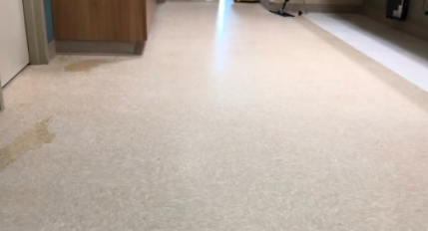
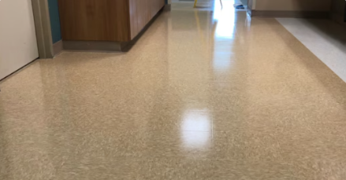
Resilient Floor Care
2
Example
Before
After
Notes:
Dull floor image: https://multimedia.3m.com/mws/media/2567164O/vct-floor-after-spp-and-purple-pad.jpg
Shiny floor image: https://multimedia.3m.com/mws/media/2567170O/vct-floor-after-4-coats-of-protect-and-shine.jpg

Slide 5
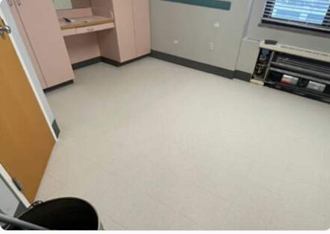
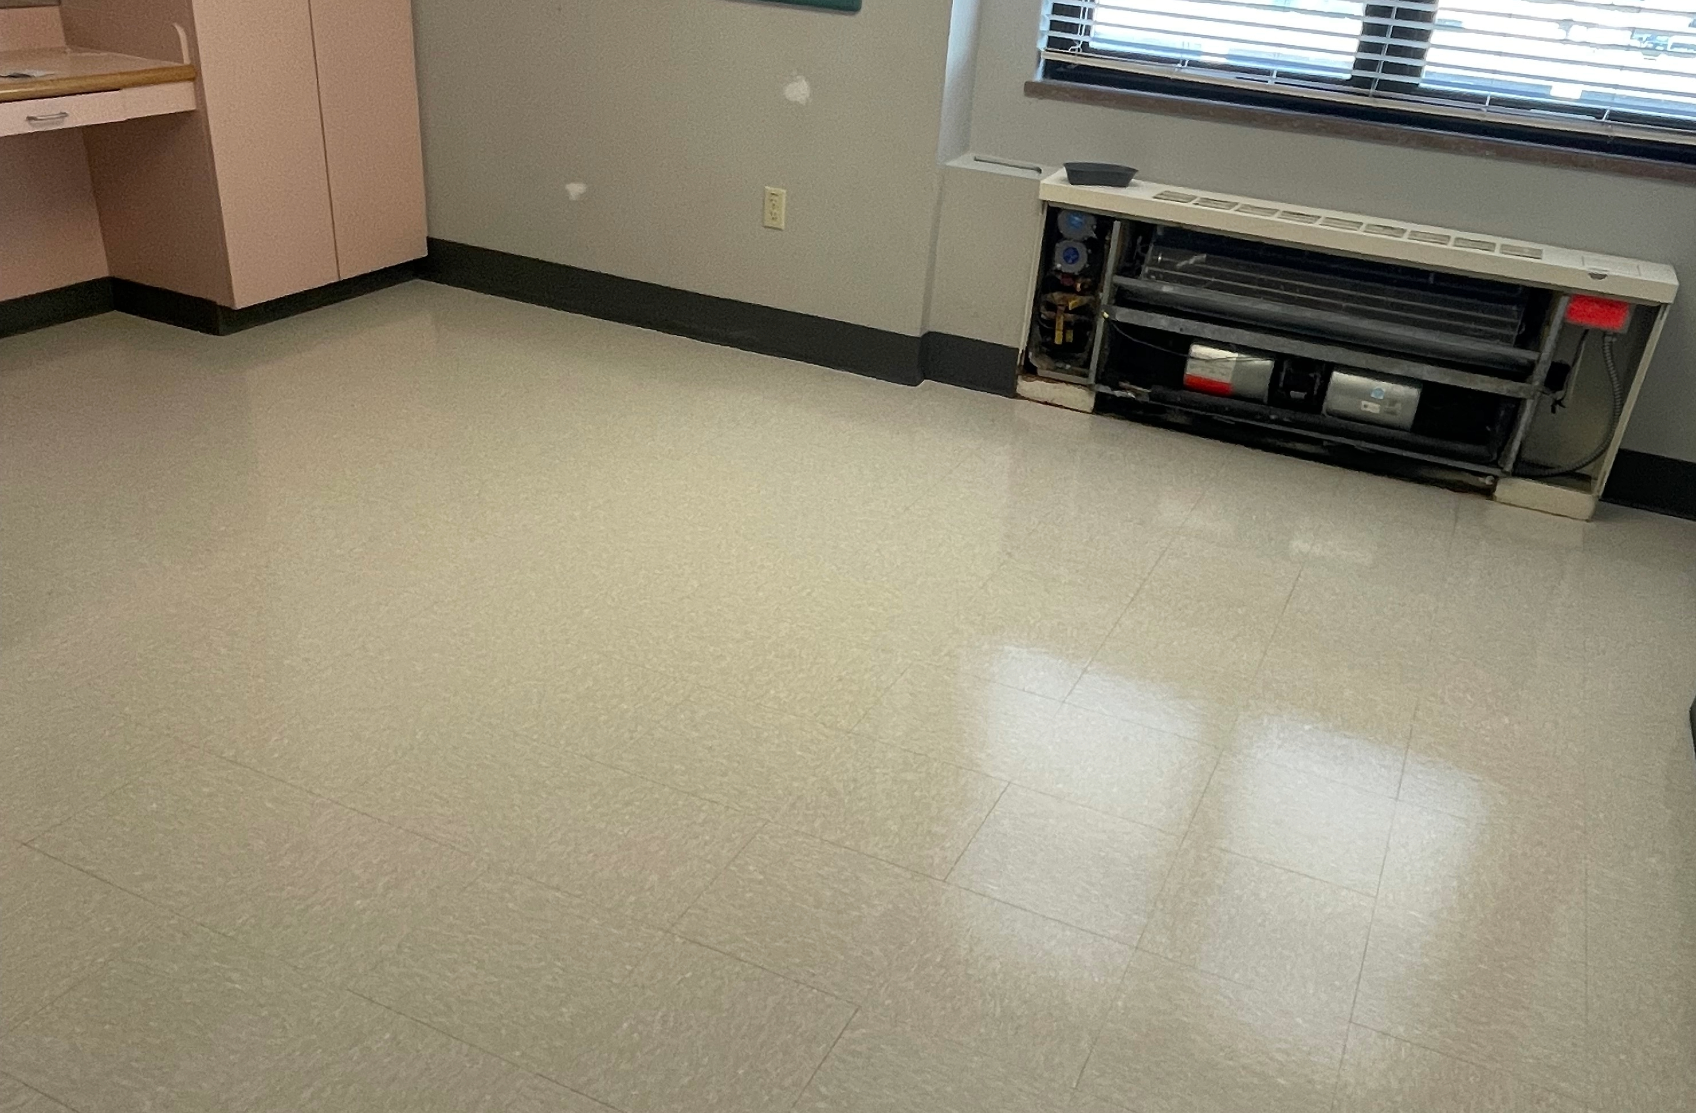
Resilient Floor Care
3
Example
Before
After
Before
After
Notes:
Dull floor image: https://multimedia.3m.com/mws/media/2567165O/vct-floor-before-protect-and-shine-3.jpg
Shiny floor image: https://multimedia.3m.com/mws/media/2567156O/vct-floor-after-protect-and-shine-3.jpg

Slide 6
Resilient Floor Care
4
Example
Before
After
Notes:
Dull floor image: https://multimedia.3m.com/mws/media/2567164O/vct-floor-after-spp-and-purple-pad.jpg
Shiny floor image: https://multimedia.3m.com/mws/media/2567170O/vct-floor-after-4-coats-of-protect-and-shine.jpg

Slide 7
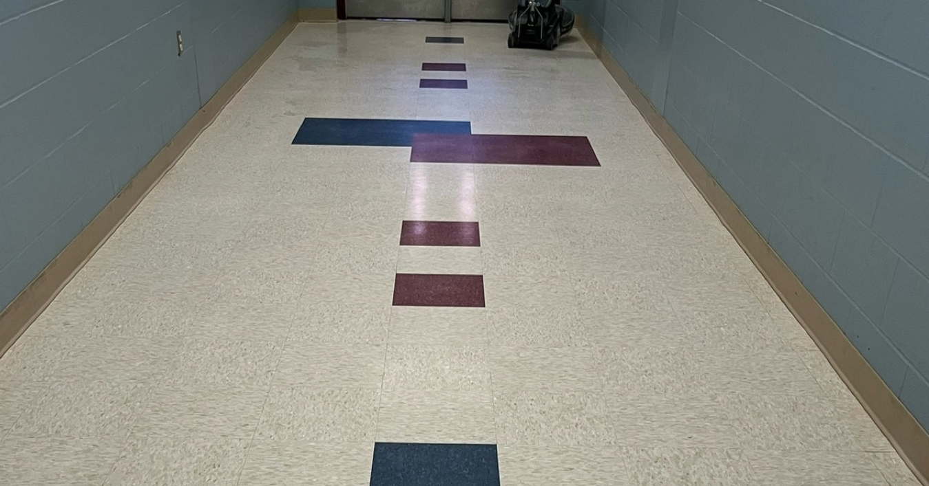
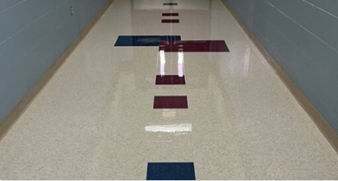
Resilient Floor Care
5
Example
Before
After
Notes:
Dull floor image: https://multimedia.3m.com/mws/media/2567166O/vct-floor-before-protect-and-shine-4.jpg
Shiny floor image: https://multimedia.3m.com/mws/media/2567157O/vct-floor-after-protect-and-shine-4.jpg

Slide 8
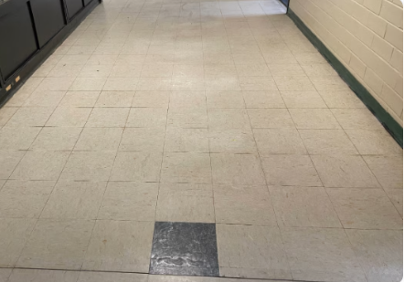
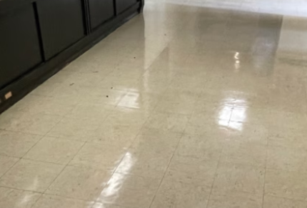
Resilient Floor Care
6
Example
Before
After
Notes:
Dull floor image: https://multimedia.3m.com/mws/media/2567167O/vct-floor-before-protect-and-shine-5.jpg
Shiny floor image: https://multimedia.3m.com/mws/media/2567158O/vct-floor-after-protect-and-shine-5.jpg

Slide 9
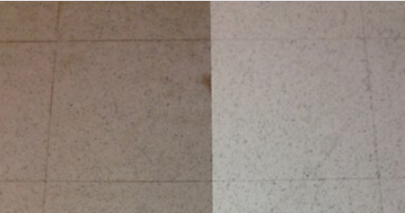
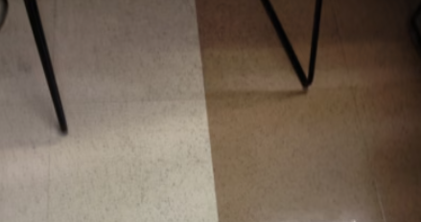
Resilient Floor Care
7
Example
Before
After
Notes:
Dull floor image: https://multimedia.3m.com/mws/media/2567168O/vct-floor-before-protect-and-shine-6.jpg
Shiny floor image: https://multimedia.3m.com/mws/media/2567159O/vct-floor-after-protect-and-shine-6.jpg

Slide 10
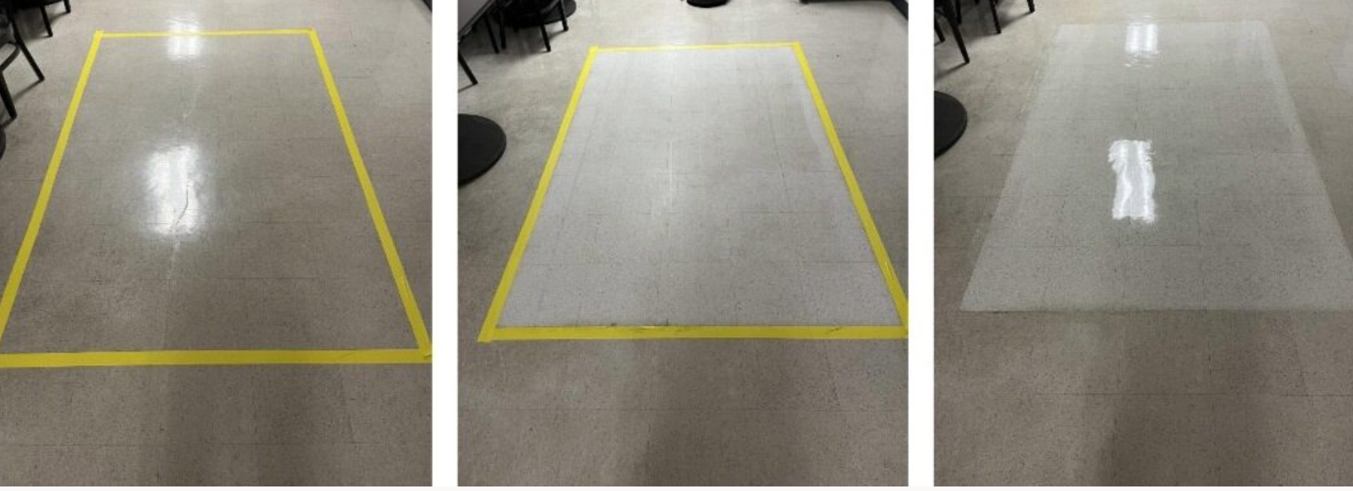
Resilient Floor Care
8
Example
Before
After
Notes:
https://multimedia.3m.com/mws/media/2567171O/vct-floor-before-and-after-4-coats-of-protect-and-shine.jpg

Slide 11
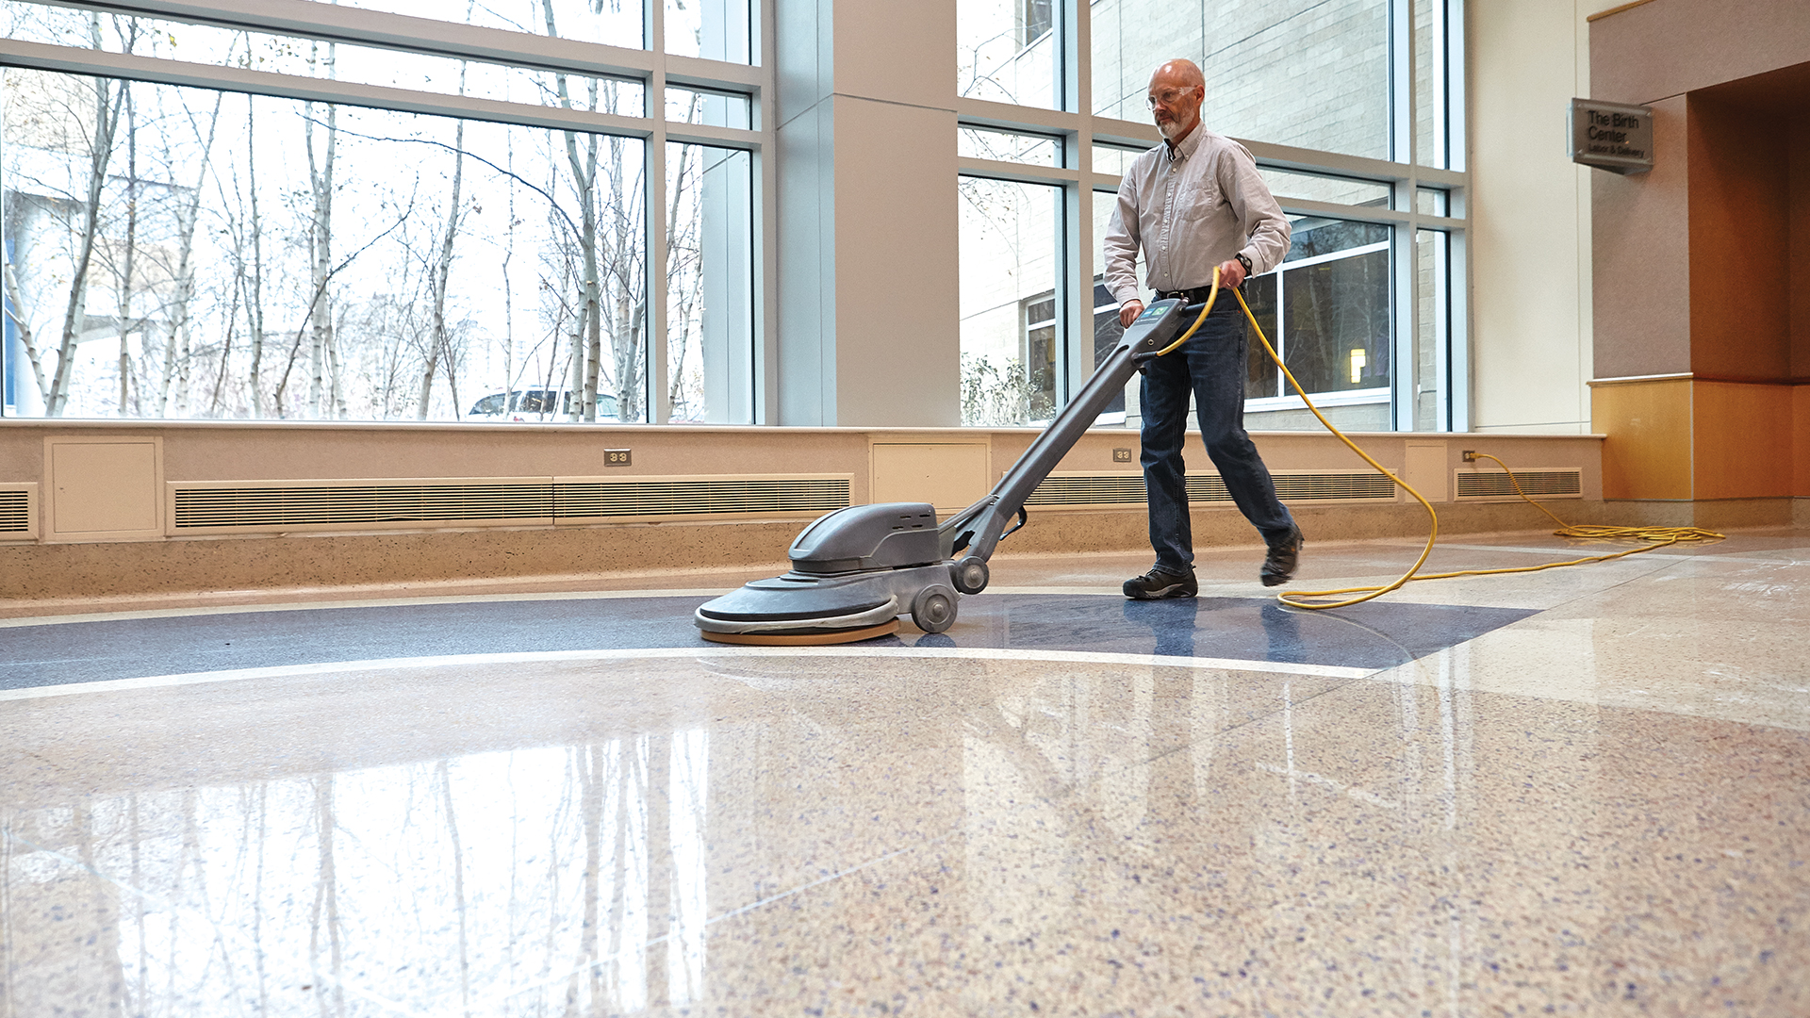
Stone Floor Restoration
and Protection
Notes:
https://multimedia.3m.com/mws/media/1351250O/man-walking-with-swing-machine-stone-floor-side-angle.tif

Slide 12
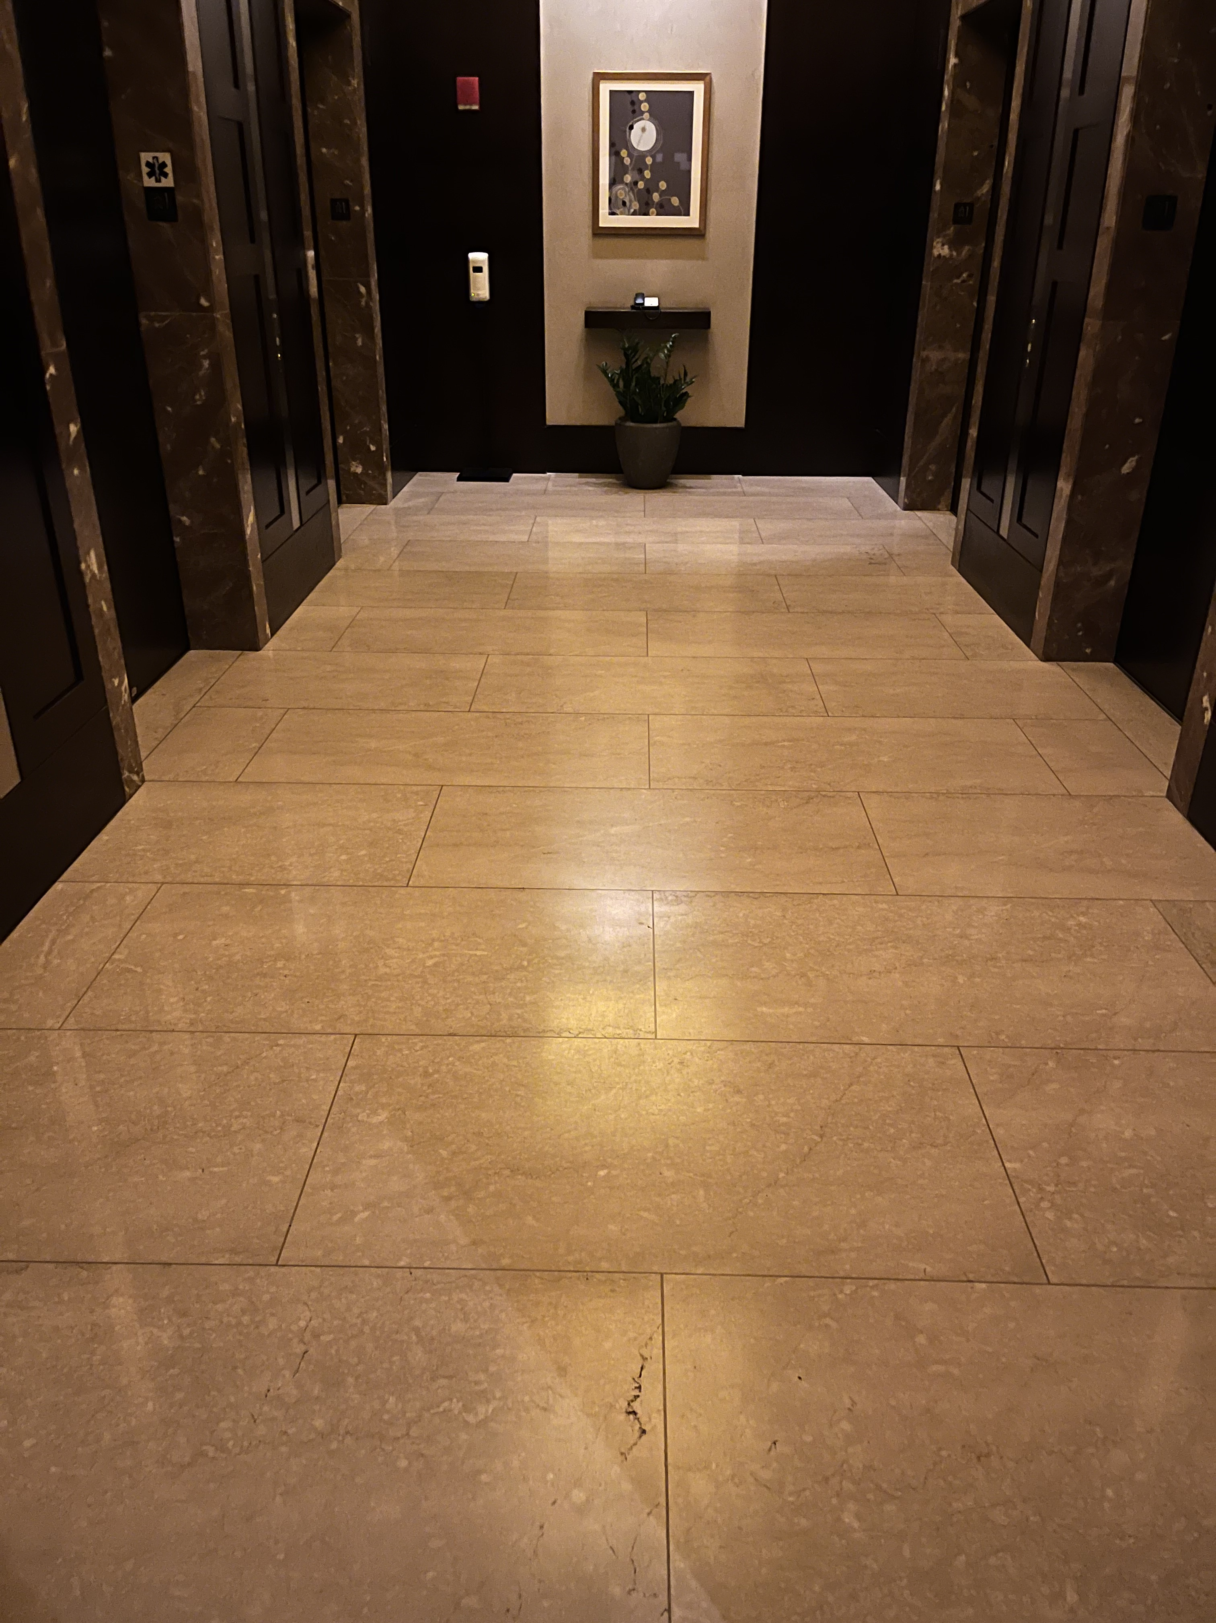
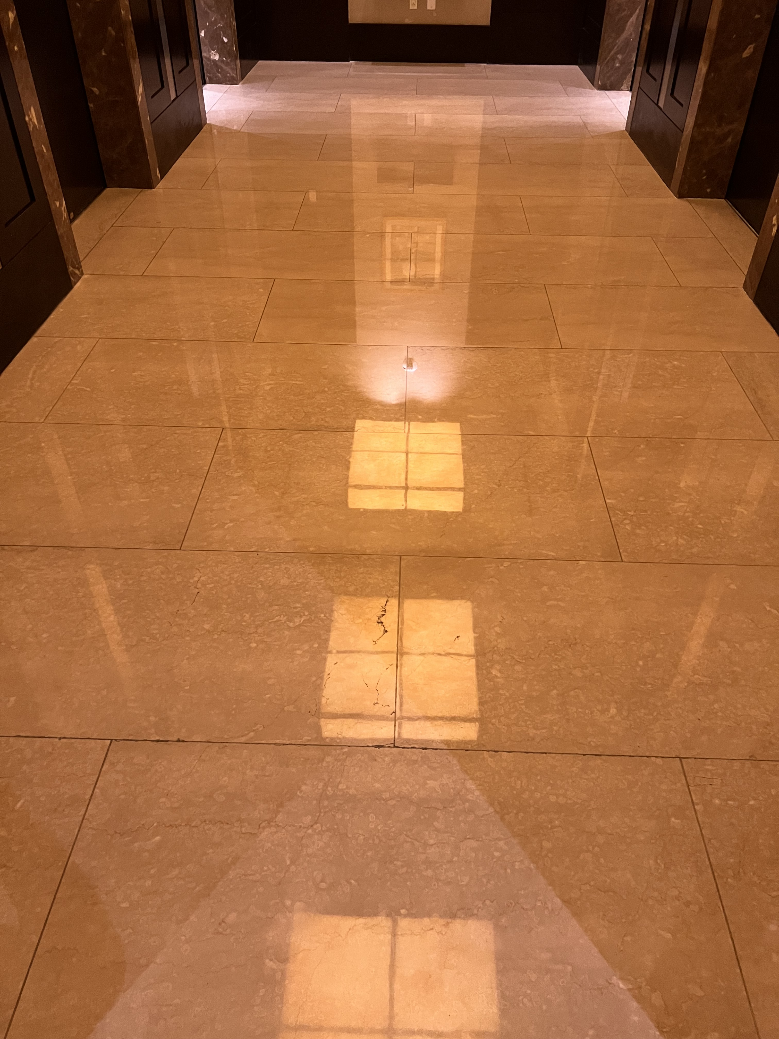
Stone Floor Restoration and Protection
1
Example
Before
After
Notes:
Dull floor image: https://multimedia.3m.com/mws/media/2543874O/tan-marble-floor-before-stone-floor-protection-system.jpg
Shiny floor image: https://multimedia.3m.com/mws/media/2543873O/tan-marble-floor-after-stone-floor-protection-system.jpg

Slide 13
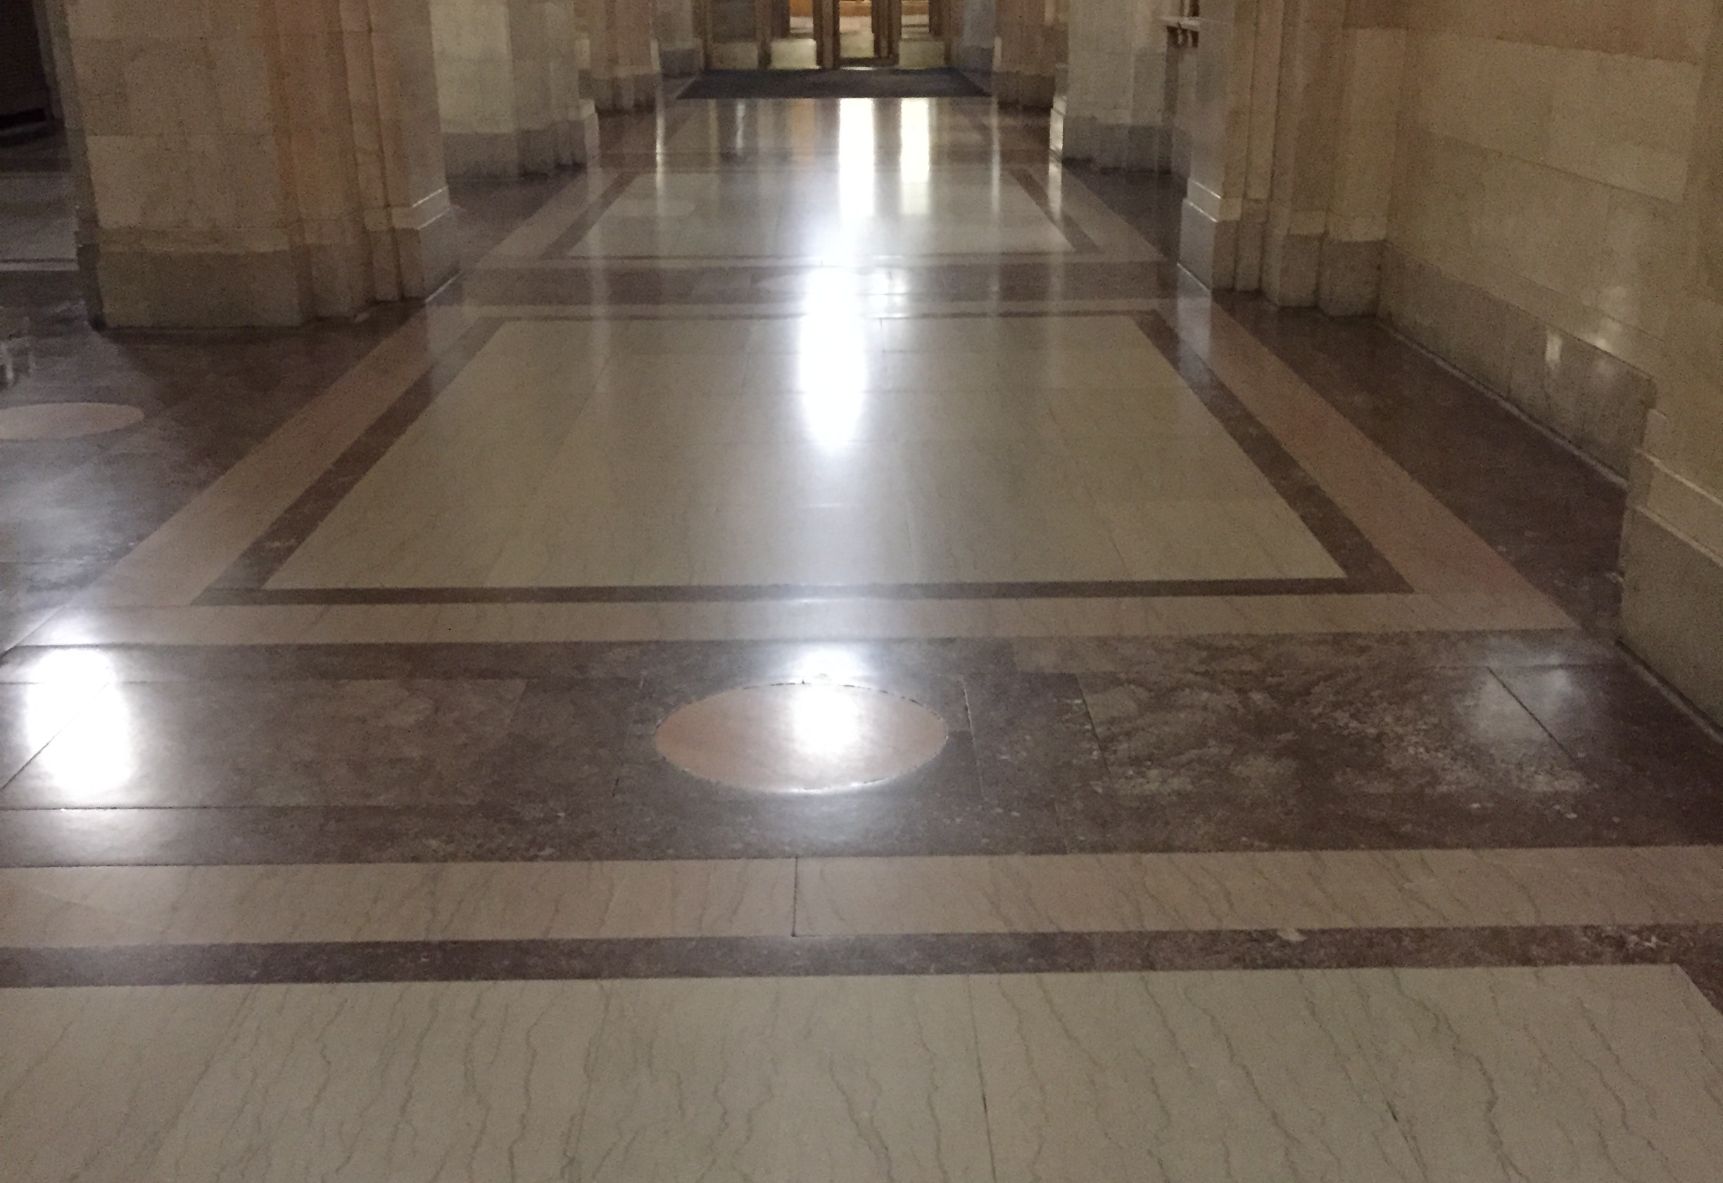
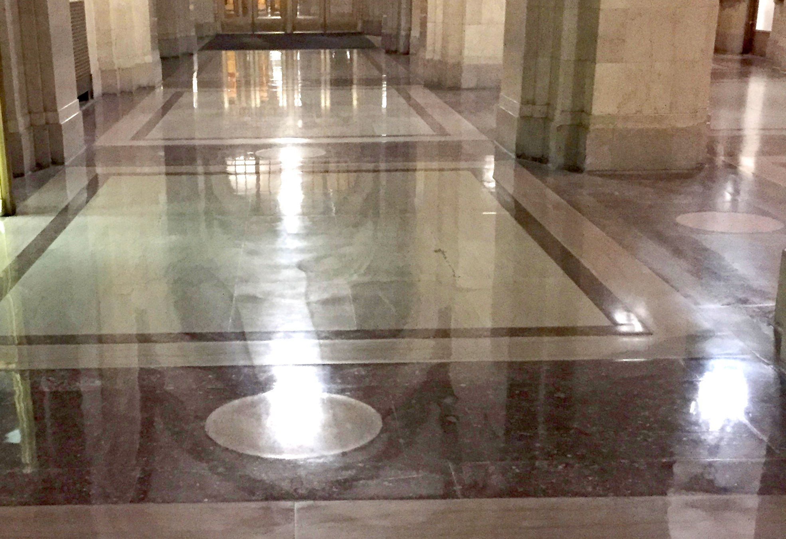
Stone Floor Restoration and Protection
2
Example
Before
After
Notes:
Dull floor image: https://multimedia.3m.com/mws/media/2543872O/patterned-marble-floor-before-stone-floor-protection-system.jpg
Shiny floor image: https://multimedia.3m.com/mws/media/2543871O/patterned-marble-floor-after-stone-floor-protection-system.jpg

Slide 14
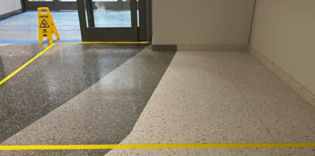
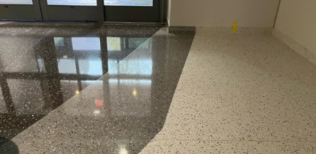
Stone Floor Restoration and Protection
3
Example
Before
After
Notes:
Dull floor image: https://multimedia.3m.com/mws/media/2548953O/white-gray-black-terrazzo-floor-before-stone-floor-care-protection-system.jpg
Shiny floor image: https://multimedia.3m.com/mws/media/2548952O/white-gray-black-terrazzo-floor-after-stone-floor-care-protection-system.jpg

Slide 15
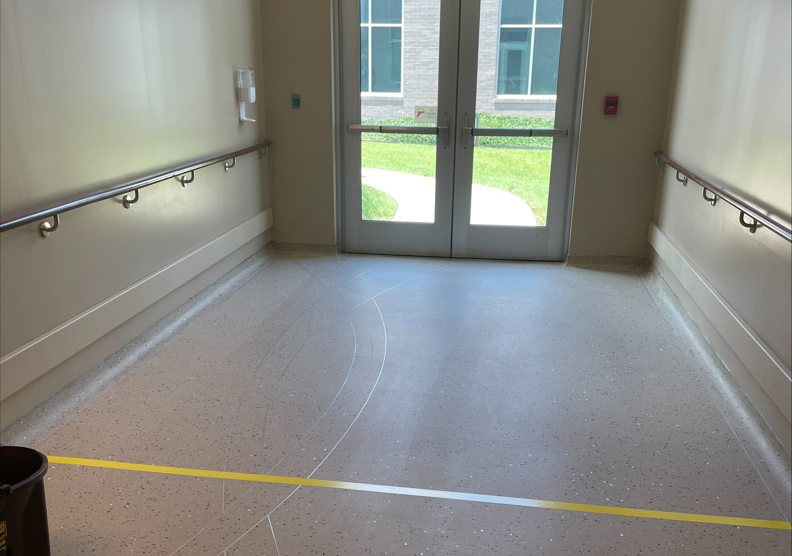
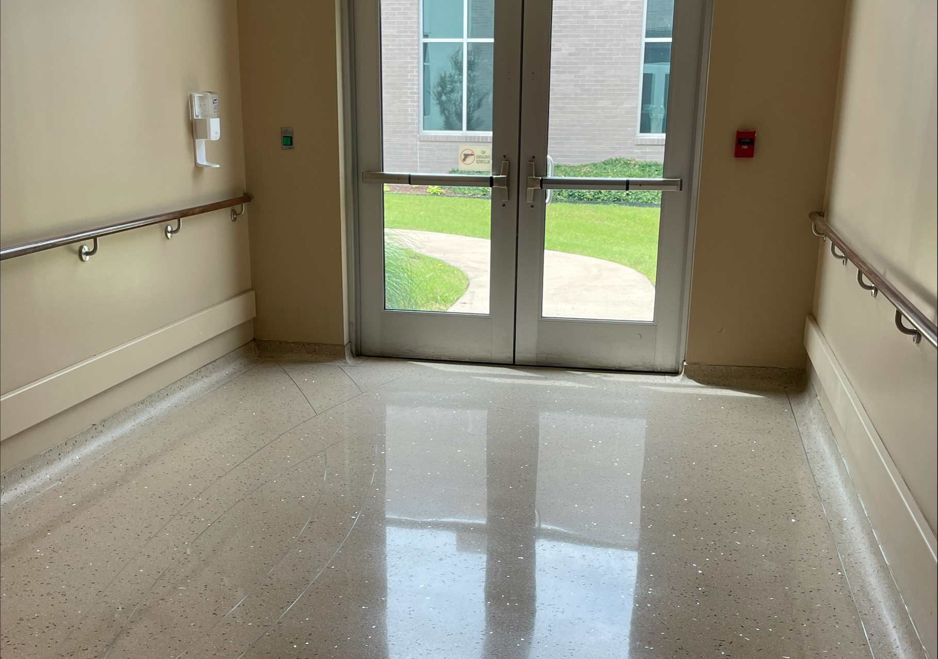
Stone Floor Restoration and Protection
4
Example
Before
After
Notes:
Dull floor image: https://multimedia.3m.com/mws/media/2548949O/cream-terrazzo-floor-before-stone-floor-care-protection-system.jpg
Shiny floor image: https://multimedia.3m.com/mws/media/2548948O/cream-terrazzo-floor-after-stone-floor-care-protection-system.jpg

Slide 16
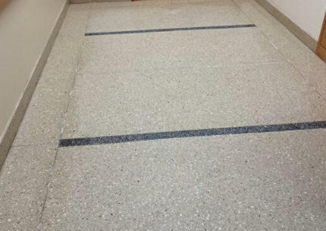
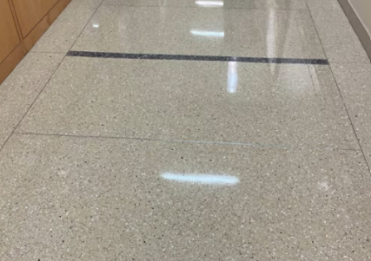
Stone Floor Restoration and Protection
5
Example
Before
After
Notes:
Dull floor image: https://multimedia.3m.com/mws/media/2548950O/black-and-gray-terrazzo-floor-before-stone-floor-care-protection-system.jpg
Shiny floor image: https://multimedia.3m.com/mws/media/2548951O/black-and-gray-terrazzo-floor-after-stone-floor-care-protection-system.jpg

Slide 17
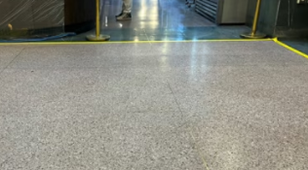
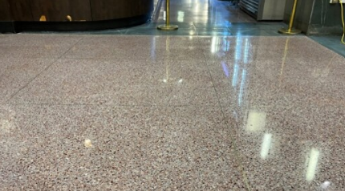
Stone Floor Restoration and Protection
6
Example
Before
After
Notes:
Dull floor image: https://multimedia.3m.com/mws/media/2567029O/terrazzo-floor-before-picture.jpg
Shiny floor image: https://multimedia.3m.com/mws/media/2578159O/terrazo-floor-after-stone-floor-protection-system.jpg

Slide 18
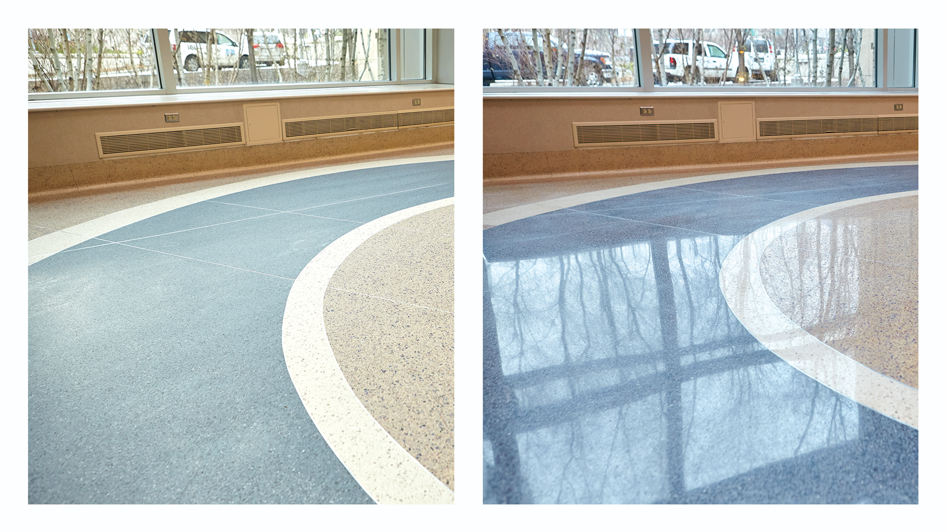
Stone Floor Restoration and Protection
7
Example
Before
After
Notes:
Dull floor image: https://multimedia.3m.com/mws/media/2567029O/terrazzo-floor-before-picture.jpg
Shiny floor image: https://multimedia.3m.com/mws/media/2578159O/terrazo-floor-after-stone-floor-protection-system.jpg

Slide 19


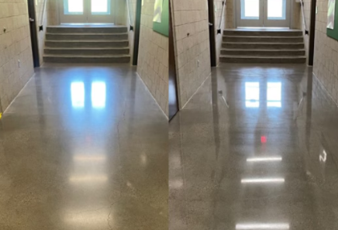
Stone Floor Restoration and Protection
8
Example
After Images Only
Before
Notes:
Shiny floor image: https://multimedia.3m.com/mws/media/2567014O/concrete-floor-before-and-after-stone-floor-protection-system-picture.jpg
Shiny floor image: https://multimedia.3m.com/mws/media/2540225O/concrete-floor-after-stone-floor-protection-system.jpg
Shiny floor image: https://multimedia.3m.com/mws/media/2540226O/concrete-floor-before-stone-floor-protection-system.jpg

Slide 20
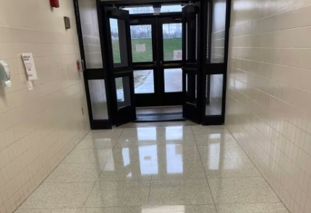
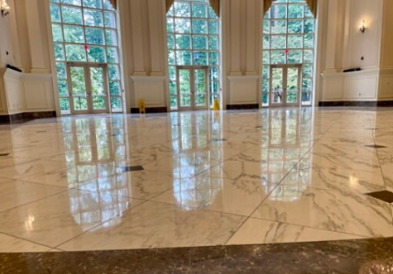

Stone Floor Restoration and Protection
9
Example
After Images Only
Before
Notes:
Shiny floor image: https://multimedia.3m.com/mws/media/2567021O/terrazzo-floor-after-picture-us.jpg
Shiny floor image: https://multimedia.3m.com/mws/media/2543875O/marble-floor-after-stone-floor-protection-system.jpg
Shiny floor image: https://multimedia.3m.com/mws/media/2567013O/concrete-floor-after-stone-floor-protection-picture.jpg

Slide 21
Thank you
IMPORTANT NOTICE: This presentation is intended for professional and industrial users only. 3M makes no warranties, express or implied, in this presentation including, but not limited to, the warranties of fitness for a particular purpose. Potential customers should refer to applicable 3M specifications and warranties when determining if the products and product solutions in this presentation are appropriate for their intended application.

