Slide 1
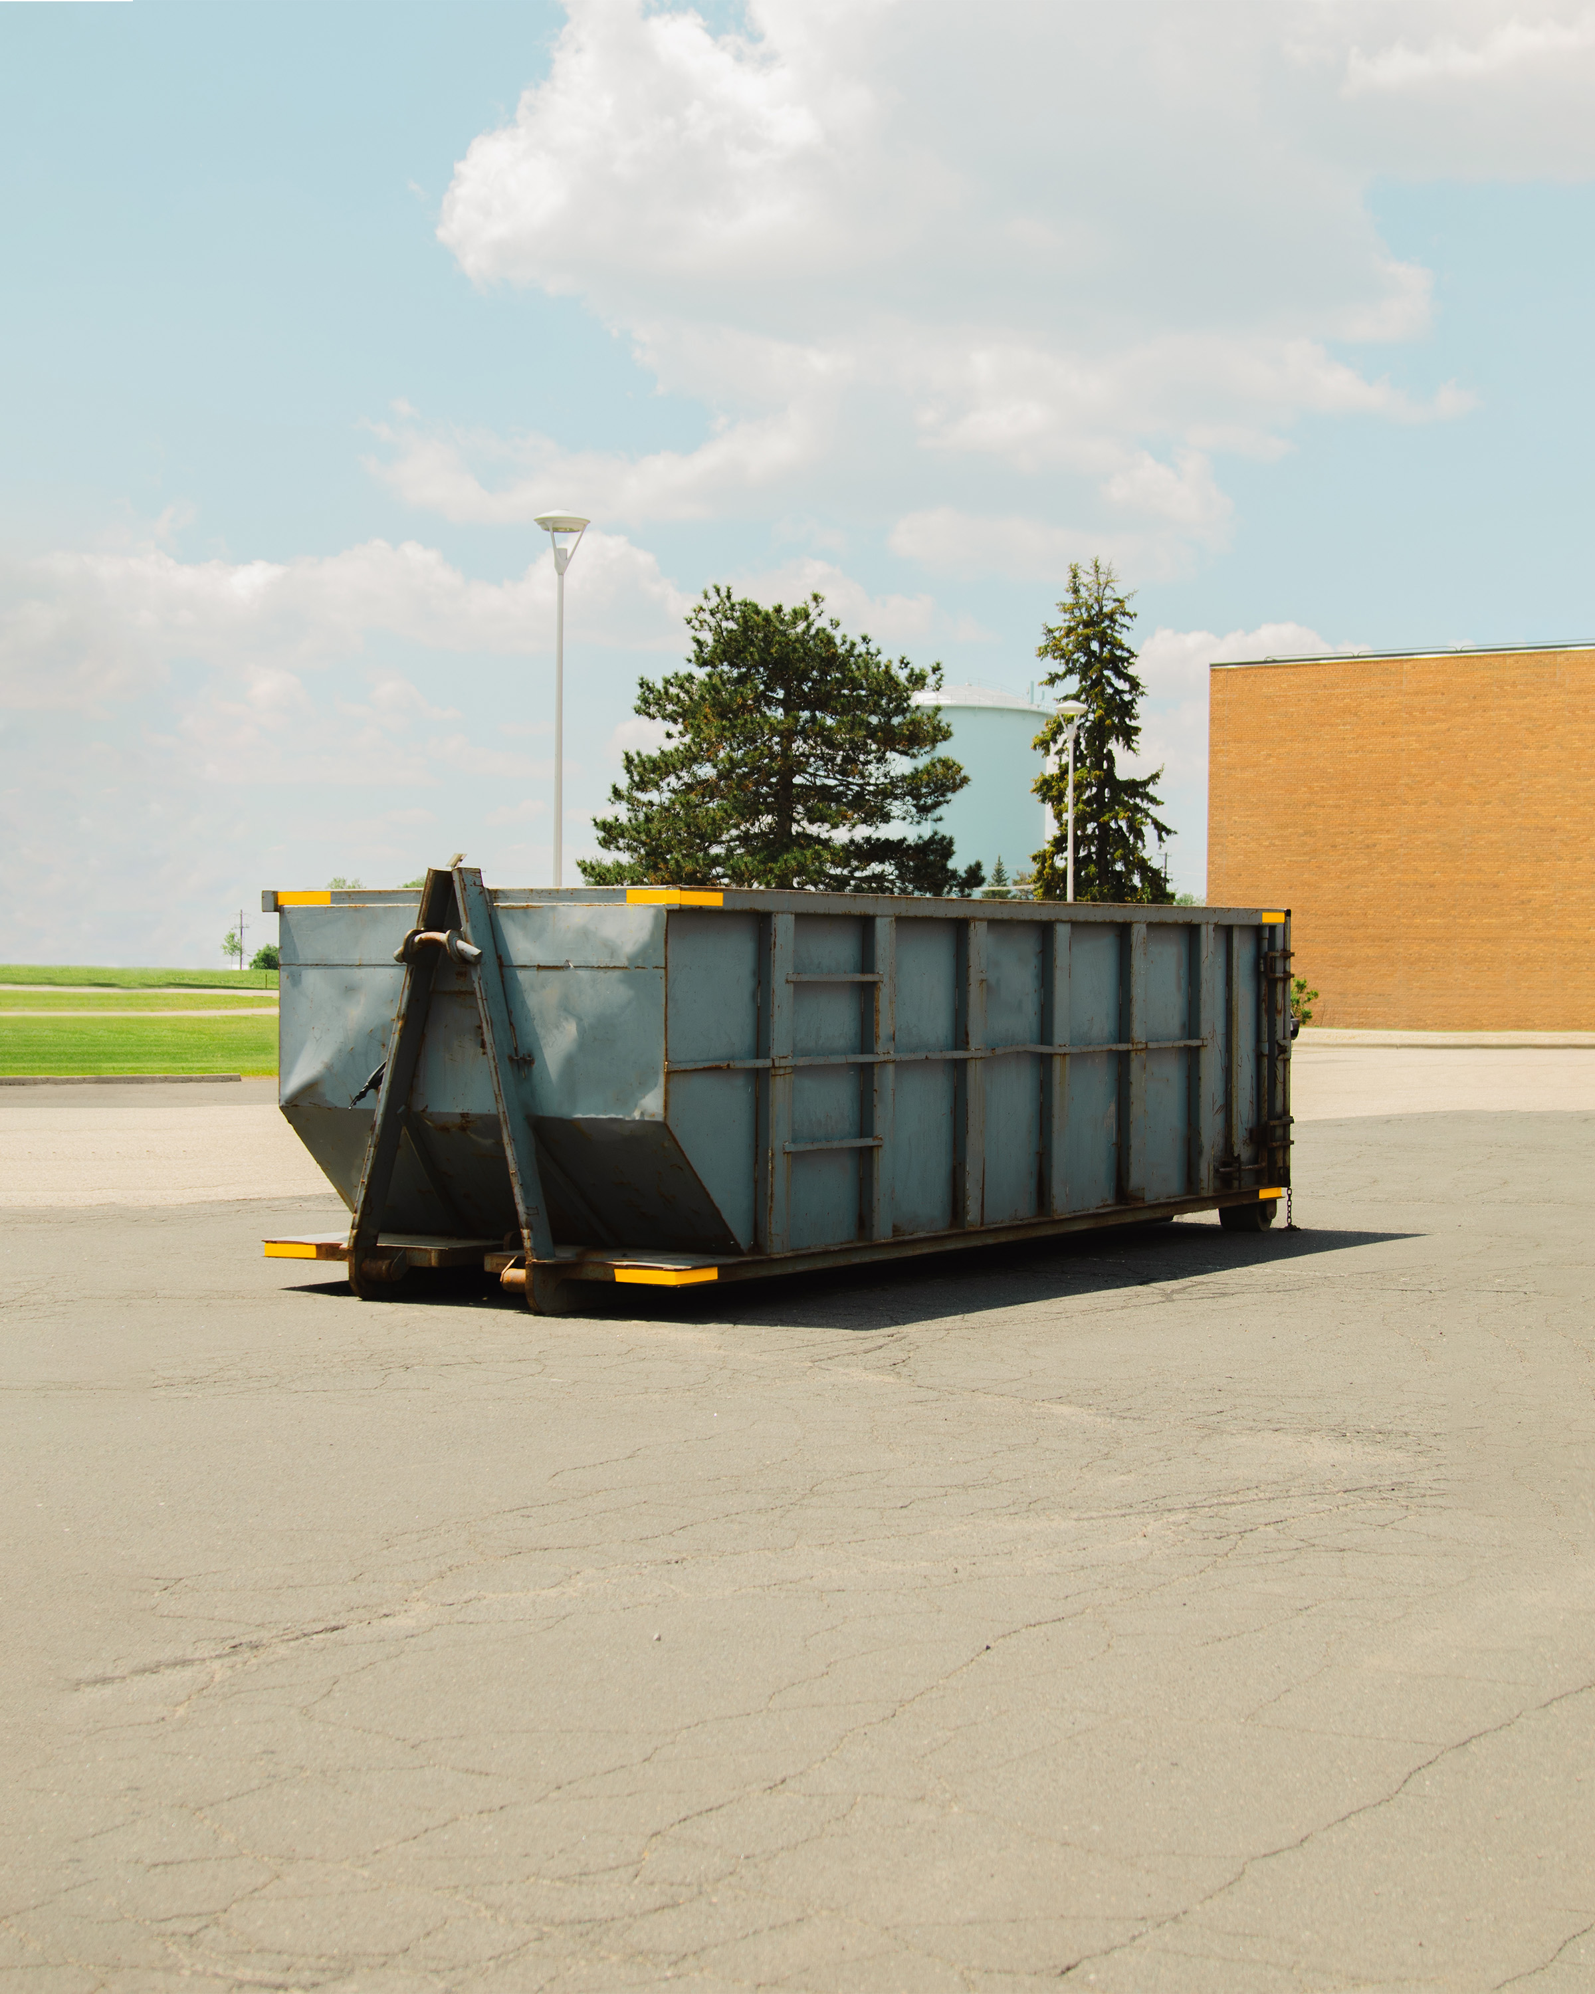
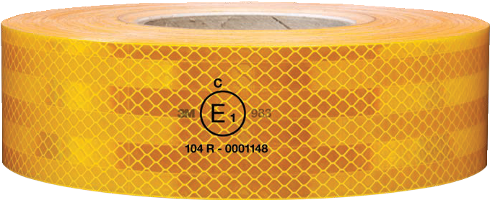
Give trash receptacles and storage containers outstanding visibility.
3M™ Diamond Grade™ Conspicuity Markings 983-21.
Visibility is key to helping prevent accidents. Trash receptacles and storage containers are virtually invisible at night, making these large and solid objects a danger to road users. Adding reflectivity can lead to fewer crashes, injuries and fatalities on our roads ¹.
Sustituir la cinta Reflectiva
basado en su vida útil
podría impedir alrededor de
481 choques, 3 muertes y
16 lesiones graves en la
carretera por año. Esto suma
un estimado de $1.5 millones
de euros ($1.7Musd) en
ahorros y beneficios.
Fuente: FMCSA. Costos unitarios de los choques de camiones medianos y pesados. Marzo de 2007

Slide 2
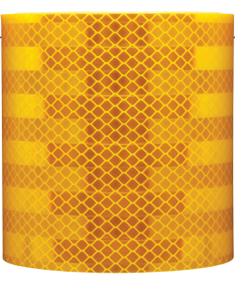
On track to get notice.
Providing better visual information to drivers helps them to detect stationary objects and make decisions faster.
3M™ Conspicuity Markings do just that.
3M Conspicuity markings series 983 provides high brightness and their fluorescent yellow color helps to improve 24/7 visibility. They feature superior weathering performance and show the least variability in brightness due to weathering ².
Senate Bill No. 806, Chapter 722.
Approved by Governor October 10, 2023.
Effective January 1st , 2025: Requires that a manufacturer - who sells or provides for compensation a trash receptacle, or storage container that is designed to be placed on a roadway or the curb of a roadway - to mark the trash receptacle or storage with a reflector on each side with fluorescent yellow reflective strips, made of high-performance retroreflective sheeting of American Society for Testing and Materials (ASTM) D4956-13 Type IX. At least 6” wide and 4” long, placed vertically over each corner of the container. ³
983-21 Conspicuity Construction: durable and rigid, with aggressive adhesion and 10-years warranty.
NHTSA. The Effectiveness of Retroreflective Tape on Heavy Trailers. 2001
Compared to markings from select manufacturers (DOT-C2 regulated marking colors), *Xe Arc Test as per ASTM D4956-19 Method 1
Health and Safety Code (HSC), Section 26275. Senate Bill No. 806
Increase your visibility at 3M.com/Conspicuity
Sustituir la cinta Reflectiva
basado en su vida útil
podría impedir alrededor de
481 choques, 3 muertes y
16 lesiones graves en la
carretera por año. Esto suma
un estimado de $1.5 millones
de euros ($1.7Musd) en
ahorros y beneficios.
Commercial Branding and Transportation Division
3M Center, Building 223-3N-33
St. Paul, MN 55144-1000
1-800-553-1380
3M and Diamond Grade are trademarks of 3M. All other trademarks are property of their respective owners.
© 3M 2024. All rights reserved.
Fuente: FMCSA. Costos unitarios de los choques de camiones medianos y pesados. Marzo de 2007

