Slide 1
Microfluidics & Diagnostics
Global Portfolio
Converting Partners
Notes:
1865906 - Shutterstock ID 1495891703

Slide 2
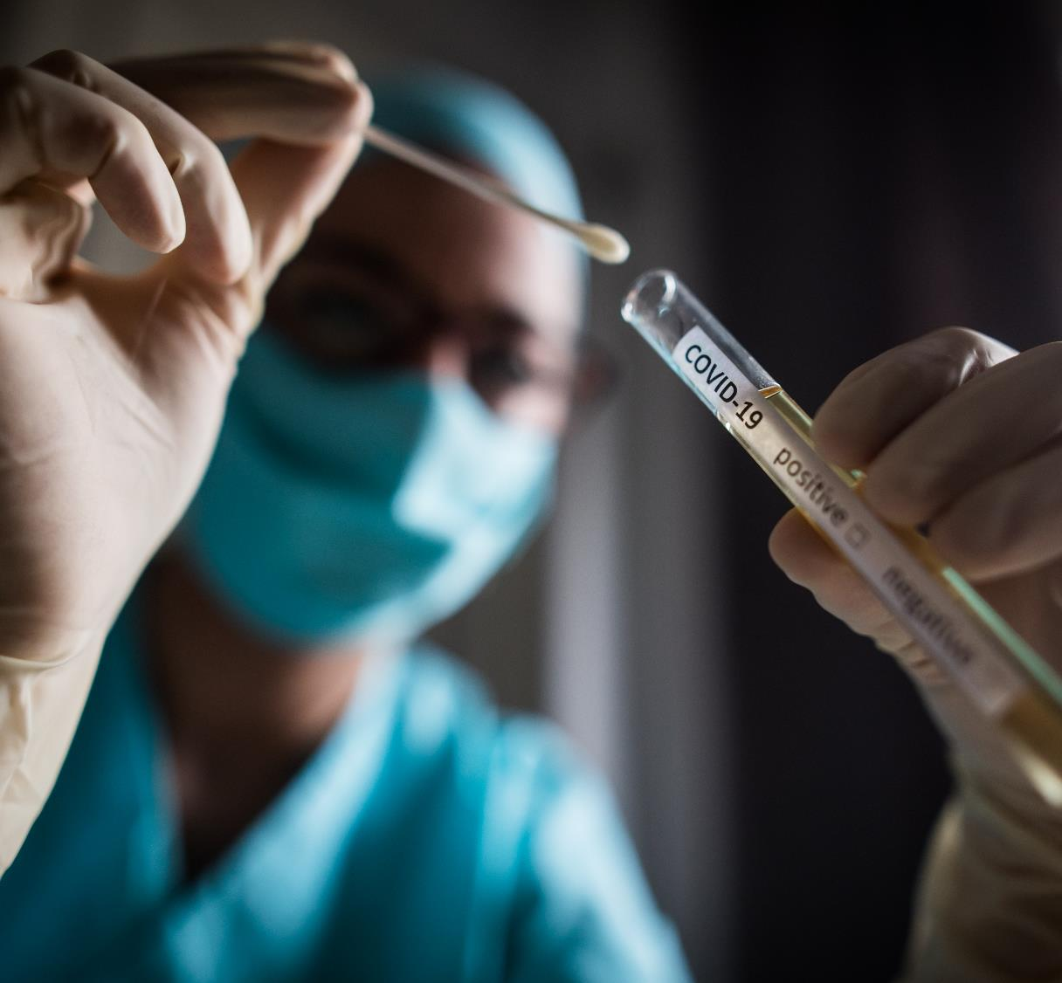
Improve lives in ways big and small.
Point of care diagnostic solutions from 3M
With 55 years of healthcare industry experience, 3M is uniquely positioned to help you design and manufacture diagnostic tests that incorporate microfluidics.
Notes:
Celum ID: 1900417 - AdobeStock_332761044
Why does your topic matter?
You create lifesaving technology. The from small single use blood glucose test strips to large intricate designs requiring next level sophistication and new microfluidic materials your designs enable those effected by disease or living with chronic conditions such as diabetes to make life-sustaining decisions while maintaining their independence and active lifestyles.
We are (re)imaging the materials and design requirements of the next small diagnostic devices and how 3M Science can come to the aid of device designers across the globe. Healthcare is changing rapidly with diagnosis and screening technologies needing to be ever more fast and accurate at the point of need. Chronic disease management such as diabetes that is impacting100’s of millions of lives daily are consistent drum beat. Additionally infectious disease outbreaks such as Corona, SARS, MERS, along the more common seasonal flu require high volume and rapid screening to contain and treat outbreaks.
Speed, accuracy, and availability at the point of need is critical to disease management
3M Medtech materials are used everyday in a multitude of applications to bring aid and treatment to patients across the globe and industry.
Common in every microfluidic device fluid needs to move as a minimum from point A to point B. In more complex Lab on a Chip (LOC) multipoint reactions fluid may need to move from A to B via a mixing step and/or a separation step and may need to continue moving to points C for detection.
Sounds simple, right? Maybe so for a one-off prototype but put this into mass production and things just got a lot more complicated.
Sample ports, sample conduits and test chambers must be manufactured to exacting specifications and tolerances, if not, the accuracy of the finished device will be compromised.
Example: some blood glucose test strips rely on timing of the blood flow to the enzyme. If the speed of reaction is not consistent, it will affect accuracy of the reading. Too slow or too fast will result in measurement errors.
In a LOC device there may be an array of tests or assays and multiple sample handling systems requiring an ordered or synchronized reaction, the rate of flow must be tightly controlled for a complete reaction.
Working on a microscale, tens to hundreds of micrometers, means that not so visible properties such as surface energy (hydrophilicity) of the material used in fabrication of the channel becomes amplified.

Slide 3
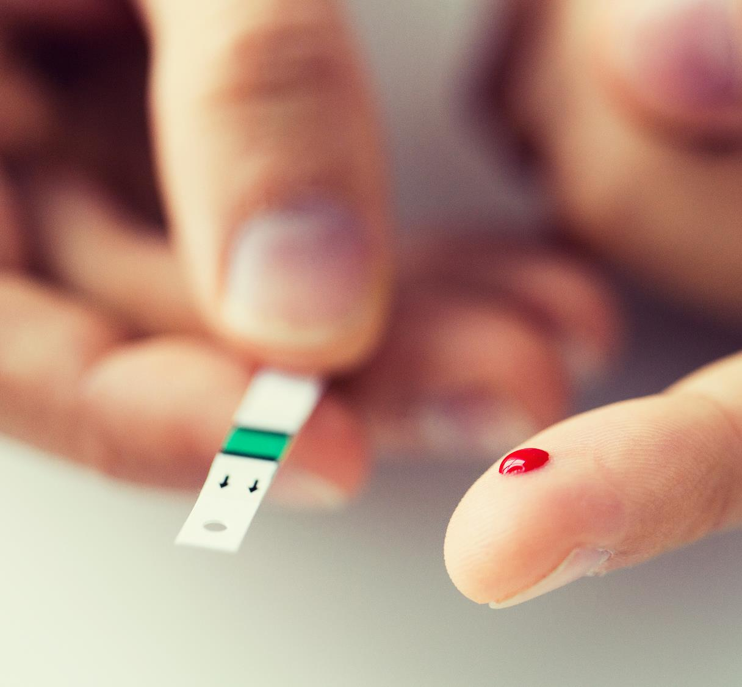
Improve lives in ways big and small.
Microfluidic devices
are important for chronic disease management
If a device does not present results accurately, adverse clinical outcomes may result ranging from life threatening events to severe chronic complications.
Notes:
Celum ID: 1856730 - Shutterstock-ID-564750094.jpg
Why does your topic matter?
You create lifesaving technology. The from small single use blood glucose test strips to large intricate designs requiring next level sophistication and new microfluidic materials your designs enable those effected by disease or living with chronic conditions such as diabetes to make life-sustaining decisions while maintaining their independence and active lifestyles.
We are (re)imaging the materials and design requirements of the next small diagnostic devices and how 3M Science can come to the aid of device designers across the globe. Healthcare is changing rapidly with diagnosis and screening technologies needing to be ever more fast and accurate at the point of need. Chronic disease management such as diabetes that is impacting100’s of millions of lives daily are consistent drum beat. Additionally infectious disease outbreaks such as Corona, SARS, MERS, along the more common seasonal flu require high volume and rapid screening to contain and treat outbreaks.
Speed, accuracy, and availability at the point of need is critical to disease management
3M Medtech materials are used everyday by millions in a multitude of applications to bring aid and treatment to patients across the globe and industry.
Common in every microfluidic device fluid needs to move as a minimum from point A to point B. In more complex Lab on a Chip (LOC) multipoint reactions fluid may need to move from A to B via a mixing step and/or a separation step and may need to continue moving to points C for detection.
Sounds simple, right? Maybe so for a one-off prototype but put this into mass production and things just got a lot more complicated.
Sample ports, sample conduits and test chambers must be manufactured to exacting specifications and tolerances, if not, the accuracy of the finished device will be compromised.
Example: some blood glucose test strips rely on timing of the blood flow to the enzyme. If the speed of reaction is not consistent, it will affect accuracy of the reading. Too slow or too fast will result in measurement errors.
In a LOC device there may be an array of tests or assays and multiple sample handling systems requiring an ordered or synchronized reaction, the rate of flow must be tightly controlled for a complete reaction.
Working on a microscale, tens to hundreds of micrometers, means that not so visible properties such as surface energy (hydrophilicity) of the material used in fabrication of the channel becomes amplified.

Slide 4
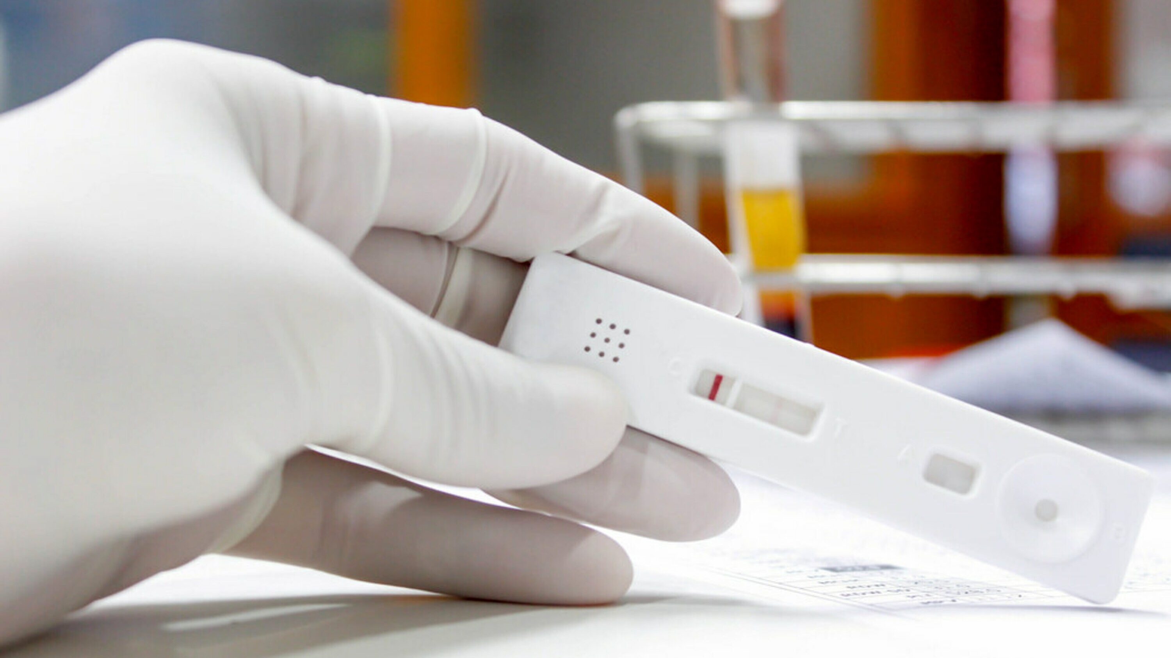
Diagnostics are poised for growth
The pandemic opened our eyes to what diagnostics could do. Elevated consumer expectations; better data integration and more testing units in the field underline the potential for growth
Global Point of Care Diagnostics Market
USD, Billions
+12%
2019
2020
2021
2026
Source: BCC Market Research, Point of Care Diagnostics (HLC043G) 2022
Notes:
Celum ID 1862787
BCC Market Research - HLC043G; Point of Care Diagnostics: Technologies and Global Markets

Slide 5


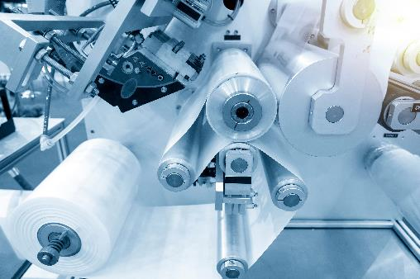
Diagnostics is a demanding market with specific considerations
Material Properties
Compatibility
Manufacturability
Low Fluorescence
Caliper Tolerances
Light Transmission Spectra
Clarity or Haze
Solvent Resistance
Biocompatibility
Thermo Stability
Chemically Inert
Assay Compatible
Die Cutting
Quality Uniformity Control
Traceability
Manufacturing to Scale
Change management
Notes:
Celum image IDs: 932877 - Getty ID 176643185, 927888 - Getty ID 88621116, 1865906 - Shutterstock ID 1495891703
The three main categories critical in design considerations: Material Properties, Compatibility & Manufacturability, but they all need to work together
Materials choices for microfluidic device channels run the gamut from the original silicone and glass materials to today’s polymer-based thermoplastics, elastomers and paper-based membranes. Each has its own advantages and disadvantages depending on the end users’ specific needs and application. Combining materials of different types and bonded together with various technologies like advanced biocompatible adhesives is a great way to produce modern diagnostic devices.
Thermoplastic and paper-based materials have advantages in fabrication for large scale and lower cost production and can be easily integrated into high speed automated systems. The formats lend themselves for web based assembly techniques that can simplify assembly, maintain control of materials, and allow straightforward material management techniques during production.
Paper and cellulose materials have the advantage of lower cost and sustainability, while plastic materials although possibly more expensive, may offer additional benefits in durability, uniformity, strength, chemical resistance and optical transparency.
Advances in robotics, artificial intelligence, 3D printing and laser cutting make these materials well suited for low cost manufacture of complex systems on a microscale.

Slide 6
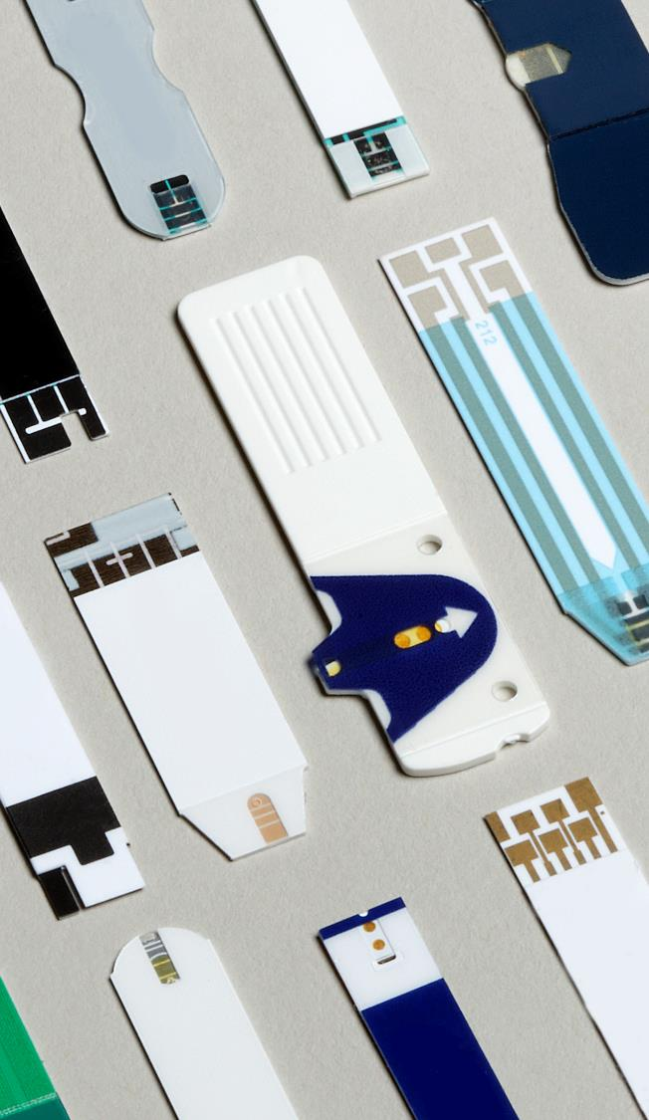
Helping to solve the
customer’s problem
with 3M Science.
Ad
Adhesives
Fi
Films
Notes:
Celum ID: 790802 - Test strips rt.tif
At MedTech we frequently interact with customers engaged in a huge range of applications – blood glucose test strips usually require novel enzymes and electrochemical reactions, molecular diagnostics typically requires fluorescence detection or thermal management requirements. Our partners may present problems or questions pertaining to there specific applications such how is the light is filtered, or if a material surface has a molecule present, a certain roughness, or the ability to bind or capture an reagent.
Discuss how 3M is in a unique position to bring many technologies together to address the needs of our partners – some of the relevant technologies of interest are hilited
Adhesives – liquid or PSA can bond various films and device layers together
Production of films either flat or structured can be used in multiple layers of device product
Microreplication is being deployed to both films and PSA layers to produce capillary channels, wells and vents in very tight tolerances
Surface modification can be used to change the hydrophilicity of a plastic film or produce functional groups available for binding / separation steps
Modeling is being looked at to predict how materials will perform when exposed to stresses or heating and cooling operations
Finally light management in films can be used to filter light, polarize, reflect, or change the direction of light
You could use a story like below to indicate how 3M works across functional groups -
As an individual contributor in the MedTech group, I have knowledge in a diverse subset of technology elements such as adhesives, biomaterials, and films. However, a lot of what I’ve talked about thus far may be outside my realm of expertise. In these system level models or complex designs, we need and use input and expertise from many of 3M’s elements on the periodic table of technologies.
For these types of problems, One routinely needs to characterize the mechanical or optical performance of materials using our world class Analytical Lab. I can call up my buddy Carl and request that he measure the tensile, compression and shear properties or obtain spectra data of the candidate materials being targeted by the analysis. I can ask him to measure those at standard or perhaps more extreme conditions of temperatures or after customer processing.
At 3M we leverage the capabilities and vast expertise across the corporation to solve customers problems and aid in the development of novel diagnostic devices

Slide 7
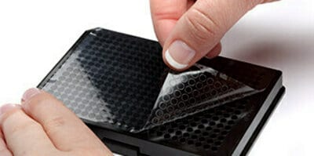
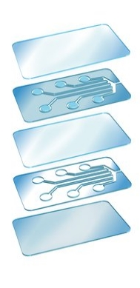
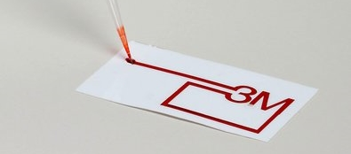
3M™ Microfluidic help device manufactures overcome critical challenges
Aid Fluid Flow
Seal an assembly or chamber
Combined with die cutting to create microfluidic channels
Adhere different layers together
Notes:
Celum image IDs: 954558P – hydrofilm; 2069950 sealing tape; 790826 3M channels, layers 1062031; drop spreading 107484

Slide 8
Connecting People, Ideas and Technologies
Considerations for designing microfluidic devices
What is your application?
What are your design criteria?
Do you have upstream material processing needs or specific material formats for best production?
Will your desired application need to move fluid, mix, or separate a biological sample?
What are the assay / chemistry requirements?
What are the storage and use conditions?
What processing steps for device production such as deposition, drying and do processes involve organic solvents or water?
Have you considered scale up and commercialization needs?
Notes:
Celum image IDs: Shutterstock ID 114863167
Overview of consideration when developing a microfluidic device.
What have we learned is there are many factors that contribute to a microfluidic device. The number one criteria is of course understanding the specific application and how the device materials function and work together in the final design.
Microfluidics is a muti-functional discipline which requires a skilled mastery of several not so simple technologies: fluid management, material properties, precision fabrication, electronic, sensing, and chemical know how. Because the scope of microfluidic device design is vast and the specifics of each device varied you should consider the design requirements carefully and partner with a knowledgeable team of experts.
THERE IS A LOT TO CONSIDER/THINK ABOUT!

Slide 9
3M™ Microfluidic Hydrophilic Film Solutions
Product Family
All 3M™ Hydrophilic films offer….
Single Side without surfactant
(9984)
Single Sided Hydrophilic w/ mask
(9901Pb)
  Hydrophilic performance
  Biocompatibility
  Low autofluorescence
  Optical clarity
  3.9mil backing thickness
  Coating made without surfactant
  Single Sided
  Printable backside
  24 month shelf life
  Pre-mask to protect film during handling
  Single sided hydrophilic coating
  Printable backside
  24 month shelf life
Double Sided Hydrophilic
(9962)
Single Sided Hydrophilic
(9938)
  Two sided hydrophilicity
  Printable
  14 month shelf life
  Single sided hydrophilic coating
  Backside with special coating to prevent coating transfer
  18 month shelf life
Product as supplied in original packaging will maintain stated properties for stated period from date of manufacture when stored in conditions listed on the relevant technical information sheet. Please see website for additional details.
Notes:
Our adhesive categories can be sorted based on the medical device construction and use.
Celum IDs 9984 /9938/9962-2179486; 9901Pb 2179495

Slide 10




3M™ Microfluidic Adhesive Solutions
Product Family
Silicone High Performance
(9980, 9981, 9982)
Silicone Delayed Tack
(9795, 9795T)
  Immediate Tack
  High Bonding Silicone Adhesive
  Adhesion to LSE materials
  Designed for PCR
  Available with PET or Foil backings
  Delayed Tack
  Adhesion bond builds slowly
  Adhesion to LSE materials
  Designed for PCR
  Available in thicker backings for greater structural rigidity
PCAT Acrylic Adhesive
(9969, 9972A)
Acrylic Adhesive
(9792, 9793, 9964, 9965)
  Clean cutting
  Precision controlled thickness
  Designed for high volume assembly
  Adheres to various substrates
  Hydrophobic
  Available with PET or Foil backings
Notes:
Our adhesive categories can be sorted based on the medical device construction and use.
Celum image IDs:
Silicone High Performance: 1087070
Silicone Delayed Tack: 1087070
Acrylic Adhesive (Precision): 1087020
Acrylic Adhesive: 1087069

Slide 11
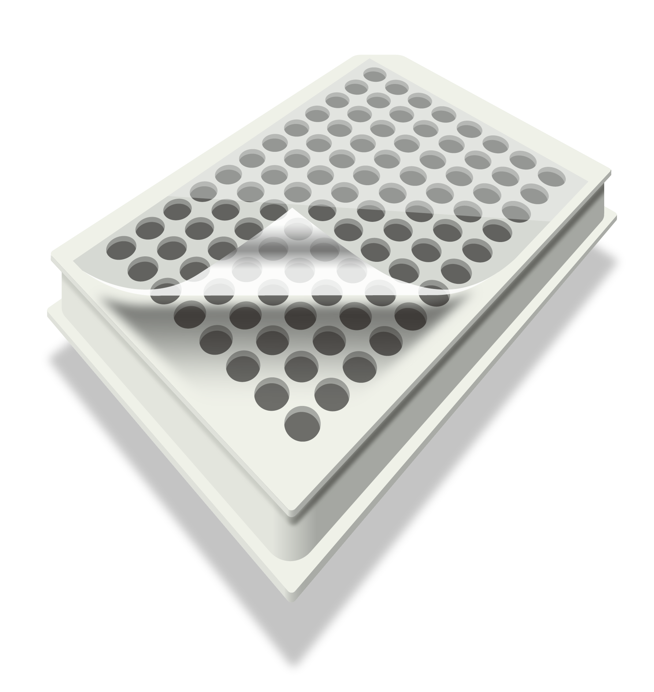
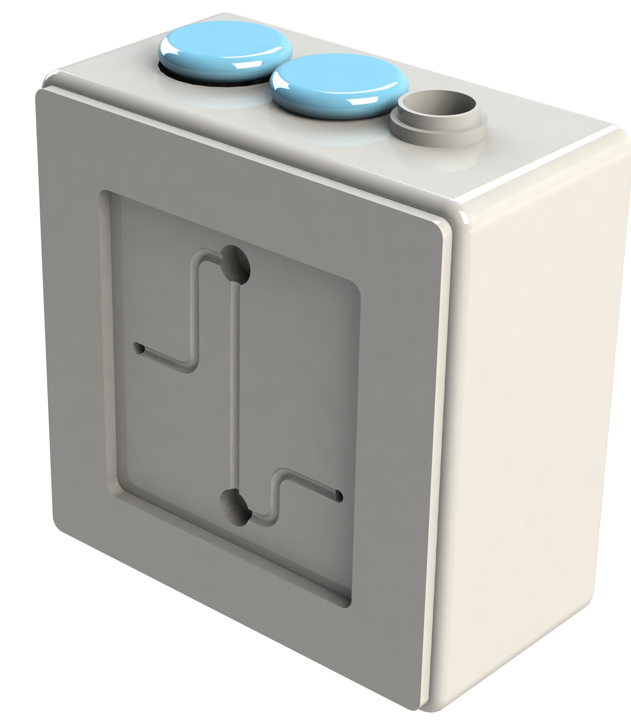
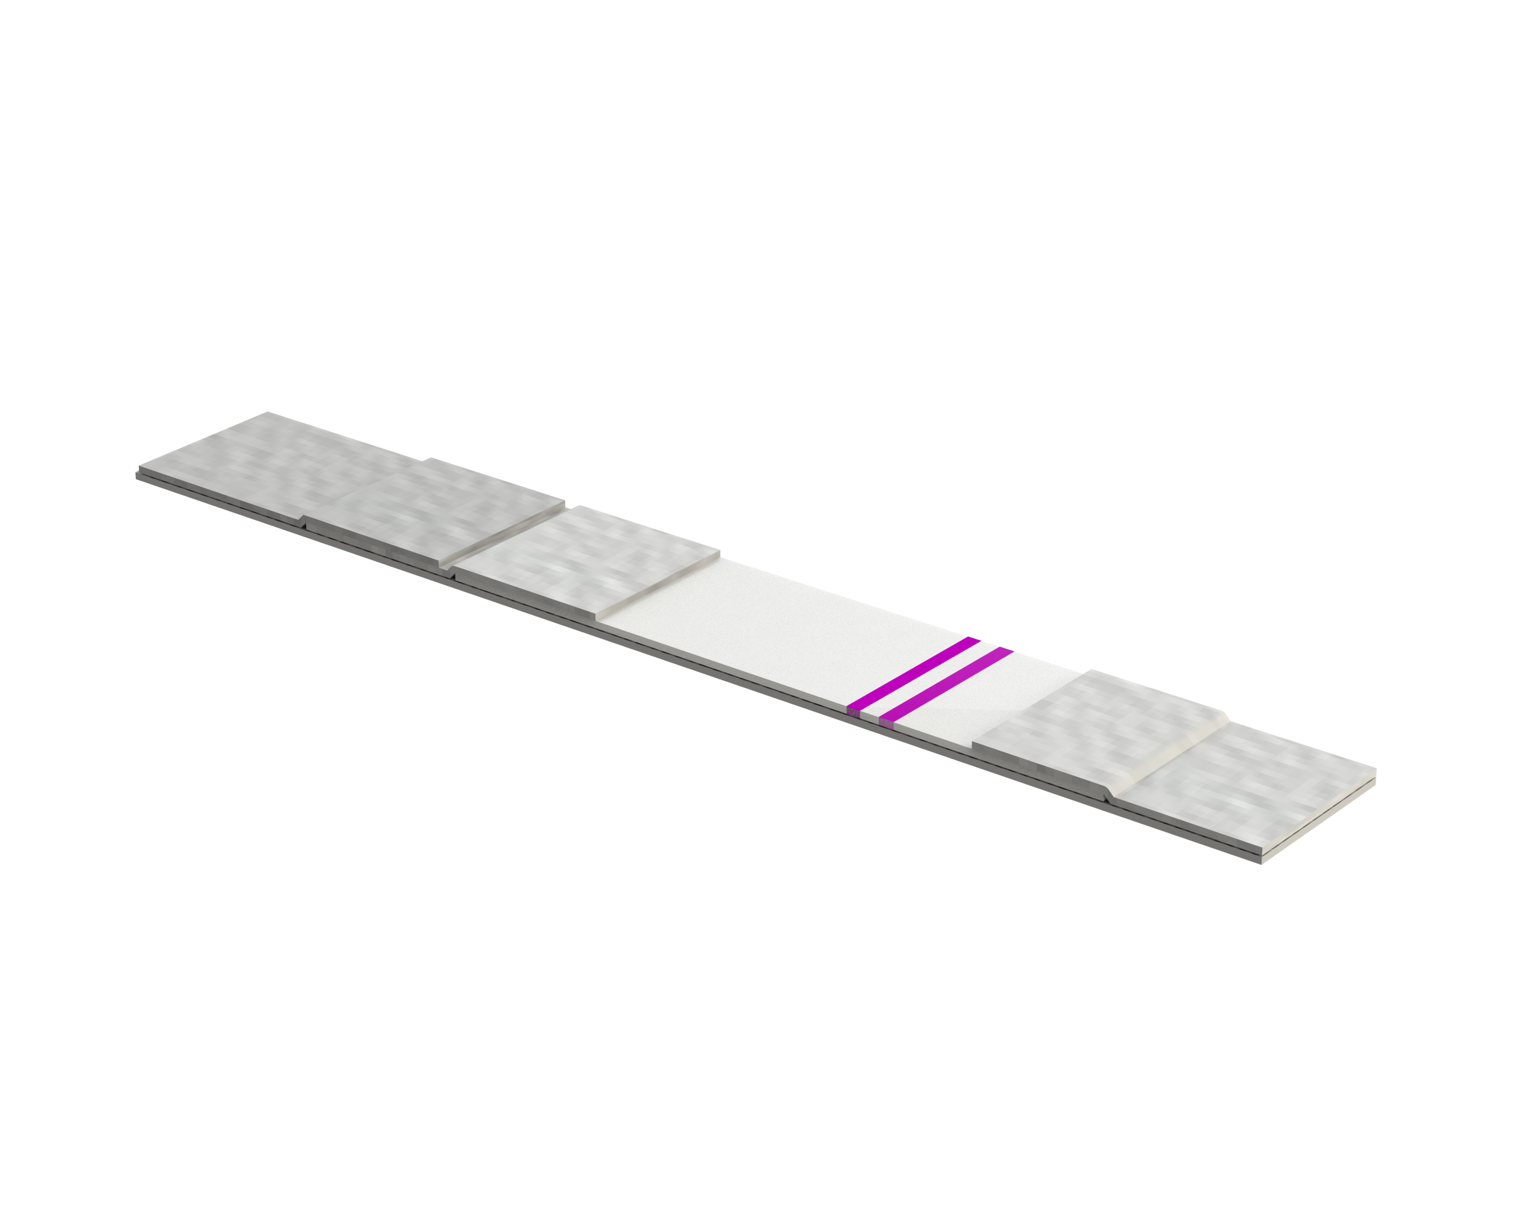
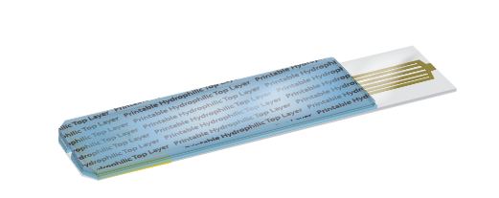
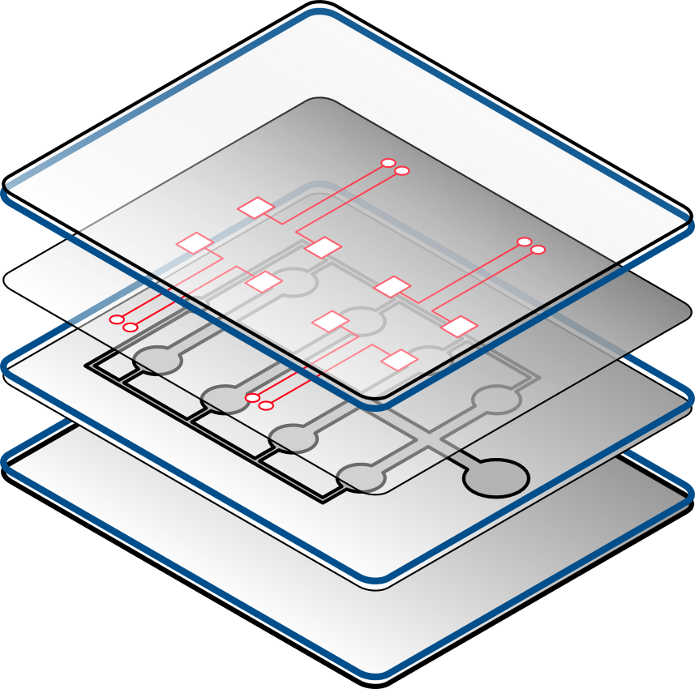
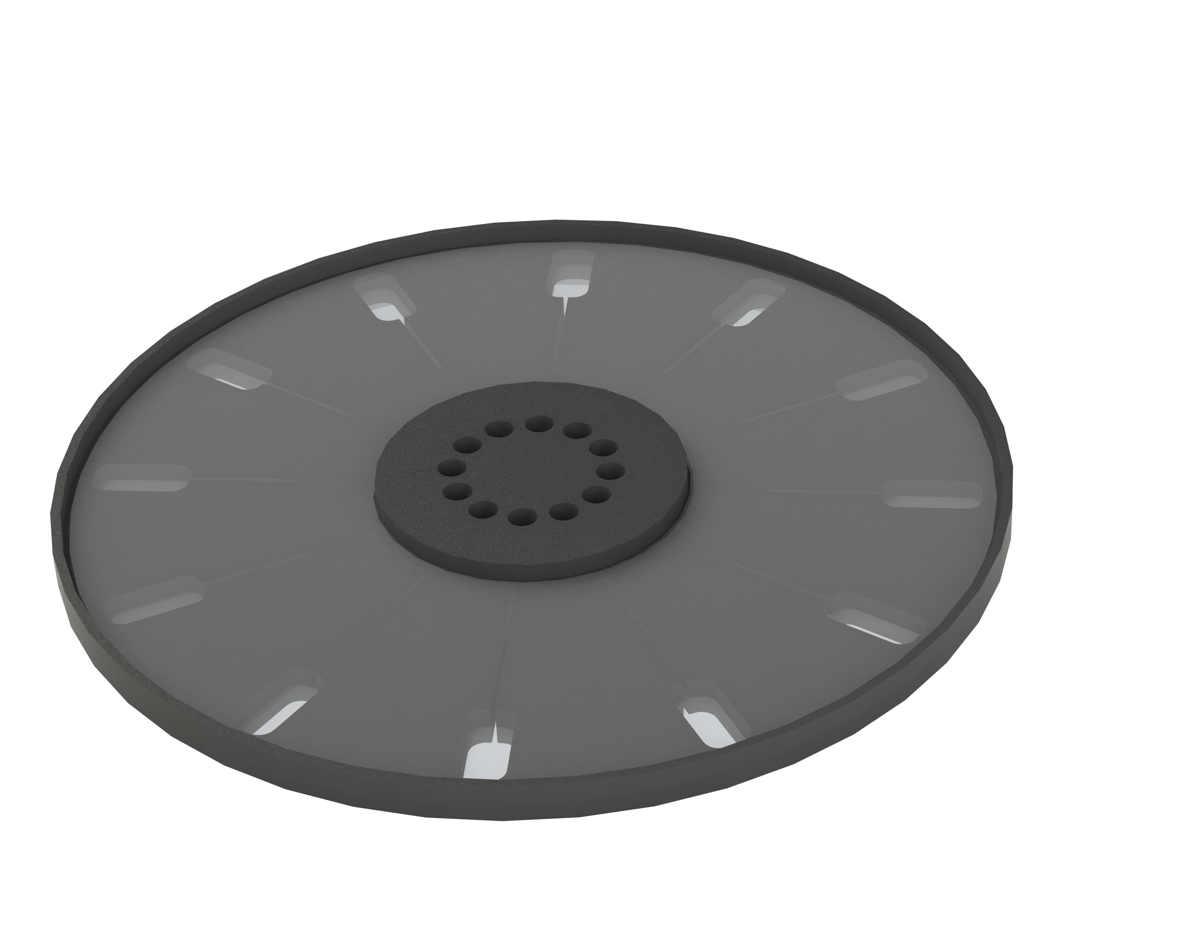
Common Diagnostic Formats
Microtiter Plates
Lateral Flow Strip
Capillary Test Strip
Lab on a Chip
Microfluidic Disc
Molded Cartridge
Lower complexity molded part used for high volume testing
Signal is read by large machines to provide quantitative output
Unlikely to be used outside dedicated labs
Lowest cost, single analyte
Qualitative result is usually provided with on-test visual indication
Often used at point of care outside healthcare setting
Lower cost, single analyte
Quantitative result is provided by a companion palm sized reader
Often used outside a healthcare setting for chronic disease mgmt.
Moderate Cost, multi-analyte
Quantitative result is provided by a desktop sized reader
Possibly used outside clinical lab setting (ex. Doctors office, pharmacist)
Moderate Cost, multi-analyte
Quantitative result is provided by a desktop sized reader with signal amplification
Possibly used outside clinical lab setting (ex. Doctors office, pharmacist)
Moderate/high cost, multi-analyte, may include complex fluidics
Quantitative result is provided by a desktop sized reader with signal amplification
Possibly used outside clinical lab setting (ex. Doctors office, pharmacist)
Where the customer starts might not be where they want to end
Notes:
Microplate: 2178990
Lateral Flow: drawn by Dave Franta, release signed
Capillary Test Strip: 1062032
Lab on a chip: drawn by Dave Franta, release signed
Microfluidic Disk: drawn by Dave Franta, release signed
Molded Cartridge: drawn by Dave Franta, release signed

Slide 12
Microtiter Plate
Basic function
Versatile, standardized vehicle for high volume testing compatible with automated liquid handling equipment. Injection molded plate types may be specialized for the type of assay to be performed. The target analyte is detected usually via a colorimetric or fluorescence indicator dye in solution with the target analyte.
-
Format Key Concerns
-
Relevant 3M materials
3M™ Microfluidic Diagnostic Tapes
  3M™ Microfluidic Diagnostic Tape, 9795, Silicone Adhesive Tape (delayed tack)
  3M™ Microfluidic Diagnostic Tape, 9982, Silicone Adhesive on Tape (hi-bond)
  3M™ Microfluidic Diagnostic Tape, 9792, Single Sided (acrylate on foil)
  3M™ Microfluidic Diagnostic Tape, 9793, Single Sided Clear Polyolefin Tape (acrylate)
1
Material Properties
Compatibility
Manufacturability
Low Fluorescence
Caliper Tolerances
Light Transmission Spectra
Clarity or Haze
Solvent Resistance
Biocompatibility
Thermo Stability
Chemically Inert
Assay Compatible
Die Cutting
Quality Uniformity Control
Traceability
Manufacturing to Scale
Change management
Notes:
Microplate: 2178990

Slide 13
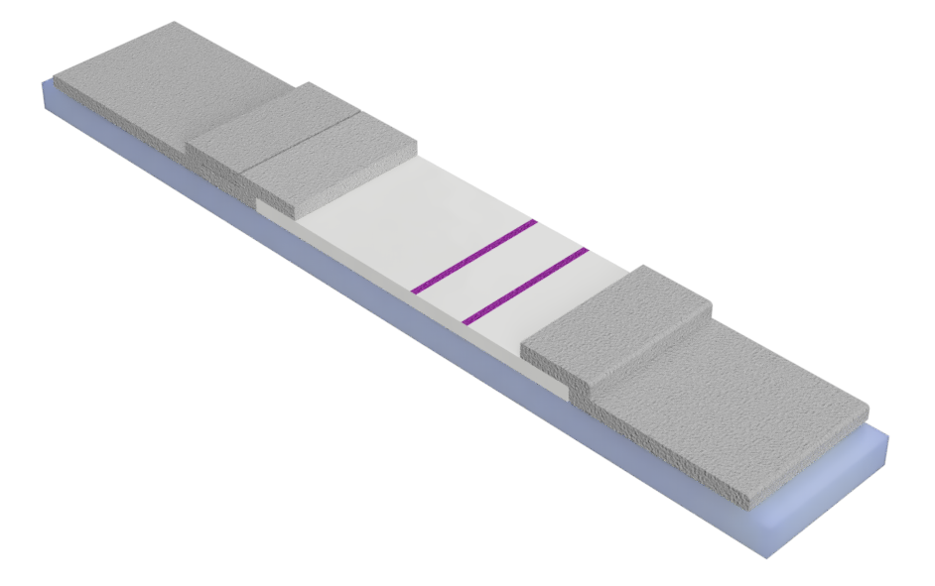
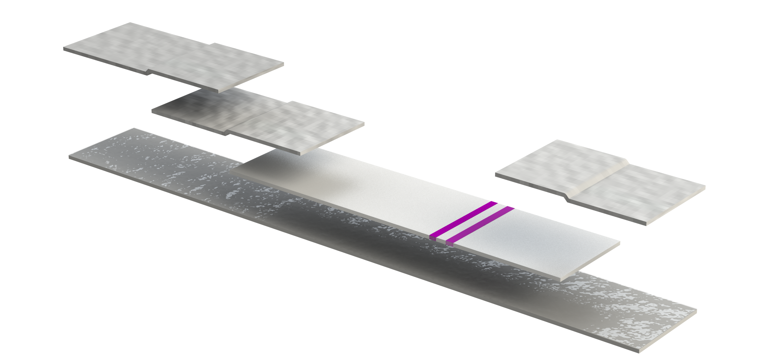
Lateral Flow Test Strip
Basic function
Wicking / membrane materials are used to control the flow of a biological fluid. The target analyte is detected via a colorimetric indicator within a central membrane pad. The devices are widely used and typically very low cost POCT devices
-
Format Key Concerns
Relevant 3M materials
3M™ Microfluidic Diagnostic Tape 9969, Transfer Tape
3M™ Microfluidic Diagnostic Tape 9972A, Thick Spacer Tape
Material Properties
Compatibility
Manufacturability
Low Fluorescence
Caliper Tolerances
Light Transmission Spectra
Clarity or Haze
Solvent Resistance
Biocompatibility
Thermo Stability
Chemically Inert
Assay Compatible
Die Cutting
Quality Uniformity Control
Traceability
Manufacturing to Scale
Change management
1
2
Notes:
drawn by Dave Franta, release signed

Slide 14
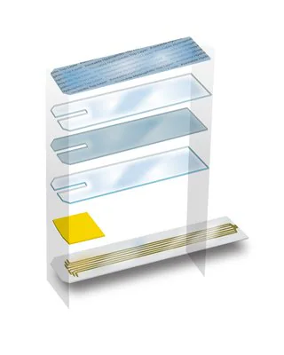
Capillary Test Strip
Basic function
Hydrophilic films and die cut tapes are used to create channels to wick capillary blood into test zone. The target analyte is detected usually via electrochemical measurements with companion meter device to from a system. The devices are widely used and typically low cost POCT devices.
-
Format Key Concerns
Relevant 3M materials
3M™ Microfluidic Diagnostic Films
  3M™ Hydrophilic Polyester Film, 9962, Thin two-sided surfactant coated
  3M™ Microfluidic Diagnostic Film 9984, Clear Hydrophilic Film without surfactant
  3M™ Microfluidic Diagnostic Film 9901Pb, Thin Single-Sided Hydrophilic Film
  3M™ Microfluidic Diagnostic Film 9938, Thin Single-Sided Hydrophilic Film
3M™ Microfluidic Diagnostic Tapes
  3M™ Microfluidic Diagnostic Tape 9969, Transfer Tape
  3M™ Microfluidic Diagnostic Tape 9972A, Thick Spacer Tape
Material Properties
Compatibility
Manufacturability
Low Fluorescence
Caliper Tolerances
Light Transmission Spectra
Clarity or Haze
Solvent Resistance
Biocompatibility
Thermo Stability
Chemically Inert
Assay Compatible
Die Cutting
Quality Uniformity Control
Traceability
Manufacturing to Scale
Change management
1
2
Notes:
Capillary Test Strip: 1062032
Test Strip layers: 1062034

Slide 15
Lab-on-a-Chip
Basic function
Hydrophilic films and die cut tapes are used to create channels to process biologics. The target analyte is detected usually via fluorescence measurements with companion meter device to form a system.
Format Key Concerns
Material Properties
Compatibility
Manufacturability
Low Fluorescence
Caliper Tolerances
Light Transmission Spectra
Clarity or Haze
Solvent Resistance
Biocompatibility
Thermo Stability
Chemically Inert
Assay Compatible
Die Cutting
Quality Uniformity Control
Traceability
Manufacturing to Scale
Change management
1
Relevant 3M materials
3M™ Microfluidic Diagnostic Silicone Tapes
  3M™ Microfluidic Diagnostic Tape, 9795, Silicone Adhesive Tape (delayed tack)
  3M™ Microfluidic Diagnostic Tape, 9982, Silicone Adhesive on Tape (hi-bond)
3M™ Microfluidic Diagnostic Acrylate Tapes
  3M™ Microfluidic Diagnostic Tape 9969, Transfer Tape
  3M™ Microfluidic Diagnostic Tape 9972, Thick Spacer Tape
3M™ Microfluidic Diagnostic Hydrophilic Films
  3M™ Hydrophilic Polyester Film, 9962, Thin two-sided surfactant coated
  3M™ Microfluidic Diagnostic Film 9984, Clear Hydrophilic Film without surfactant
  3M™ Microfluidic Diagnostic Film 9901Pb, Thin Single-Sided Hydrophilic Film
  3M™ Microfluidic Diagnostic Film 9938, Thin Single-Sided Hydrophilic Film
2
3
Notes:
drawn by Dave Franta, release signed

Slide 16
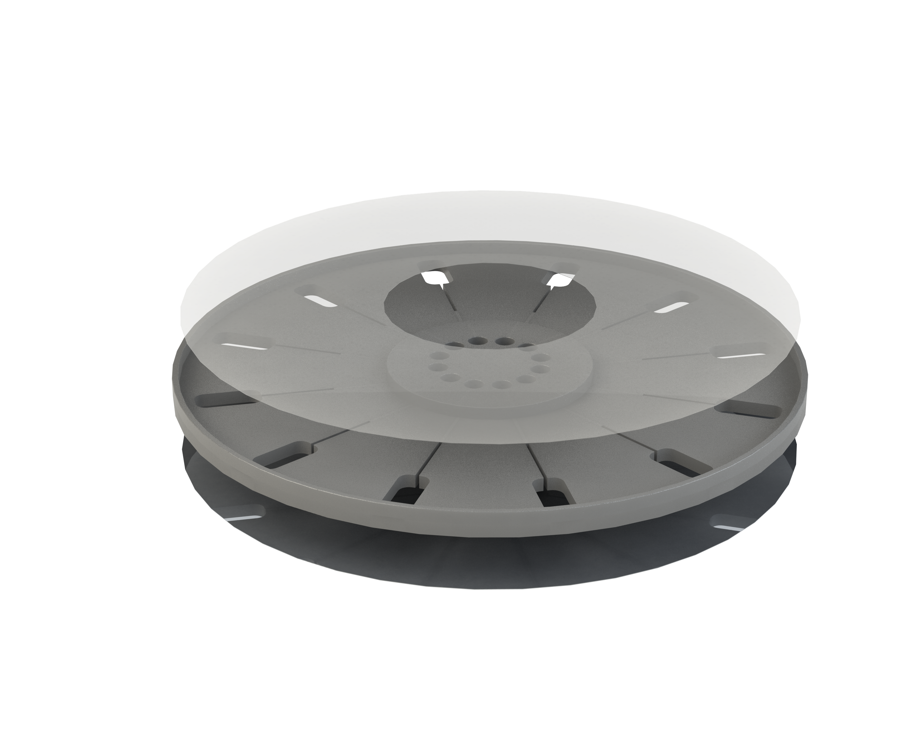
Microfluidic Disk
Basic function
Injection molded components along combined with tapes used to direct fluids, accomplish sample preparation and measurement tasks for one or more assays. Disc functionality can be quite diverse with sophisticated on-board operations to produce a “sample-to-answer” solution.
Format Key Concerns
Material Properties
Compatibility
Manufacturability
Low Fluorescence
Caliper Tolerances
Light Transmission Spectra
Clarity or Haze
Solvent Resistance
Biocompatibility
Thermo Stability
Chemically Inert
Assay Compatible
Die Cutting
Quality Uniformity Control
Traceability
Manufacturing to Scale
Change management
1
Relevant 3M materials
3M™ Microfluidic Diagnostic Tapes
  3M™ Microfluidic Diagnostic Tape, 9795, Silicone Adhesive Tape (delayed tack)
  3M™ Microfluidic Diagnostic Tape, 9982, Silicone Adhesive on Tape (hi-bond)
  3M™ Microfluidic Diagnostic Tape, 9981, Silicone Adhesive on Tape (bright foil)
  3M™ Microfluidic Diagnostic Tape, 9980, Silicone Adhesive on Tape (4 mil foil)
  3M™ Microfluidic Diagnostic Tape, 9792, Single Sided (acrylate on foil)
1
Notes:
drawn by Dave Franta, release signed

Slide 17
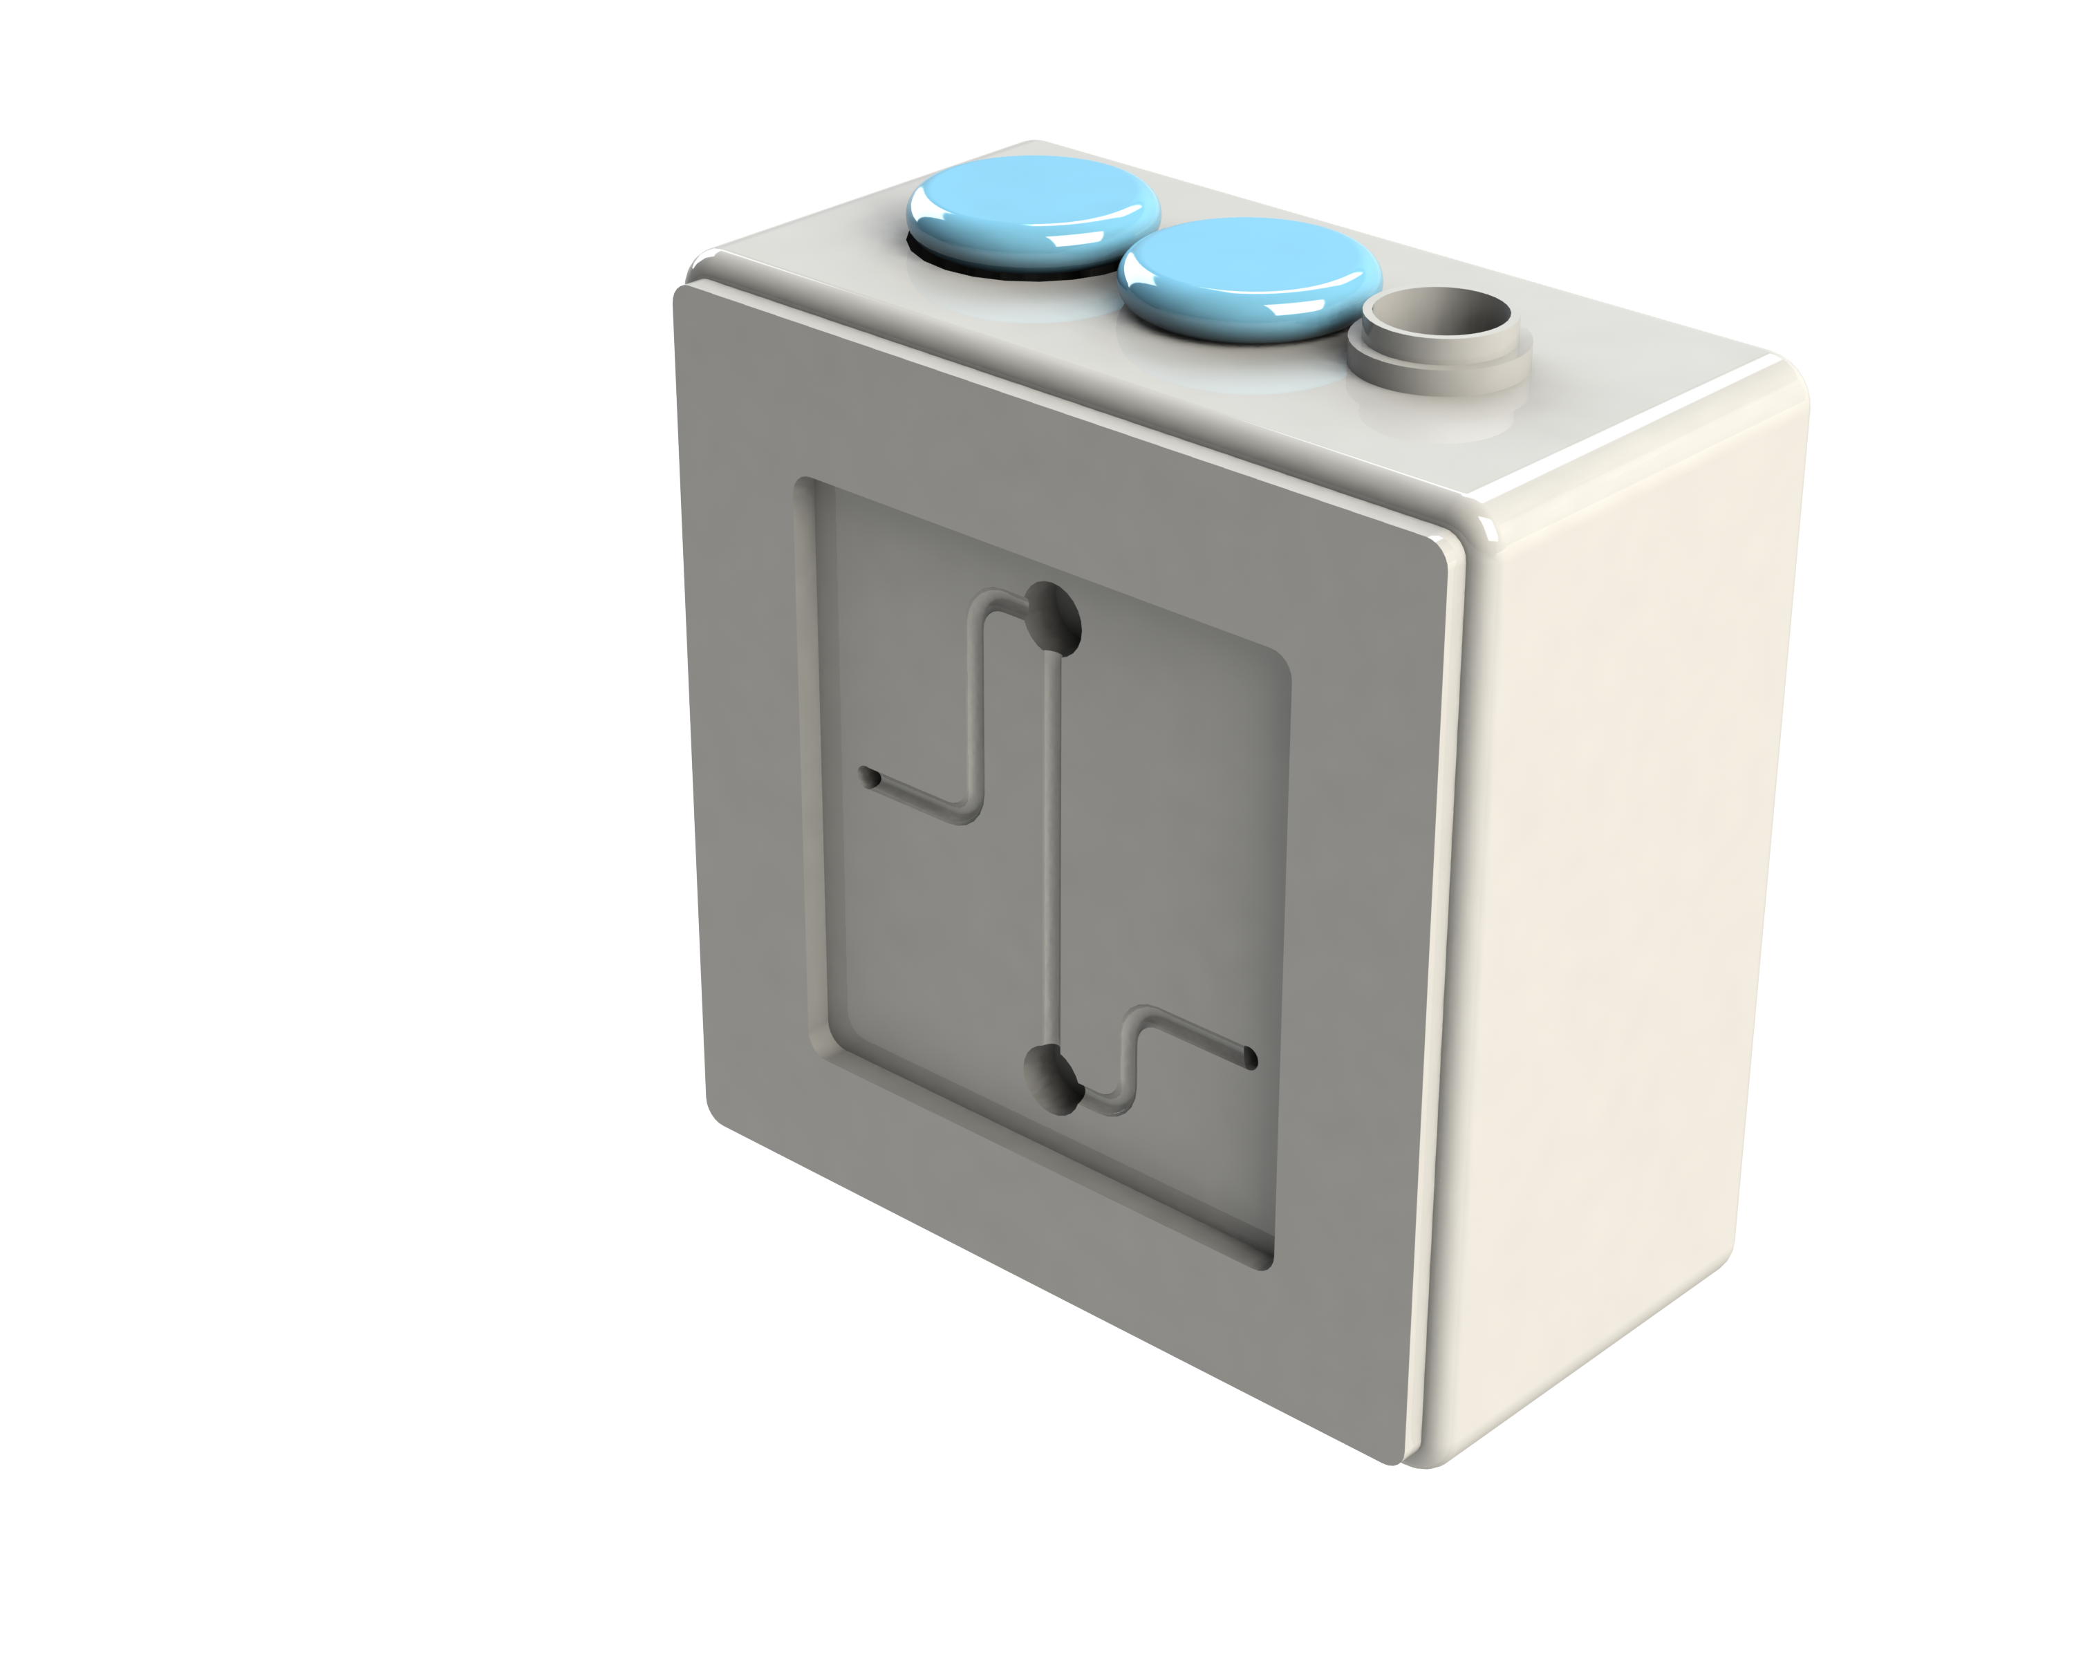
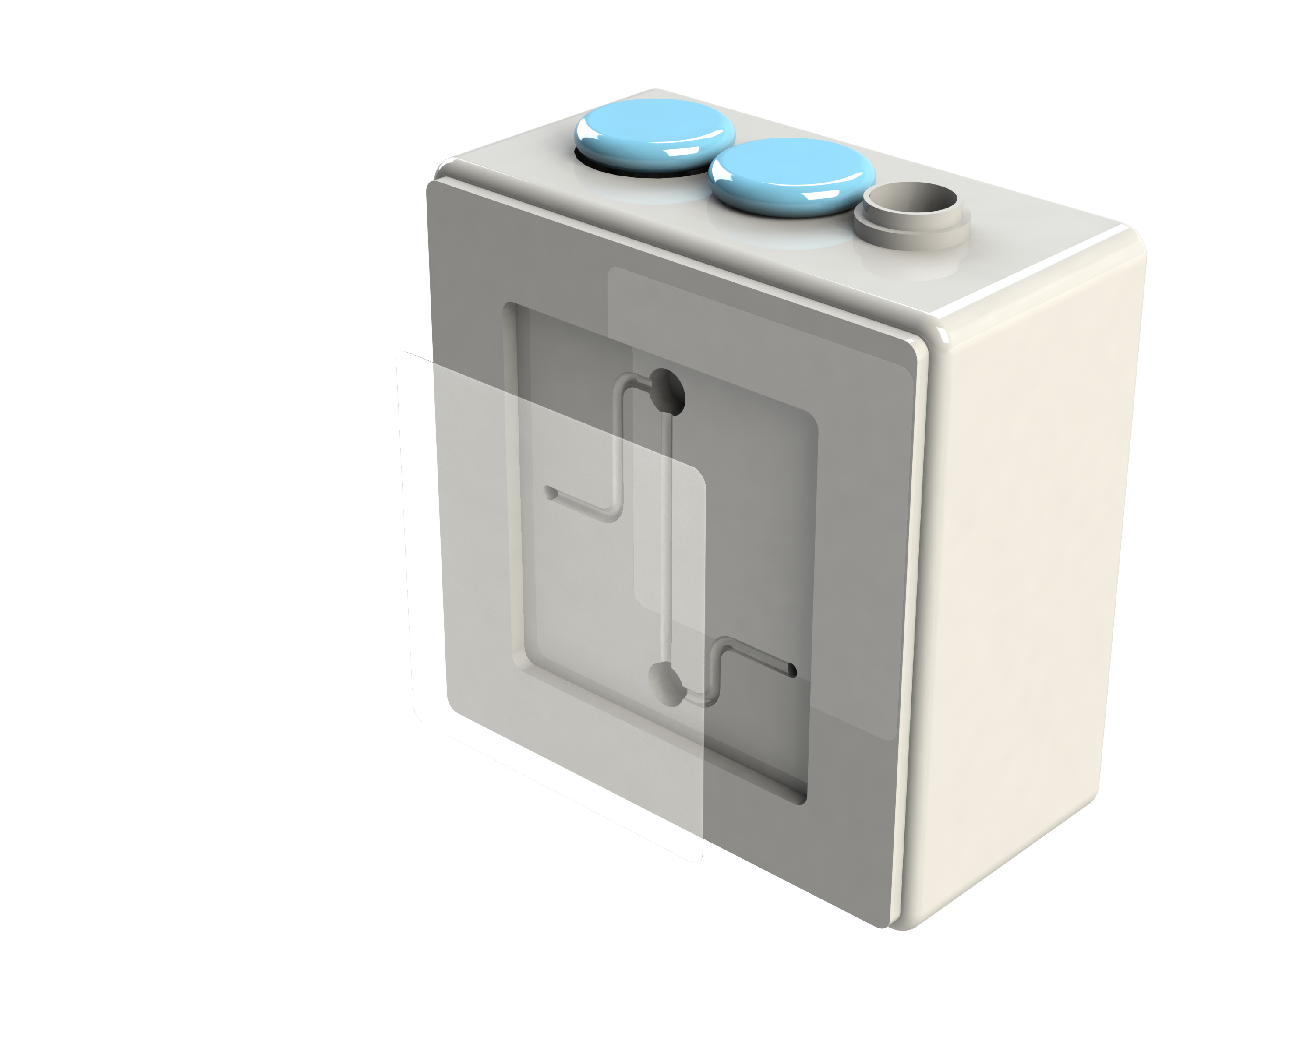
Molded Test Cartridge
Basic function
Injection molded components along combined with adhesives and tapes used to direct fluids, accomplish sample preparation and measurement tasks for one or more assays. Cartridge functionality can be quite diverse with sophisticated on-board operations to produce a “sample-to-answer” solution.
-
Format Key Concerns
Relevant 3M materials
3M™ Microfluidic Diagnostic Tapes
  3M™ Microfluidic Diagnostic Tape 9795, Silicone Adhesive Tape (delayed tack)
  3M™ Microfluidic Diagnostic Tape 9795T, Silicone Adhesive Tape (thick)
  3M™ Microfluidic Diagnostic Tape, 9982, Silicone Adhesive on Tape (hi-bond)
Material Properties
Compatibility
Manufacturability
Low Fluorescence
Caliper Tolerances
Light Transmission Spectra
Clarity or Haze
Solvent Resistance
Biocompatibility
Thermo Stability
Chemically Inert
Assay Compatible
Die Cutting
Quality Uniformity Control
Traceability
Manufacturing to Scale
Change management
1
Notes:
drawn by Dave Franta, release signed

Slide 18
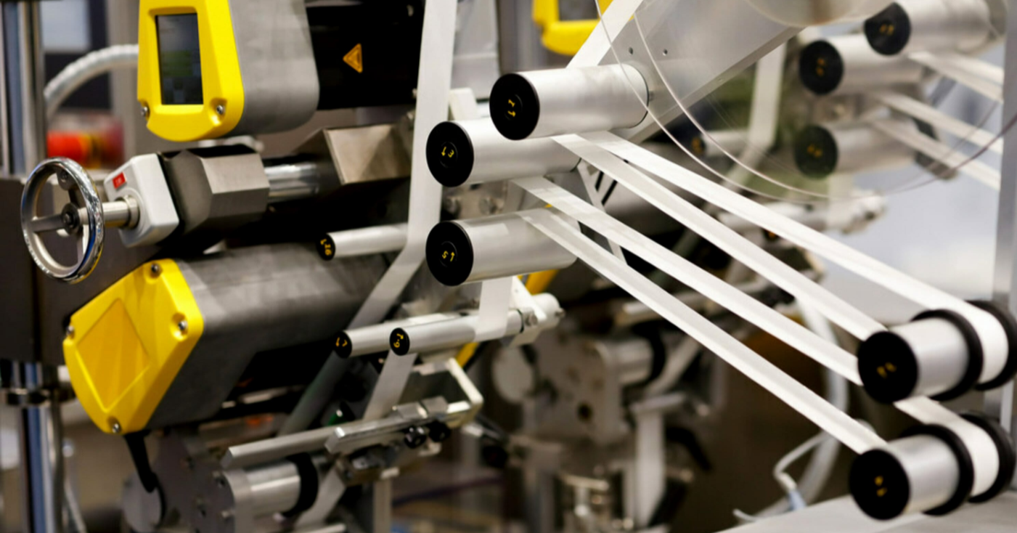
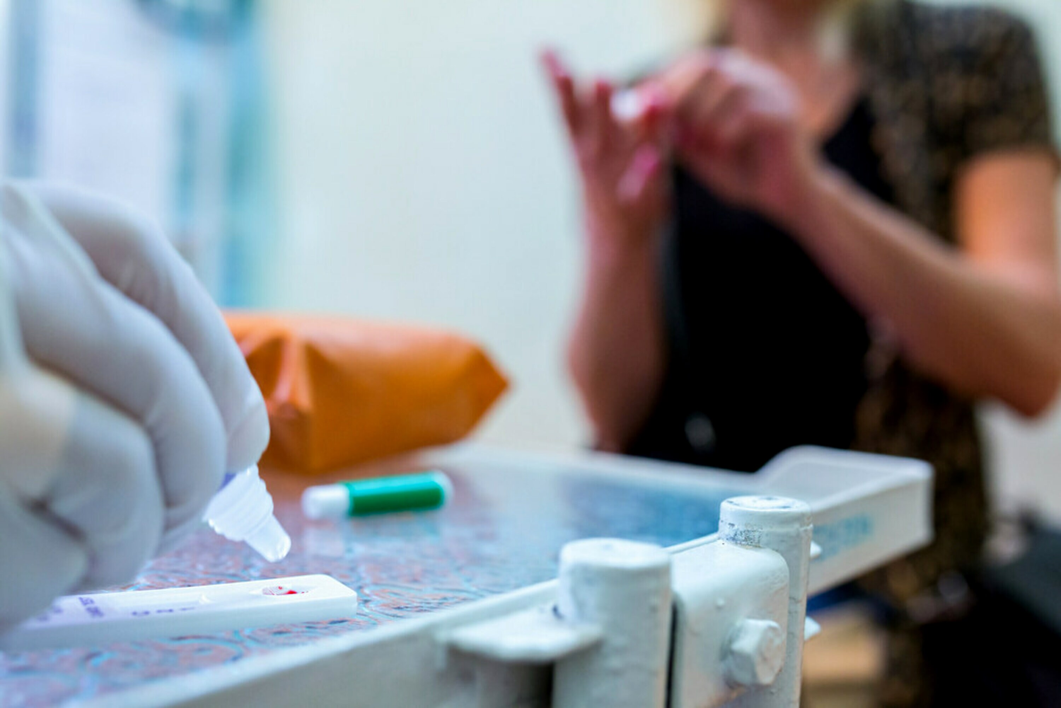

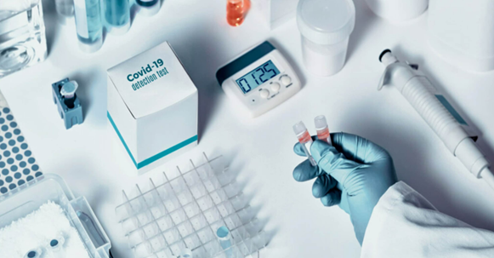
What does 3M Medtech think is next?
More large scale solutions moving towards roll to roll and laminate construction
Rising demand for films with high optical quality
Strong machine placement during the pandemic will provide faster growth for compatible assays
POCT focus shifts from Covid to Sexual Health and bio-markers related to acute conditions (stroke, heart attacks, head injury)
Notes:
Celum ID: Counter clockwise starting at 9
1862889 - Shutterstock-ID-564750094.jpg;
2139623
1862778
1862850

Slide 19

Partner with
3M experts
3M brings decades of science and technology innovation to every project, along with a global network of experts. All our products are manufactured according to strict quality measures.
In addition, we support 3M Preferred Converters for technical expertise. Our goal is to help get your medical device to market.
Ready to collaborate?
Visit FindMyAdhesive.com to get started.
Notes:
Getty-ID-495573540.jpg (ID:1229267) – edited to include Find My Adhesive screen
Why does your topic matter?
You create lifesaving technology. The from small single use blood glucose test strips to large intricate designs requiring next level sophistication and new microfluidic materials your designs enable those effected by disease or living with chronic conditions such as diabetes to make life-sustaining decisions while maintaining their independence and active lifestyles.
We are (re)imaging the materials and design requirements of the next small diagnostic devices and how 3M Science can come to the aid of device designers across the globe. Healthcare is changing rapidly with diagnosis and screening technologies needing to be ever more fast and accurate at the point of need. Chronic disease management such as diabetes that is impacting100’s of millions of lives daily are consistent drum beat. Additionally infectious disease outbreaks such as Corona, SARS, MERS, along the more common seasonal flu require high volume and rapid screening to contain and treat outbreaks.
Speed, accuracy, and availability at the point of need is critical to disease management
3M Medtech materials are used everyday by millions in a multitude of applications to bring aid and treatment to patients across the globe and industry.
Common in every microfluidic device fluid needs to move as a minimum from point A to point B. In more complex Lab on a Chip (LOC) multipoint reactions fluid may need to move from A to B via a mixing step and/or a separation step and may need to continue moving to points C for detection.
Sounds simple, right? Maybe so for a one-off prototype but put this into mass production and things just got a lot more complicated.
Sample ports, sample conduits and test chambers must be manufactured to exacting specifications and tolerances, if not, the accuracy of the finished device will be compromised.
Example: some blood glucose test strips rely on timing of the blood flow to the enzyme. If the speed of reaction is not consistent, it will affect accuracy of the reading. Too slow or too fast will result in measurement errors.
In a LOC device there may be an array of tests or assays and multiple sample handling systems requiring an ordered or synchronized reaction, the rate of flow must be tightly controlled for a complete reaction.
Working on a microscale, tens to hundreds of micrometers, means that not so visible properties such as surface energy (hydrophilicity) of the material used in fabrication of the channel becomes amplified.

Slide 20

Thank you
Learn more:
www.3M.com/ScienceBehindtheStrip
Notes:
Celum image IDs: 1036092, 980592
Insert photo and link to whitepaper or landing page

