Slide 2
Notes:
Part of our transformation journey is deploying our new global Enterprise Resource Planning system. This new system will be the backbone of our enhanced global operations and:
Connects our systems worldwide, while driving consistency across our operations
Makes it easier for you to transact with us, and elevating the service we provide
Provides increased speed and agility to better respond to your needs
We realize you may have experienced ERP deployments with other suppliers.
To help you understand how our ERP deployment will impact your company, we will walk you through the deployment schedule, share what we have learned from previous deployments, and how specifically we will work with you throughout this process.

Slide 3
3M is transforming our company to deliver superior service, with improved speed and agility to position both of our companies for future growth.
This reference guide highlights key changes you may see as we deploy our ERP. Please review with contacts in your organization such as purchasing, receiving, accounts payable and quality to assess whether any updates are needed to your processes or systems.
Notes:
3M is undergoing a company-wide transformation focused on helping you drive growth. The backbone of this transformation is the implementation of a new ERP (or Enterprise Resource Planning) system which enables our transactions to flow seamlessly.
Our ERP rollout is scheduled over the next several years, beginning with ordering and transactional activities, followed by distribution centers and finally our manufacturing plants.
Communication is critical to our success – we will contact you in advance of any changes

Slide 4
Notes:
This guide focuses on changes you will see to a variety of the documents you receive. Changes that impact multiple documents or transactions have been grouped under process changes.
Some information included on documents comes directly from our shipping sites – either a distribution center or a manufacturing plant. You may see information vary, based on whether the site has implemented ERP. We have noted those instances on the document pages.
This guide can be used in a modular fashion so you can save pages that are more relevant by job function. Therefore you will see key information repeated across the document pages.
Since we have a wide variety of order documents today, we will focus on our future version and the changes you will see on the new format rather than reviewing every field.
You will see many of the same fields repeated on documents throughout the guide. We will focus on just a few key changes on each of those documents.
We have worked diligently to reduce the impact to our customers. However, we encourage you review the information and assess whether you need to make changes to your system or processes.

Slide 5
Notes:
Most things will stay the same – for example, you will continue to see your purchase order across documents and you can use the same product numbers to order. However, you will notice a few changes, particularly to the look of the documents you receive, which will have a more consistent appearance and layout.
You’ll notice the addition of a 10-digit 3M ID number to most documents. You will continue to see the existing 11-digit 3M ID number you use today.
Order timing will now be calculated to a delivery date rather than a ship date.
Invoice numbers are now assigned at time of billing rather than at order entry and there are new numbers applied at order entry and shipping.
We are introducing a new online partner portal called bCom which will allow 24/7 access to order entry and information.
If you order certificates, you will see a change to the format and some changes to the information included on the certificate.
These are a few highlights of changes you will see in this reference guide, designed to help you navigate changes you will see as 3M implements a new order entry system.

Slide 6
Notes:
The document types and key information, such as your purchase order number, remain the same. We have added a few new fields to documents, assigned as the order moves through the system.
Today, invoice numbers are assigned at order entry and appear on all order, shipping and billing documents.
In the future, an order number is assigned at order entry, a delivery number is added to shipping documents such as the packing slip and label, and finally an invoice number is applied at billing.
In addition, 3M is introducing new fields on documents. This reference shows which numbers will appear on each document. You will see that the order number is common across most. Your purchase order number will be applied to all documents as it is today.

Slide 7
Notes:
Non deployed site could be the sites from Pakistan, Saudi Arabia
This page provides additional detail and definitions in case you have a question about a particular field.
Although you will see the addition of a 10-digit 3M ID, you can continue to use the numbers you use today.
Also, note that the numbering system is now based on random assignment of numeric digits, however each begins with a consistent digit for easy recognition. For example, the order number begins with “4” and is assigned when your order is processed. While the delivery number beginning with an “8” is added to each shipment as your order moves to a distribution center or manufacturing site. The assignment of the delivery number to each shipment is similar to how the current 3M invoice number is assigned to each shipment, followed by the invoice number, beginning with “9”.
Your purchase order number will continue to be referenced across documents and in our system.

Slide 8
Notes:
Pick ack time: new ERP the date they order is the date they receive
Order timing will be calculated to a delivery date to make it easier to plan when your order will arrive.
We encourage you to begin using delivery dating as appropriate when communicating to us around your timing requirements.

Slide 9
Notes:
Order status do not appear on order acknowledgments; status is indicated by delivery date

Slide 10
Notes:
The packing list and label formats are not changing in our new system and they reflect a shorter product description field. Therefore, we will continue to use the existing description on the packing list and shipping label, which may differ from the product description on new forms such as the order confirmation, invoice and/or ship notice.
Please note that all other product related information will remain consistent such as UPC, Catalog Number, Customer Part Number and 3M ID Number. Only the product description may vary. This difference is especially important to highlight with areas in your organization where you do a comparison between documents, such as in accounts payable, where comparing billing and shipping documents as an audit occurs when approving payments.

Slide 11
Notes:
Note: Answer : Once Customer Master Info Record (CMIR) set up in SAP, order will flow thru per CMIR conversion.
If missing setup, will follow Stocking UOM
OTC states, they will still receive fax orders. Depending on how the order come in ie not via bCom, the 3m shipping document may not reflect the original order description that they have created in their fax orders.
You may see different unit-of-measure codes on documents as we convert to new codes. For example, you may see the new standard code “CV” used to indicate a billing unit of “case” where we may have previously used CA or CS.
In all instances, you can continue to use the existing codes and be assured that the difference does not affect the quantity you receive.

Slide 12
Notes:
Although shelf life is not changing, you will see a change to how shelf life is displayed. You will now see a specific date of manufacture and a specific expiry date. In some instances when a certificate is received from a deployed site there may be instances when the shelf life expiry date will read “Not Determined”. Refer to the technical data sheet for more information on shelf life.

Slide 13
Notes:
3M is introducing a new online partner portal called bCom where you can place orders, check order status and view other product and pricing information, accessible on a computer, tablet or mobile device. You will receive more information closer to deployment as we communicate your transition or onboarding more specific to your unique experience.

Slide 14
Notes:
Today there are a variety of products that are ordered without predefined characteristics such as size and color. In the future, 3M will have the capability to provide predefined characteristics or options available to choose from for many products.

Slide 15
Notes:
On the order confirmation, notice that the customer account numbers changed. Although your existing account numbers will not be displayed, you can continue using your existing account numbers, for example, on remittances.
The invoice number no longer appears on the order confirmation. Instead, a 3M order number is assigned to all the products on the order confirmation and the invoice number is assigned later during the billing process.

Slide 16
Notes:
Here we note additional changes to the order confirmation. For example, customers will initially see a delivery date listed as, “TBD,” (or to be determined) for products shipping from non-deployed sites. This will be updated once the date is confirmed by the shipping site.

Slide 17
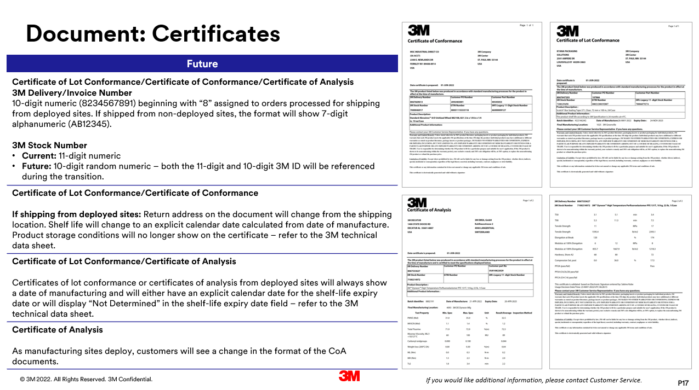
Notes:
Certificates will have a variety of changes depending on which certificate is ordered. You may see that some information may change, such as the return address, or information is added such as delivery number and a new 10-digit 3M ID number, also known as 3M stock number. You will see a change to the format of the expiration date, which will be shown as an explicit date.
Product storage conditions will no longer show on the certificate and in some cases the expiration date will display “Not Determined”. Please refer to the 3M technical data sheet for more information.

Slide 18
Notes:
Both shipping labels and carton labels will show the addition of the 10-digit 3M ID number. The shipping label will also show a delivery number or shipping reference number. Pre-printed labeling will be transitioned over time.

Slide 19
Notes:
Delivery not will remain in the original format but will have additional information such as a shipping reference number and the 10-digit 3M ID number. Note the 3M ID number may be referenced below the product description.
The product description noted on delivery note may vary from the product description shown on order and billing documents. All other product numbers will remain the same to enable you to confirm the correct product is received and billed.

Slide 20
Notes:
New ERP solution will not change format of those road Transportation documents

Slide 21
Notes:
As the order moves to billing, the invoice number is now assigned. The invoice references the order number assigned at order entry, the delivery number assigned at shipping and the invoice number assigned at billing.

Slide 22
Notes:
The suggestion is that we educate the sales people to explain what a deployed site is by naming a country or manufacturing plant.
The customer account numbers are changed. Although your existing account numbers will not be displayed, you can continue using your existing account numbers, for example on remittances.
You may notice that line numbers on our new documents now contain an additional zero, for example lines numbered 1, 2 and 3 will now appear as 10, 20, 30.

Slide 24
Document: Return Goods Authorization
Future
Return Goods Authorization Number Current: GAR does not exist. Future: 10-digit numeric (6234567891) beginning with “6”. Return Goods Authorization”. It is a system generated document that is created automatically and sent to customers only once return is approved and confirmed by 3M. It is not manually created by CIR.
Original Document Reference Invoice Number: Current: 8-digit numeric (12345678), sequential for related shipments or backorders, prefix significant Future: 10-digit numeric (9234567891) beginning with “9”. Randomly assigned, non-sequential.
Unit of Measure Future: Nomenclature for some units of measure may appear differently depending on order placement method, for example electronic, fax, etc.
3M SKU Current: 11-digit numeric Future: 10-digit random numeric – both the 11-digit and 10-digit 3M ID will be referenced during the transition. Customers may continue to use 11-digit 3M ID, UPC, 3M Catalog Number and/or Customer Part Number.
NOTE: Return value will not appear on the Return Goods Authorization document.
New Format
If you would like additional information, please contact Customer Service.
P24
Notes:
The return goods authorization has a new format and reflects new information such as the addition of a 10-digit SKU or 3M ID. Unit of Measure formats may change but do not affect product quantity. Please note that the RGA no longer displays a total return value.

Slide 25
Notes:
The credit and debit memos will contain similar information to the invoice with new fields such as delivery number. Customer account numbers are changed but you may continue to use existing account numbers.

Slide 26
Notes:
Similar to the invoice, the credit memo will reflect a new line numbering format in increments of 10 and Unit of Measure formats may appear differently but do not affect product quantity.

Slide 27
Notes:
On the debit memo the customer account numbers are changed. Although your existing account numbers will not be displayed, you can continue using your existing account numbers, for example, on remittances.

Slide 28
Notes:
The debit memo contains similar changes to the invoice and credit memo, for example, referencing the order number assigned at time of order placement.

