Slide 1
3M™ Clarity™ Aligners Attachments

Slide 2
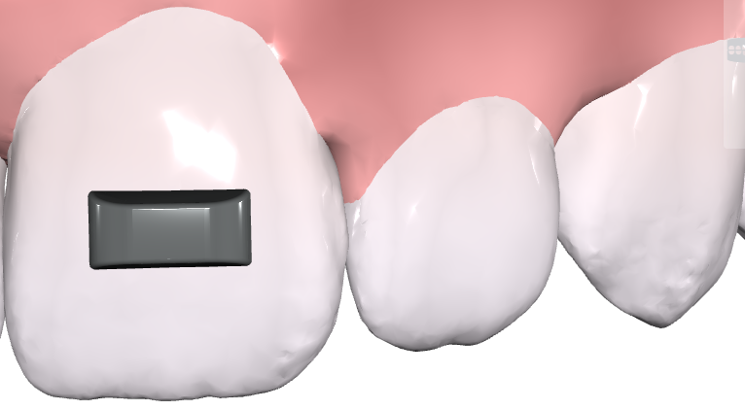
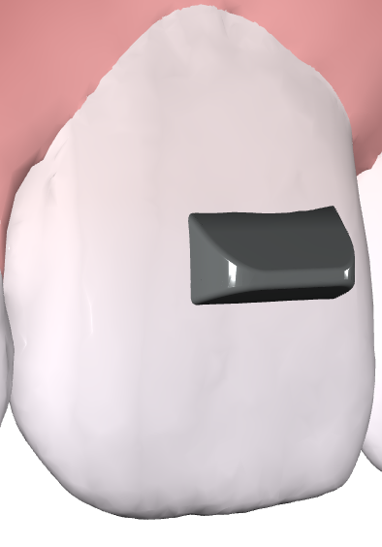
3M™ Clarity™ Aligners: Attachment Options
BAR
BEVEL
Notes:
Speaker Notes:
Slide 2: Clarity Aligners: Attachment Options
Close up of a dental model with tooth and gum, with bar attachment placed.
Close up of a dental model with tooth and gum, with bevel attachment placed.
Clarity Aligners: Attachment Options – Bar and Bevel.
With 3M Clarity Aligners there are two types of attachments. A Bar and a Bevel Attachment. From here, the clinician can customize these attachments in a variety of different ways such as the length, width, and depth of each attachment in the treatment design.

Slide 3
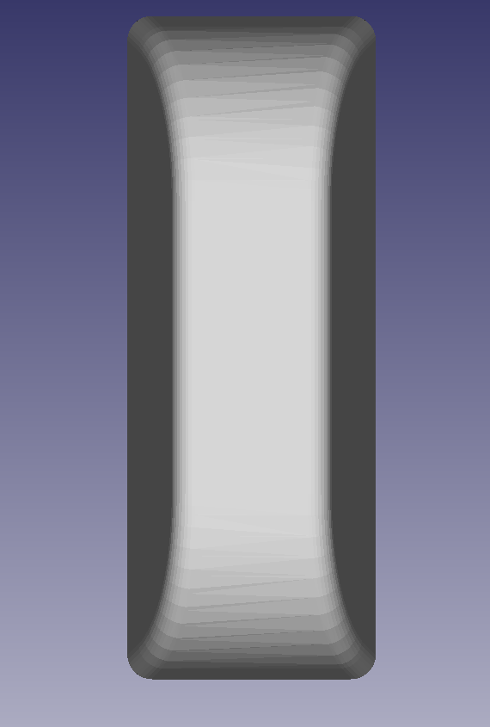
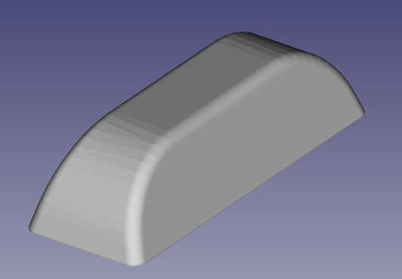
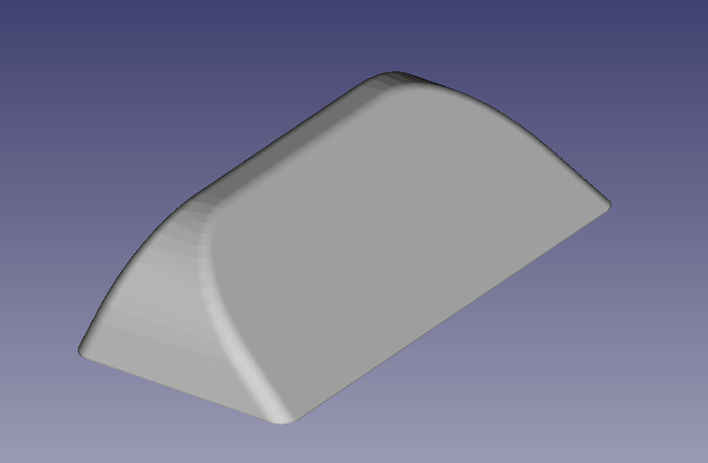
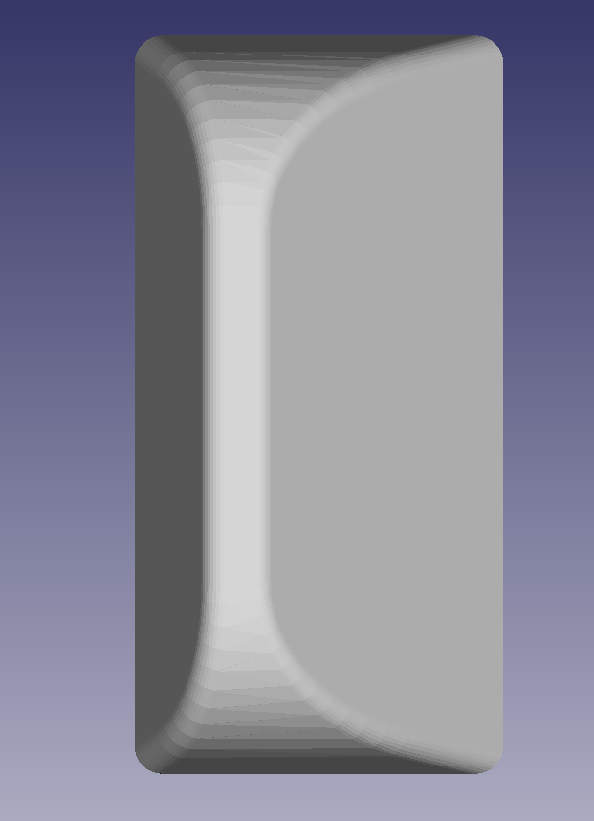
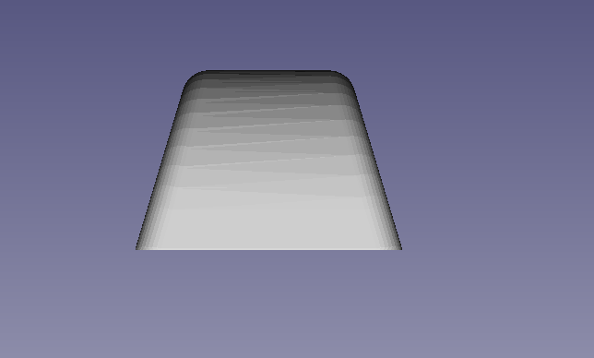
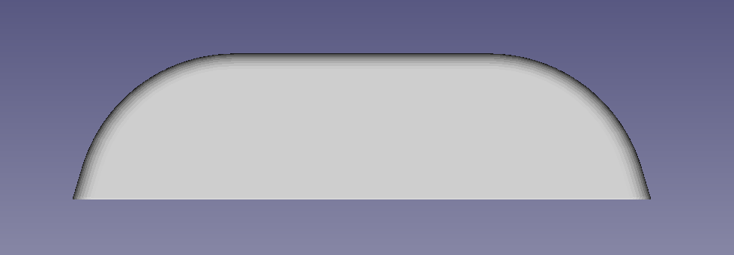
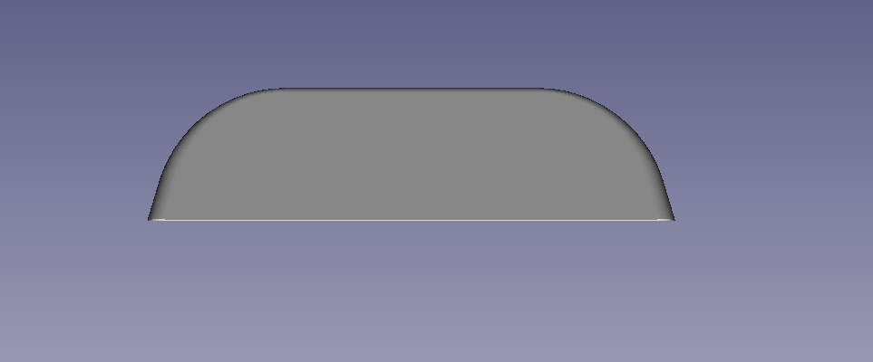
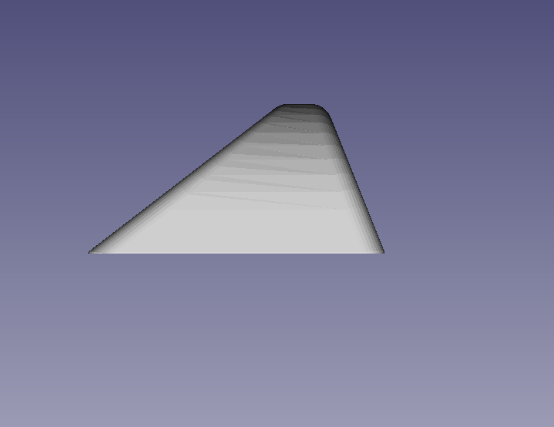
Attachment Design
Attachments are available in two shapes, bar and bevel. The bevel has a sloped surface which is designed to be used as a “pushing surface”. Both the bar and bevel have rounded ends and are customizable with a wide range of lengths, widths, and depths.
Bar
Bevel
Bar
Bevel
Rounded Ends
Pushing Surface
Notes:
Speaker notes:
Slide 3: Attachment Design
Front and side view of a bar attachment.
Font and side view of a bevel attachment.
Four comparison views of bar and bevel attachments. Both have rounded ends, and pushing surfaces.
Attachment Design.
Attachments are available in two shapes, bar and bevel. They differ in that the bevel has a sloped surface which is designed to be used as a “pushing surface”. Both bar and bevel have rounded ends to aid aligner seating when slight misfit occurs. Both are customizable with a wide range of lengths, widths, and heights.

Slide 4
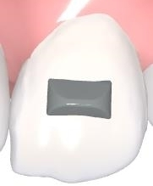
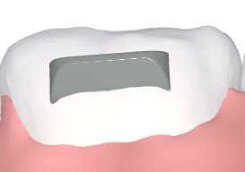
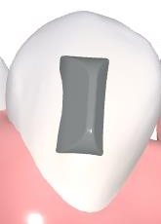
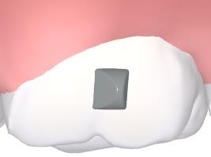
Attachments: Default Location
By default, attachments are centered on the labial/buccal surface of the clinical crown in a horizontal or vertical orientation.
Notes:
Slide 4: Attachments: default location
Close up of a dental model with tooth and gum, with bar attachment placed.
Close up of a dental model with tooth and gum, with centered attachment placed.
Close up of a dental model with tooth and gum, with centered attachment placed.
Close up of a dental model with tooth and gum, with centered attachment placed.
Clarity Aligners: Attachments – Default Location
By default, attachments are centered on the labial or buccal surface of the clinical crown in a horizontal or vertical manner.
Demo Case ID - 973XQC.

Slide 5
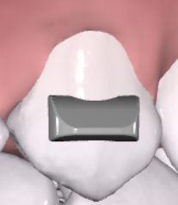
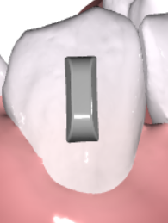
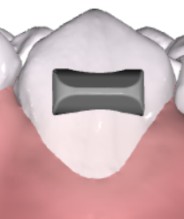
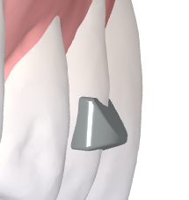
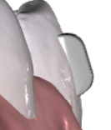
Clarity Aligners: Default Attachment Starting Stage and Sizing
Bevel
Bar
Length (Bevel) = 4.0 mm
Length (Bevel) = 4.0 mm
Length (Bar) = 4.0 mm
By 3M default:
Attachments will be placed at stage 1
Attachments will not be removed or changed mid-treatment unless requested
Attachment starting stage and size can be specified in the prescription
Bevel
Bar
Width (Bevel) = 2.0 mm
Width (Bar) = 1.5 mm
Bevel
Bar
Depth (Bevel) = 1.0 mm
(rise from the tooth)
Depth (Bar) = 1.0 mm
(rise from the tooth)
Notes:
Speaking Notes:
Attachment default size and staging placement.
By default, attachments will be placed at stage 1 and will not be removed or changed mid-treatment unless requested. Attachment starting stage and size can be specified in the prescription
Length is determined by tooth size and the default is 4 mm for length with a bar and bevel
Length (Bevel & Bar) = 4.0 mm
Width (Bevel) = 2.0 mm
Width (Bar) = 1.5 0mm
Depth bevel & Bar = 1.00 m
(rise from the tooth)

Slide 6
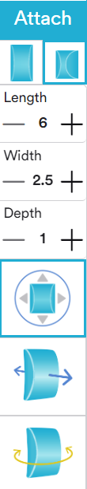
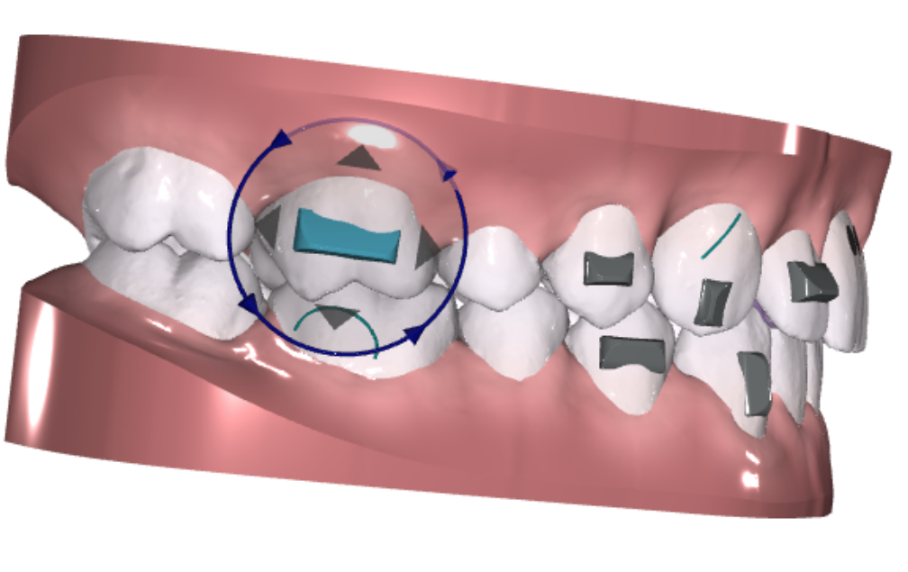
Clarity Aligners: Maximum Attachment Sizes
Customizable is Length, Width, and Depth and Position
Max length up to 6mm (Bar and Bevel)
(limited by tooth size)
“Shape” Bevel or Bar
Dimensions
Max width (Bevel) = 2.5 mm
Max width (Bar) = 2 mm
Rotate & Translate
Max depth (Bar and Bevel) = 1 mm
(rise from the tooth)
Intrude & Extrude
Adjust Bevel Angle
Notes:
Speaking Notes:
Customizable in Length, Width, and Depth and Position
If no preference is indicated in the prescription, the treatment design team will adjust the attachment to match the desired movements.
Once the treatment design is ready for review, the Clinician has control over the attachment design including the shape, dimensions, rotation, intrusion/extrusion and angle of the bevel on the beveled attachment. The Maximum attachment sizes
Max length up to 6mm
(limited by tooth size)
Max width (Bevel) = 2.5 mm
Max Width (Bar) = 2 mm
Max depth = 1 mm
(rise from the tooth)

Slide 7
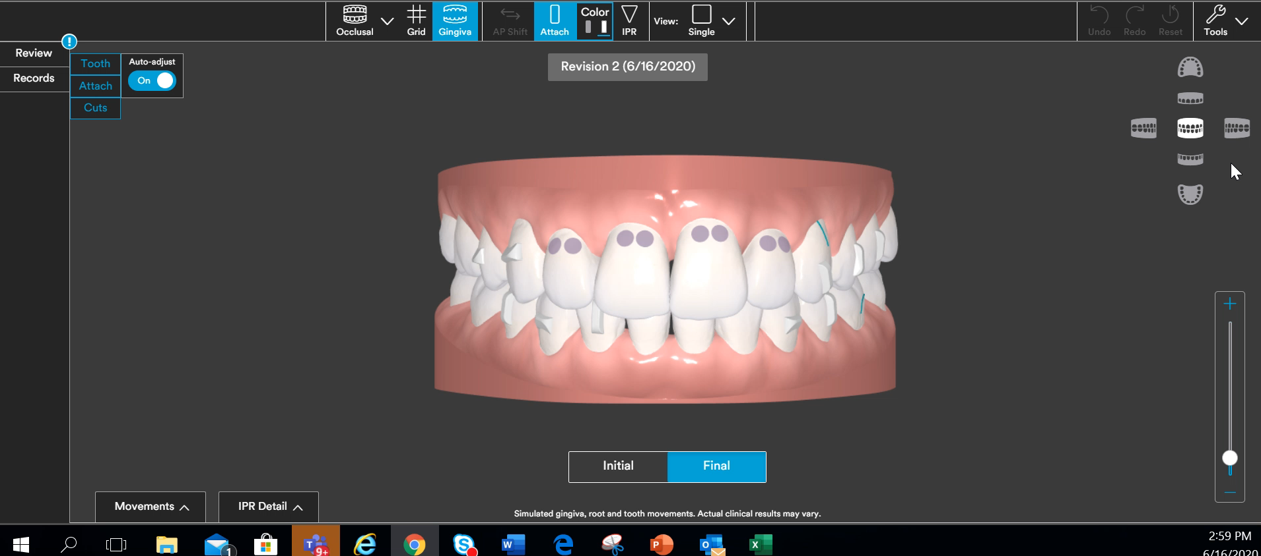
Adjusting Attachments (VIDEO)
Notes:
Slide 7: Adjusting Attachments
Intra-slide video demonstrating effect of adjusting attachments using a 3D model rendering.
Adjusting Attachments.
Attachments are placed first based on prescription and second on 3M attachment design strategies. Click on the attachment to rotate or move mesial, distal, incisal or gingival. You can increase or decrease the length, width or depth. You also have the option to intrude or extrude and add angulation, if necessary. To move or copy an attachment, right click. To place a new attachment, simply click on the attachment type and then drag and drop on the desired tooth.

Slide 8
Attachment Design Strategy
Notes:
Slide 8
Attachment Design Strategy

Slide 9







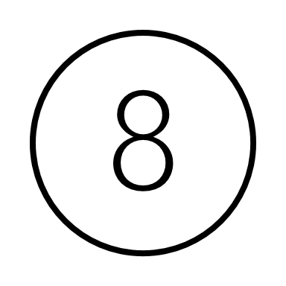
Default Hierarchy of Attachment Design
Type, Location, and Orientation
Priority
Movement
Extrusion
Rotation
Root Torque
Tipping (Mesial-Distal)
Translation (Mesial-Distal)
Intrusion
Crown Torque (Buccal-Lingual)
Expansion
Notes:
Default Hierarchy of Attachment Design
Type, Location, and Orientation
Read slide

Slide 10

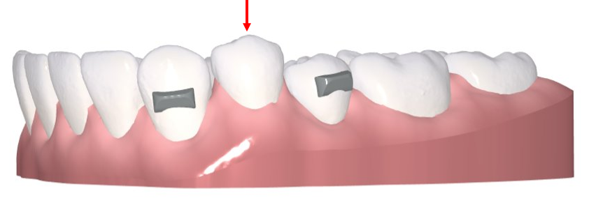
Attachment Design Strategy
Movement | Location | Type | Threshold | Strategy | Design
Extrusion | Incisors Canines Premolars Molars | Horizontal bevel towards the gingiva | Extrusion greater than 0.2 mm for incisors; greater than 0.5 mm for canines, premolars, and molars | Designed to provide a “pushing surface” for extrusion
Intrusion | Placed on the teeth adjacent to the intruding tooth or segment of teeth | Horizontal bevel towards the gingiva | Intrusion greater than 0.5 mm | Designed to provide retention on adjacent teeth to support intrusion
Notes:
Speaker Notes:
Slide 10: Attachment Design Strategy
Dental model of lower teeth and gums, with arrow pointing to single tooth intrusion.
Attachment Design Strategy. Now we will describe the strategies in which attachments are employed with the 3M Defaults. Defaults can be modified by the clinician per their Rx and clinical preferences.
When the threshold value is reached, the default attachment is placed.
Read rest of slide.

Slide 11
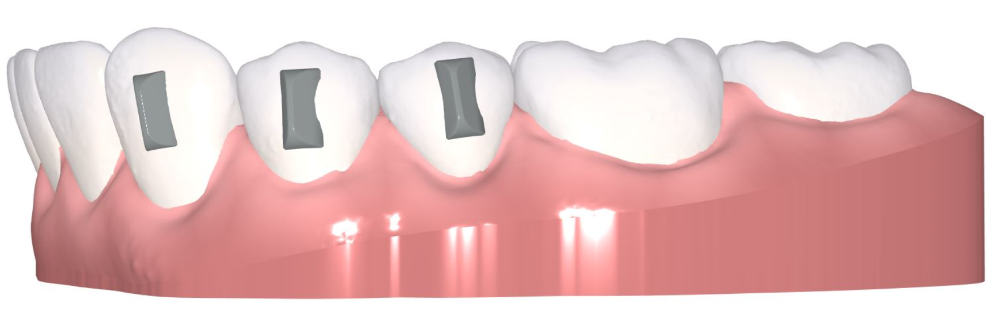
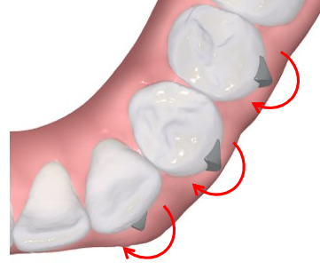
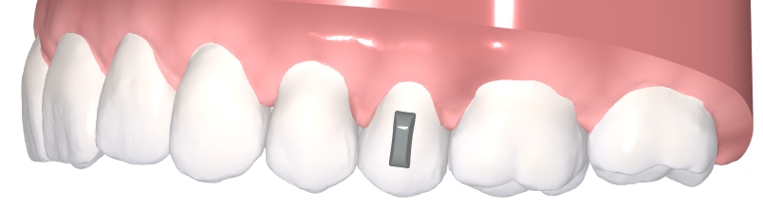
Attachment Design Strategy
Movement | Location | Type | Threshold | Strategy | Design
Rotation | Canines Premolars Molars | Vertical bevel facing toward the rotational force (see image) | Rotation greater than 10° | Designed to provide a “pushing surface” to de-rotate teeth
Tipping (Mesial-Distal) | Incisors Canines Premolars Molars | Vertical bar | Tipping movement greater than 7° | Designed to provide tray anchorage for controlled tipping
Notes:
Speaker Notes:
Slide 11: Attachment Design Strategy
Dental model of lower teeth and gums, with bars placed.
Close-up dental model of lower teeth and gums, with bars placed, showing rotation of teeth.
Close-up dental model of upper teeth and gums, with bars placed.
Attachment Design Strategy, continued.
The next movement is rotation. Read rest of slide.
When the threshold value is reached, the default attachment is placed.

Slide 12
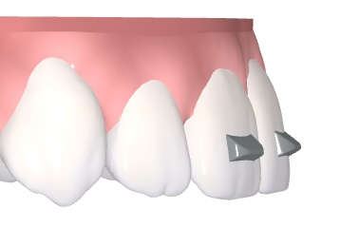
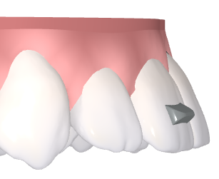
Attachment Design Strategy
Movement | Location | Type | Threshold | Strategy | Design
Root Torque (Buccal) | Incisors Canines Premolars Molars | Horizontal bevel towards the gingiva | Root movements resulting in greater than 25° change in inclination | Designed to support root movement and provide tray retention
Crown Torque (Buccal-Lingual) | Incisors Canines Premolars Molars | Horizontal bevel towards the gingiva | Inclination change greater than 25° | Designed to support crown movement and provide tray retention
Notes:
Side view of dental model of lower teeth and gums, with bars placed, showing space closure.
Speakers Notes
Attachment Design Strategy continued
Read slide
When the threshold value is reached, the default attachment is placed.

Slide 13
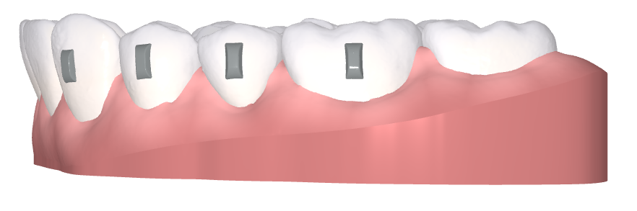
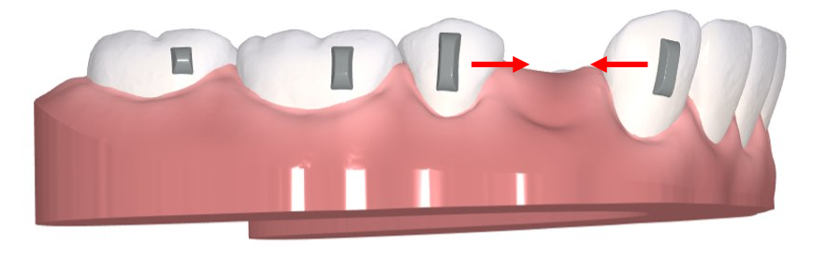
Attachment Design Strategy
Movement | Location | Type | Threshold | Strategy | Design
Translation (Mesial-Distal) | Incisors Canines Premolars Molars | Vertical bar | 1 mm | Designed to keep roots upright while translating crowns
Space Closure (Mesial-Distal) | Incisors Canines Premolars Molars | Vertical bar | 1 mm | Designed to resist tipping during space closure
Notes:
Speakers Notes:
Slide 13: Attachment Design Strategy
Side view of dental model of lower teeth and gums, with bars placed, showing space closure.
Attachment Design Strategy, continued.
Movement – Translation mesial-distal… read the slide.
When the threshold value is reached, the default attachment is placed.

Slide 14
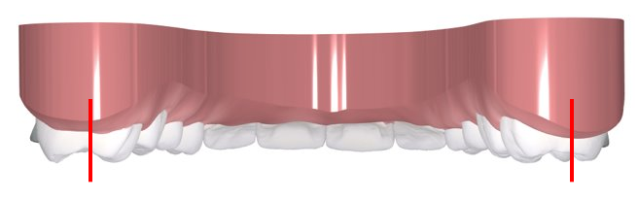
Attachment Design Strategy
Movement | Location | Type | Threshold | Strategy | Design
Maxillary Expansion | Canines Premolars Molars | Horizontal bevel towards the gingiva | Expansion requiring translation greater than 1.0 mm | Designed to reduce unwanted torque
Notes:
Speakers Notes:
Inside view of dental model of upper teeth and gums with bevel attachment, with arrow pointing to maxillary expansion.
Attachment Design Strategy, continued.
Movement – maxillary expansion. Read rest of slide.
When the threshold value is reached, the default attachment is placed.

Slide 15
Attachment Design Strategy – Additional Options
Notes:
Speaker notes:
Attachment Design Strategy – Additional Options

Slide 16
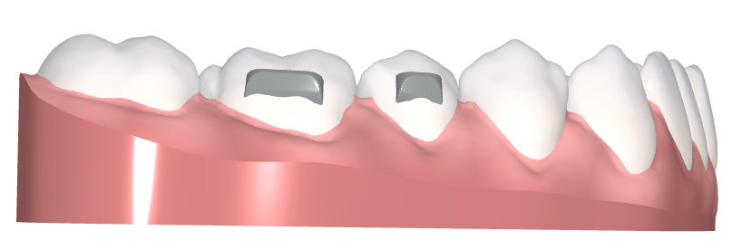
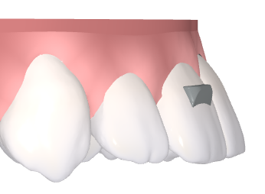
Attachment Design Strategy – Additional Options
Movement | Location | Type | Threshold | Strategy | Design
Retention | Placed upon request | Horizontal bevel towards the gingiva | n/a | Designed to provide tray retention especially for cases with short clinical crowns
Root Torque (Lingual) | Incisors Canines | Horizontal bevel towards incisal edge | Root movement resulting in greater than 25° of inclination change | Designed to support root movement and provide tray retention Alternative option to torque points
Notes:
Speaker notes:
Attachment Design Strategy – Additional Options – read slide.
When the threshold value is reached, the default attachment is placed.

Slide 17
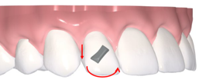
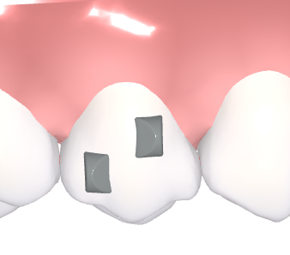
Attachment Design Strategy – Additional Options
Movement | Location | Type | Threshold | Strategy | Design
Extrusion/Rotation | Lateral Incisors | Bevel “sash” - diagonally-oriented beveled attachment | Per request | Designed for compound movements, such as simultaneous extrusion and rotation This orientation is available upon doctor request
Tipping | Placed upon request | Two Bevels “yin-yang” | Per request | Designed to aid in tipping movement by providing a coupling force This orientation is available upon doctor request
Notes:
3, open bite in demo modified in revision to get yin-yang image
Speakers Notes:
Attachment Design Strategy – additional options
Read slide
When the threshold value is reached, the default attachment is placed.

Slide 18
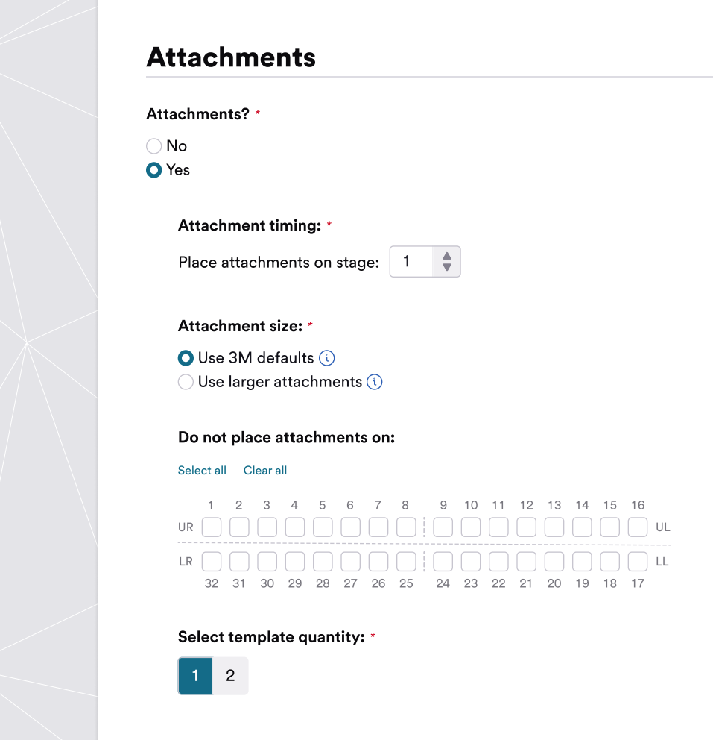
Attachments and the Prescription
Tips to help with success
Utilize attachment restrictions to indicate any teeth that you do not want attachments placed
Option for two attachment templates per order
Please note any additional, case specific, attachment requests in the ‘Special Instructions’ text box at the top of the Prescription.
Notes:
Speaker Notes:
Slide 17: Attachments and the Prescription
Attachments and the Prescription.
Tips to help with success
Utilize attachment restrictions to indicate any teeth that you do not want attachments placed
Option for two attachment templates per order
Please note any additional, case specific, attachment requests in the ‘Special Instructions’ text box at the top of the Prescription.
Deviations from the 3M defaults can be selected in the prescription

Slide 19
Thank You!

