Slide 1
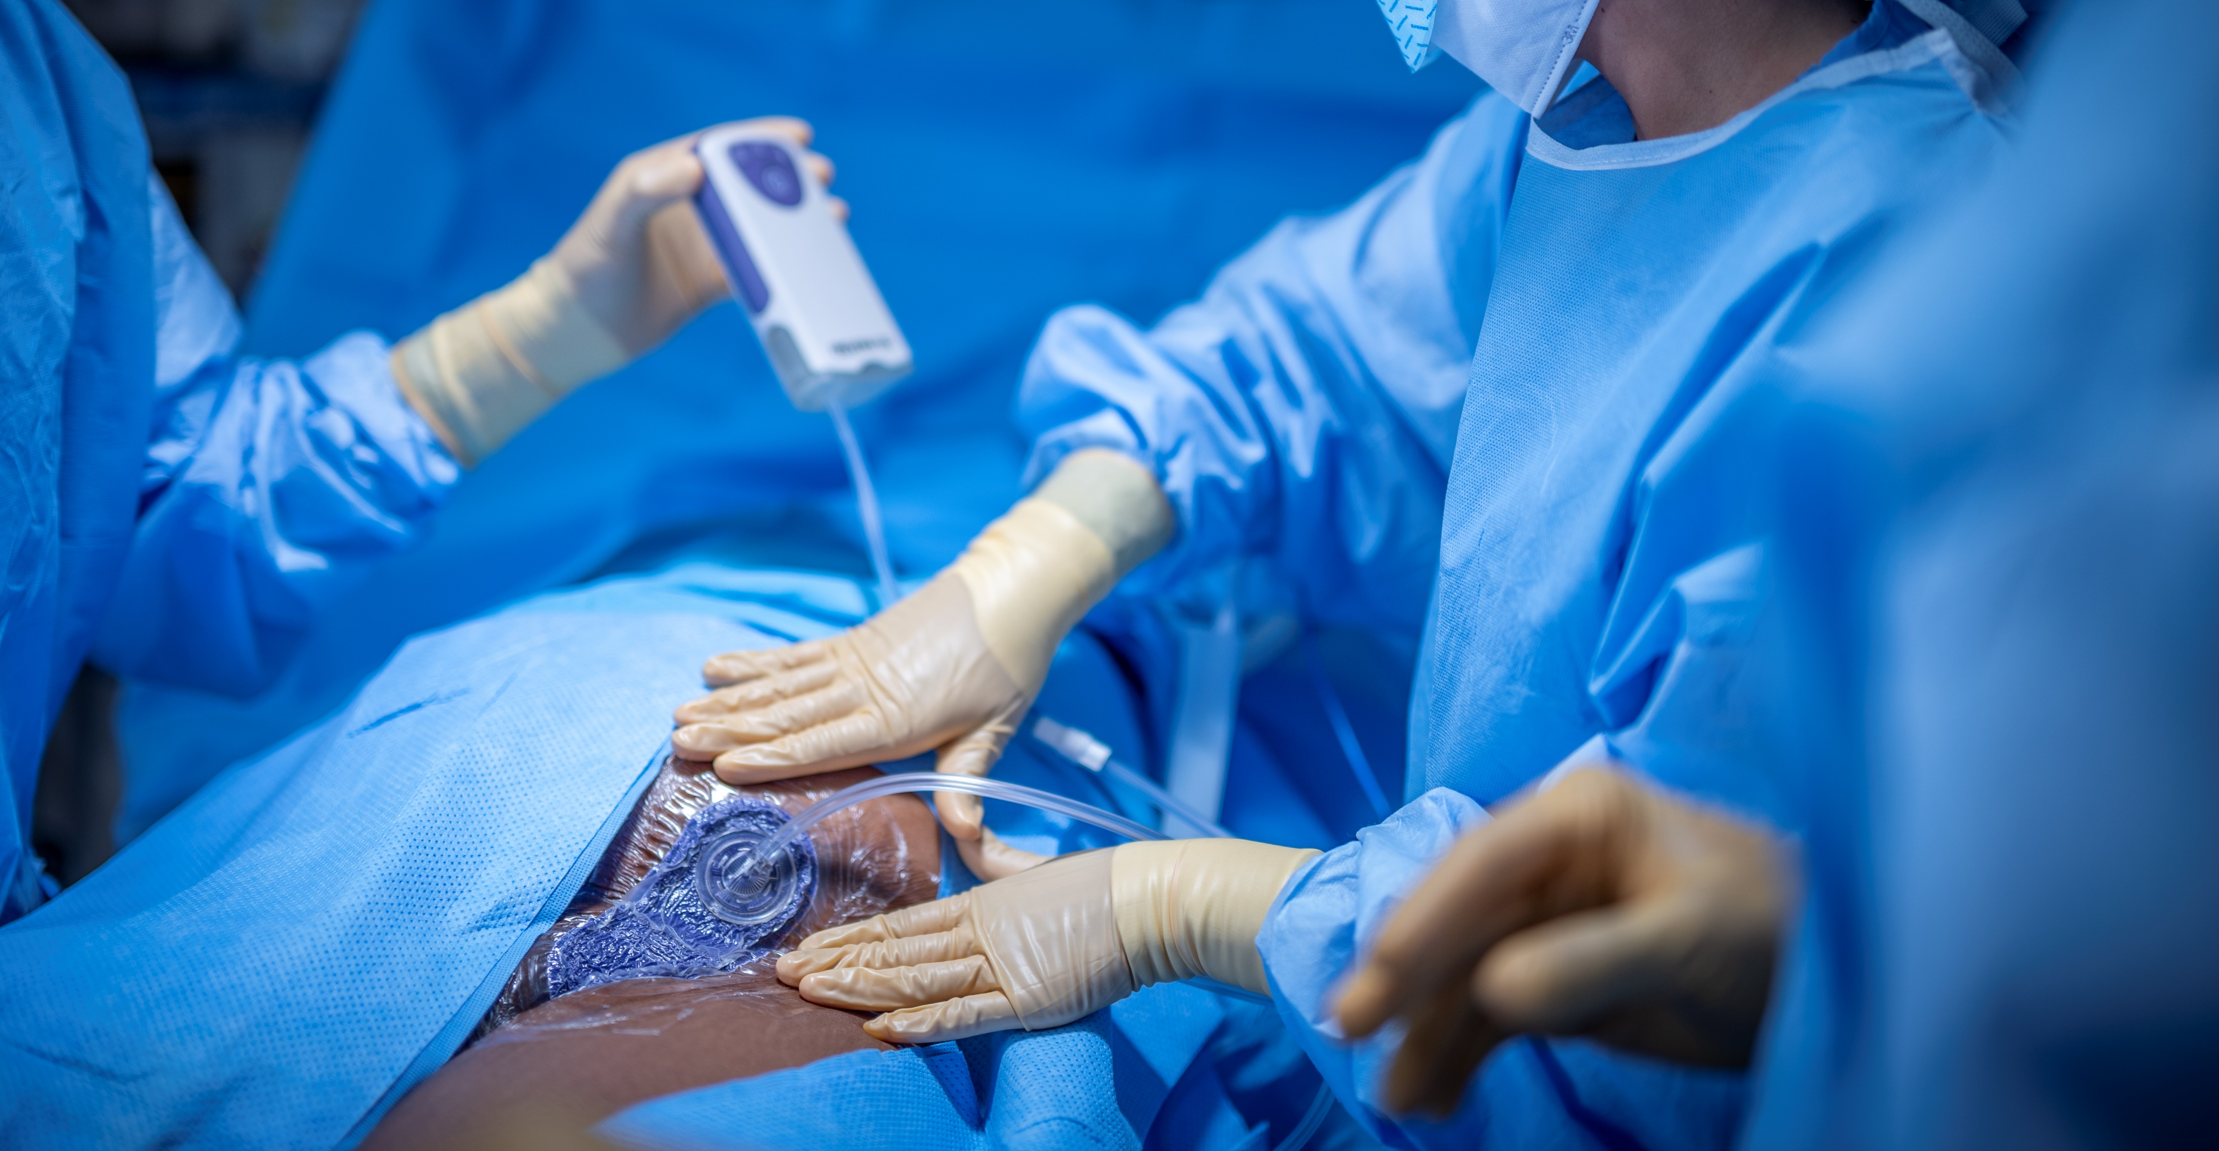

Clinical Evidence
Vascular Surgery

Slide 2
Negative Pressure Therapy for Incision Management
For over 25 years, negative pressure vacuum-assisted closure (V.A.C.®) technology has been clinically shown to promote wound healing by reducing edema and promoting granulation tissue formation and perfusion through the removal of exudate and infectious materials.
3M extended the use of its negative pressure technology to closed surgical incisions with similarly positive clinical results, outlined in more than 70+ journal publications focused on closed incision negative pressure therapy (ciNPT), with nearly half of the evidence specific to orthopedic cases.
The 3M™ Prevena™ Incision Management System clinical evidence summaries presented adhere to the American Society of Plastic Surgeons (ASPS) Evidence Rating Scale¹ and reflect the benefits of ciNPT for different incision types and surgical outcomes compared to the standard of care.
1
2
3
4
5
Level 1a: Evidence obtained from at least one properly designed randomized controlled trial
Level 1b: Systematic reviews (with homogeneity) of randomized controlled trials
Level 2a: Evidence obtained from well-designed controlled trials without randomization
Level 2b: Individual cohort study or low quality randomized controlled trials (e.g., <80% follow-up).
Level 3:
Evidence obtained from well-designed cohort or case-control analytic studies, preferably from more than one center or research group
Level 4: Case series (and poor-quality cohort and case-control studies)
Level 5: Expert opinion without explicit critical appraisal, or based on physiology, bench research or ‘first principles.’
Reference:
1. Sullivan D, Chung KC, Eaves FF, Rohrich RJ. The Level of Evidence Pyramid: Indicating Levels of Evidence in Plastic and Reconstructive Surgery Articles. Plast Reconstr Surg 2011;128(1):311-314

Slide 3
Vascular
3M™ Prevena™ Therapy evidence
The body of evidence for using ciNPT has been growing steadily since 2006
The table listed below is based on the Evidence Rating Scale for Therapeutic Studies developed by the American Society of Plastic Surgeons (ASPS)
Surgical Incision | ASPS Level of Evidence | First Author (Year) | Surgical Incision Type | Control | Postoperative Clinical Endpoints* and institutional Health Economics
Groin Incision | 1 | Kwon (2018) | Femoral incisions following elective vascular surgery | Standard gauze | Surgical Site Complications (SSC); Surgical Site Infections (SSI) Readmission; Return to OR, Health Economics (HE)
 |  | Gombert (2018) | Vascular surgery for Peripheral Artery Disease, Groin incisions | Standard wound dressings | SSI
 |  | Pleger (2018) | Groin incision | Standard wound dressings | Wound Heling Complications, Local infections, 30 Day Revision Surgery
 |  | Antoniou (2019) | Groin incision | Standard wound dressings | Meta-analysis: SSI, Revision Surgery, Hospital length of stay
 | 3 | Chang (2020) | Infrainguinal vascular surgeries involving upper thigh/groin incisions. | Standard wound dressings | Risk stratification, HE
 | 3 | Frisbie (2020) | Proximal groin incisions, lower extremity bypass patients | Standard wound dressings | SSI, graft infection, HE
* Clinical endpoints reflect the conditions and methods specific to each publication and should not be interpreted as general outcomes related to Prevena Therapy. Individual results for each case may vary, depending on the patient, circumstances, and conditions.

Slide 4
RCT demonstrates ciNPT reduces major complications, reoperation, and readmission rates for high-risk groin incisions
1
GROIN
LOE
Kwon J, Staley C, McCullough M et al. A Randomized Clinical Trial Evaluating Negative Pressure Therapy to Decrease Vascular Groin Incision Complications. Journal of Vascular Surgery. 2018; 68(6):1744-1752.
Study Design
Prospective, single-center, randomized controlled trial
Results
Surgical Site Infections (Total)
Surgical Site Complication
Study Purpose
This prospective RCT evaluated negative pressure therapy (3M™ Prevena™ Therapy) to decrease wound complications and associated health care costs.
reduction in SSI*
10.1% (6/59) Prevena Therapy vs.
21.6% (12/60) SOC
(p=0.001)*
reduction in SSC*
11.9% (7/59) Prevena Therapy vs.
26.7% (16/60) SOC
(p=0.001)*
Surgical Site Infections (Szilagyi I)
Return to OR
Methods
The study included 119 femoral incisions closed primarily after elective vascular surgery procedures. High-risk inclusion criteria: BMI > 30, pannus, re-operative surgery, prosthetic graft, poor nutrition, immunosuppression, or HbA1c>8 1:1 Randomized to standard gauze (n=60) vs. Prevena Therapy (n=59 ) Outcomes evaluated at post-operative day 30: Wound Complications, SSI, Length of Stay (LOS), reoperation, readmission
reduction in SSI
1.7% (1/59) Prevena Therapy vs.
3.3% (2/60) SOC
2x
reduction in return to the OR*
8.5% (5/59) Prevena Therapy vs.
18.3% (11/60) SOC
(p<0.05)*
Surgical Site Infections (Szilagyi II)
Readmissions
reduction in SSI
3.4% (2/59) Prevena Therapy vs.
5.0% (3/60) SOC
reduction in readmissions*
6.8% (4/59) Prevena Therapy vs.
16.7% (10/60) SOC
(p<0.04)*
Surgical Site Infections (Szilagyi III)
Cost Savings
reduction in DSSI
5.1% (3/59) Prevena Therapy vs.
11.7% (7/60) SOC
$6045
reduction in per patient cost
$30,492 Prevena Therapy vs.
$36,537 SOC
Cost Assessment includes variable hospital costs (for both the index hospitalization and all readmission days within 30 days related to any wound complication). Hospital variable costs (not charges) for each admission were obtained from hospital administration
Key Points
Calculation(s) are derived based on relative patient group incidence rate reported in this study
Statistically significant (p<0.05)
Study suggest that negative pressure therapy for patients at high risk for groin wound complications significantly reduces major wound complication, reoperation and readmission rates and ciNPT may lead to a reduction in hospital cost
ciNPT is recommended for all groin incisions considered at high risk for wound complications

Slide 5
Multi-center RCT demonstrates ciNPT reduces SSI in high-risk vascular surgery patients
Groin
1
Gombert A, Babilon M, Barbati M et al. Closed-incision negative-pressure therapy reduces surgical site infections in vascular surgery: a prospective randomised multicentre trial (AIMS trial). Eur J Vasc Endovasc Surg. 2018; 56(3):442-448.
LOE
Study Design
Prospective, multi-center, randomized controlled trial
Results
Key Points
Surgical Site Infections (Szilagyi I, II, and III )
Summary
Study Purpose
This prospective RCT aimed to assess the potential benefit of ciNPT (3M™ Prevena™ Therapy) application to reduce the surgical site infection risk after groin incision for vascular surgery.
Reduction in SSIs
13.2% (13/98) Prevena Therapy vs.
33.3% (30/90) SOC
(p=0.0015)*
Study found closed incision negative pressure therapy (ciNPT) was associated with a reduced incidence of SSIs when compared to control group.
High-risk patients could benefit from ciNPT to help reduce the risk of total SSI.
Methods
The study evaluated 188 patients who underwent vascular surgery for peripheral artery disease (PAD) with a longitudinal groin incision at two sites in Germany between July 2015 and May 2017. High-risk inclusion criteria: smoking, cardiac risk factors including hypertension, coronary heart disease, or history or myocardial infarction, metabolic disorders including diabetes, dyslipidaemia, hyperhomocysteinaemia, or chronic renal failure. When a groin incision was performed on both sides, only one side was randomized and assess for the study. 30-day SSIs were assessed using the Szilagyi classification.
Surgical Site Infection (Szilagyi I)
Reduction in Sazilagy I SSIs*
8.1% (8/98) Prevena Therapy vs.
26.7 % (24/90) SOC
(p=0.0012)*
Calculation(s) are derived based on relative patient group incidence rate reported in this study
*Statistically significant (p<0.05)

Slide 6
Illustration of the 3M™ Prevena™ Incision Management System Cost
Effectiveness Based on Gombert et al Outcomes
Vascular Groin Hypothetical Economic Model | Prevena™ Therapy | Control
Number of Patients (n) | 98 | 90
Number of Surgical Site Infections (a) | 13 | 30
Cost Per SSI¹(b) | $21,827 | $21,827
Cost of SSI per Patient (a*b)/n | $2,895 | $7,276
Cost of Therapy Per Patient * | $495 | ---
Total Cost Per Patient | $3,390 | $7,276
Potential Per Incision Savings Using Prevena™ Therapy | $3,886
Cost Savings
Reduction in per patient cost for SSI
$3,390 Prevena Therapy vs. $7,276 SOC
1. Hou Y. Incidence and impact of surgical site infections on length of stay and cost of care in open surgical procedures. HEOR-2021-003-DAR.
*3M™ Prevena™ Peel and Place System Kit is an estimates; individual prices may vary
The above model uses selected study data to provide an illustration of estimates of costs for use of the Prevena Therapy. This model is an illustration and not a guarantee of actual individual costs, savings, outcomes or results. The hospital is advised to use this model as an illustration only to assist in an overall assessment of products and pricing.
Gombert A, Babilon M, Barbati M et al. Closed-incision negative-pressure therapy reduces surgical site infections in vascular surgery: a prospective randomised multicentre trial (AIMS trial). Eur J Vasc Endovasc Surg. 2018; 56(3):442-448.

Slide 7
RCT Study demonstrates reduction in incision complications and revision procedures
Groin
1
Pleger SP, Nink N, Elzien M et al. Reduction of groin wound complications in vascular surgery patients using closed incision negative pressure therapy (ciNPT): a prospective, randomised, single-institution study. IntWound J 2018; 15(1):75-83.
LOE
Study Design
Single Center Randomized Controlled Trial Germany
Results
Total Surgical Site Infection
Wound Healing Complications (WHC)
Reduction in SSI*
17% (1/58) Prevena Therapy vs.
16.9% (12/71) Control
(p<0.02)*
Reduction in Wound Healing Complications*
8.6% (5/58) Prevena Therapy vs.
42.3% (30/71) Control
(p<0.0005)*
Study Purpose
The purpose of the study was to investigate the effectiveness of ciNPT (3M™ Prevena™ Therapy) compared to conventional therapy on vascular surgical groin incisions.
Local Surgical Site Infection
Deep Wound Dehiscence
Methods
Patients were randomised and treated with either Prevena Therapy or the control therapy, a conventional adhesive plaster. 100 patients with 129 groin incisions were analysed: ciNPWT consisted of 58 incisions; Control consisted of 71 incisions Inclusion criteria for high-risk patients: age > 50 years, diabetes mellitus, renal insufficiency, malnutrition, obesity and chronic obstructive pulmonary disease. ciNPT was applied intraoperatively and removed on days 5–7 postoperatively. Wound evaluation based on the Szilagyi classification took place postoperatively on days 5–7 and 30.
Reduction in Local SSI*
1.7% (1/58) Prevena Therapy vs.
14.1% (10/71) Control
(p=0.02)*
Reduction in Deep Wound Dehiscence
1.7% (1/58) Prevena Therapy vs.
5.6% (4/71) Control
(p=0.387)
Deep SSI (Arterial Graft Infection)
30 Day Revision Surgery
Reduction in DSSI
0% (0/58) Prevena Therapy vs.
2.8% (2/71) Control
(p=0.501)
Reduction in Revision Surgery*
1.7% (1/58) Prevena Therapy vs.
14.1% (10/71) Control
(p=0.022)*
Calculation(s) are derived based on relative patient group incidence rate reported in this study
* Statistically significant (p<0.05)
Key Points - Summary
This study that the use of ciNPT demonstrated a statistically significant reduction of postoperative wound healing complications in the groin on postoperative days 5–7 and 30-day revision surgery

Slide 8
Illustration of the 3M™ Prevena™ Incision Management System
Cost-Effectiveness Based on Pleger et al Outcomes
Vascular Groin Hypothetical Economic Model | Prevena™ Therapy | Control
Number of Incisions (n) | 58 | 71
Number of infections (a) | 1 | 12
Cost Per Infection¹(b) | $21,827 | $21,827
Cost of Infection per Incision (a*b)/n | $376 | $3,689
Cost of Therapy Per Incision* | $495 | ---
Total Cost Per Incision | $871 | $3,689
Potential Per Incision Savings Using Prevena™ Therapy | $2,818
Vascular Groin Hypothetical Economic Model | Prevena™ Therapy | Control
Number of Incisions (n) | 58 | 71
Number of Complications (a) | 5 | 30
Cost Per Complication²(b) | $17,855 | $17,855
Cost of Complication per Incision (a*b)/n | $1,539 | $7,544
Cost of Therapy Per Incision* | $495 | ---
Total Cost Per Incision | $2,034 | $7,544
Potential Per Incision Savings Using Prevena™ Therapy | $5,510
Reduction in per-patient cost
for SSI $871 Prevena Therapy vs. $3,689 SOC
Reduction in per-patient cost
for SSCs
$2,034 Prevena Therapy vs.
$7,544 SOC
Cost Savings
Cost Savings
Hou Y. Incidence and impact of surgical site infections on length of stay and cost of care in open surgical procedures. HEOR-2021-003-DAR.
Hou Y. Incidence and impact of surgical site complications on length of stay and cost of care in open surgical procedures. HEOR-2021-004-DAR.
*3M™ Prevena™ Peel and Place System Kit and Control therapy (gauze) changed once a day at $18 a week are estimates; individual prices may vary
The above model uses selected study data to provide an illustration of estimates of costs for use of the Prevena Therapy or Standard of Care (Control). This model is an illustration and not a guarantee of actual individual costs, savings, outcomes or results. Results are based on selected study data and may not be typical. The hospital is advised to use this model as an illustration only to assist in an overall assessment of products and pricing.
Pleger SP, Nink N, Elzien M et al. Reduction of groin wound complications in vascular surgery patients using closed incision negative pressure therapy (ciNPT): a prospective, randomised, single-institution study. IntWound J 2018; 15(1):75-83.

Slide 9
Potential reduction in incisional wound complications when using ciNPT
GROIN
3
Frisbie JJ, Bordoli S J, Simmons J M, Frisbie JJ, Zuiderveen SK. Utilizing closed incisional negative pressure therapy reduces peripheral bypass infection rates without increasing costs.
Cureus. 2020 Jul 16;12(7):e9217.
LOE
Study Design
Retrospective before/after comparative cohort study (Level III)
Results
Key Points
Surgical Site Infection
Summary
Study Purpose
The study investigated the effect of closed incisional negative pressure therapy (ciNPT) on the incidence of surgical site infections (SSI) and cost effectiveness of its use for vascular bypass patients
Reduction in SSIs*
3.5% (4/113) Prevena Therapy vs.
11.8% (12/102) Control
(p=0.02)*
ciNPT resulted in a decrease in surgical site infections.
Reduced SSI rate led to a significant cost-effective measure for the institution.
Institution implemented routine use of ciNPT for all lower extremity vascular bypass patients.
Methods
Retrospective review of outcomes before and after initiation of 3M™ Prevena™ Therapy. Institution implemented ciNPT for re-vascularization procedures from May 2018 to August 2018 The control group, (standard wound dressings) consisted of 102 patients who underwent lower extremity bypass surgery between September 2017 and April 2018. The Prevena Therapy group included of 113 patients from September 2018 and April 2019. Study endpoints determined at day 30: total SSI, deep SSI and superficial SSI and on year follow up for graft infections. Cost analysis was separately performed utilizing hospital metrics.
Deep Surgical Site Infection
Reduction in DSSIs*
0.9% (1/113) Prevena Therapy vs.
6.9% (7/102) Control
(p=0.02)*
Cost Savings
Reduction in Per Patient Cost for SSI
$911 Prevena Therapy vs. $1,617 SOC
Per Patient Cost Savings: $706
Calculation(s) are derived based on relative patient group incidence rate reported in this study
* Statistically significant (p<0.05)

Slide 10
Risk-stratification to identify high-risk patients leads to potential cost savings
Vascular
3
Chang B, Sun Z, Peiris P et al. Deep learning-based risk model for best management of closed groin incisions after vascular surgery. Journal of Surgical Research 2020;254:408-406
LOE
Study Design
Single center retrospective cohort study
Results
Appropriately matched SSI Risk and Treatment
Potential Cost Reduction with risk-stratification and Prevena Therapy
Study Purpose
Primary objectives: apply the prediction model to a cohort of vascular surgery patients to assess the appropriate use of 3M™ Prevena™ Therapy for the management of incisions after vascular surgery assess impact of adoption of risk-based prediction model on financial outcomes
Correct match of high-risk with ciNPT and low-risk with SOC
High-risk + Prevena Therapy (n=148)
Low-risk + SOC (n=57)
205 of 370
Average Per-Patient Cost
Prevena Therapy on high risk $1143
No risk stratification $ 1,544
Mean per Patient Cost Savings: $401
Inappropriately matched SSI Risk and Treatment
Key Points
Methods
a deep learning-based, risk-based prediction model was retrospectively applied data set of 370 patients undergoing vascular surgery at Duke University. ciNPT or control dressings applied over closed incisions at the surgeon’s discretion. Predictive risk scores were generated for each patient and used to categorize patients as “high” and “low” predicted risk for SSI. Patients were further divided into four groups for analysis: (1) low-risk patients who received SOC, (2) low-risk patients who received ciNPT, (3) high-risk patient who received SOC, and (4) high-risk patients who received ciNPT SSI event rates were calculated for each group
Summary
Incorrect match of high-risk with SOC and low-risk with ciNPT
High-risk + SOC (n=134)
Low-risk + Prevena Therapy (n=31)
165 of 370
Using a risk prediction model to aid decision making in the care of closed incisions after vascular surgery and can help optimize the utilization of ciNPT, its outcomes, and associated costs.
Surgical Site Infections
Reduction in Surgical Site Infections
6.8% (10/148) High-risk Prevena Therapy vs. 20.9% (28/134) High-risk SOC
(p<0.001)*
Calculation(s) are derived based on relative patient group incidence rate reported in this study
* Statistically significant (p<0.05)

Slide 11
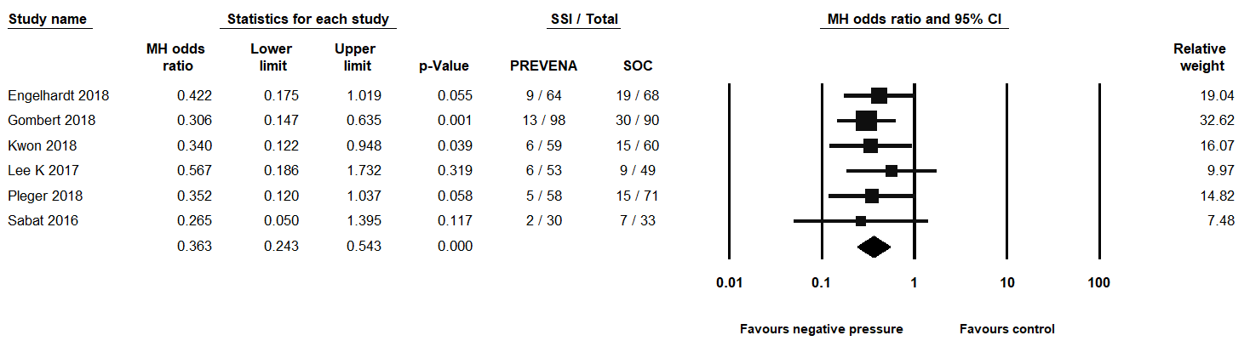
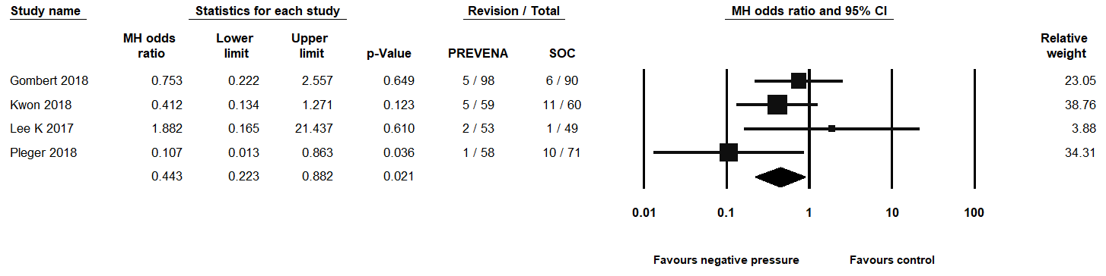
META Analysis: Superior efficacy of prophylactic ciNPT therapy for groin wounds in vascular surgery
Groin
1
Antoniou G, Onwuka C, Antoniou S et al. Meta-analysis and trial sequential analysis of prophylactic negative pressure therapy for groin wounds in vascular surgery. J Vasc Surg 2019; 70 (5):1700-1710.
LOE
Study Design
Meta-analysis and trial sequential analysis
Results
Key Points
Surgical Site Infections
Summary
Study Purpose
To compare the efficacy of ciNPT with SOC in closed surgical wound incisions in vascular surgery
Prophylactic use of negative pressure wound therapy (NPWT) helps improve over SOC through reduction in the risk of SSI in vascular surgical groin patients.
ciNPT patients have reduced risk for
  surgical site infection (p<0.0001)
  revision surgeries (p=0.02)
Shorter hospital stay for patients with ciNPT (p=0.01)
“All studies included in our analysis were published recently (2016-2019) representing contemporary clinical practice in the Western world.”
“Evidence can be considered to be conclusive and that no more trials are required to investigate the primary outcome.”
Methods
Systematic Review of literature to identify RCTs comparing prophylactic ciNPT with SOC in closed groin incisions in vascular surgery. Fixed-effect model was used to calculate pooled odds ratio or risk difference and 95% confidence intervals. All studies identified compared 3M™ Prevena™ Therapy to SOC. Primary outcome: Surgical Site Infection Secondary outcomes: revision surgery, in-hospital mortality, hospital length of stay, and readmission Identified 6 RCTs on a total of 733 groin surgical wounds: ciNPT n=362 vs. SOC n=371 (all published between (2016-2018) Gombert et al 2018 Engelhardt et al 2018 Pleger et al 2018 Kwon et al 2018 Lee et al 2017 Sabat et al 2016
Revision Surgery
Hospital Length of Stay
2 days
Shorter Hospital Length of Stay*
-2.14 days (95% CI: -3.78 to -0.49)
(p=0.01)*
Figures have been replicated from Antoniou et al.
*Statistically significant (p<0.05)

Slide 12
META Analysis: Superior efficacy of prophylactic ciNPT therapy for groin wounds in vascular surgery
Groin
1
Antoniou G, Onwuka C, Antoniou S et al. Meta-analysis and trial sequential analysis of prophylactic negative pressure therapy for groin wounds in vascular surgery. J Vasc Surg 2019; 70 (5):1700-1710.
LOE
Study Design
Meta-analysis and trial sequential analysis
Results
Surgical Site Infections - Total
Hospital Length of Stay
Study Purpose
To compare the efficacy of ciNPT with SOC in closed surgical wound incisions in vascular surgery
Shorter Hospital
Length of Stay*
-2.14 days
(95% CI: -3.78 to -0.49) (p=0.01)*
2 days
Methods
Systematic Review of literature to identify RCTs comparing prophylactic ciNPT (3M™ Prevena™ Therapy) with SOC in closed groin incisions in vascular surgery. Fixed-effect model was used to calculate pooled odds ratio or risk difference and 95% confidence intervals. All studies identified compared 3M™ Prevena™ Therapy to SOC. Primary outcome: Surgical Site Infection Secondary outcomes: revision surgery, in-hospital mortality, hospital length of stay, and readmission Identified 6 RCTs on a total of 733 groin surgical wounds: ciNPT n=362 vs. SOC n=371 (all published between (2016-2018) Gombert et al 2018 Engelhardt et al 2018 Pleger et al 2018 Kwon et al 2018 Lee et al 2017 Sabat et al 2016
Figures have been replicated from Antoniou et al.
*Statistically significant (p<0.05)
Key Points
Szilagyi I-III
 | 3M™ Prevena™ Therapy |  | SOC
 | Events | Total | Events | Total | Estimate (95% CI) | P-value
Szilagyi I | 22 | 279 | 48 | 289 | OR 0.4 (0.24, 0.69) | 0.001*
Szilagyi II | 12 | 279 | 24 | 289 | OR 0.51 (0.25, 1.04) | 0.06
Szilagyi III | 3 | 279 | 11 | 289 | RD -0.03 (-0.05, 0.00) | 0.05
Prophylactic use of negative pressure wound therapy (NPWT) helps improve over SOC through reduction in the risk of SSI in vascular surgical groin patients.
ciNPT patients have reduced risk for
    surgical site infection (p<0.0001)
    revision surgeries (p=0.02)
Shorter hospital stay for patients with ciNPT (p=0.01)
“All studies included in our analysis were published recently (2016-2019) representing contemporary clinical practice in the Western world.”
“Evidence can be considered to be conclusive and that no more trials are required to investigate the primary outcome.”
OR=Odds Ratio; RD=Risk Difference
Revision Surgery

Slide 13
3M™ Prevena™ Therapy for the high-risk Vascular patient
How to identify the patient as high-risk for surgical site infection or complication:
Groin incisions
Kwon J, Staley C, McCullough M et al. A randomized clinical trial evaluating negative pressure therapy to decrease vascular groin incision complications. Journal of Vascular Surgery. 2018; 68(6):1744-1752.
Patients are high-risk if they have ≥ 1 of the following risk factors:
Re-operative surgery
Prosthetic vascular graft
Age > 50 years
BMI > 30 kg/m²
Significant pannus
Malnutrition
Smoker
Immunosuppression
Cardiac risk factors
  hypertension
  coronary heart disease
  history or myocardial infarction
Chronic obstructive pulmonary disease (COPD)
Uncontrolled diabetes (hemoglobin A1c >8%)
Chronic kidney disease
Dyslipidaemia
Hypercholesterolaemia
Hyperhomocysteinaemia
Gombert A, Babilon M, Barbati M et al. Closed-incision negative-pressure therapy reduces surgical site infections in vascular surgery: a prospective randomised multicentre trial (AIMS trial). Eur J Vasc Endovasc Surg. 2018; 56(3):442-448.
Pleger SP, Nink N, Elzien M et al. Reduction of groin wound complications in vascular surgery patients using closed incision negative pressure therapy (ciNPT): a prospective, randomised, single-institution study. IntWound J 2018; 15(1):75-83.

