Slide 1
Urban Safety and Mobility
3M Transportation Safety Division
Date

Slide 2

We help bring families home safely.
Notes:
This is the TSD Mission Statement

Slide 3





3M’s Mission on Increasing Safety on Roadways
Action to halve road fatalities
Road Safety Trust Fund Founding Partner
ROSS Center for Sustainable Cities
Support TZD Virtual Pledge Wall
National Complete Streets Coalition
By working with leading global organizations, 3M’s mission is to improve road safety and realize zero fatalities through the deployment of advanced technologies

Slide 4
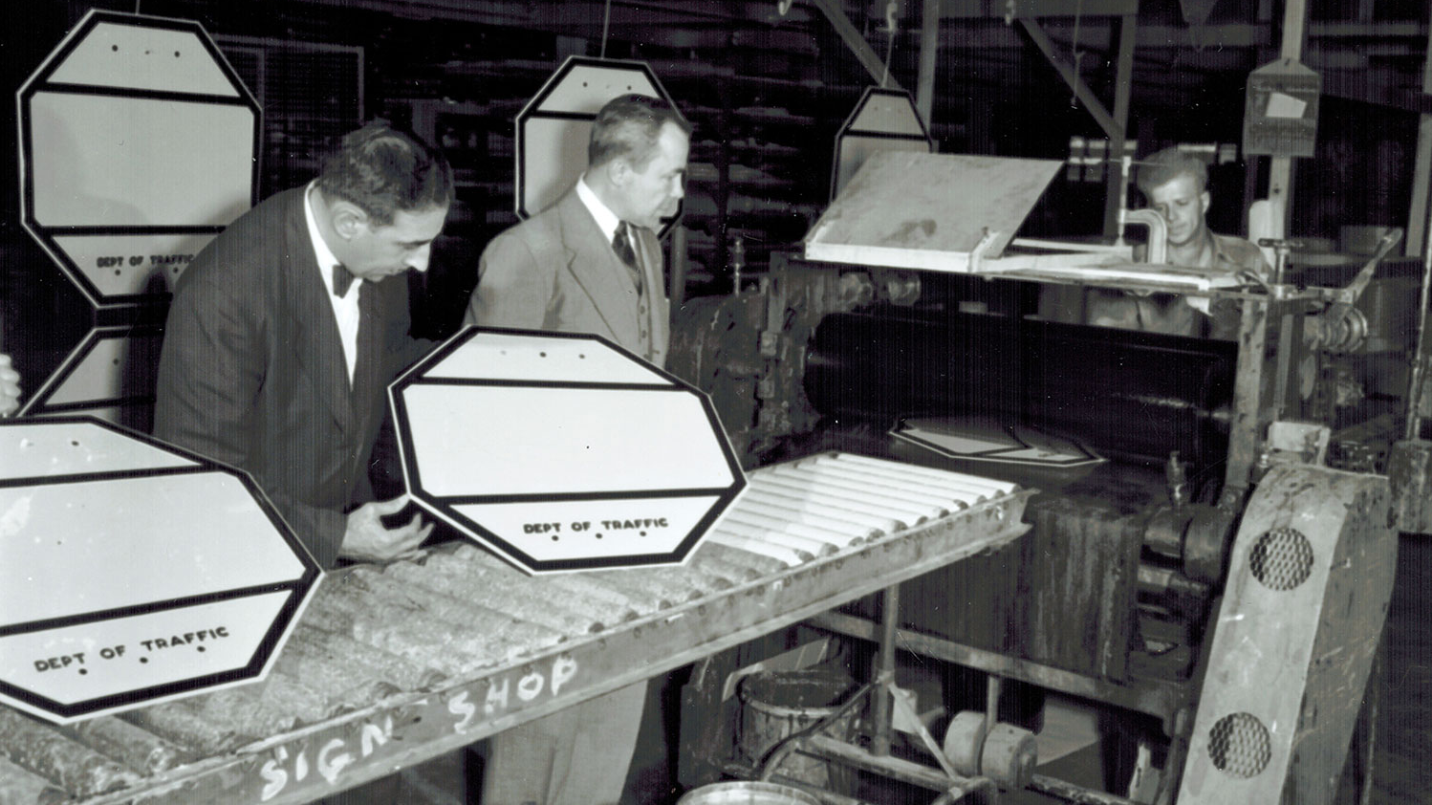
And we have been doing it for a long time.

Slide 5
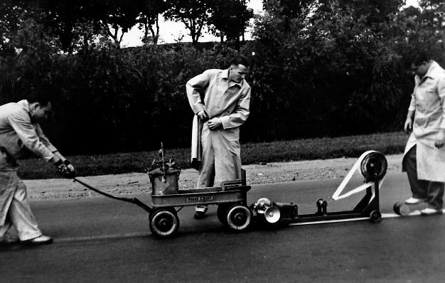
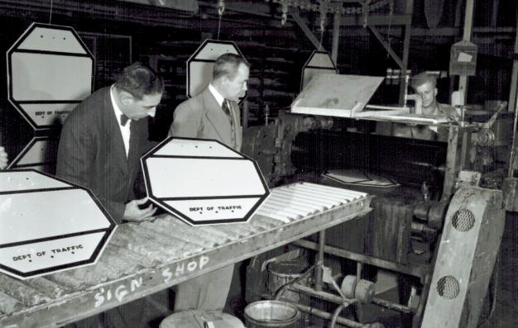
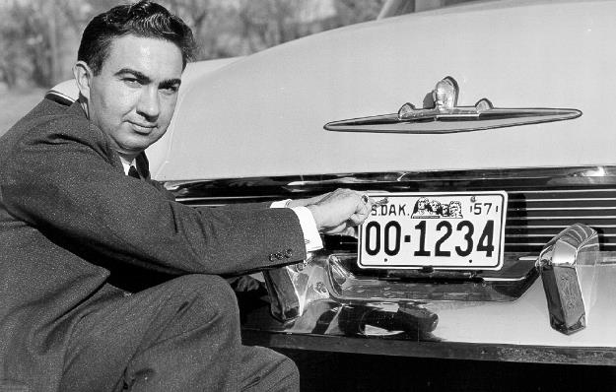

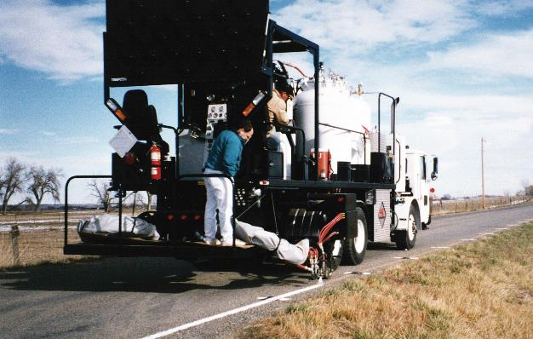

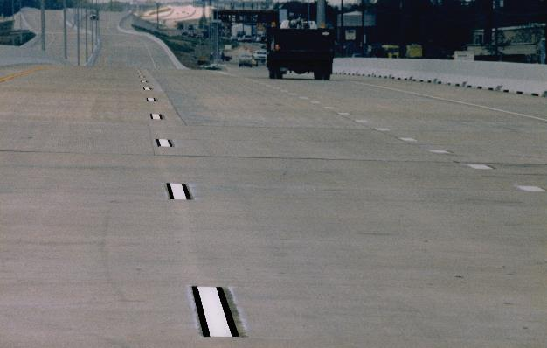

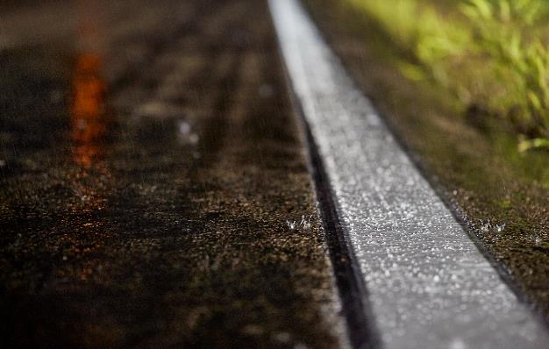
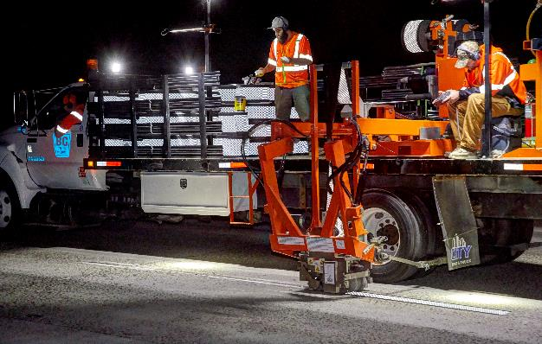
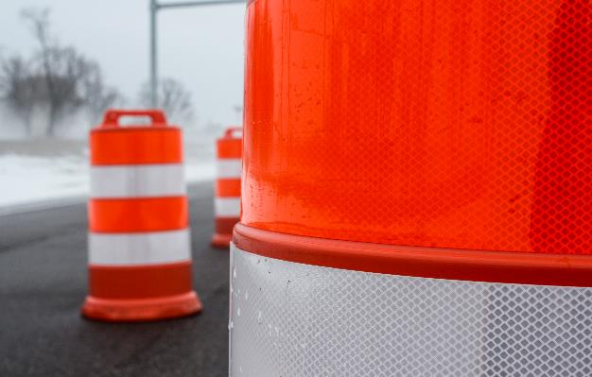

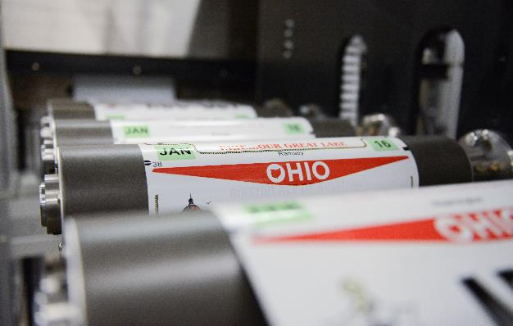

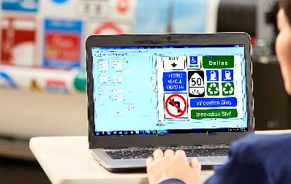
3M Transportation Safety Division History
1930
3M invents reflective sheeting and installs the first fully-reflective traffic
sign in 1939; reflective technology expands to road markings and license plates.
Microreplication technology improves retro reflectivity and increases day and nighttime sign visibility. Fluorescent technology makes work zone signs and devices and pedestrian crossings more visible during dusk, dawn, and inclement weather.
Wet reflective technology makes road markings visible in the rain; conspicuity markings make trucks and vehicles more visible; digital printing innovations enable enhanced graphics and more efficient traffic sign and license plate production.
2020
Notes:
3M has been applying Science to Life to solve transportation safety challenges over the last 80 years
Reflective technology was applied to road markings after we invented the first fully-reflective traffic sign in 1939 to improve marking visibility at night
In the mid 90’s contrast markings were developed to improve visibility of markings on light colored surfaces like concrete
More recently, we’ve applied 3M science to solve another key transportation safety challenge: pavement marking visibility at night in the rain
3M has been and will continue to be focused on solving the most pressing transportation safety related challenges for the foreseeable future

Slide 6
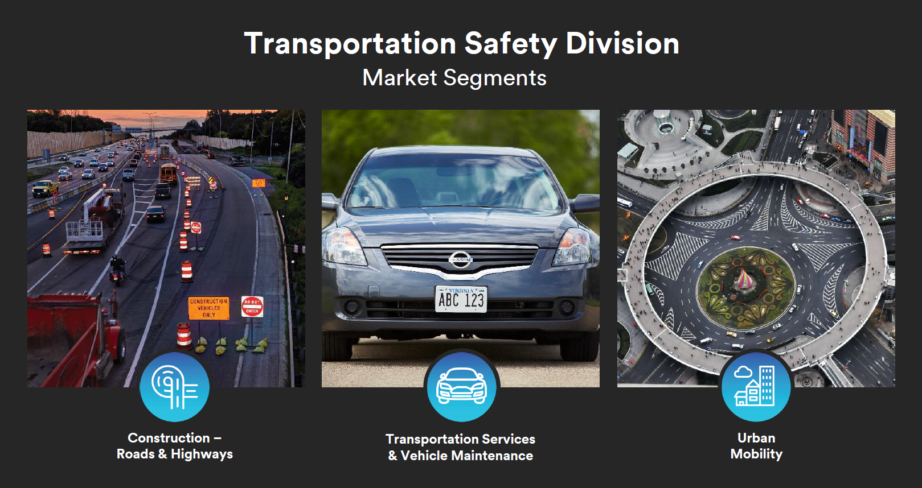

Slide 7
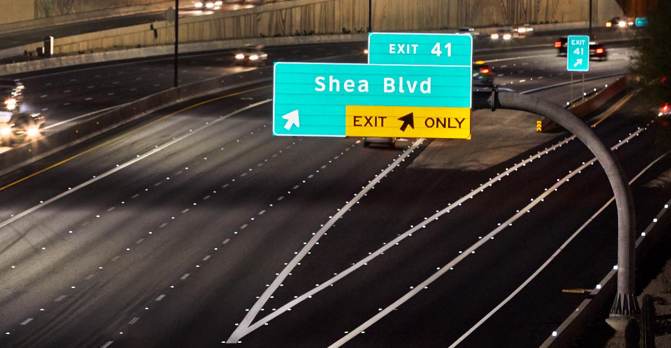
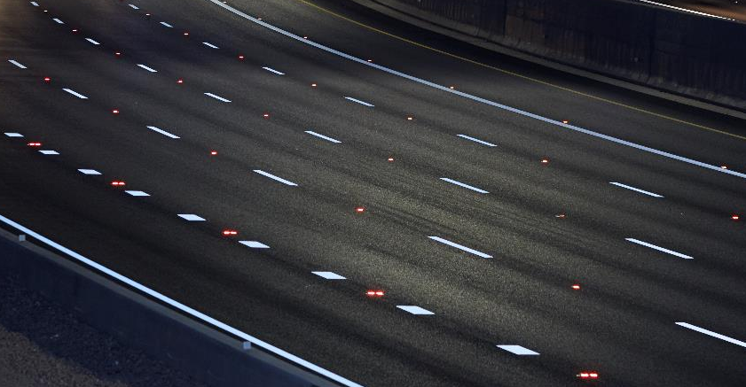
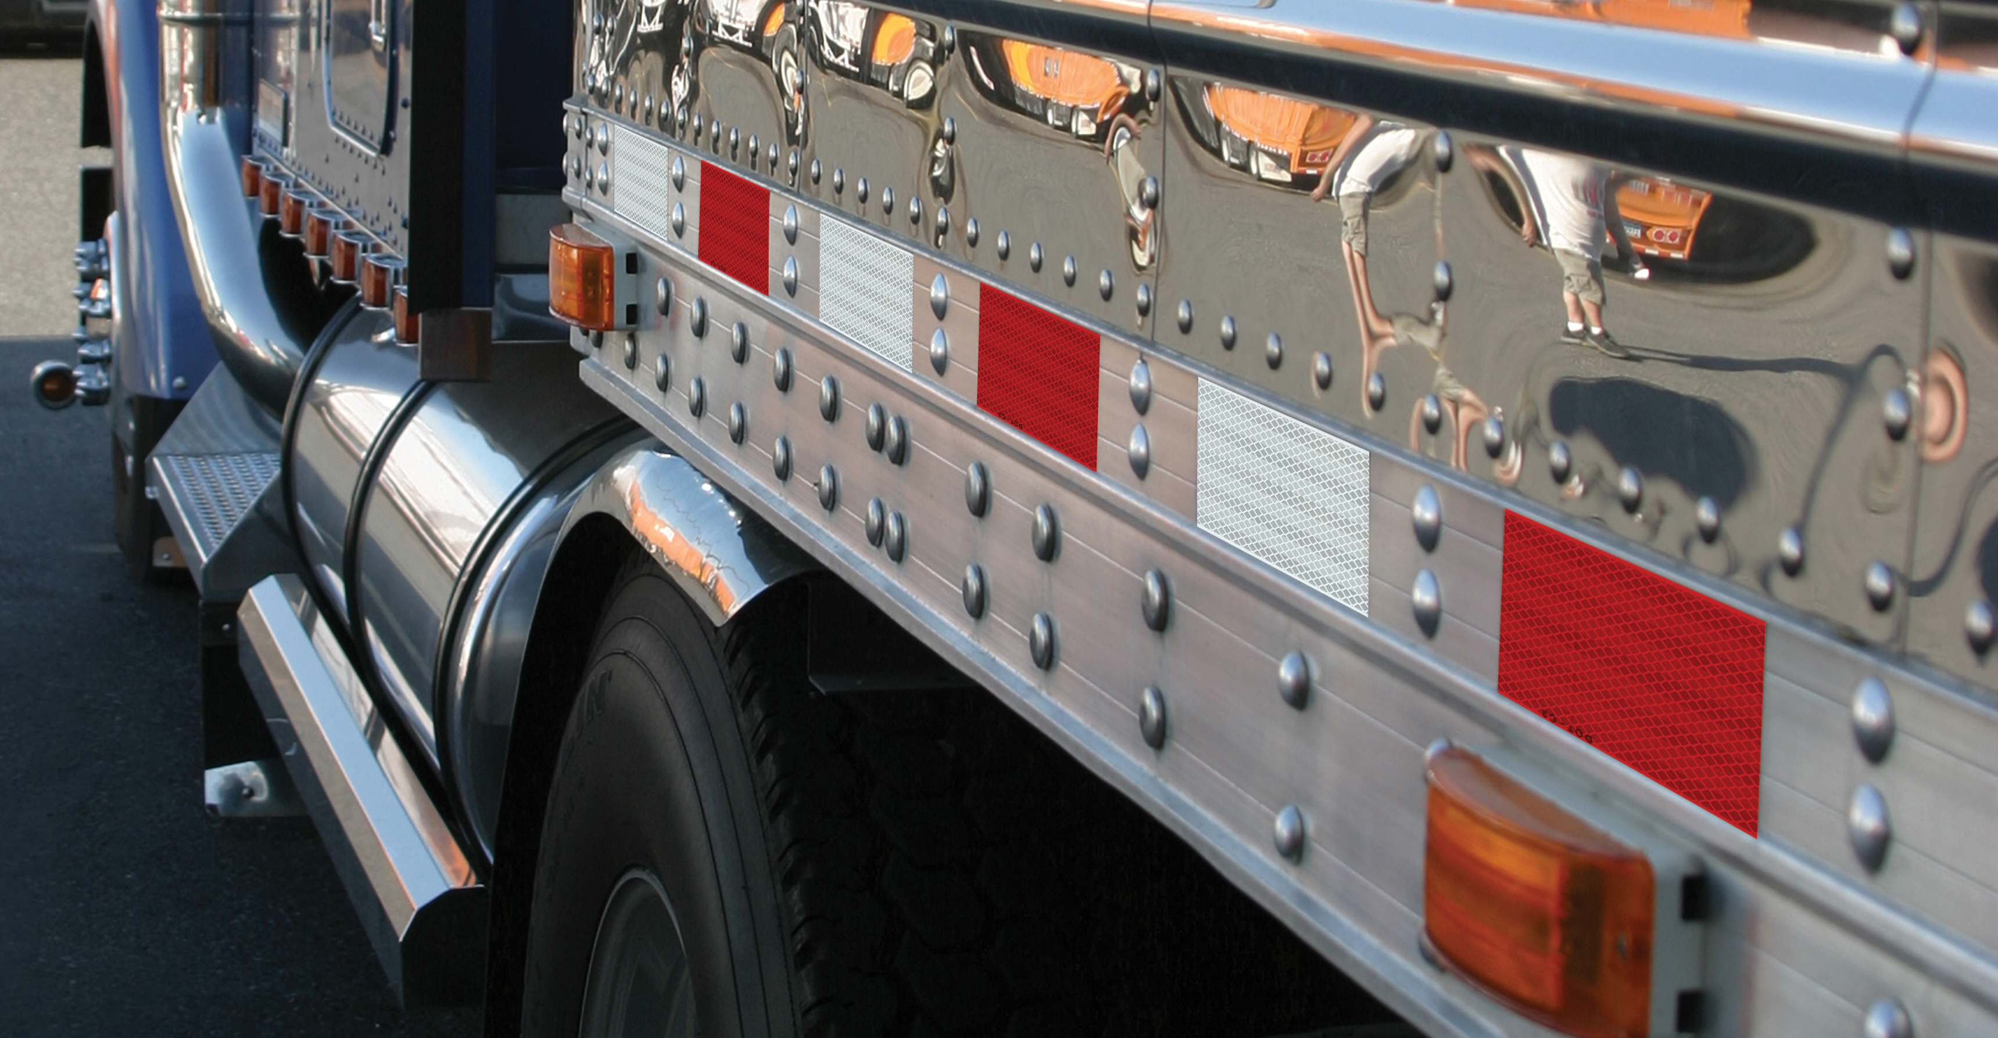

Science of Safety and Retro-reflectivity
Traffic
Signs
Pavement
Markings
Vehicle
Markings
Wet
Reflectivity
Studies have found that where more-visible signs are installed, crash numbers have fallen
25% to 46%
In three to six years
Durable Pavement Marking Tape
Truck collisions down
49%
58%
3x
Reduction in
Wet – Night Fatalities
In 22 years
brighter
32%
Than standard markings after 15 months
Reduction in
Wet – Night Crashes
Notes:
Ripley, D.A, Howard R. Green Company, ITE AB04H313, Quantifying the Safety Benefits of Traffic Control Devices—Benefit-Cost Analysis of Traffic Sign Upgrades, 2005 Mid-Continent Transportation Research Symposium Proceedings.
Assessment of the Durability of Wet Night Visible Pavement Markings: Wet Visibility
Project Phase IV; Virginia Tech Transportation Institute
Safety Effects of Wet-Weather Pavement Markings: TRB 19-04199
Source: https://www.ncbi.nlm.nih.gov/pubmed/22974680

Slide 8



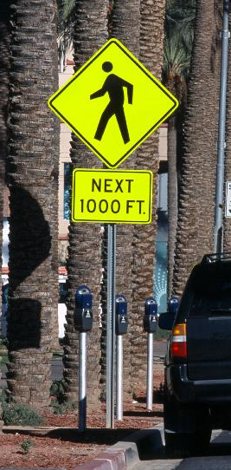
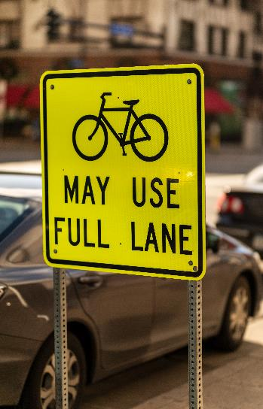
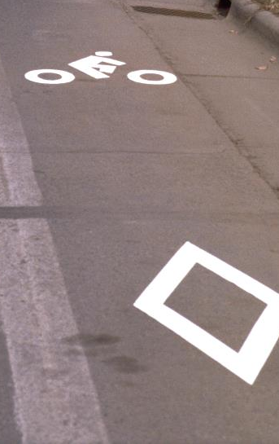
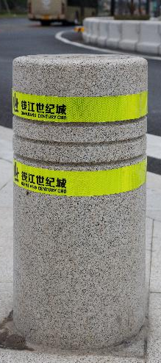
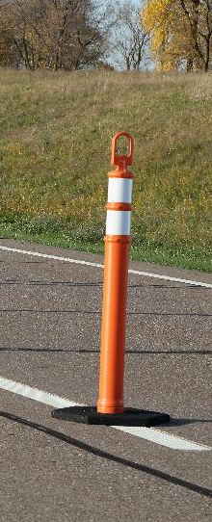
Holistic solutions to help enable safer urban mobility
Wayfinding and Safety Signage
Markings, Symbols, and Crosswalks
Delineation Markings

Slide 9
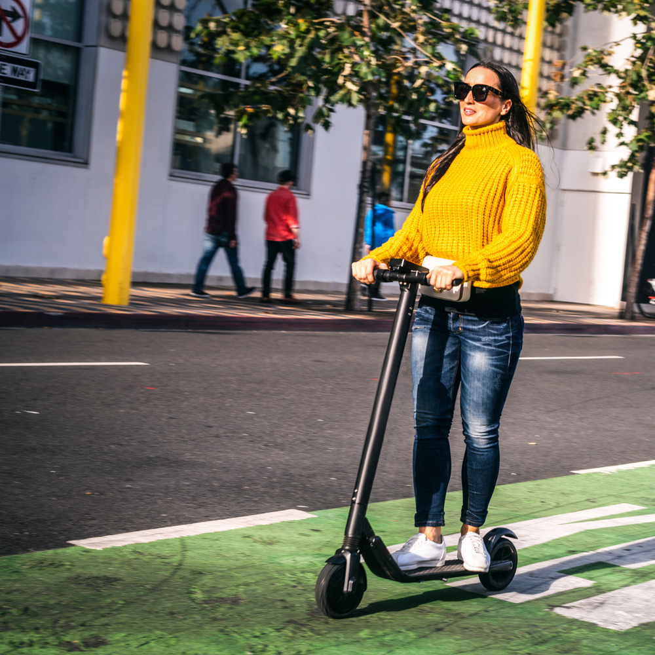

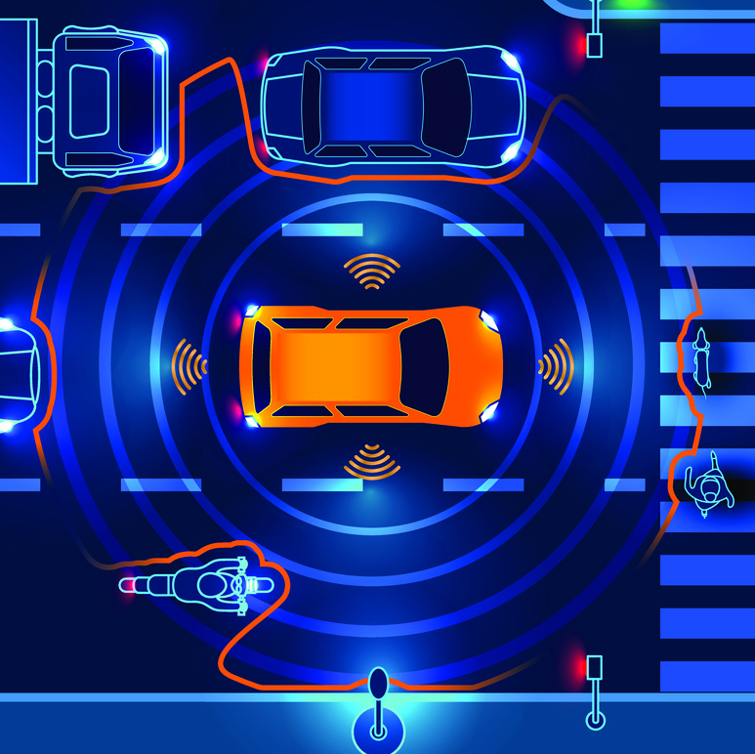

Four Current Revolutions in the
Transportation Industry
Micro Mobility
Ride
Sharing
Connected
& Automated Vehicles
Vehicle Electrification
Notes:
Industry is on the cusp of a change due to increased safety risk of road users, new technologies, regulations and business models

Slide 10
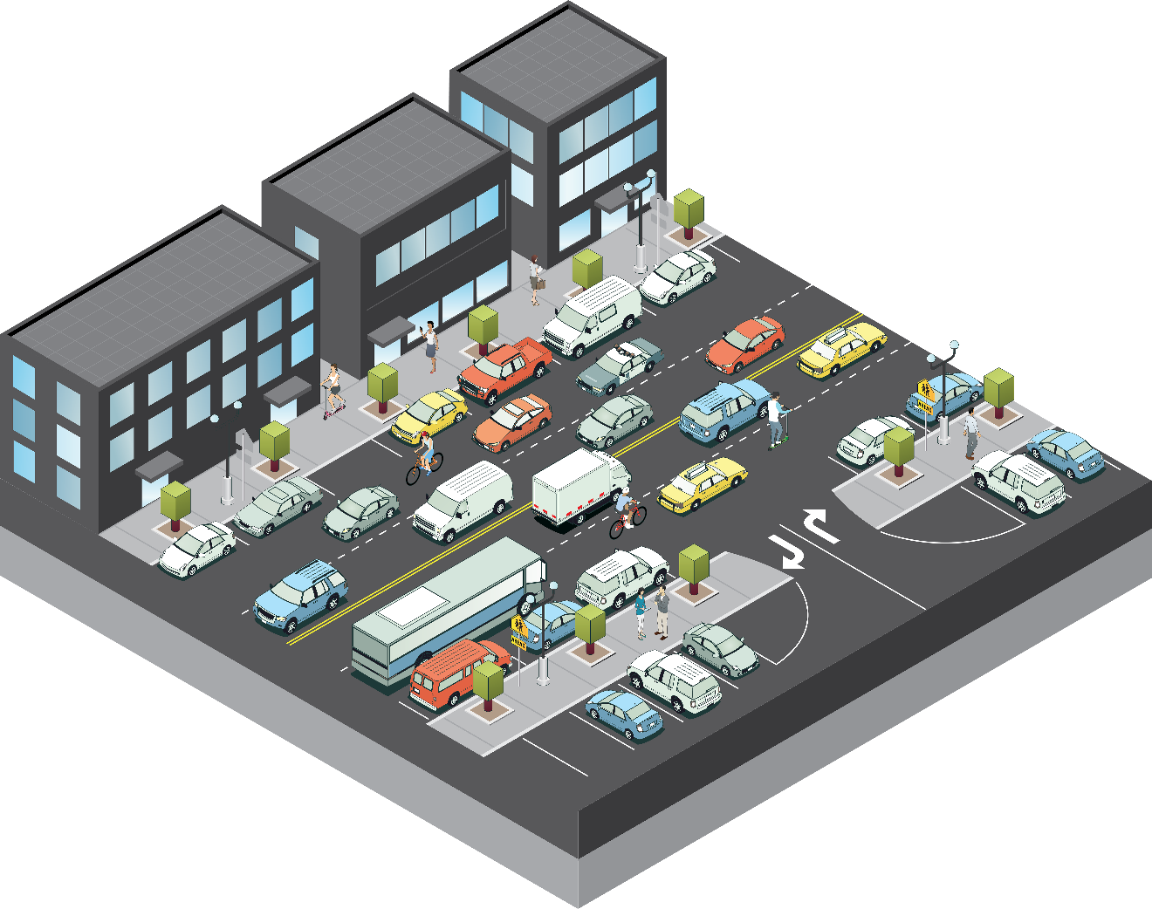
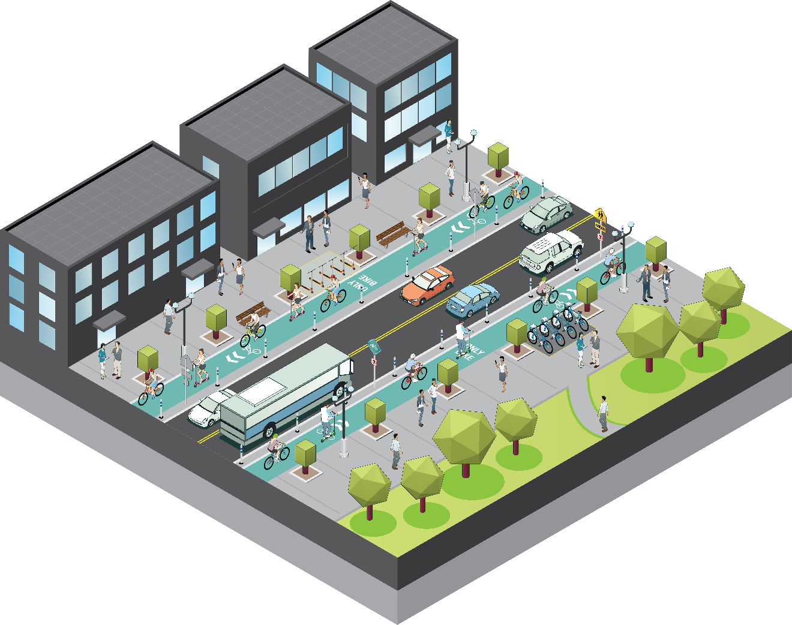
These trends and challenges are going to fundamentally alter the roads of our cities and how we interact with them

Slide 11

Power Metrics
6,227
pedestrian deaths in US
74%
in urban areas
79%
fatalities happen at dawn, dusk or night
Source: GHSA, NHTSA
Notes:
GHSA: https://www.ghsa.org/sites/default/files/2019-02/FINAL_Pedestrians19.pdf

Slide 12
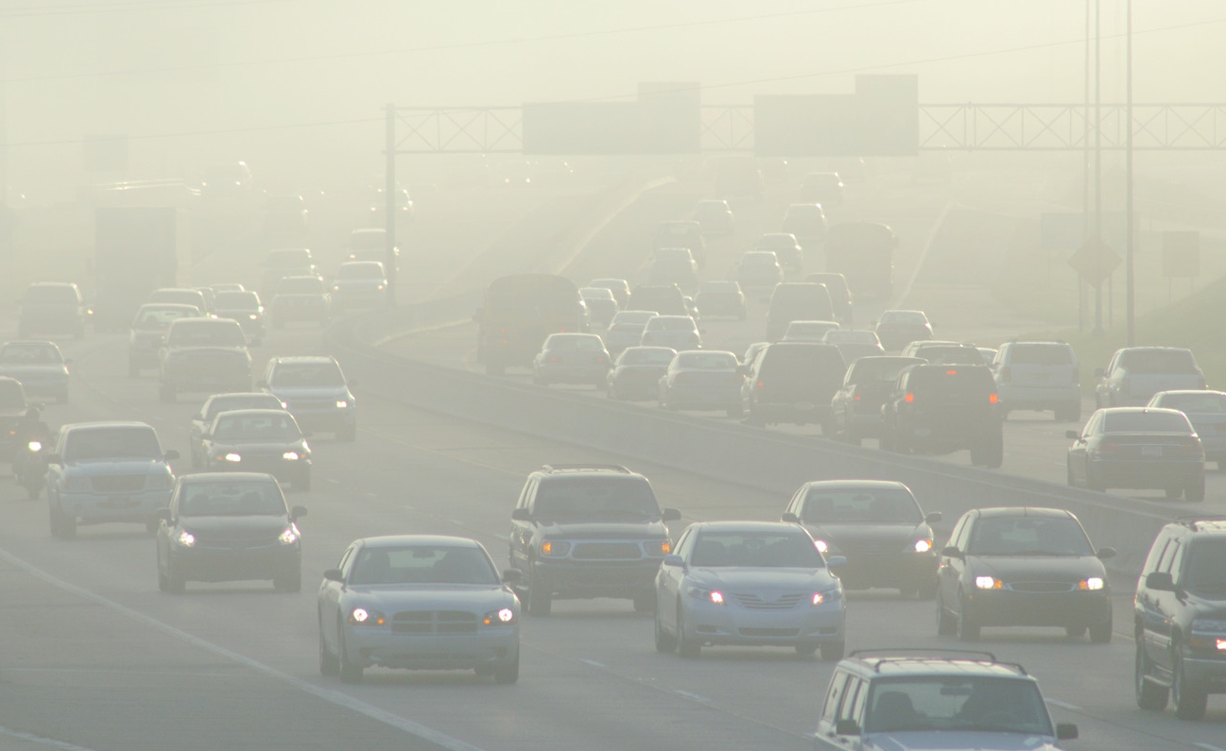


01
02
03
Improving Safety
Congestion and Air Quality
Transportation
Equity
Top 3 Challenges Every City Cares About
Solutions to urban safety and accessibility problems will evolve in tandem with cities
Improving roadway safety is a top priority, driven by analytics and greater access to pedestrian data.
Traffic congestion and limited infrastructure funding create major strain on existing roadways.
Officials prize easy maintenance, durability, and low-cost solutions when shopping for transportation safety products.
Source: Research by 3M & Government Business Council

Slide 13


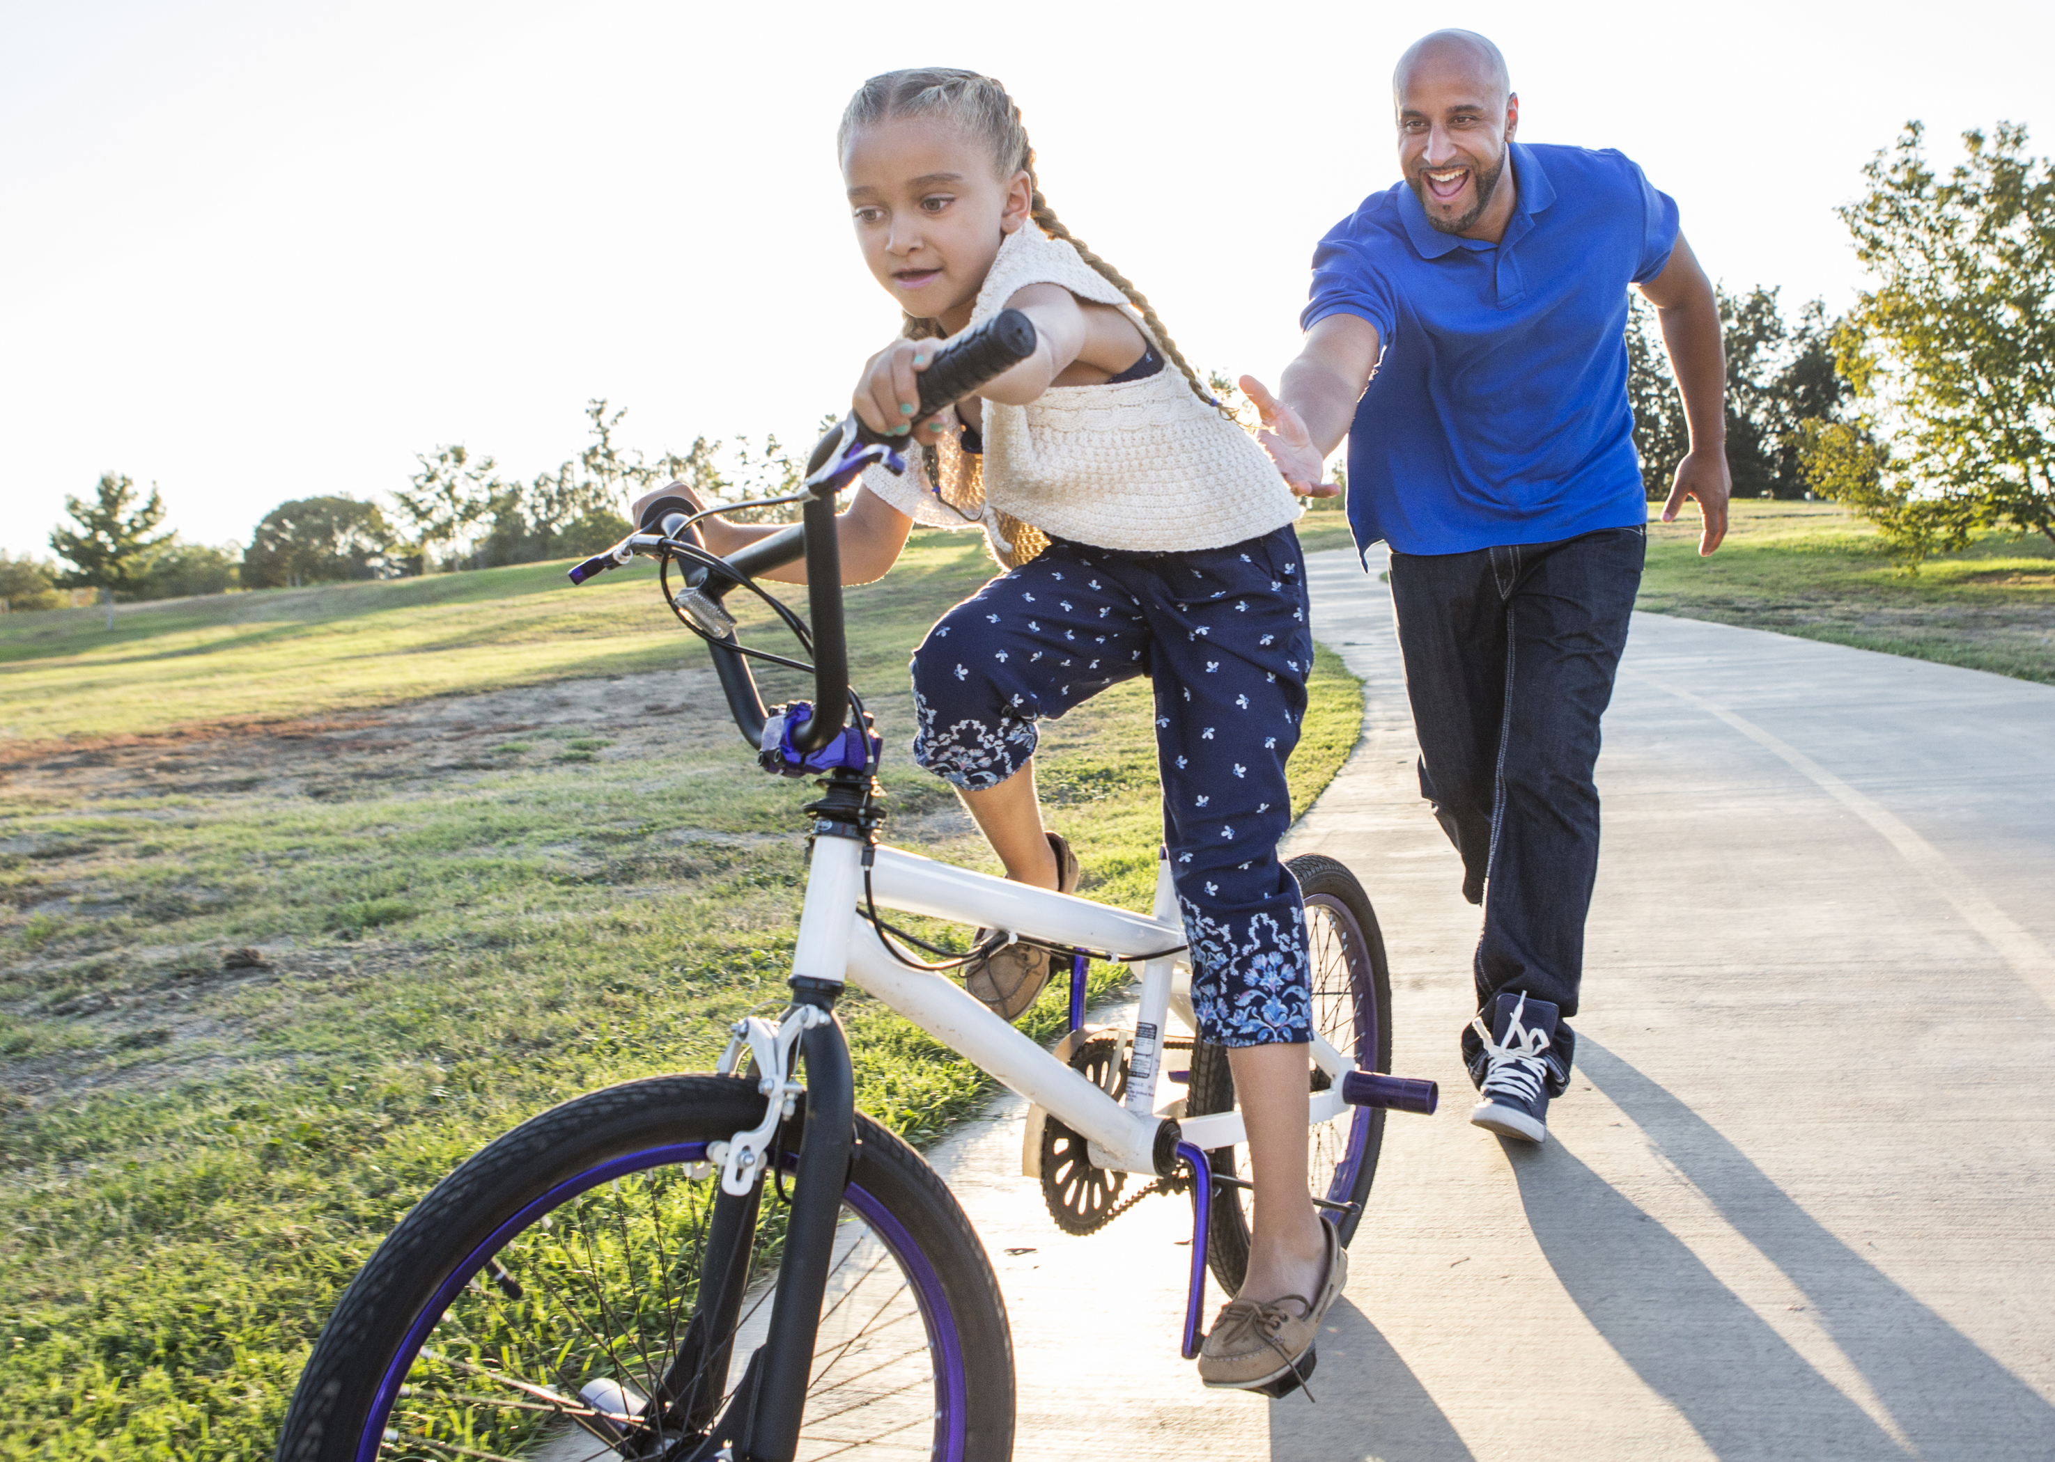
03. Transportation Equity
Lack of safe walking and bicycling conditions represent an obstacle to adequate physical activity for young people*
*National Institute of Health
Women are considerably less likely to commute by bicycle because they are more sensitive to road safety conditions*
Complete Streets create a more equitable transportation system by providing affordable, convenient, and accessible modes of transportation for all people, including vulnerable populations*
*Transportation Research Board
*Victoria Transport Policy Institute

Slide 14
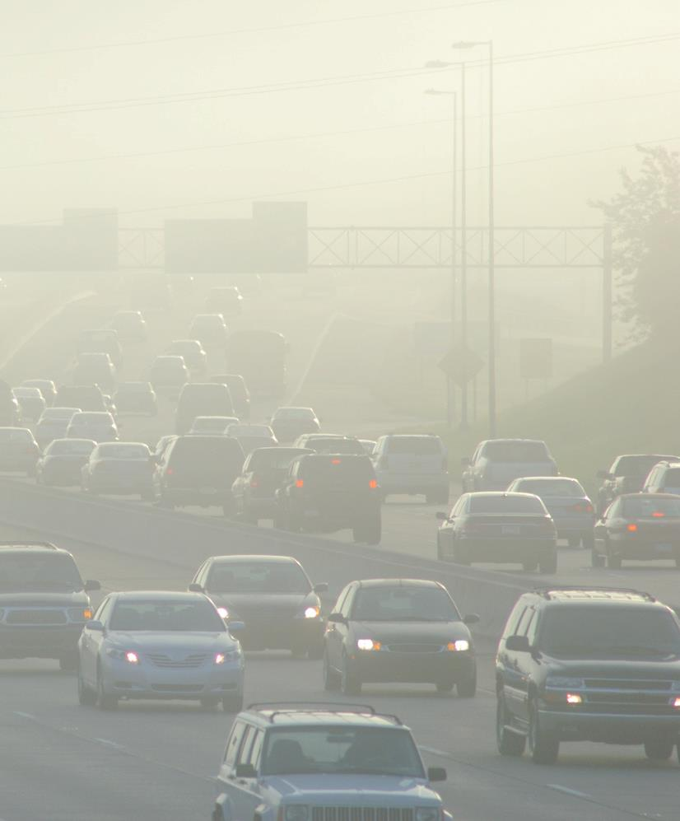
02. Congestion and Air Quality
Multimodal transportation programs improve quality of life in cities
$7,869 / quality-adjusted life year gained via NYC Citi Bike Exchange Program
Rapid transit projects have the potential to reduce greenhouse gas emissions
11 new bus rapid transit projects in Mexico, Colombia, China, India, and South Africa by 31.4 million tons over the next 20 years. This amount is equivalent to the annual emissions of more than 6.5 million cars**
Cities prioritize multimodal safety and adjust policy
Vision Zero commitments
Complete Streets Policies
Implement FHWA Countermeasures
Source: *Journal of Urban Health, ** EMBARQ

Slide 15
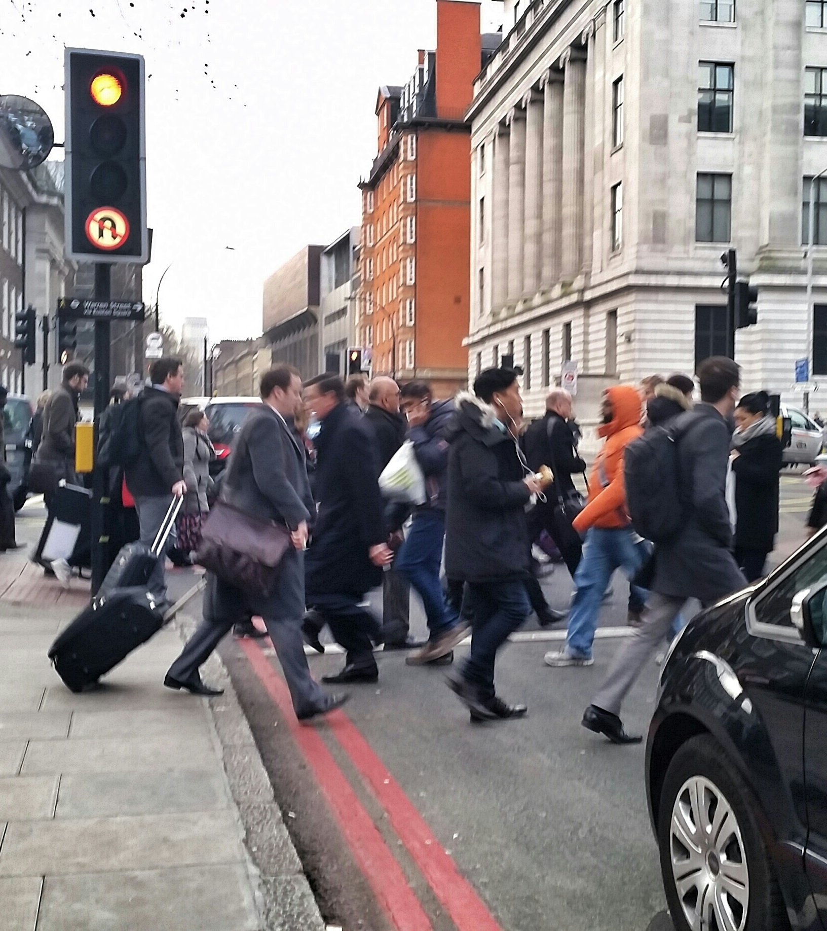
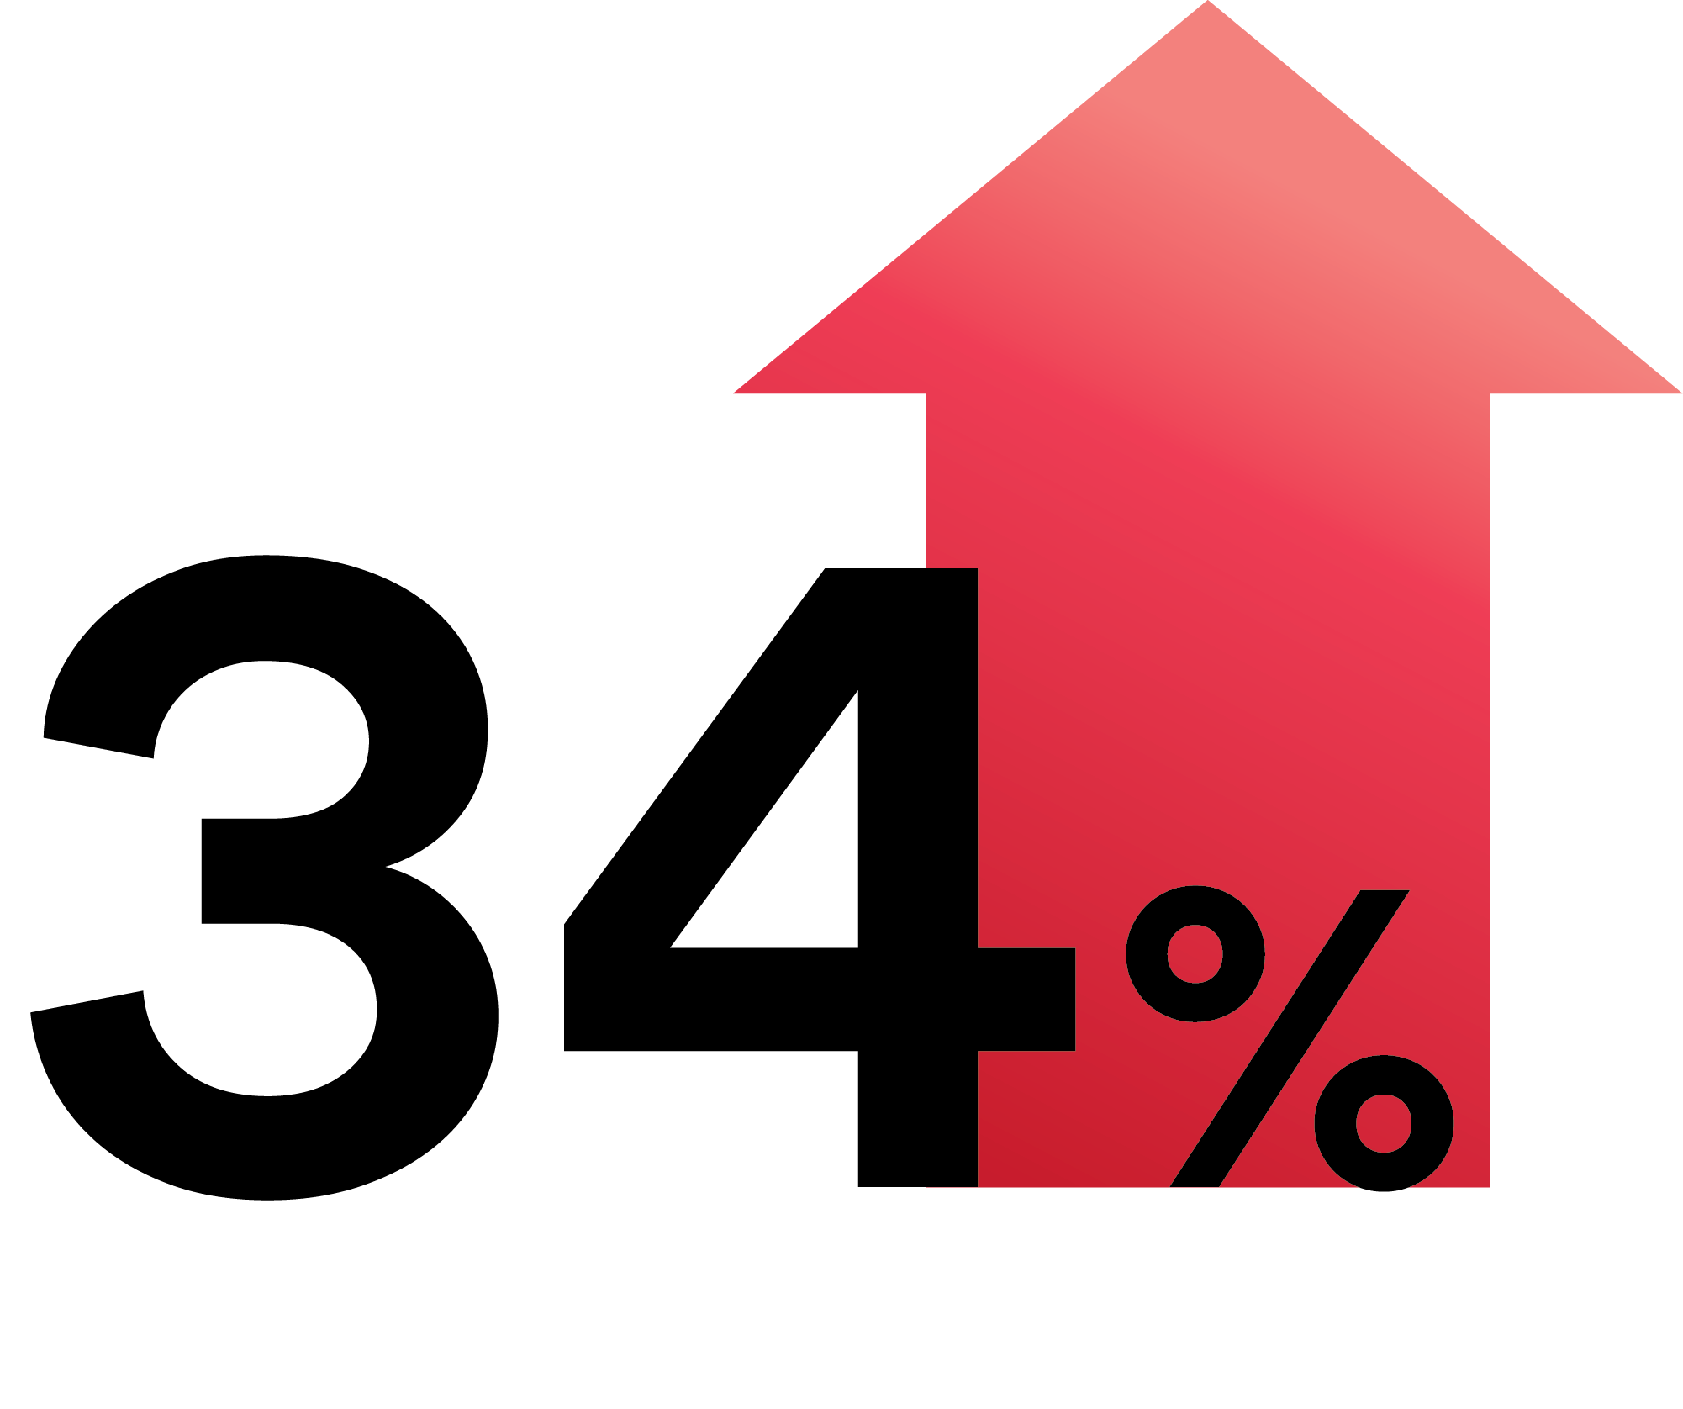
01. Improving Safety
Urban fatalities
increased
Since 2009
Source: NHTSA

Slide 16
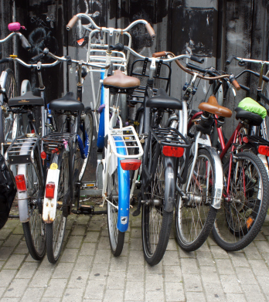
01. Improving Safety
859 cyclist fatalities in 2018, an increase of 6.3% since 2017. The deadliest in the last 30 years.
Source: NHTSA

Slide 17
Road diets allow space for
curb extensions, bicycle lanes,
and other countermeasures which
can reduce crashes by 19-47%
Source: FHWA Road Diets; FHWA Crosswalk Visibility
Notes:
Road diet reference: https://safety.fhwa.dot.gov/ped_bike/step/docs/TechSheet_RoadDiet_508%20compliant.pdf
Crosswalk visibility reference: https://safety.fhwa.dot.gov/ped_bike/step/docs/TechSheet_VizEnhancemt_508compliant.pdf

Slide 18
Road diets allow space for
curb extensions, bicycle lanes,
and other countermeasures which
can reduce crashes by 19-47%
Crosswalk visibility enhancements
such as markings and warning signage
can reduce crashes by 23-48%
Source: FHWA Road Diets; FHWA Crosswalk Visibility
Notes:
Road diet reference: https://safety.fhwa.dot.gov/ped_bike/step/docs/TechSheet_RoadDiet_508%20compliant.pdf
Crosswalk visibility reference: https://safety.fhwa.dot.gov/ped_bike/step/docs/TechSheet_VizEnhancemt_508compliant.pdf

Slide 19
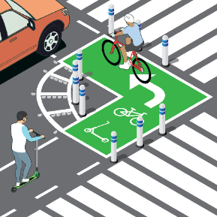

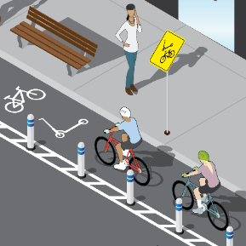
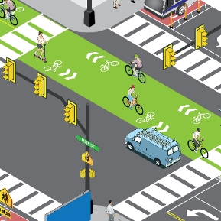
Proven Infrastructure Countermeasures
Curb Extension
Mid-Block Crossing
Bike Lane
Intersection
Curb extensions can greatly improve the visibility between pedestrians and drivers
USDOR FHWA Signalized Intersections: An Informational Guide – Safety
Updated: September 4, 2014
https://safety.fhwa.dot.gov/intersection/conventional/signalized/fhwasa13027/ch9.cfm
¾ of pedestrian fatalities occur mid-block
https://usa.streetsblog.org/2019/06/14/building-a-safer-mid-block-crossing/
Sense of safety is a barrier to bicycling, and separation is associated with increased perceptions of safety
Perceived Safety and Separated Bike Lanes in the Midwest: Results from a Roadway Design Survey in Michigan (Rebecca L. Sanders1 and Belinda Judelman1 - 1Toole Design Group, LLC, Portland, OR)
More than 50% of combined total of fatal and injury crashes occur at or near intersections
USDOT FHWA Intersection Safety
Updated: December 2, 2019
https://highways.dot.gov/research/research-programs/safety/intersection-safety

Slide 20
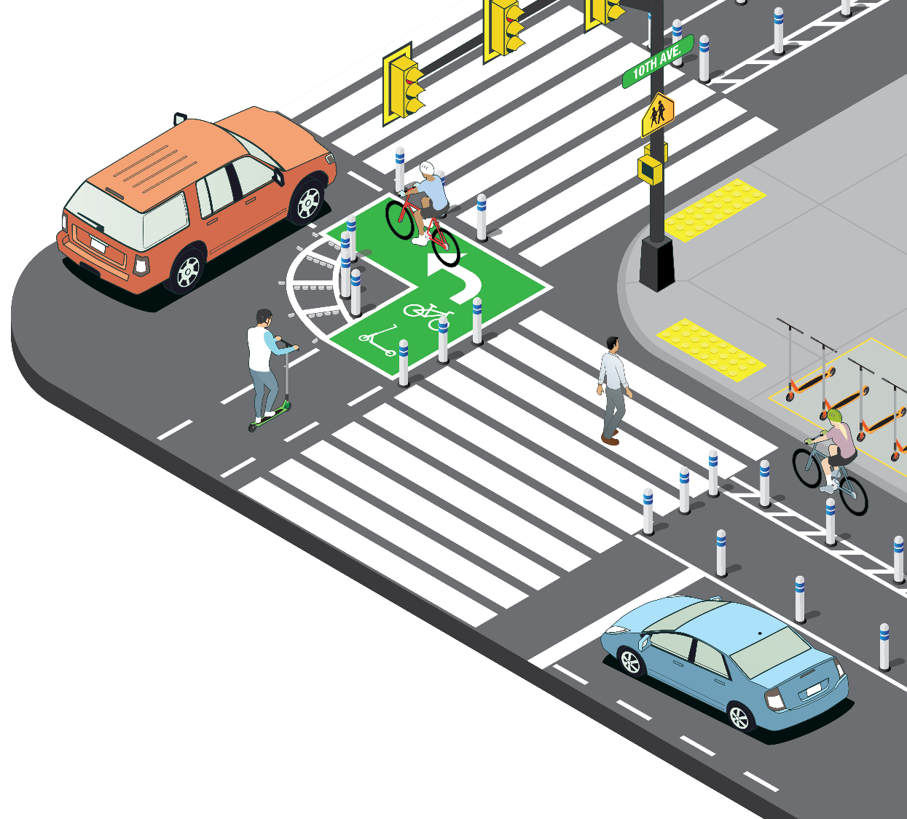
Traffic Calming
Conflict zone reduction
Dedicated space for all
Simple and scalable
Cost Effective
Curb Extension
FHWA Toolbox of Countermeasures and Their Potential Effectiveness

Slide 21


Products
3M™ Stamark™ Pavement Marking Tapes
3M™ Stamark™ Symbols & Legends
3M™ Raised Pavement Markers (RPM)
Red and White 2 Way
3M™ Diamond Grade™
Flexible Work Zone Sheeting

Slide 22
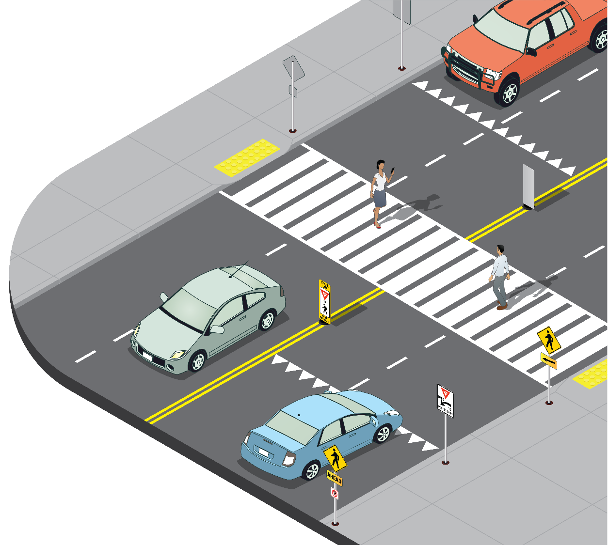
Greater visibility
Traffic Calming
Simple and Effective
Easy to understand
Mid-Block
Crossing
FHWA Toolbox of Countermeasures and Their Potential Effectiveness for Intersection Crashes

Slide 23
Products
3M™ Stamark™
Pavement Marking Tape
3M™ Diamond Grade™
Fluorescent Sheeting
3M™ Diamond Grade™
Reflective Sheeting

Slide 24
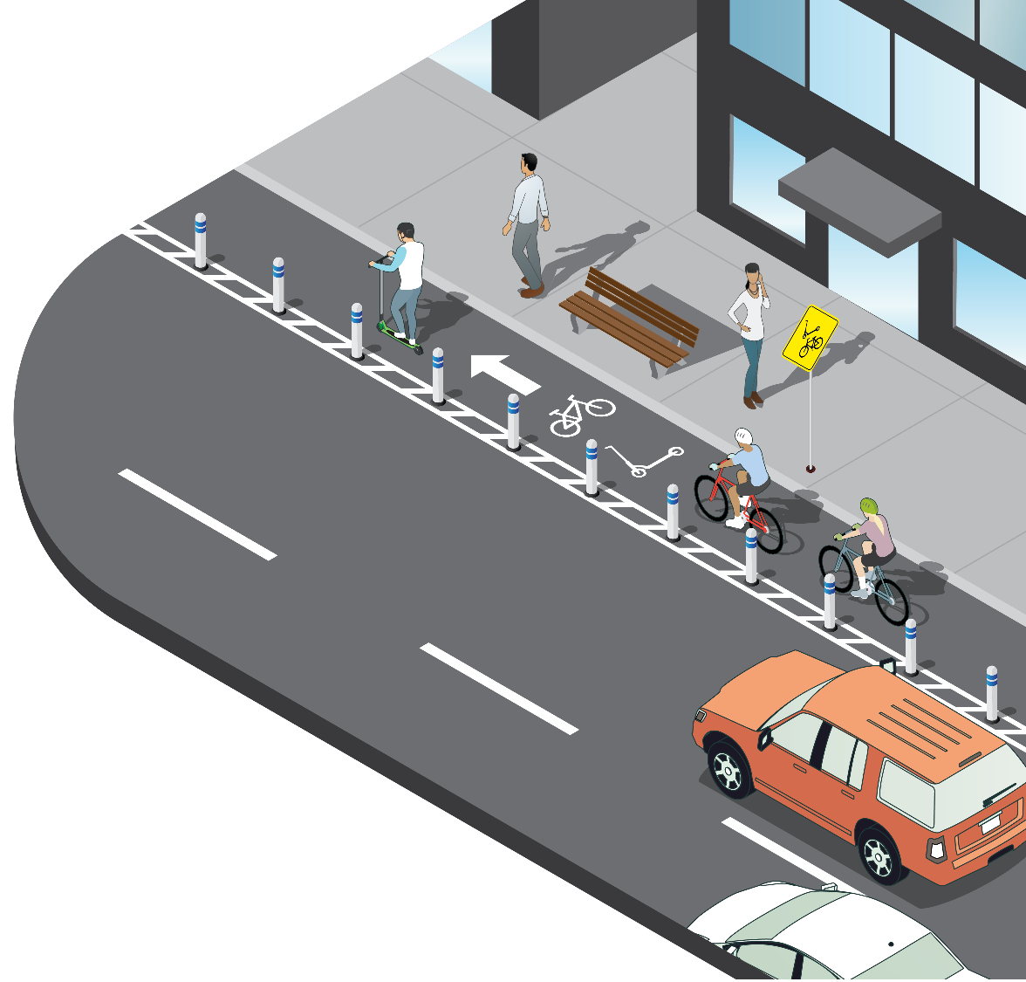
Dedicated user space
Safer
Easy to install
Easy to modify
Permanent and temporary options
Bike
Lane
FHWA Toolbox of Countermeasures and Their Effectiveness of Bike Lanes

Slide 25
Products
3M™ Stamark™
Pavement Marking Tape
3M™ Stamark™
Symbols and Legends
3M™ Diamond Grade™
Reflective Sheeting
3M™ Diamond Grade™
Flexible Work Zone Sheeting

Slide 26
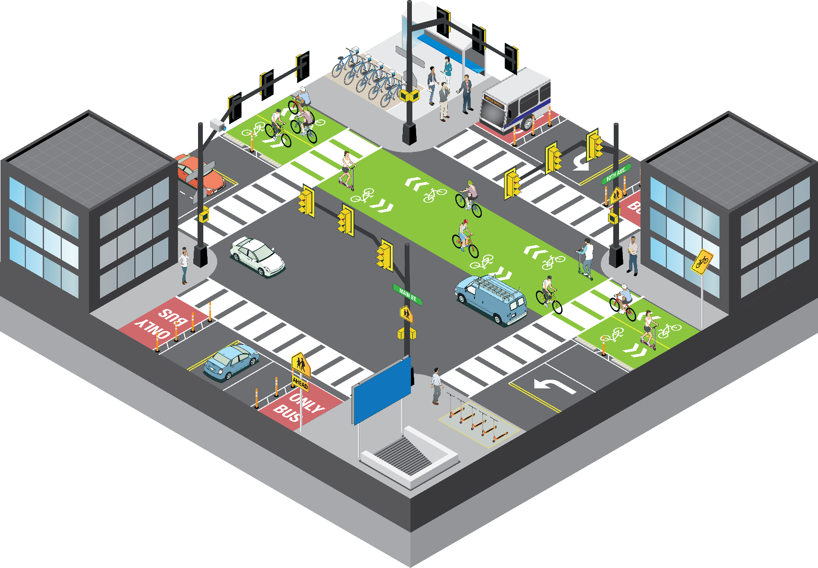
Help make pedestrians and/or crosswalks more visible
Inclement weather visibility
Permanent and Temporary options
High Visibility
Intersection
FHWA Crosswalk Visibility Enhancements

Slide 27
Products
3M™ Stamark™
Pavement Marking Tape
3M™ Stamark™
Symbols and Legends
3M™ Diamond Grade™
Reflective Sheeting
3M™ Diamond Grade™
Flexible Work Zone Sheeting

Slide 28
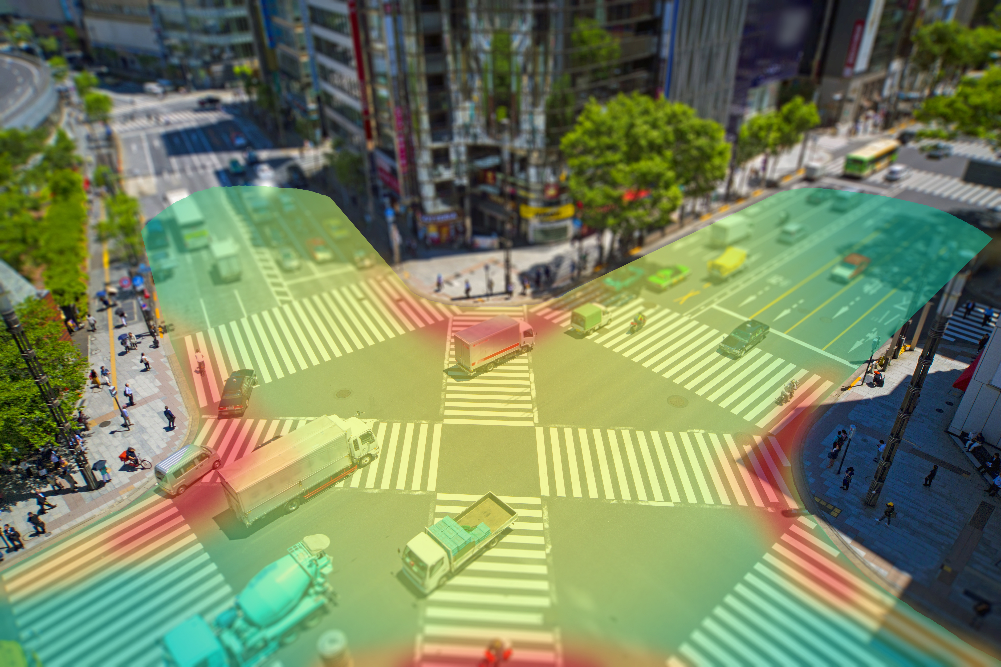
Safety Analytics
Visualize intersection and streets to help create pro-active solutions
Quantify safety impact of changes and share improvements with stakeholders
3M collaborates with data analytics technology leaders to provide data driven safety solutions

Slide 29

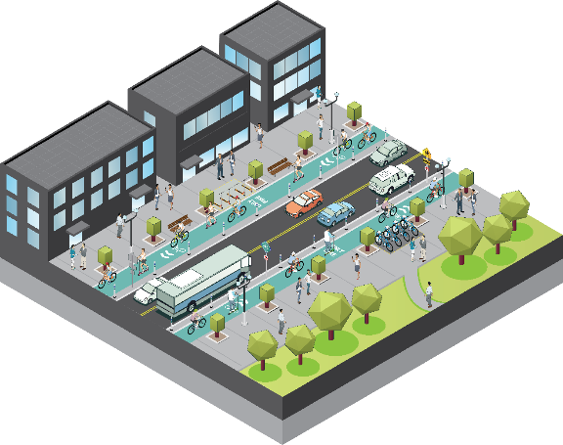

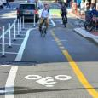
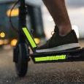

Urban Safety Solutions
Parking and wayfinding
Bike lane and scooters
Traffic light backplates
Anti-graffiti
Delineators between bicycle/scooter lanes and vehicle lanes
Sheeting for traffic cones and barrels
Bollard sheeting
Symbols and legends
Intersection markings
Raised pavement markers
Bike lanes
Parking for multi-modal transportation
Bicycles
Scooters
School buses
Delivery vehicles and other small trucks
Public works vehicles
Intersection Analysis
Roadway Assets

Slide 30
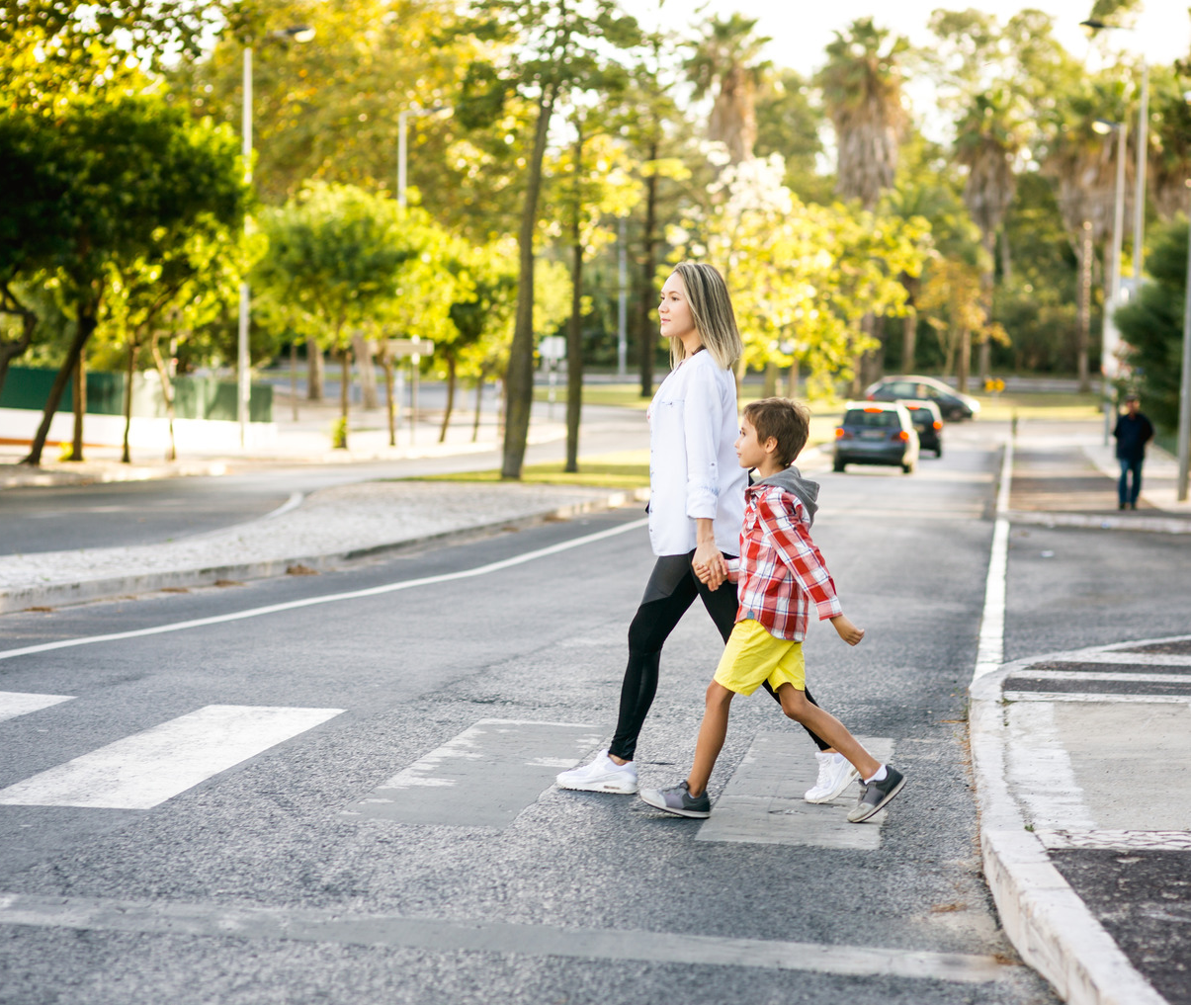
A mission toward Zero
Our goal is to help drive roadway deaths to zero using a suite of products that address safety concerns on every facet of the road

Slide 31
Thank you

