Slide 1
Help Improve Road Safety with Wet Reflective Pavement Markings
Presenter
Transportation Safety Division

Slide 2
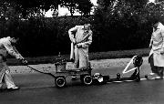
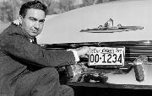
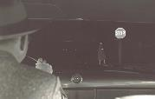
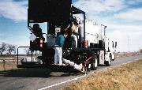
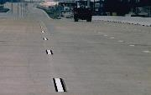
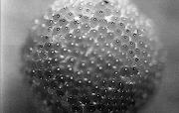
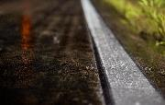
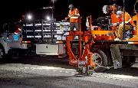
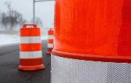
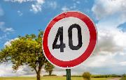
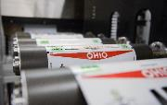
3M Transportation Safety Division History
1930
3M invents reflective sheeting and installs the first fully-reflective traffic sign in 1939; reflective technology expands to road markings and license plates.
Microreplication technology improves retro reflectivity and increases day and nighttime sign visibility. Fluorescent technology makes work zone signs and devices and pedestrian crossings more visible during dusk, dawn, and inclement weather.
Wet reflective technology makes road markings visible in the rain; conspicuity markings make trucks and vehicles more visible; digital printing innovations enable enhanced graphics and more efficient traffic sign and license plate production.
2020
Notes:
3M has been applying Science to Life to solve many transportation safety challenges over the last 80 years
Reflective technology was applied to road markings after we invented the first fully-reflective traffic sign in 1939 to improve marking visibility at night
In the mid 90’s contrast markings were developed to improve visibility of markings on light colored surfaces like concrete
More recently, we’ve applied 3M science to solve another key transportation safety challenge: improving pavement marking visibility at night in the rain
Now, I know what transportation officials are thinking – why should I dedicate limited resources to helping solve this problem? The next few slides outlines a data driven case for why we would argue funding should be directed towards this technology
First…

Slide 3
3M Technology improves the visibility of roadway infrastructure
Signing
Pavement Markings
Temporary Traffic Control
Notes:
Broadly speaking, 3M helps improve the visibility of important guidance related roadway infrastructure through:
Bright reflective sign sheeting
Bright durable pavement markings
Highly visible fluorescent temporary traffic controls for highly visible work zones
While all technologies are important, I’d like to focus today’s discussion on the role pavement markings have on reducing crashes and helping bring families home safely

Slide 4
Pavement markings must be visible both day and night
Notes:
According to the US DOT, Pavement markings are one of the most important traffic control devices – they provide continuous information to road users to the roadway alignment, vehicle positioning, and other important driving-related tasks.
Of course, in order for pavement markings to be functional, they must remain visible to drivers at all hours of the day
But how often have you driven at night in the rain and not been able to see the pavement markings – I’d say a good majority of everyone on this call has experienced a situation like one I just described – in fact driving at night in the rain is a major problem on our roadways.

Slide 5
Driving at night in the rain is a big problem
Notes:
I’ll start by asking a rhetorical question – how often have

Slide 6
In 2017, 6,952 people died in crashes on U.S. roads when it was raining¹.
Notes:
According to the latest data from the USDOT, 6952 people lost their lives on American roadways while it was raining – that’s roughly the equivalent of a commercial airline crash every other week.
1) Source: US DOT National Highway Traffic Safety Administration, Fatality Analysis Reporting System (FARS). 2017 – Available from: https://www.nhtsa.gov/researchdata/fatality-analysis-reporting-system-fars

Slide 7
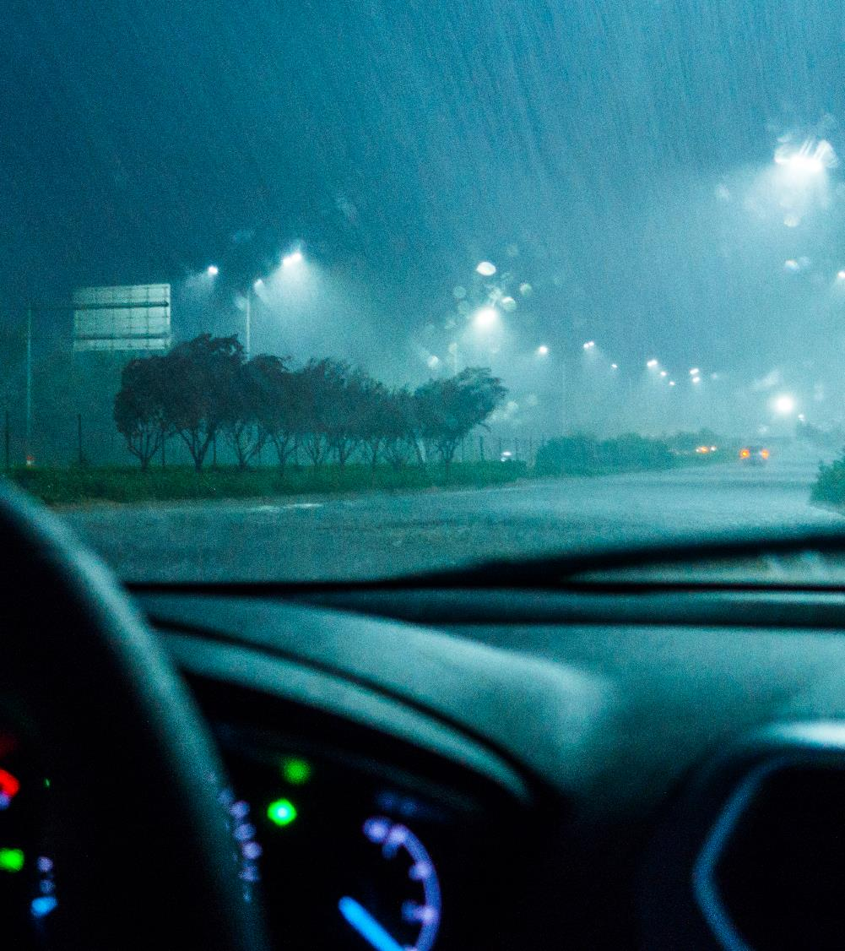
55% (or 3,811) of those deaths occurred at night or in low light conditions¹.
Notes:
Over half of those fatalities occurred at night or in low light conditions, that is the equivalent of closer to 1.5 commercial airliner crashes every month.
1) Source: US DOT National Highway Traffic Safety Administration, Fatality Analysis Reporting System (FARS). 2017 – Available from: https://www.nhtsa.gov/researchdata/fatality-analysis-reporting-system-fars

Slide 8
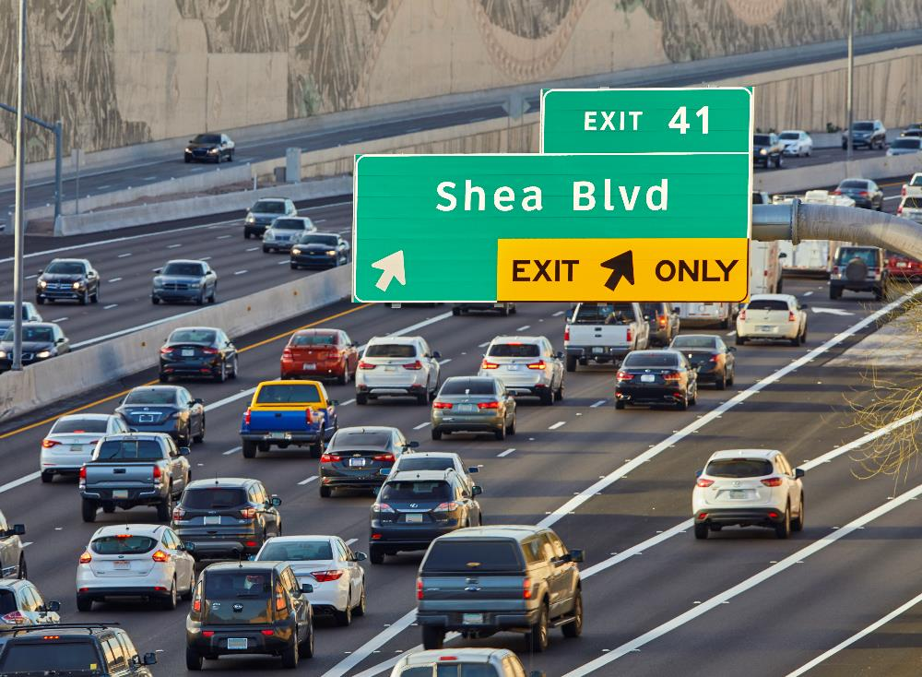
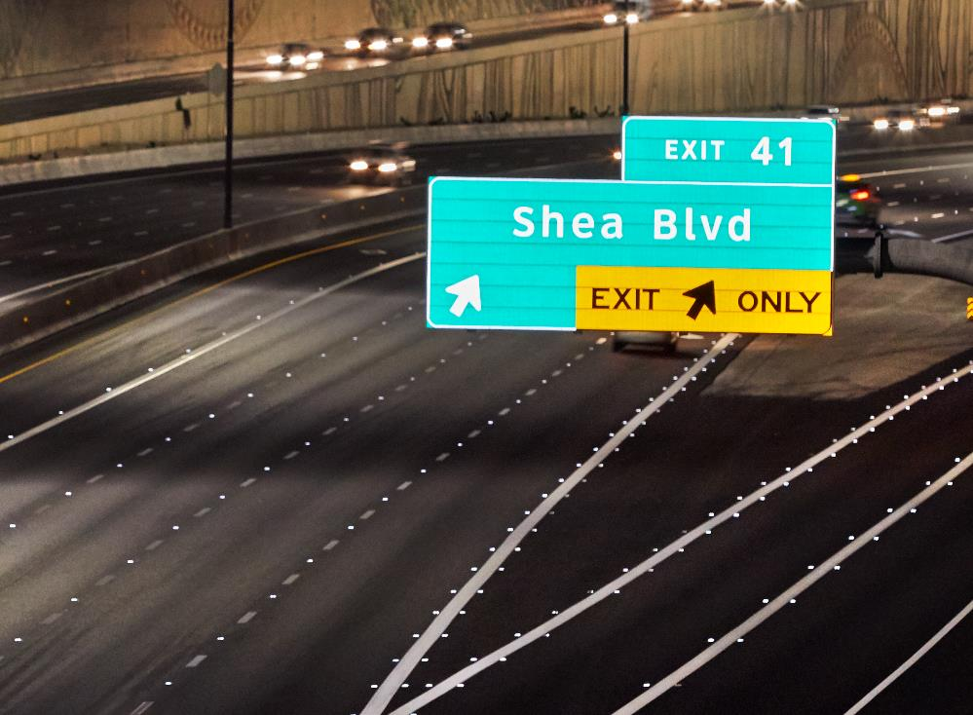
Only 25% of travel occurs at night².
Notes:
Yet we know that roughly 25% of vehicle travel occurs at night – so despite the fact that only 25% of travel occurs at night, over half of the fatalities happen in these conditions. The data is clear, driving at night in the rain is a big problem and these two conditions rain are over aggravating factors in crash risk.
2) Source: US DOT National Highway Traffic Safety Administration. Passenger Vehicle Occupant Fatalities by Day and Night – A Contrast. May 2007, https://crashstats.nhtsa. dot.gov/Api/Public/ViewPublication/810637

Slide 9
Why Wet Reflective Pavement Markings Matter
Notes:
Now that we have set the stage for what is at stake, I’d like to quickly provide an example of why Pavement marking visibility in all weather conditions matters. Let’s place ourselves in the drivers seat.

Slide 10
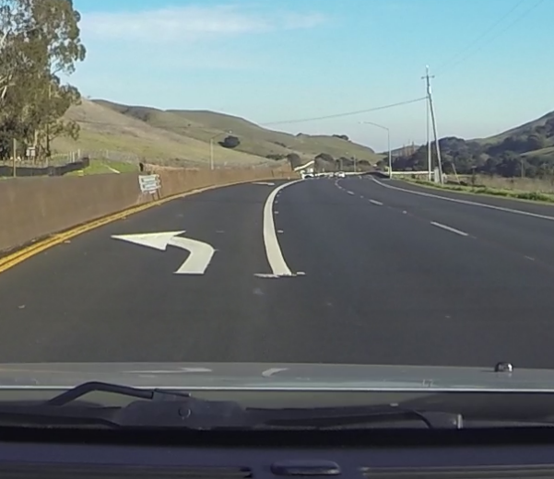
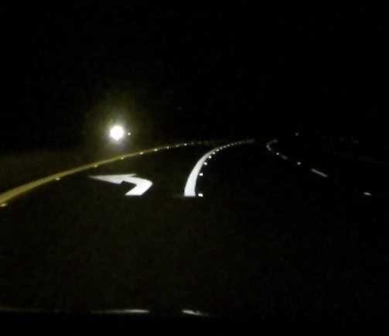
What do drivers see?
Daytime Dry
Night-time Dry
Night-time Rainy
Notes:
The three images that you see on the screen are taken from the same left hand turn lane but in different lighting and atmospheric conditions. That’s not the only difference, the technology between the white and yellow markings are different. Notice how all of the markings are fully visible in daytime and night time dry conditions but not in the nighttime rainy.
The solid white line and left turn symbol almost disappear to the driver ultimately failing to communicate important roadway navigation information.
Only the Yellow line is fully visible in all three conditions because it has all weather technology that make the marking visible day or night, rain or shine.
So this is what you or I would see on most roadways at night during the rain, but what’s the true impact of having only markings that are only visible in dry conditions?

Slide 11
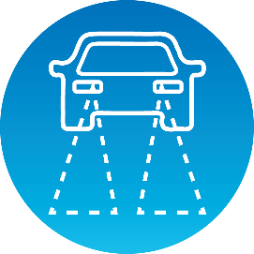
What happens when pavement markings disappear?
Reduced
Visibility³
Increased Discomfort³
Less Effective
Lane Guidance⁴
Increased
Crash Risk⁵
Notes:
There has been recent research to document the safety effects of not being able to see pavement markings at night in the rain.
In 2016, the European Road Federation concluded a multi-year study that found that when markings aren’t visible at night in the rain driver visibility is reduced and driver discomfort is significantly increased.
More recently in 2019, studies have looked at how pavement marking visibility at night in the rain impacts guidance systems on connected and autonomous vehicles – not surprisingly if we humans can’t see the lines then camera systems on these cars can’t see them either decreasing the effectiveness of these important safety features
And finally all of these risk factors lead to increased crash risk – a 2019 study published in Accident Analysis and Prevention found that crash risk increased as high as 80% when it was raining at night.
So we’ve now established that 1) driving at night in the rain is a big problem and 2) pavement marking visibility at night in the rain matters but do wet reflective markings actually help solve the problem?
Sources:
3) Konstandinos Diamandouros, and Michael Gatscha. “Rainvision: The impact of road markings on driver behavior – wet night visibility”. 6th Transport Research Arena, April 18-21, 2016. European Road Federation
4) Pike, A., Clear, S., Hedblom, T., and Whitney, J. “How Might Wet Retroreflective Pavement Markings Enable More Robust Machine Vision?” Transportation Research Record 1-6, 2019
5) Omranian, S., Sharif, H., Dessouky, S., Weissmann, J., “Exploring rainfall impacts on the crash risk on Texas roadways: A crash-based matched-pairs analysis approach.” Accident Analysis and Prevention, vol. 117, 2018, pp. 10-20

Slide 12
Research links wet reflective markings to helping reduce crashes
Safety Evaluation of Wet Reflective Pavement Markings: FHWA-HRT-15-083
46%
41%
12%
Reduction in Run-off-road crashes on multi-lane roads
Reduction in crashes with injury on multi-lane roads
Reduction in crashes with injury on freeways
Notes:
Luckily, there has been a focused attempt by the industry to evaluate the effectiveness of all weather pavement markings like the yellow line from a few slides ago.
This FHWA study from 2015 found that roadways that installed all weather pavement markings saw a significant decline in run off the road crashes and crashes with injuries on multi-lane roads and a modest reduction in crashes with injuries on freeways
Source: US DOT Federal Highway Administration. Safety Evaluation of Wet-Reflective Pavement Markings. Dec. 2015, FHWA-HRT-15-083

Slide 13
Research links wet reflective markings to helping reduce crashes
Safety Effects of Wet-Weather Pavement Markings: TRB 19-04199
32%
49%
Reduction in Wet – Night Crashes
Reduction in Wet – Night Fatalities
Notes:
A more recent study conducted by Texas A&M Transportation Institute and presented at this year’s annual TRB show found similar safety benefits of wet weather pavement markings.
The study evaluated was a rigorous before and after analysis on what happened to wet night crashes and wet night fatalities on roughly 700 miles of roads in Texas after wet weather markings were installed – the findings from this study confirm what FHWA had concluded in 2015:
all weather markings are a countermeasure that help reduce crashes
Source: Park, ES., Carlson, P., Pike, A., “Safety Effects of Wet-Weather Pavement Markings.” Transportation Research Board 2019 Annual Meeting: Available from: https://trid.trb.org/view/1572259

Slide 14
Not all pavement marking optics are created equal
Notes:
Now I’m going to turn it over to Tom, one of 3M’s division scientists for Pavement markings to explain the science behind wet reflective markings – before I do that, I’d like to show a short video

Slide 15
Pavement Marking Optics - Video
Notes:
https://multimedia.3m.com/mws/media/1610708O/reflective-optics-animated-video.mp4

Slide 16
Optics in the pavement markings return light back toward its source.
Notes:
Optics or Beads are used to retroreflect light back to the driver. Beads are either applied directly to a marking or beads are coated onto elements which is then either applied onto or embedded into a pavement marking.

Slide 17
When light travels from air into water, the direction changes. This change is called refraction.

Slide 18
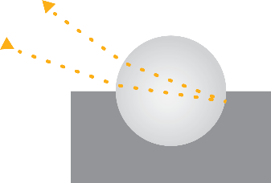
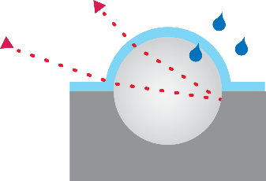
1.5 refractive index glass beads are commonly used for dry conditions, but fail in wet/rainy conditions
Dry 1.5 Refraction Index
Wet 1.5 Refraction Index
Notes:
Bead/Optics refracts light from oncoming headlight to the back of the bead which is typically embedded with a pigment material, it’s then reflected at the back of the bead and refracted as it exits heading back to the driver.
1.5 index beads are common in the industry, in dry conditions they are fairly bright.
But as 1.5 beads start get to wet, the refractive index is reduced. Light passing from air (1.0 RI) through a water film that has an index of refraction of 1.33 will change the overall RI of the index. The RI of that 1.5 bead is now reduced by ratio of 1.33 as it gets wetter and it acts more like a 1.1 RI bead which is not efficient as retroreflector at all.

Slide 19
1.9 refractive index beads are more efficient and increase light return in dry conditions, but still fail in wet/rainy conditions
Dry 1.9 Refraction Index
Wet 1.9 Refraction Index
Notes:
1.9 index beads are also common in the Pavement Markings industry. Because of a higher refractive index it has a larger aperture, it has more of the surface area of the bead capable of bending light to the back of the bead, also has enough refractive index to bend that light again closer to that incoming ray of light so 1.9 index beads will have higher retroreflectivity than 1.5 index beads in dry conditions.
But, like 1.5 beads, when a 1.9 bead gets wet it’s refractive index also starts to become reduced acting closer to a 1.4 refractive index bead and then in that case it does not have refractive index to bend light back to the driver so it’s not useful as a retroreflector for the driver.

Slide 20
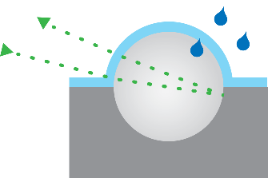
For beads, only 2.4 optics provide useful light return
in nighttime rainy conditions
Dry 2.4 Refraction Index
Wet 2.4 Refraction Index
Notes:
2.4 beads are also utilized in the industry – it has too high of a refractive index in dry index, it bends light too much.
But now as that 2.4 index beads gets wet with water it acts like a 1.8 refractive index bead when it is wet with water. 2.4 work very well when they are wet.

Slide 21
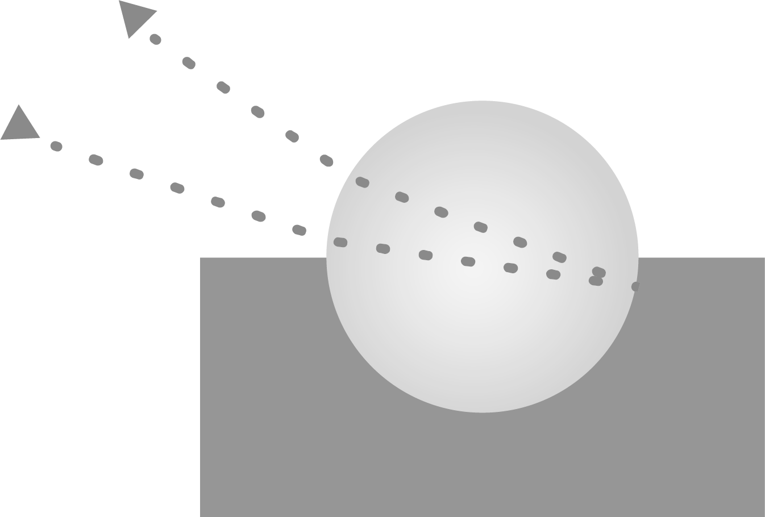
For all weather performance you want both 1.9 and 2.4 refractive index optics.
Dry 1.5 Refraction Index
Dry 1.9 Refraction Index
Dry 2.4 Refraction Index
Wet 1.5 Refraction Index
Wet 1.9 Refraction Index
Wet 2.4 Refraction Index
Notes:
3M employs 1.9 and 2.4 index beads in various ratios so when it is dry out our 1.9 beads share the burden of providing retroreflectivity and when it rains the 2.4 RI beads start taking over.

Slide 22
What to consider when building a wet reflective specification

Slide 23
Select the Right Test Method for Wet Retroreflectivity
ASTM Wet Continuous vs. Wet Recovery – during rainfall and after rainfall
Wet-Continuous ASTM E2832-12
Condition of continuous wetting
Simulates wet reflectivity of marking during rainfall
5-10 mins to complete
Wet Recovery ASTM E2177-19
Condition of standard wetness
Simulates wet reflectivity of marking after it’s stopped raining
3-5 mins to complete
Wet-Continuous
ASTM E2832-12
Wet-Recovery
ASTM E2177-19
Notes:
There are two ASTM test methods currently supported by the industry
Very different test methods, you will get different results depending on what you use

Slide 24
Forthcoming Human Factors Research from TTI & MnDOT
Final report expected to be published this month
Background: Currently no minimum wet visibility retroreflectivity standards
Project: Determine driver needs, recommended wet continuous retroreflectivity values
How it will be used: Justify state-wide standards for wet reflective pavement markings

Slide 25
GDOT Case Study Video
Notes:
https://www.3m.com/3M/en_US/road-safety-us/applications/road-markings/wet-reflective-pavement-markings/?utm_medium=redirect&utm_source=vanity-url&utm_campaign=3m.com/wetreflective

Slide 26
Wet Reflective Pavement Markings from 3M
All weather solutions for many applications
3M™ Connected Roads
All Weather Elements
3M™ Stamark™ High Performance Tape
Series 380AW
3M™ Stamark™ Wet Reflective Removable Tape Series 710

Slide 27
Key Takeaways
To learn more visit: www.3M.com/wetreflective
Rain and light conditions are aggravating factors in crash risk
Not all pavement marking optics have the same performance capabilities
2.4 refractive index optics provide optimal light return during rainy conditions at night
At night, during rainy conditions, non-wet reflective markings can’t be seen
Wet continuous test method is preferred
Recent research links wet reflective pavement markings to helping reduce crashes
Forthcoming human factors research from TTI/MnDOT to set visibility standards

Slide 28
Questions?

Slide 29
Thank you!

Slide 30
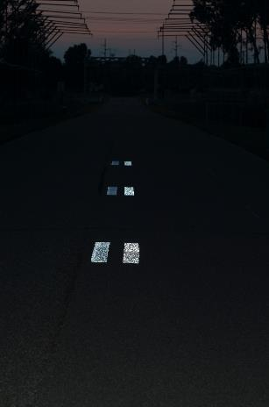
Wet reflective pavement markings help bring families home safely
A data driven safety case for wet reflective pavement markings
Rain at night is a big problem
Wet Reflective Markings Matter
Proven Safety Countermeasure
Dry
Rainy
Rain and light conditions are over
aggravating factors in crash risk
At night, during rainy conditions, non-wet reflective markings disappear
Recent research links wet reflective markings to helping reduce crashes
6952 fatalities on US roads during rain event¹
25% of road travel occurring at night²
55% of fatalities during rain occurred at night¹
Reduced driver visibility³
Less effective CAV guidance systems⁴
Increased crash risk⁵
FHWA*: 46% reduction run off road crashes⁶
FHWA*: 40% reduction crashes with injuries⁶
TTI: 49% reduction wet night fatalities⁷
*On multi-lane roads
Sources: USDOT Federal Highway Administration, European Road Federation, Transportation Research Record, Accident Analysis And Prevention, Texas Transportation Institute
Notes:
Sources:
1) US DOT National Highway Traffic Safety Administration, Fatality Analysis Reporting System (FARS). 2017 – Available from: https://www.nhtsa.gov/researchdata/fatality-analysis-reporting-system-fars
2) US DOT National Highway Traffic Safety Administration. Passenger Vehicle Occupant Fatalities by Day and Night – A Contrast. May 2007, https://crashstats.nhtsa. dot.gov/Api/Public/ViewPublication/810637
3) Konstandinos Diamandouros, and Michael Gatscha. “Rainvision: The impact of road markings on driver behavior – wet night visibility”. 6th Transport Research Arena, April 18-21, 2016. European Road Federation
4) Pike, A., Clear, S., Hedblom, T., and Whitney, J. “How Might Wet Retroreflective Pavement Markings Enable More Robust Machine Vision?” Transportation Research Record 1-6, 2019
5) Omranian, S., Sharif, H., Dessouky, S., Weissmann, J., “Exploring rainfall impacts on the crash risk on Texas roadways: A crash-based matched-pairs analysis approach.” Accident Analysis and Prevention, vol. 117, 2018, pp. 10-20
6) US DOT Federal Highway Administration. Safety Evaluation of Wet-Reflective Pavement Markings. Dec. 2015, FHWA-HRT-15-083
7) Park, ES., Carlson, P., Pike, A., “Safety Effects of Wet-Weather Pavement Markings.” Transportation Research Board 2019 Annual Meeting: Available from: https://trid.trb.org/view/1572259

