Slide 1
3M™ Advanced Flexible Engineer Grade Series 7300
Transportation Safety Division
External Sales Presentation
February, 2019

Slide 2
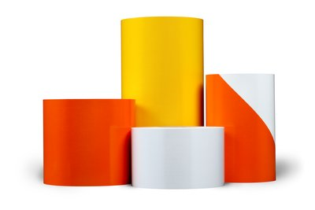
Why is 3M™ introducing a new flexible Engineer Grade Sheeting?
Engineer Grade beaded sheeting was invented by 3M in 1948
7300 series is an engineer grade sheeting that provides the benefits of microprismatic optics, improved whiteness, and ease of handling
3M has improved Engineer Grade beaded sheeting by incorporating flexible and microprismatic qualities, delivering a unique solution to address the needs of the market for Temporary Traffic Control applications
3M’s Transportation Safety Division remains committed to developing new products & technologies for all customers and all ranges of specifications
Note to approvers: This pic will be replaced with a new pic that includes red/white

Slide 3
3M™ Advanced Flexible Engineer Grade Series 7300
Optics: Benefits of prismatic retroreflective optics combined with handling you would typically expect from a beaded sheeting
Conformability: Meets multiple application requirements from manual application to fully automated machine application. Conforms to virtually any curved surface for a flexible solution
Adhesive: Pre-coated pressure sensitive adhesive optimized for metal and low energy surfaces like plastic and moderately rough or porous wood.
Surface: Designed with an impact resistant coating making it resistant to scratching during application and durable enough to withstand work zones and other harsh environments
Compliant: Meets a variety of global specifications including ASTM-D4956 Type I and EN 12899-1 Class 1

Slide 4
Great value for agencies who specify Engineer Grade performance in their work zones
Compliant: Meets a variety of global specifications including ASTM-D4956 Type I and EN 12899-1 Class 1
Colors: Meets all outdoor weathering requirements for ASTM-D4956 Type I and EN 12899-1 Class 1
Impact Resistant: Shows no cracking or delamination outside of the actual area of impact when subjected to the impact test in accordance with ASTM-D4956 Type I and EN 12899-1 Class 1
Flexibility: Is sufﬁciently ﬂexible to show no cracking when tested in accordance ASTM-D4956 Type I and EN 12899-1 Class 1
Outdoor Weathering: Weather resistant and show no appreciable cracking, scaling, pitting, blistering, edge lifting, or curling, after outdoor exposures when tested in accordance ASTM-D4956 Type I and EN 12899-1 Class 1
Brand: The 3M™ brand is trusted and proven worldwide

Slide 5
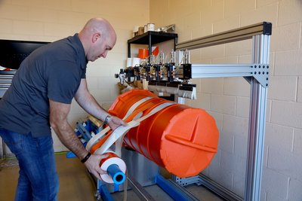
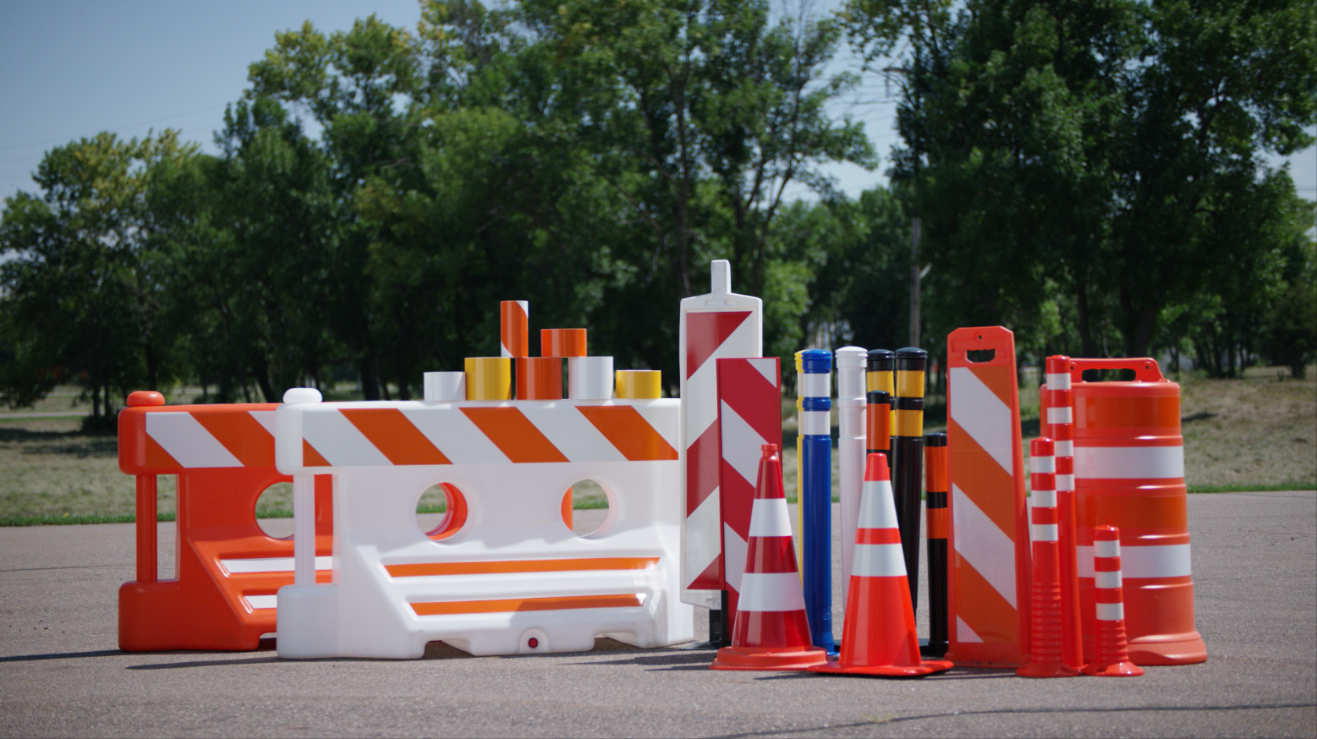
Manufacturing efficiency value for converters and manufacturers of traffic control devices who require Engineer Grade sheeting to service their customers
Adhesive: Pre-coated pressure sensitive adhesive optimized for metal and low energy surfaces like plastic and moderately rough or porous wood
Substrates: Universal sheeting for multiple substrates with minimal requirements for surface preparation*
Conformability: Meets multiple application requirements from manual application to fully automated machine application. Conforms to virtually any curved surface for a flexible solution
Liner: Easy removal polycoated paper liner with enhanced curl resistance
Compatibility: Compatible with flatbed cutting, die cutting, or other converting methods
Brand: The 3M™ brand is trusted and proven worldwide
*See information folders and Product Bulletins for specific surface preparation requirements.

Slide 6
Long-lasting value for end-users who require Engineer Grade sheeting and rely on their devices to remain compliant thorough out their typical service life
Compliant: Meets a variety of global specifications including ASTM-D4956 Type I and EN 12899-1 Class 1
Colors: Meets all outdoor weathering requirements for ASTM-D4956 Type I and EN 12899-1 Class 1
Impact Resistant: Shows no cracking or delamination outside of the actual area of impact when subjected to the impact test in accordance with ASTM-D4956 Type I and EN 12899-1 Class 1
Flexibility: Is sufﬁciently ﬂexible to show no cracking when tested in accordance ASTM-D4956 Type I and EN 12899-1 Class 1
Outdoor Weathering: Weather resistant and show no appreciable cracking, scaling, pitting, blistering, edge lifting, or curling, after outdoor exposures when tested in accordance ASTM-D4956 Type I and EN 12899-1 Class 1
Brand: The 3M™ brand is trusted and proven worldwide

Slide 7
3M™ Advanced Flexible Engineer Grade Series 7300
Recommended Uses:
Polyvinyl chloride (PVC) traffic cones
Reboundable plastic traffic control device such as drums, barricades, channelizers, posts and tubes
Other low energy surfaces used for traffic control devices such as pre-treated plywood, and moderately rough or porous wood
Other applications where a flexible reflective sheeting is required that is compatible with a variety of substrates
Standard Color | Product Number | Standard Roll Widths
White | 7310 | 4”, 6” 24”, 30” 36” 48”
Orange | 7314 | 4”, 6” 24”, 30” 36” 48”
Yellow | 7311 | 24”, 30” 36” 48”
Orange/White | 7334 or 7336 | 8”, 12” 24”, 48”
Red/White | 7332 | 12”, 24”, 48”
* Check with your local 3M representative for additional sizes

Slide 8
Questions?

Slide 9
Thank you!

Slide 10
3M™ Advanced Flexible Engineer Grade Features, advantages, benefits summarized
Unique Characteristic | Feature | Advantage | Benefit
Top Film | Scratch resistant | Impervious to scratching during application | Satisfied purchasing customers
Top Film | Impact resistant | Longer lasting devices | >Continued service of devices >Mitigates needs to changes devices that are in service
Top Film | Conformable | Meets multiple application requirements from manual application to fully automated machine application | Manufacturing efficiencies
Top Film | Conformable | Conforms to virtually any curved surface for a flexible solution | Manufacturing efficiencies
Adhesive | Specially designed with pressure sensitive adhesive | Optimized for low energy surfaces | >Manufacturing efficiencies >Long term field performance
3M Prismatic | Meets global retroreflective sheeting standards such as ASTM D-4956-16 Type 1 (USA), EN-12899-1 Class 1(EU), JIS Z 9117 | >Retroreflective Performance (Initial & Over-time) >Daytime/Night-time Color (Initial & Over-time) | >Long term compliance to standards & specifications >Enhanced safety for all road users
3M™ Reflective Sheeting | 3M Brand | Credible, compliant products | >Long term compliance to standards & specifications >Enhanced safety for all road users

