Slide 1
3M™ RPM Series 290/190 Sales Aid
Pavement Marking
Transportation Safety Division
2018
Andrew Goodrich, Pavement Marking Global Marketer

Slide 2
Being 3M
Marketing laws regarding differ from country to country.
Before localizing and translating content, please review campaign assets with your subsidiary’s legal team to confirm that the content meets with your country’s legal requirements. If it does not, adjust accordingly and with agreement from your legal team.
Reminders
Email
Check your country’s email legal requirements. If you are unaware of your country’s requirements, check in with your DRC. They likely have a marketing automation specialist who is familiar with the specific requirements of each country within their region.
Content
Use “top competitor” rather than name a competitor
Do not make claims about products unless documented substantiation is available

Slide 3
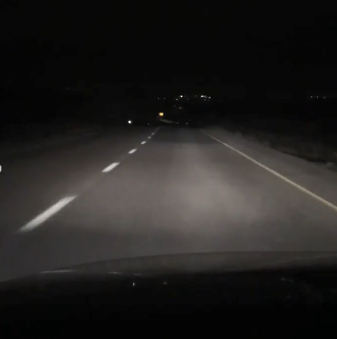
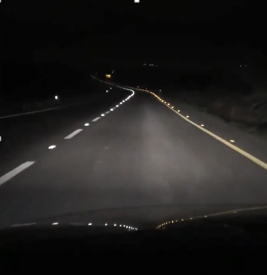
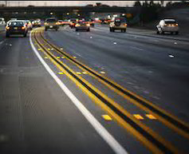
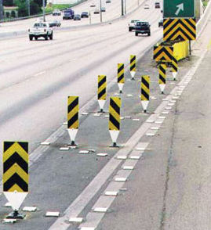
Raised Pavement Marker Basics
RPMs are used to supplement traditional pavement markings at night and in rainy conditions
Benefits of Raised Pavement Markers*
Improves roadway visibility in varying weather conditions
Decreases in nighttime crashes
Decreases in day and nighttime wet weather crashes
Decreases in guidance related crashes (e.g.) sideswipes
Typical Placement Locations of RPMs
Longitudinal Lane Markings | Other Markings
Road visibility before/after 3M™ RPM 290s are installed
*Source: Safety Evaluation of Permanent Raised Markers, NCHRP Report 518, Transportation Research Board, 2004 | Photos 3M™ RPM 290 Installed in Israel, 2017

Slide 4
RPMs Help Bring Families Home Safely
RPMs reduce crashes, help save lives and drivers find them useful
Road Safety Improvement: With and Without RPMs¹
Driver Perceptions of RPMs²
24% Crash Reduction
6% Crash Reduction
100%
100%
90%
90%
89%
81%
80%
80%
77%
70%
70%
60%
7 = Extremely Useful
Crashes %
60%
No RPMs Installed
RPMs Installed
No RPMs Installed
RPMs Installed
Percent
50%
50%
40%
40%
30%
30%
20%
20%
10%
10%
0%
0%
Two Lane Roads with AADT > 15,000 and DOC <3.5
Four Lane Freeways (Undivided) with AADT > 20,000
Help at Night in Rain (% Yes)
Help at Night in Fog (% Yes)
% Visibility Improvement
Usefulness on All Roads
Source: ¹Safety Evaluation of Permanent Raised Markers, NCHRP Report 518, Transportation Research Board, 2004
²St. Louis Inlaid Pavement Marker Survey, MoDOT #TR201611, Applied Research Associates, 2017
Notes:
Two studies that linked to overall safety – first a 2004 study by TRB – aggregate analysis of multiple different states – quantify the safety impact of RPMs on different road types
Driver perception – 2017 MoDOT study – drivers overwhelmingly find RPMs useful particularly in dangerous conditions
Clear that RPMs are an important component of roadway safety
Link to safety is important, TSD thought leader on road safety, this product fits into that position

Slide 5
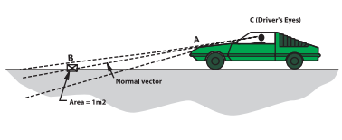
3M’s Unique Selling Advantage: Highly Reflective
3M Diamond Grade™ microprismatic optics delivers on brightness performance
3M™ RPM 290 Reflective Features
Driver Retroreflection Performance
Highly reflective 3M™ Diamond Grade™ microprismatic optics
3M™ 290 Lens Minimum and Typical Retroreflectivity: (mcd/lux)*
Simulated Distance |  | White |  | Yellow |  | Red |  | Blue
Feet | Meters | Min. | Typical | Min. | Typical | Min. | Typical | Min. | Typical
100 | 30 | 40 | 80 | 24 | 48 | 10 | 20 | 4 | 8
300 | 91 | 350 | 500 | 210 | 300 | 88 | 125 | 35 | 50
500 | 152 | 600 | 1000 | 360 | 600 | 150 | 250 | 60 | 100
Polycarbonate lens with protective hardcoat protects against abrasion or scratches to keep the lens clearer
Bottom Line:
3M™ Raised Pavement Markers are highly visible at night and in rainy conditions
Source: 3M™ Series 290 Product Bulletin
*Note: Lens was designed to be brighter farther away due to observation angle

Slide 6
3M’s Unique Selling Advantage: Durable Construction
Impact resistant polycarbonate body and lens coating deliver superb body and lens durability
3M™ RPM 290 Durability Features
NTPEP On-Road Durability Test Data
Polycarbonate lens with protective
hardcoat and independent cells to resist cracks
Average 3M™ RPM 290 Lens Surface and Body Rating After 2 years
5, New
4, Good
3.7
3.5
3, Fair”
3.5
2, Poor
1, Very Poor
0, Missing
6 Months
12 Months
18 Months
24 Months
Impact resistant
polycarbonate body
Computer-aided
internal rib design
Location: I-75 near Florida/Georgia Border
AADT: High, 39,000-41,000
Truck Traffic: High, 24-26%
Surface: Concrete
Lens Surface
Body
Bottom Line:
3M™ RPMs are engineered for long-lasting performance and to stay on the road
https://data.ntpep.org/
Note: The preceding test data excerpts were reproduced with the permission of AASHTO, however, this does not constitute endorsement or approval of the product, material or device by AASHTO
Source: 3M™ Series 290 Product Bulletin, NTPEP # RPM (08GA0-04)

Slide 7
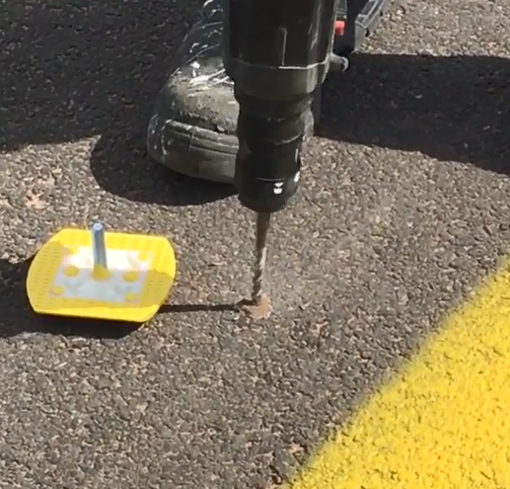
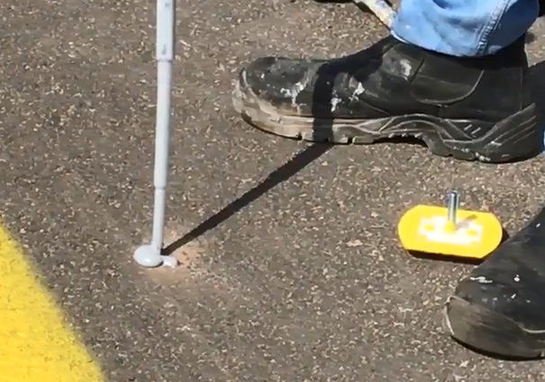
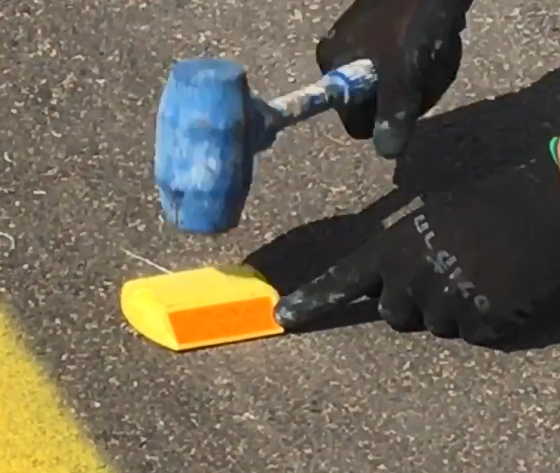
3M’s Unique Selling Advantage: Fast and Easy Application
3M™ RPM 290 is easy to apply which helps reduce road closure time and saves contractors time
RPM without a Spike
RPM with Spike(s)
1
Apply recommended adhesive
1
Drill hole into road surface
2
Set RPM using finger-holds
2
Apply recommended adhesive
Apply recommended amount of pressure to set
3
3
Done! Road open!
3
Insert and secure RPM and done!
Bottom Line:
Easy application results in less road closure time and contractor time efficiencies
Note: See Information Folder 290 for Detailed Application Guidelines

Slide 8
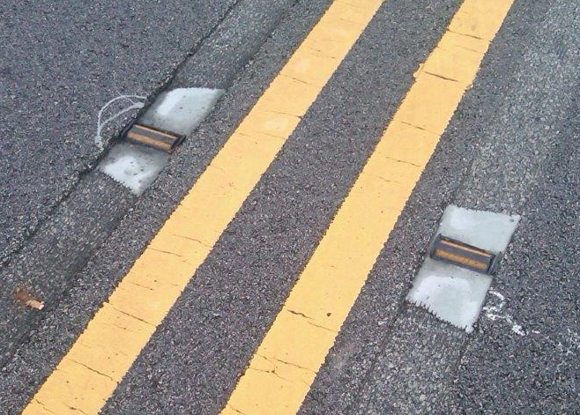
3M’s Unique Selling Advantage: Water Resistant
3M™ 190 RPM can deliver superb performance during challenging weather conditions
Water Penetration Resistance
Snowplowable Grooved 190 Application
3M Lab Water Penetration Test
Markers conditioned at 145⁰ F for 10 minutes
Markers submerged in a water bath for 10 minutes
Markers visually inspected for water penetration and measured for reflectivity in accordance with ASTM E809
No markers had water penetration and all maintain brightness values outlined on “Visibility” page, see product bulletin for details
Bottom Line:
3M™ Raised Pavement Markers are ideal for plowable grooved application
Source: 190 Product Bulletin

Slide 9
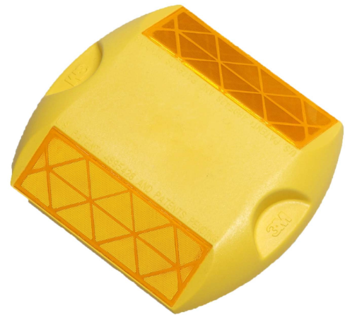
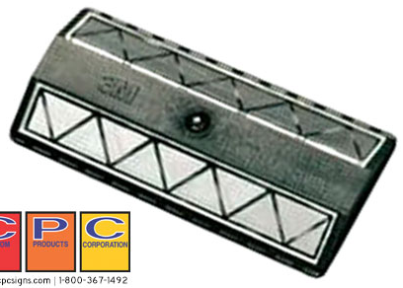
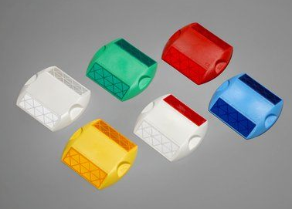
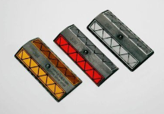
3M’s RPM Product Portfolio
3M has a complete portfolio of product format and color choices for any application
3M RPM Series 290
Base Model
3M RPM Series 290 PSA
3M RPM Series 290
Single Spike
Product Features:
Diamond Grade™ microprismatic optics
Impact resistant polycarbonate body/lens
Finger grips for easy application
Available Options:
Body: white, yellow, red, green, blue
Lens: white, yellow, red, green, blue
One-Way or Two-Way
Additional Product Features:
Pressure Sensitive Adhesive pad for easy application and removal ideal for work zones
Available Options:
Body: white, yellow, red, green, blue
Lens: white, yellow, red, green, blue
One-Way or Two-Way
Additional Product Features:
Single steel spike for superb adherence to road surface and durability
Available Options:
Body: white, yellow, red
Lens: white, yellow, red
One-Way or Two-Way
3M RPM Series 290
Dual Spike
3M RPM Colors
3M RPM Series 190
Additional Product Features:
Able to insert into snowplowable metal casting
Available Options:
Body: Black
Lens: white, yellow, red, blue
One-Way or Two-Way
Additional Product Features:
2 polycarbonate spikes for strong adherence to road surface and durability
Available Options:
Body: white, yellow, red
Lens: white, yellow, red
One-Way or Two-Way
Series 290
White, yellow, red, green, blue body/lens
One-way or two way
Series 190
White, yellow, red, blue body/lens
One-way or two way

Slide 10
Example RPM Specifications
Standards vary around the globe but typically test reflectivity, color, and durability
Standard and Primary Region | Lab test specifications |  |  | On road specifications | Comments
ASTM D4280 / D4383 United States | Size & Construction Reflectivity, Initial Reflectivity, post abrasion Flexural strength | Compressive strength Color Lens impact strength Temperature cycling |  | None | Most competitors meet minimum performance levels in standard resulting in price pressure
BS EN1463-1 / EN1462-2 Europe | Type and Description Dimensions: height and size Reflectivity, initial Color |  |  | # of road studs remaining after 12 months on the road Reflectivity after 12 months on the road | Performance levels are low but on road test demonstrates 3M’s durability value proposition
ABNT NBR 1436-13 Brazil | Reflectivity, Initial Reflective element type Body Type Construction Type |  | Fixation: Spike or no Spike Color Impact Resistance | Reflectivity after # of months depending on type of RPM and AADT | On road reflectivity test helps 3M demonstrate value prop
Bottom Line:
Retained performance levels helps ensure better performing products on the road
Source: ASTM D4280, ASTM D4383, BS EN 1463-1, BS EN 1463-2, ABNT NBR 14636-13

