Slide 1
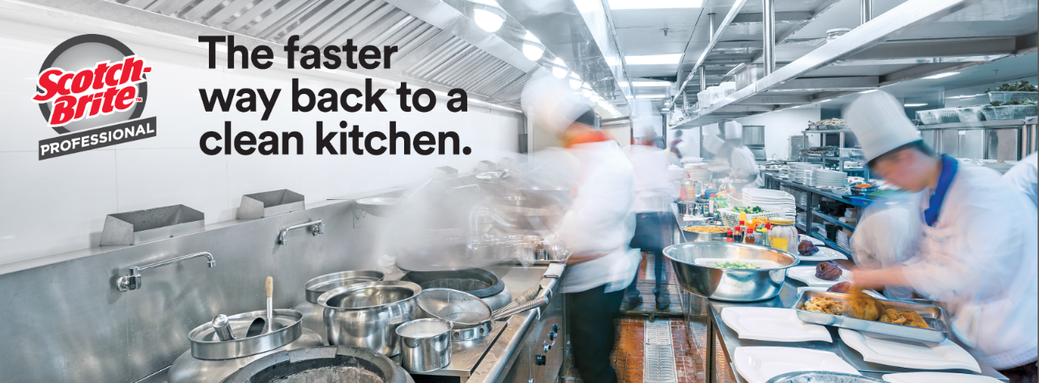
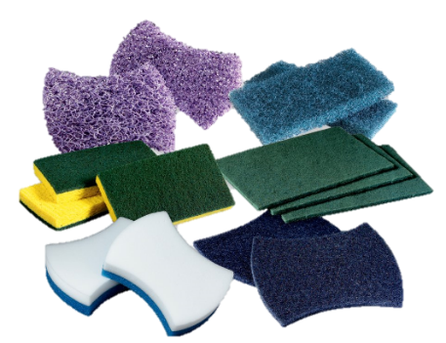
Scotch-Brite™ Professional Scouring Pads and Sponges

Slide 2
Who do we design our solutions for?
 | Full Service Restaurants | Limited Service Restaurants | Hospitality | Health Care – Assisted Living
Key Trends | Increasing labor costs New Players: Fresh food subscriptions/ ubereats Independent and fast-casual competition. | Increasing labor costs Food Safety Fast Casual Evolution – Personalization Evolving the definition of healthy | Restaurant service becoming a more important revenue generator | Providing unique amenities: Restaurant style dinning
Top Cleaning Needs | Cleaning Time: Tools that help kitchen staff clean faster with less elbow grease Food Safety: tools/cleaning products that are safe for use on food contact surfaces and do not leave residue behind that could contaminate food Employee Safety: tools/cleaning products that are safe to use (easy on hands, does not give off strong chemical odors) The right tool for the right job: tools that can be used in different applications/surfaces
Brand Owners

Slide 3
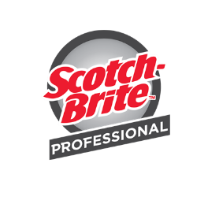
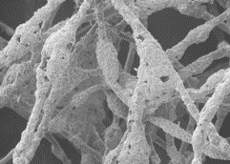
What makes the Scotch-Brite™ Professional Scouring Pads and Sponges Different?
Scotch-Brite™ Hand Pad Generously Coated Fiber
Effective and consistent performance throughout the life of the pad:
Abrasive mineral coated uniformly on fibers
Abrasive mineral particles are evenly distributed throughout the pad to ensure effective, consistent and long lasting performance for the life of the pad
Resin system is designed to provide durability and resistance to degradation from exposure to hot water, detergents and normal cleaning liquids
Coated Fiber
Competitive Hand Pad Coated Fiber
Bare Fiber

Slide 4
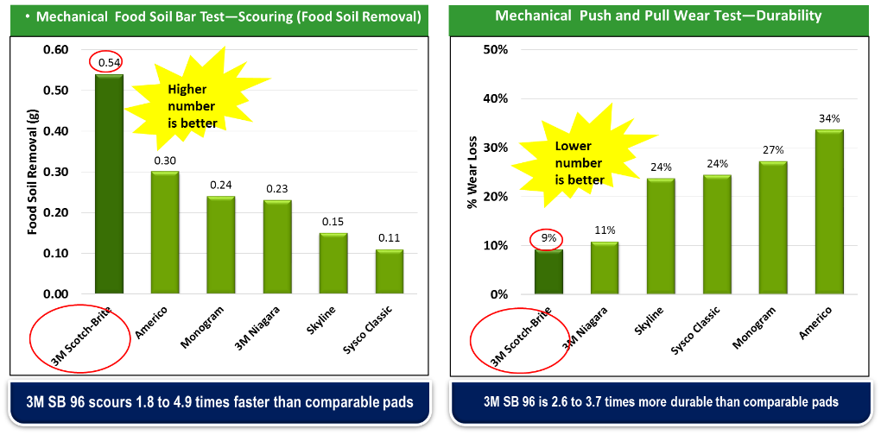
What makes the Scotch-Brite™ Professional Scouring Pads Different?

Slide 5
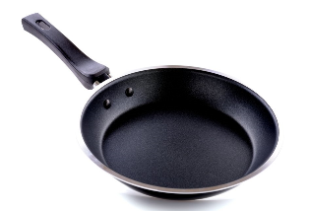
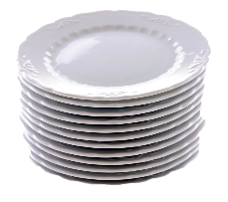
The Scotch-Brite™ Professional Scouring Pads Portfolio
Problem
Cleaning up delicate surfaces such as non-stick, china, glass and plastic-ware
Solution
Scotch-Brite™ Professional portfolio of Light Duty Hand pads

Slide 6
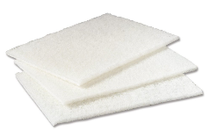
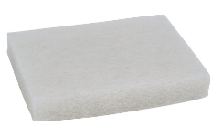
Light Duty Hand Pads
Scotch-Brite™ Light Duty Cleansing Pad 98
Soft, non-woven fibers and mild abrasive
For everyday cleaning of delicate surfaces such as stainless steel, ceramic and glass
Common uses include bathrooms and glass surfaces
Pad Size: 6” x 9”
20 pads per case
Certified by HACCP International
Scotch-Brite™ Light Duty Scrubbing Pad 9030
Thick, hand-sized pad
Common uses include plastic containers and fine china
Pad Size: 3.5” x 5”
Certified by HACCP International

Slide 7
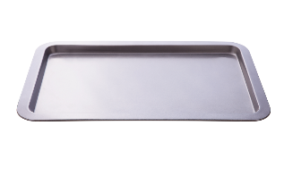
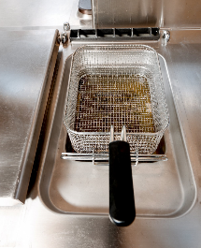
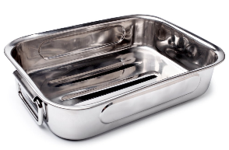
The Scotch-Brite™ Professional Scouring Pads Portfolio
Problem
Cleaning up commercial-grade cooking utensils and equipment such as baking sheets, hotel pans, kettles and fryers
Solution
Scotch-Brite™ Professional portfolio of Medium & Heavy Duty Hand pads

Slide 8
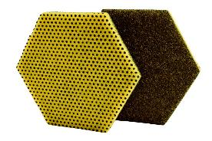
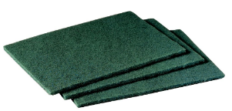
Medium Duty Hand Pads
NEW
Scotch-Brite™ Dual Purpose Scouring Pad 96HEX
One pad. Two tasks.
Features a yellow raised power dot side that aggressively scours away tough messes with less elbow grease
The smooth side scours away fine particles and grease leaving a clean and shiny surface
Common uses include pots, hotel pans and baking sheets
Pad Size: 5.75” x 5”
15 pads per case
Certified by HACCP International
Scotch-Brite™ General Purpose Scrubbing Pad 96
The original synthetic scouring pad - Scours 2 to 5X faster and is 2 to 3X more durable than comparable non-3M pads
For everyday cleaning of cooking utensils and equipment
Common uses include pots, hotel pans and baking sheets
Pad Size: 6” x 9”
20 pads per case
Certified by HACCP International
Available in Cash & Carry pack out

Slide 9
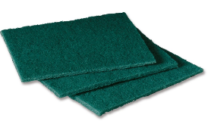
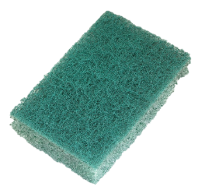
Medium Duty Hand Pads
Scotch-Brite™ General Purpose Scouring Pad 105
The original synthetic scouring pad in a convenient size
For everyday cleaning of cooking utensils and equipment
Common uses include pots, hotel pans and baking sheets.
Pad Size: 4.5” x 6”
40 pads per case
Certified by HACCP International
Scotch-Brite™ General Purpose Scrubbing Pad 9650
Thicker, hand-sized version of the Scotch-Brite™ General Purpose Pad 96
Convenient size eliminates the need to cut or fold pad
Common uses include kitchen equipment and countertops,
Pad Size: 3” x 4.5”
40 pads per case
Certified by HACCP International

Slide 10
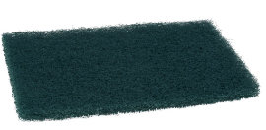
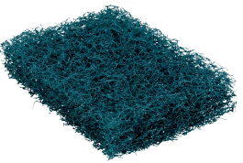
Heavy Duty Hand Pads
Scotch-Brite™ Heavy Duty Scouring Pad 86 & 86CC
Open construction pad with tough fibers and abrasives to make fast work of heavy duty cleaning jobs
For heavily baked-on food and food processing equipment
Common uses include pots and pans, kitchen and cooking equipment
Pad Size: 6” x 9”
12 pads per case
Certified by HACCP International
Available in Cash & Carry pack out
Scotch-Brite™ Extra Heavy Duty Scour Pad 88 & 88CC
Thick, open mesh construction. Rinses easily and doesn’t splinter or rust
Can replace stainless steel scrubbers.
Common uses include stubborn cheese and thick sauce deposits
Pad Size: 6” x 9”
40 pads per case
Certified by HACCP International
Available in Cash & Carry pack out

Slide 11
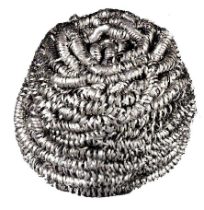
Heavy Duty Hand Pads
Scotch-Brite™ Stainless Steel Scrubbers 83, 84 & 84CC
High quality stainless steel, won’t rust or splinter
Removes baked-on food
Common uses include pots, hotel pans, baking dishes, grills and ovens
Pad Size: 1.25 & 1.74 oz
Available in Cash & Carry pack out

Slide 12
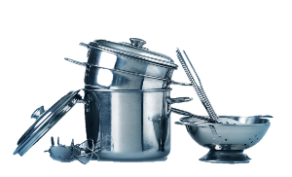
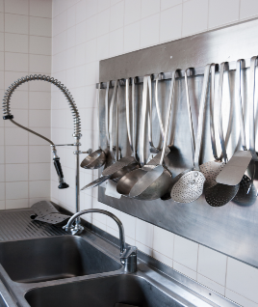
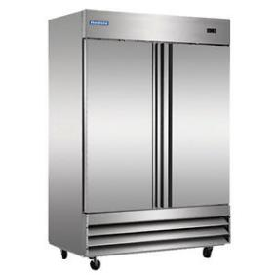
The Scotch-Brite™ Professional Scouring Pads Portfolio
Problem
Cleaning up delicate surfaces such as stainless steel cooking utensils and kitchen equipment
Solution
Scotch-Brite™ Professional portfolio of Low Scratch Scouring Pads

Slide 13
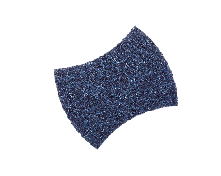
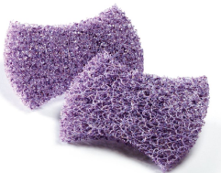
Low Scratch Hand Pads
Scotch-Brite™ Power Pad 2000 & 2000BP
Scours at least 7X faster than competitive non-scratch pads, and scratches at least 10X less than competitive medium duty scouring pads
Common uses include stainless steel, elevators, water dispensers, non-stick cooking utensils and equipment.
Pad Size: 5.5” x 3.9”
20 pads per case
Certified by HACCP International
Scotch-Brite™ Purple Scour Pad 2020 & 2020CC
Cleans the dirtiest pots and pans twice as fast as conventional heavy duty scouring with less scratching
Can replace stainless steel scrubbers
Common uses include stubborn cheese and thick sauce deposits
Pad Size: 2.8” x 4.5”
24 pads per case
Certified by HACCP International
Available in Cash & Carry pack out

Slide 14
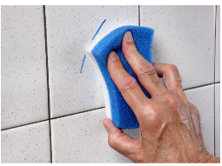
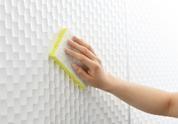
The Scotch-Brite™ Professional Sponges Portfolio
Problem
Cleaning up stains, marks, scuffs, soap scum, and hard water stains found across commercial buildings areas such as elevators, countertops, bathrooms, lobby's
Solution
Scotch-Brite™ Professional portfolio of Sponges

Slide 15
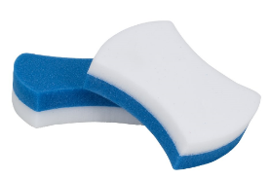
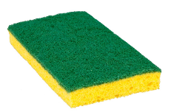
Scrubbing Sponges
Scotch-Brite™ Easy Erasing Pad 4004CC & 4004BP
Innovative white polymeric foam erases hard to clean stains, marks and scuffs.
Soft, flexible pad cleans many surfaces and is safe for indirect food contact areas
Common uses include walls and ceramic tile
Pad Size: 2.8” x 4.5” x 1.2”
12 sponges per case
Scotch-Brite™ Medium Duty Scrub Sponge 74 & 74CC
Dual action cleaning tool. On one side it’s a 96 scouring pad for scrubbing and cleaning
On the other side, the cellulose sponge quickly wipes up spills and messes and can carry cleaning solutions to the works surface
Common uses include bathrooms, lobby’s and countertops
Pad Size: 6.1” x 3.6” x 0.7”
20 pads per case
Available in Cash & Carry pack out

Slide 16
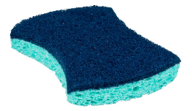
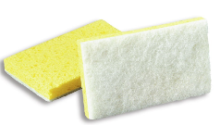
Scrubbing Sponges
Scotch-Brite™ Power Sponge 3000 & 3000CC
Two cleaning tools in one – a Scotch-Brite Power Pad combined with a sponge
Up to 8X less abrasive than other medium/heavy duty scouring products to help reduce scratching
Features 3M’s anti-microbial technology – sponge resists growth or odor causing bacteria
Common uses include pot & pans, walls and ceramic tile
Pad Size: 2.8” x 4.5” x 0.6”
20 sponges per case
Available in Cash & Carry pack out
Scotch-Brite™ Light Duty Scrub Sponge 63
Two cleaning tools in one – light duty pad won’t scratch most surfaces
For everyday cleaning commercial buildings and kitchens
Common uses include stainless steel elevators, glass and ceramic surfaces in bathrooms
Pad Size: 6.1” x 3.6” x 0.7”
20 pads per case

Slide 17
Contact your 3M Authorize Sales Distributor
3M.com/foodservice
1-800-698-4595

